Slide 1
Max Pooling
Conv
Up-conv
Copy and Crop
128
256
256
128
256
256
140X140
104X104
102X102
100X100
138X138
136X136
512
512
1024
512
68X68
66X66
64X64
56X56
54X54
52X52
1024
32X32
30X30
28X28

Slide 2
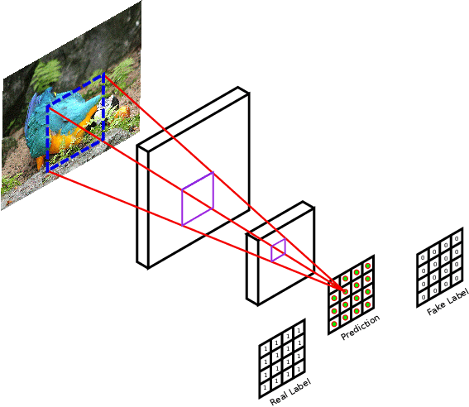
PatchGAN Discriminator

