Slide 1
M42740
Sequence diagrams and APIs
for MThing payment transaction
MyongJi University
Min Hyuk Jeong
Sang Kyun Kim
Notes:
This contribution presents several sequence diagrams for MThing payment transactions.

Slide 2


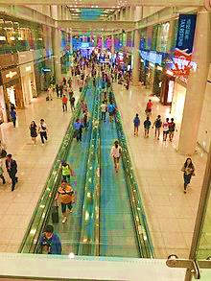
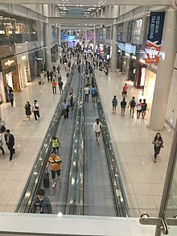


Notes:
First situation is transaction between user and an Mthing.
This man wants to see how many people in the airport.
So he pays to an Mcamera and getting a video from an Mcamera.

Slide 3
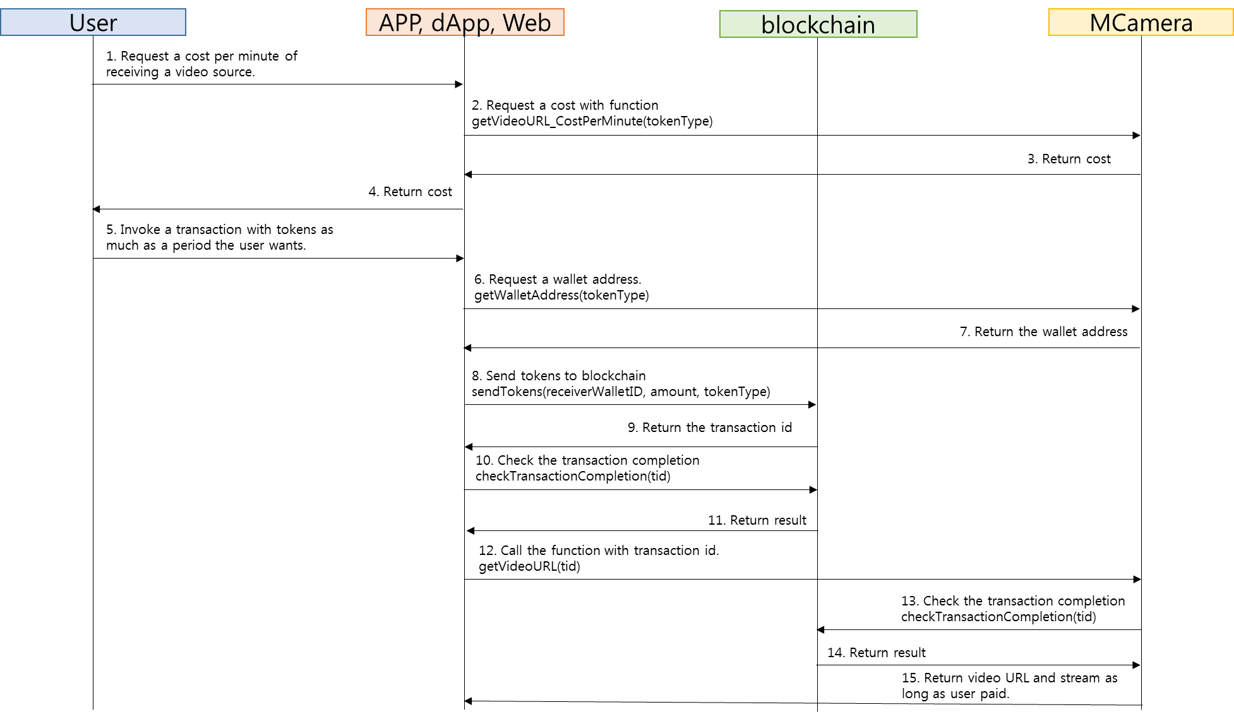
Payment process between an MThing and a user
Notes:
This is the sequence diagram of a payment process between an MThing and a user with some applications.
In This contribution assumes that IoMT is already connected to a blockchain for a payment transaction, which can produce a transaction id for the proof of payment completion.

Slide 4
Payment process between an MThing and a user

Slide 5
Payment process between an MThing and a user
Notes:
This contribution presents several sequence diagrams for MThing payment transactions.
This contribution assumes that IoMT is already connected to a blockchain for a payment transaction, which can produce a transaction id for the proof of payment completion.
This is the sequence diagram of a payment process between an MThing and a user with some applications.

Slide 6
Payment process between an MThing and a user
Notes:
This contribution presents several sequence diagrams for MThing payment transactions.
This contribution assumes that IoMT is already connected to a blockchain for a payment transaction, which can produce a transaction id for the proof of payment completion.
This is the sequence diagram of a payment process between an MThing and a user with some applications.

Slide 7
Payment process between an MThing and a user
Notes:
This contribution presents several sequence diagrams for MThing payment transactions.
This contribution assumes that IoMT is already connected to a blockchain for a payment transaction, which can produce a transaction id for the proof of payment completion.
This is the sequence diagram of a payment process between an MThing and a user with some applications.

Slide 8
Payment process between an MThing and a user
Notes:
The details will be explained at the end of this presentation.

Slide 9
Payment process between an MThing and a user
Notes:
This contribution presents several sequence diagrams for MThing payment transactions.
This contribution assumes that IoMT is already connected to a blockchain for a payment transaction, which can produce a transaction id for the proof of payment completion.
This is the sequence diagram of a payment process between an MThing and a user with some applications.

Slide 10
Payment process between an MThing and a user
Notes:
This contribution presents several sequence diagrams for MThing payment transactions.
This contribution assumes that IoMT is already connected to a blockchain for a payment transaction, which can produce a transaction id for the proof of payment completion.
This is the sequence diagram of a payment process between an MThing and a user with some applications.

Slide 11
Payment process between an MThing and a user
Notes:
This contribution presents several sequence diagrams for MThing payment transactions.
This contribution assumes that IoMT is already connected to a blockchain for a payment transaction, which can produce a transaction id for the proof of payment completion.
This is the sequence diagram of a payment process between an MThing and a user with some applications.

Slide 12
Payment process between an MThing and a user
Notes:
This contribution presents several sequence diagrams for MThing payment transactions.
This contribution assumes that IoMT is already connected to a blockchain for a payment transaction, which can produce a transaction id for the proof of payment completion.
This is the sequence diagram of a payment process between an MThing and a user with some applications.

Slide 13





Slide 14
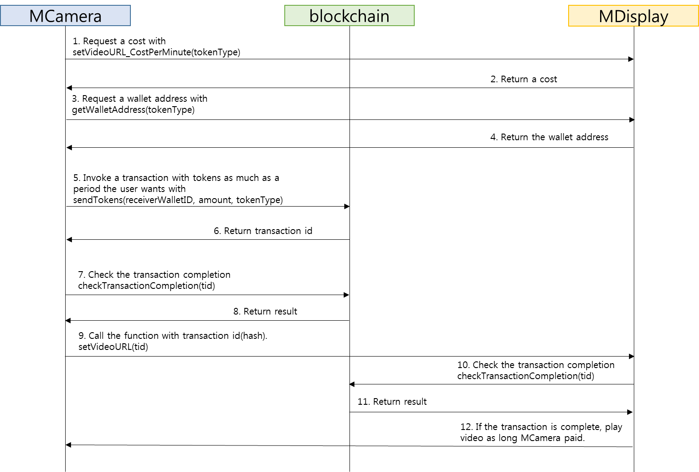
Payment process between MThings.
Notes:
This sequence diagram is about a payment process between MThings with an unsupervised manner.

Slide 15
Payment process between MThings.
Notes:
This sequence diagram is about a payment process between MThings with an unsupervised manner.

Slide 16
Payment process between MThings.
Notes:
This sequence diagram is about a payment process between MThings with an unsupervised manner.

Slide 17
Payment process between MThings.
Notes:
This sequence diagram is about a payment process between MThings with an unsupervised manner.

Slide 18
Payment process between MThings.
Notes:
This sequence diagram is about a payment process between MThings with an unsupervised manner.

Slide 19
Payment process between MThings.
Notes:
This sequence diagram is about a payment process between MThings with an unsupervised manner.

Slide 20
Payment process between MThings.
Notes:
This sequence diagram is about a payment process between MThings with an unsupervised manner.

Slide 21
Functions which need to be added
string sendTokens(string receiverWalletID, float amount, string tokenType)
This function is used for an MThing to send tokens to another MThing. This function requires a wallet address of a receiver, amount of tokens to send with a token type. A return value from a blockchain is a transaction id.
int checkTransactionCompletion(string tid)
An MThing (e.g., a sender) and its corresponding MThing (e.g., a receiver) are able to check if the (money) transaction is complete with the transaction id. It returns 1 if the transaction has completed, returns 0, otherwise.
string getWalletAddress(string tokenType)
This function return the wallet address corresponding token type. If the tokenType is not supported, returns null.
Notes:
These are functions that need to be added to part 2.

