Slide 1
SUPPLY CHAIN OPERATIONS
BO Self Serve Dashboard
A complete walkthrough of every feature — how it works,
what it shows, and the value it delivers to supply chain teams.
Status & Anomaly Detection · 5 Core Features · Zero SAP Access Required

Slide 2
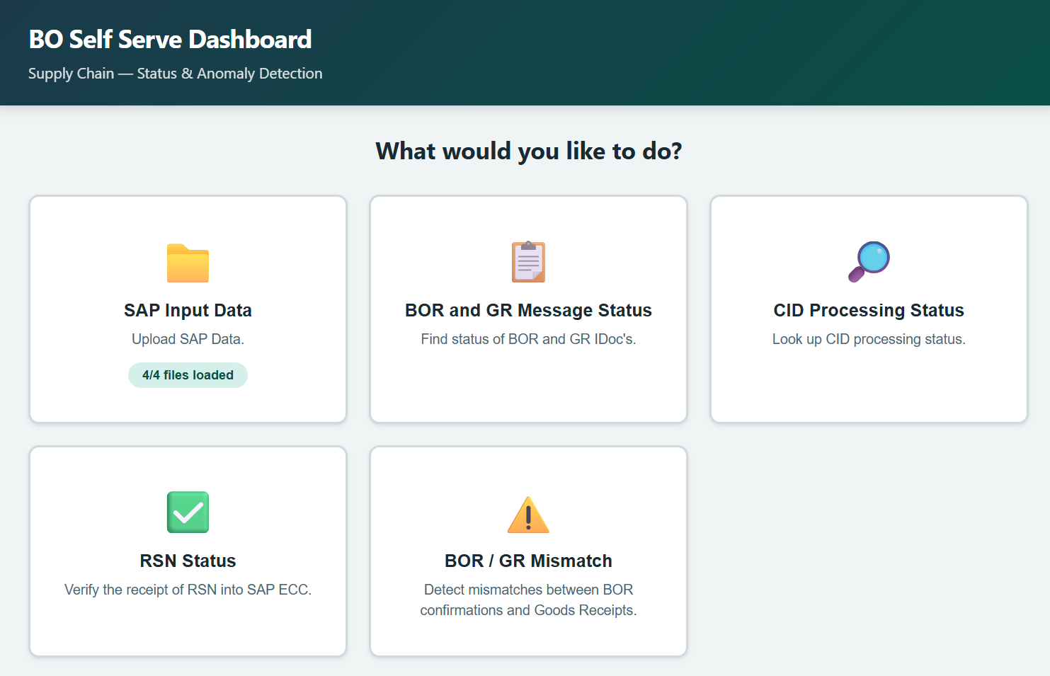
HOME SCREEN
🏠 Dashboard Landing Page
A clean, card-based home screen that gives users one-click access to every capability.
✓ 5 feature cards with clear descriptions
✓ Upload badge shows file readiness
✓ Intuitive icons for instant recognition
✓ Supply chain branded color theme
✓ Works on desktop and tablet

Slide 3
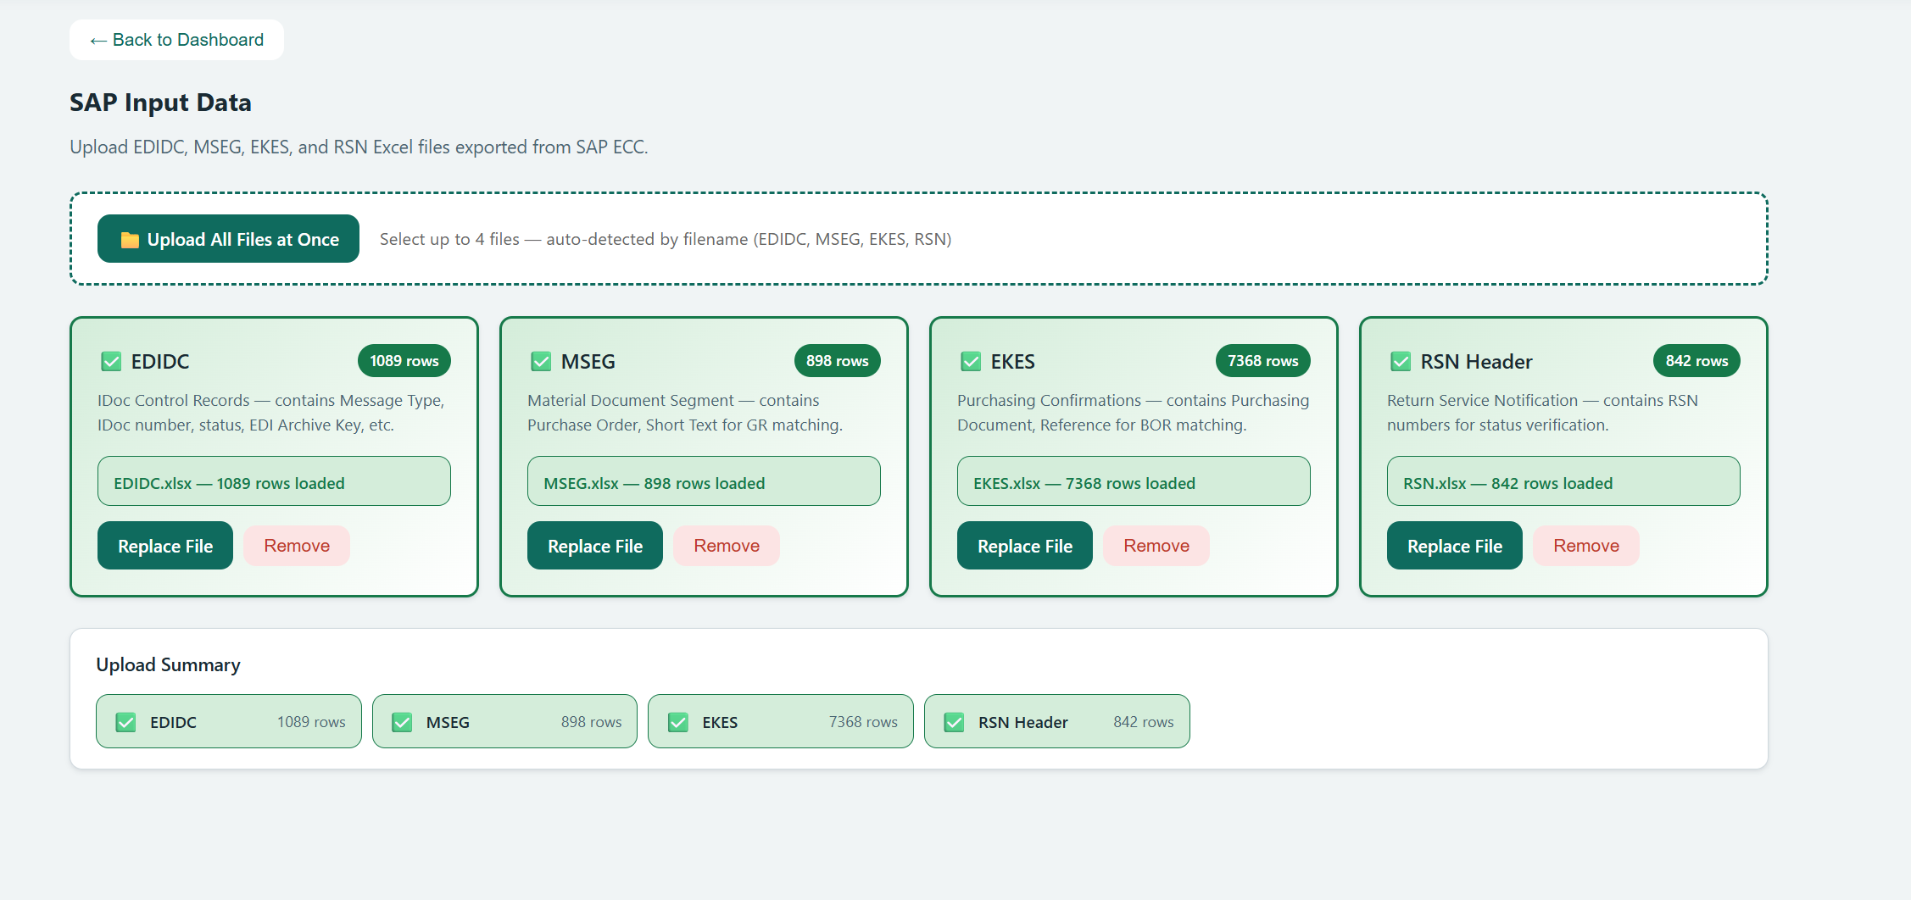
FEATURE 1
📁 SAP Input Data
Upload 4 SAP Excel exports — EDIDC, MSEG, EKES, and RSN — individually or all at once.
✓ Bulk upload with auto file-type detection
✓ Row counts shown per file (e.g. 7,368 rows)
✓ Background parsing via Web Worker
✓ DRM-protected file detection with guidance
✓ Replace or remove files at any time
✓ Data persists across page refreshes (IndexedDB)

Slide 4
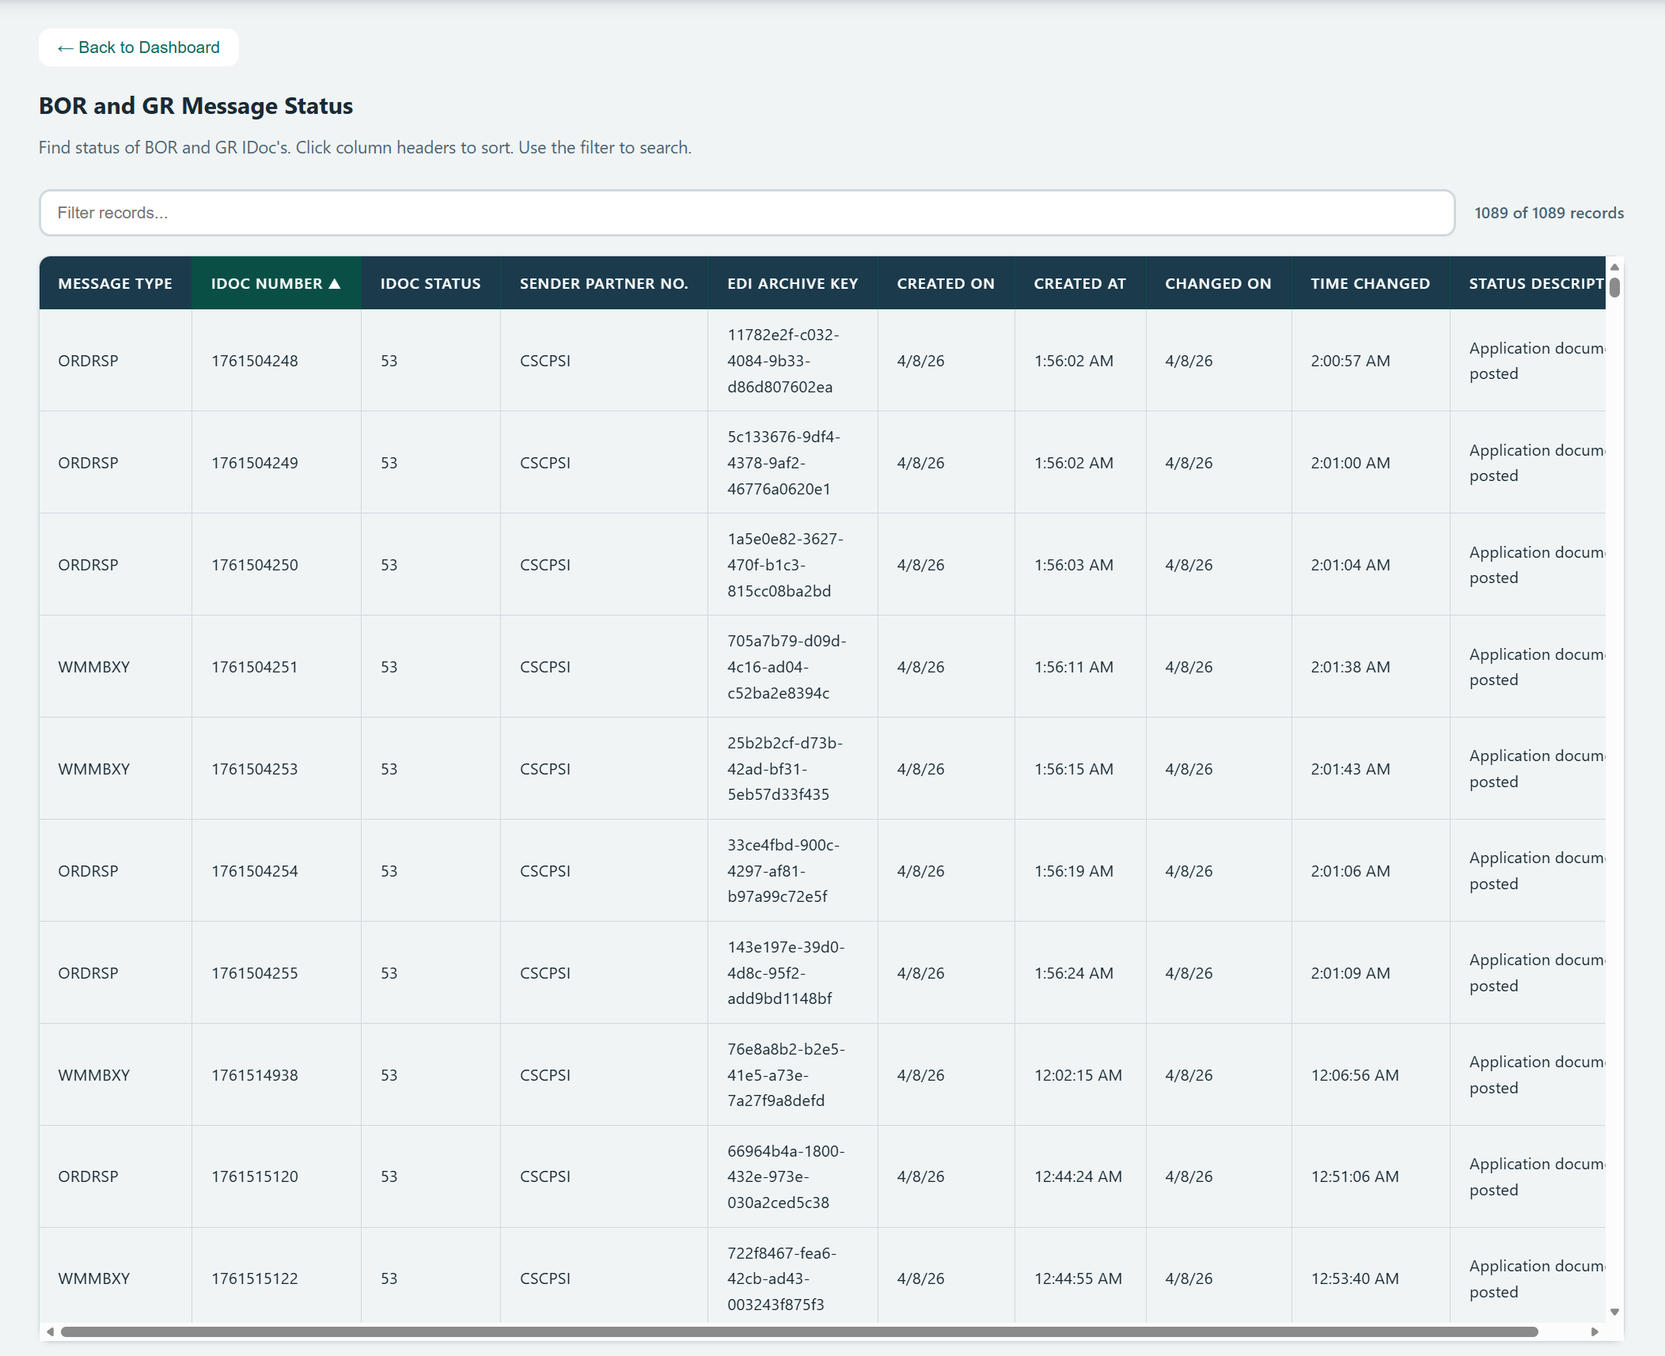
FEATURE 2
📋 BOR & GR Message Status
Displays all IDoc records from EDIDC with full status descriptions, sortable columns, and a real-time text filter.
✓ Full table of 1,000+ IDoc records at a glance
✓ Click any column header to sort
✓ Filter by Message Type, IDoc Number, or Status
✓ Human-readable status descriptions
✓ EDI Archive Key visible for CID cross-reference

Slide 5
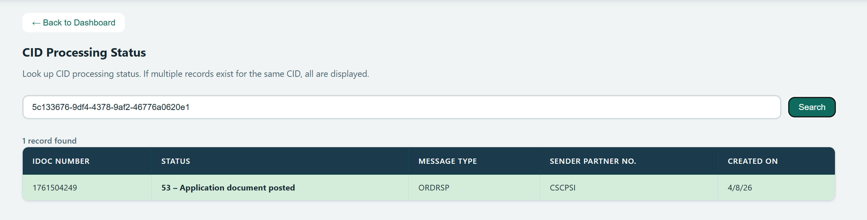
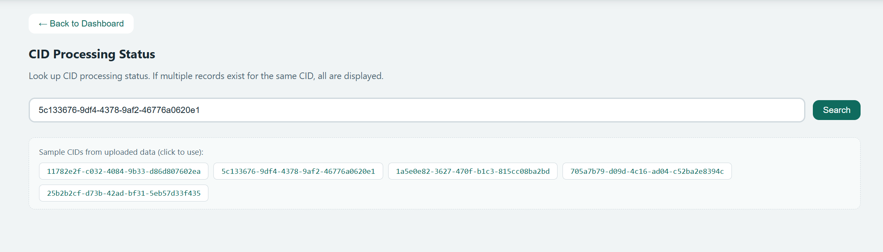
FEATURE 3
INPUT — Sample CIDs from uploaded data
🔎 CID Processing Status
Look up any Correlation ID (EDI Archive Key) to instantly find its IDoc number, processing status, and creation date.
✓ Paste a CID and hit Search — results in ms
✓ Sample CIDs from uploaded data as clickable buttons
✓ Shows all matching records for the same CID
✓ Color-coded result rows for quick scanning
OUTPUT — Search result

Slide 6
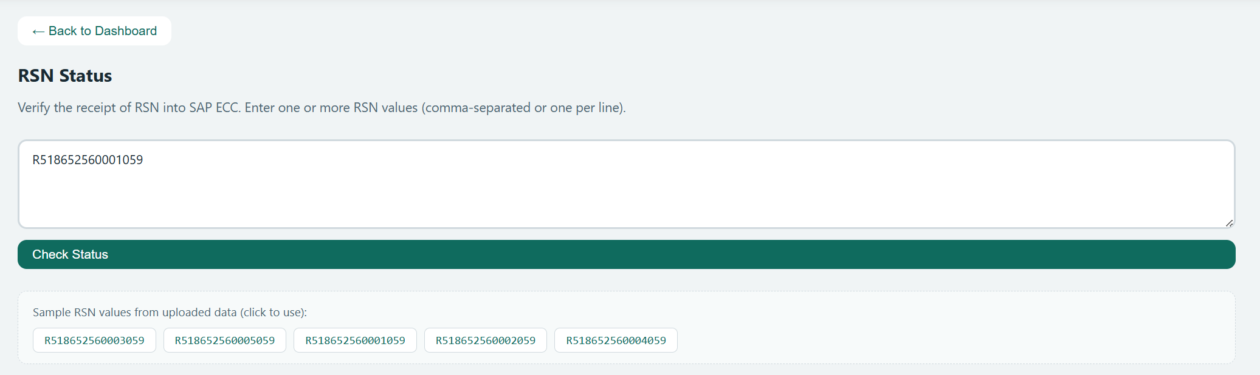
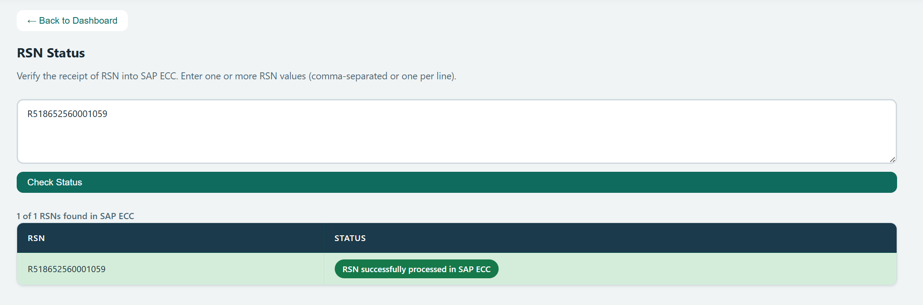
FEATURE 4
INPUT — Sample RSNs from uploaded data
✅ RSN Status Verification
Verify whether Return Service Notification numbers have been successfully received into SAP ECC.
✓ Enter RSNs comma-separated or one per line
✓ Sample RSN values shown as clickable buttons
✓ Clear "found in SAP ECC" confirmation badge
✓ Batch check multiple RSNs simultaneously
OUTPUT — Verification result

Slide 7
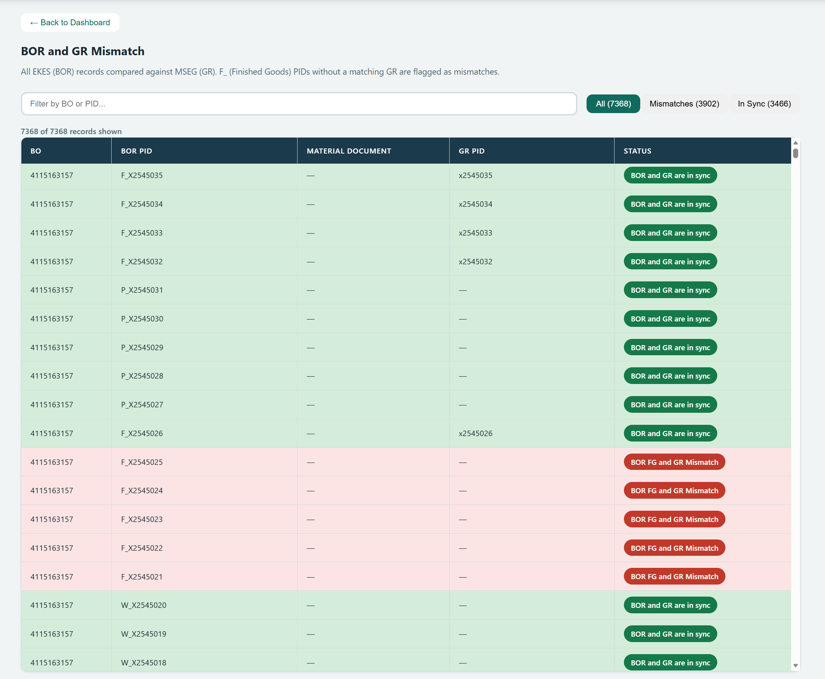
FEATURE 5
⚠️ BOR / GR Mismatch Detection
Automatically compares every EKES (BOR) record against MSEG (Goods Receipt) data and flags mismatches.
✓ All 7,000+ records compared automatically
✓ Green rows = "BOR and GR are in sync"
✓ Red rows = "BOR FG and GR Mismatch"
✓ Filter buttons: All / Mismatches / In Sync
✓ Search by BO number or PID
✓ Material Document column for traceability

Slide 8
AT A GLANCE
5 Features, One Dashboard
📁
📋
🔎
✅
⚠️
SAP Input
Data
BOR & GR
Message Status
CID Processing
Status
RSN
Status
BOR / GR
Mismatch
Bulk upload 4 Excel files with auto-detection. Web Worker parsing. IndexedDB persistence.
Full IDoc table with sorting, filtering, and human-readable status descriptions.
Instant CID lookup with sample data buttons and multi-record results.
Batch RSN verification against SAP ECC with clear pass/fail indicators.
Auto-compare all EKES vs MSEG. Green/red row coloring for anomaly detection.

Slide 9
IMPACT
What This Means for the Team
0
90%
7K+
1
SAP logins needed
for status checks
Reduction in manual
lookup time
Records compared
automatically
Upload to see
everything
Data stays in the browser — nothing leaves the user's machine.
Fully client-side, zero infrastructure cost.

Slide 10
SUPPLY CHAIN OPERATIONS
Ready to Try It?
Upload your SAP exports and start getting answers in seconds —
no SAP access, no waiting, no dependencies on other teams.
Built with React · Runs in Any Browser · 100% Client-Side

