Slide 1

Project Presentation
Vegetable Disease Classification using Deep Learning
Project ID: PCS23-50
Mentor:
Dr. Raj Kumar
Professor
Department of Computer Science
Presented by:
Vinayak Dhar Dwivedi (1900290120129)
Tushar Agrawal (1900290120122)

Slide 2
INTRODUCTION
Agriculture is the major occupation in India and it loses 35% of the crop productivity annually owing to plant diseases. The productivity in agriculture is a major factor in the economy. Harvest losses owing to illnesses are a severe problem for both large farming structures and rural communities As a result, disease detection in plants plays a significant role in agriculture. If sufficient care is not taken in this regard, then it can have major impacts on plants by affecting the quality, quantity, or productivity of the respective product or service.
In recent times, the use of artificial intelligence (AI) in agriculture has become the most important. Recent advances in computer vision and deep learning (DL) models have demonstrated the value of developing automatic plant disease detection models based on visible symptoms on leaves. Generally, the leaves of plants show the first signs of plant disease, and most diseases can be detected from the symptoms that appear on the leaves but because of the large range of diseases, identifying and classifying diseases with human eyes is not only time-consuming and labor intensive, but also prone to being mistaken with a high error rate.
With the use of Computer Vision and CNN(Convolutional Neural Network), the diseases in plants can be predicted easily at a very early stage. Thus the incorporation of modern technologies such as Deep Learning and Machine Learning in agriculture for disease prediction and classification for better production provides a cost effective solution to farmers.

Slide 3

PROBLEM STATEMENT
Plant disease in agriculture is one of the major problems for a country like India in which agriculture is the major occupation. India loses a large proportion of the crop productivity owing to plant diseases. Harvest losses owing to illnesses are a severe problem for both large farming structures and rural communities.
If sufficient care is not taken in this regard, then it can have major impacts on plants by affecting the quality, quantity, or productivity of the respective product or service. These symptoms of any plant disease is first of all shown by the leaves of the plant. Thus identifying and curing the plant diseases through their leaves at an early stage can prevent a catastrophic damage to the crops.
Our project uses highly accurate machine learning and deep learning algorithms to create a model which can classify diseases in plant using images of the leaves of the plant. A dataset of plant leaves, pre classifies with diseases if any, is used to train the model.

Slide 4
Proposed Methodology:
TensorFlow: TensorFlow is an end-to-end open-source platform for machine learning. It has a comprehensive, flexible ecosystem of tools, libraries and community resources that lets researchers push the state-of-the-art in ML and developers easily build and deploy ML powered applications.
Convolutional Neural Network: In deep learning, a convolutional neural network is a class of artificial neural network, most applied to analyze visual imagery.
Data Augmentation: Data Augmentation is a set of techniques to artificially increase the amount of data by generating new data points from existing data.
Tf Serving: TensorFlow Serving is a flexible, high-performance serving system for machine learning models, designed for production environments. TensorFlow Serving makes it easy to deploy new algorithms and experiments, while keeping the same server architecture and APIs.
FastAPI: FastAPI is a modern, fast (high-performance), web framework for building APIs with Python 3.6+ based on standard Python type hints.
TensorFlow Lite: TensorFlow Lite is a set of tools that enables on-device machine learning by helping developers run their models on mobile, embedded, and edge devices.
React JS and React Native: React JS is a free and open-source front-end JavaScript library for building user interfaces based on UI components. React Native is an open-source UI software framework. It is used to develop applications for Android, Android TV, iOS, macOS, tvOS, Web, Windows and UWP by enabling developers to use the React framework along with native platform capabilities.
Google Cloud Platform: Google Cloud Platform, offered by Google, is a suite of cloud computing services that runs on the same infrastructure that Google uses internally for its end-user products, such as Google Search, Gmail, Google Drive, and YouTube.

Slide 5
Technologies To Be Used:
Machine Learning Algorithms
TensorFlow and TensorFlow Lite
Convolutional Neural Networks(CNN)
tf serving and FastAPI
React Js and React Native

Slide 6
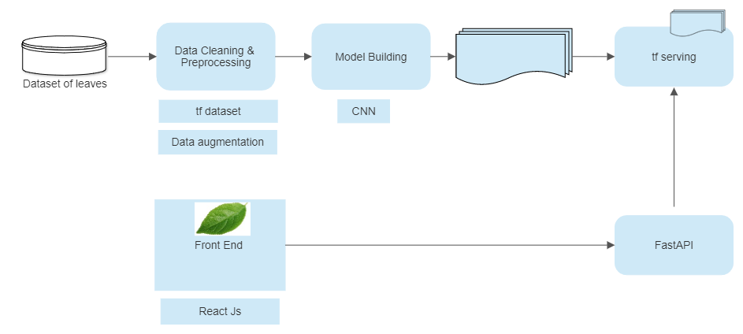
Flow Chart:
How Simple model Works

Slide 7
SOME IMPLEMENTATION

Slide 8
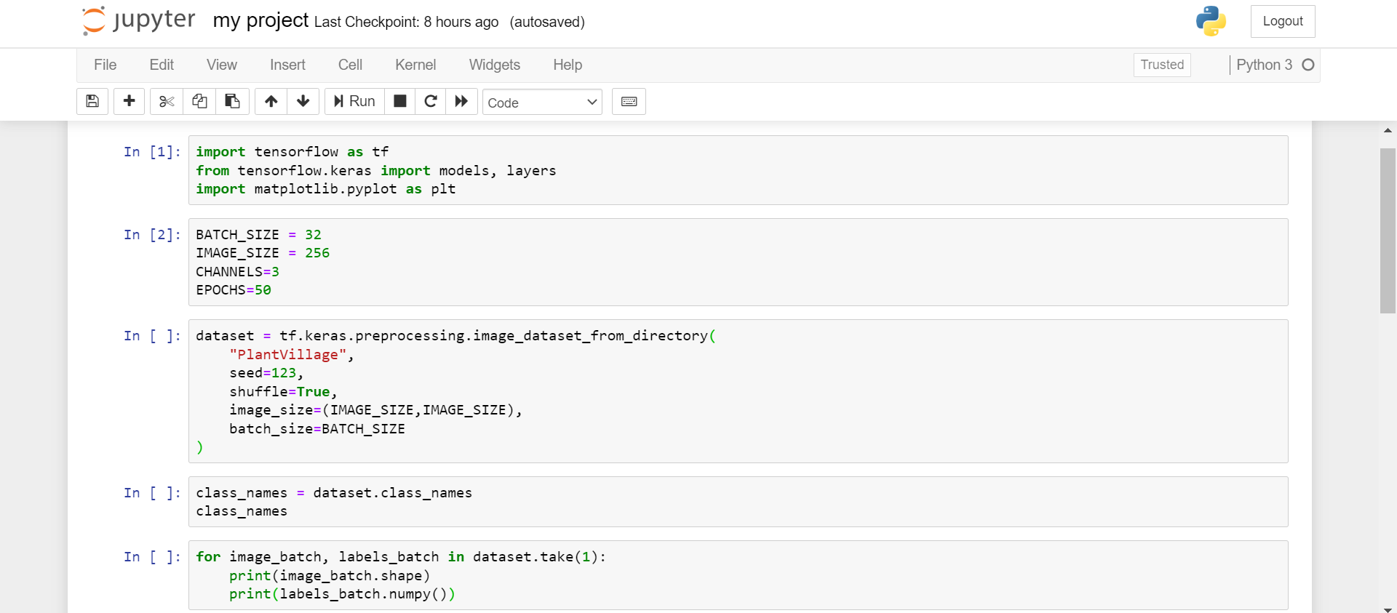
Importing Libraries and Dataset:

Slide 9
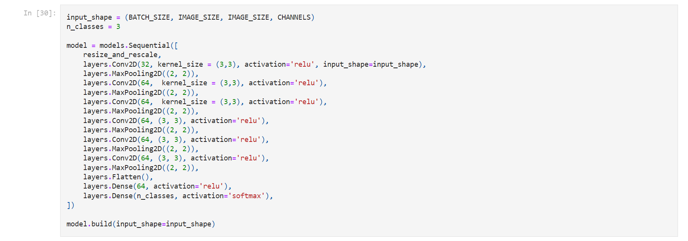
Convolutional Neural Network (CNN):

Slide 10
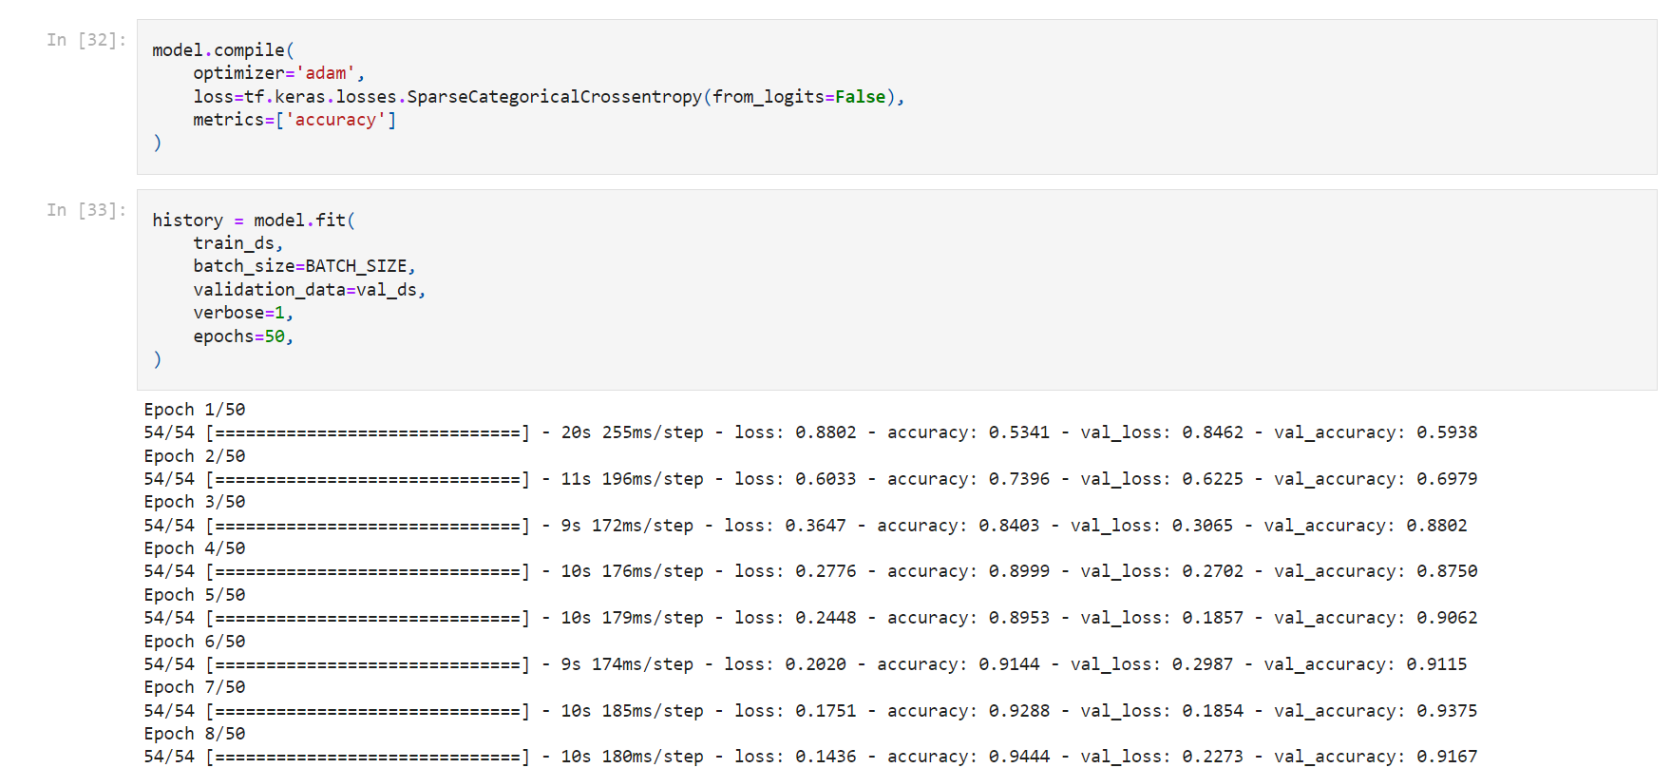
Compiling The Model:

Slide 11
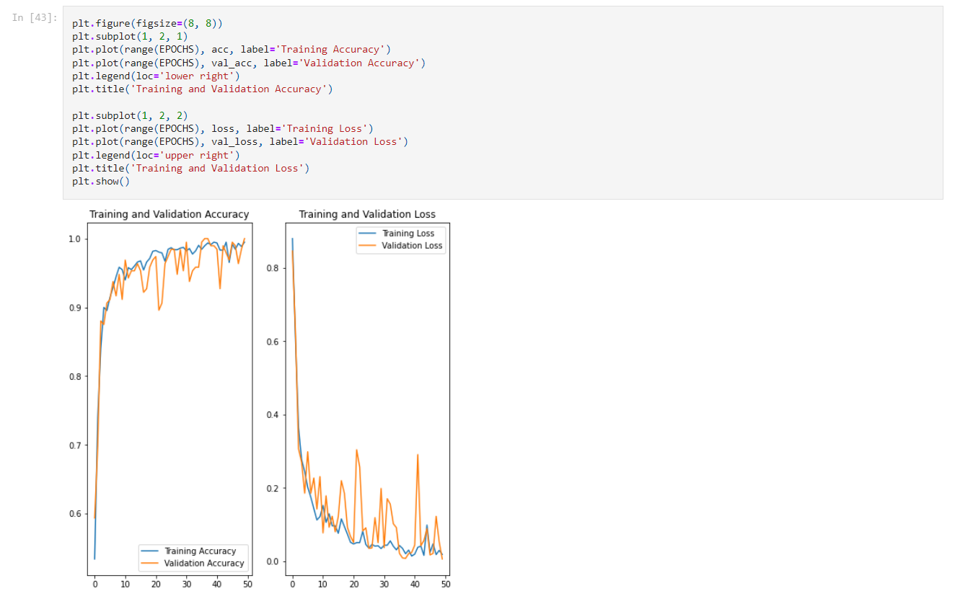
Plotting The Accuracy of the Model:

Slide 12
LITREATURE REVIEW

Slide 13
AN AUTOMATED SEGMENTATION AND CLASSIFICATION MODEL FOR BANANA LEAF DISEASE DETECTION
The productivity in agriculture is a major factor in the economy. As a result, disease detection in plants plays a significant role in agriculture. If sufficient care is not taken in this regard, then it can have major impacts on plants by affecting the quality, quantity, or productivity of the respective product or service. A method for picture segmentation is presented in this study, which is utilized for the automatic categorization of banana leaf diseases. The images are used to detect and classify diseases in banana plants. This is a cost-effective and efficient way for farmers to monitor the plant’s health. The images must be segmented in order to evaluate and extract information from them. This module of image processing isolates the object of interest from the rest of the image, allowing for more detailed analysis

Slide 14
AUTOMATED PLANT LEAF DISEASE DETECTION AND CLASSIFICATION USING OPTIMAL MobileNet BASED CONVOLUTIONAL NEURAL NETWORKS
Agriculture is the major occupation in India and it loses 35% of the crop productivity annually owing to plant diseases. Earlier plant disease detection is a tedious process because of improper laboratory facilities and expert knowledge. Automated plant disease detection techniques are advantageous for reducing the laborious task of monitoring large crop farms and for identifying disease symptoms early on, i.e., when they appear on plant leaves. Recent advances in computer vision and deep learning (DL) models have demonstrated the value of developing automatic plant disease detection models based on visible symptoms on leaves. This article proposes an automated model for detecting and classifying plant leaf diseases using an optimal mobile network-based convolutional neural network (OMNCNN). The proposed OMNCNN model operates on different stages namely preprocessing, segmentation, feature extraction, and classification. It involves bilateral filtering (BF) based preprocessing and Kapur’s thresholding based image segmentation to identify the affected portions of the leaf image.

Slide 15
BEANS LEAF DISEASES CLASSIFICATION USING MOBILENET MODEL
In recent years, plant leaf diseases has become a widespread problem for which an accurate research and rapid application of deep learning in plant disease classification is required, beans is also one of the most important plants and seeds which are used worldwide for cooking in either dried or fresh form, beans are a great source of protein that offer many health benefits, but there are a lot of diseases associated with beans leaf which hinder its production such as angular leaf spot disease and bean rust disease. Thus, an accurate classification of bean leaf diseases is needed to solve the problem in the early stage. A deep learning approach is proposed to identify and classify beans leaf disease by using public dataset of leaf image and MobileNet model with the open-source library TensorFlow. This study proposes a method to classify beans leaf disease and to find and describe the efficient network architecture (hyperparameters and optimization methods). Moreover, after applying each architecture separately the paper compares their obtained results to find out the best architecture configuration for classifying bean leaf diseases and their results. Furthermore, to satisfy the classification requirements, the model was trained using MobileNetV2 architecture under the some controlled conditions as MobileNet to check if it is possible to get faster training times, higher accuracy and easier retraining, we evaluated and implemented MobileNet architectures on one public dataset including two unhealthy classes (angular leaf spot disease and bean rust disease) and one healthy class, the algorithm was tested on 1296 images of bean leaf.

Slide 16
OPTIMIZATION OF DEEP LEARNING MODEL FOR PLANT DISEASE DETECTION USING PARTICLE SWARM OPTIMIZER
Plant diseases are a major impendence to food security, and due to a lack of key infrastructure in many regions of the world, quick identification is still challenging. Harvest losses owing to illnesses are a severe problem for both large farming structures and rural communities, motivating our mission. Because of the large range of diseases, identifying and classifying diseases with human eyes is not only time-consuming and labor intensive, but also prone to being mistaken with a high error rate. Deep learning-enabled breakthroughs in computer vision have cleared the road for smartphone-assisted plant disease and diagnosis. The proposed work describes a deep learning approach for detection plant disease. disease. The paper proposes a deep learning model strategy for detecting plant disease and classification of plant leaf diseases.
The paper focuses on detecting plant diseases in five crops divided into 25 different types of classes (wheat, cotton, grape, corn, and cucumbers). This task uses a public image database of healthy and diseased plant leaves acquired under realistic conditions.

Slide 17
EVALUATION OF IMAGE SEGMENTATION ALGORITHMS FOR PLANT DISEASE DETECTION
Processing images efficiently may be influenced by some important factors which are the techniques chosen, the field of study and the quality of images. This work studies the field of agriculture with the focus on the early detection of plant diseases through image processing. To detect plant diseases such bacterial diseases, fungal diseases and virus, two main techniques exist: The traditional techniques provided by agricultural experts during visit on the field and the artificial techniques based on images processing algorithms. Since plantations are usually distant from the cities where experts are not easy to find, the artificial techniques incorporated in computer programs become suitable. The modern techniques used to analyse images rely on existing algorithms such as k-nearest neighbor, k-means clustering, fuzzy logic, genetic algorithm, neural networks, etc. Five main phases characterise the process of images analysis: image acquisition, pre-treatment, segmentation, feature extraction and classification.

Slide 18
LeafGAN : AN EFFECTIVE DATA AUGMENTATION METHOD FOR PRACTICAL PLANT DISEASE DIAGNOSIS
Many applications for the automated diagnosis of plant disease have been developed based on the success of deep learning techniques. However, these applications often suffer from overfitting, and the diagnostic performance is drastically decreased when used on test data sets from new environments. In this article, we propose LeafGAN, a novel image-to-image translation system with own attention mechanism. LeafGAN generates a wide variety of diseased images via transformation from healthy images, as a data augmentation tool for improving the performance of plant disease diagnosis. Due to its own attention mechanism, this model can transform only relevant areas from images with a variety of backgrounds, thus enriching the versatility of the training images. Experiments with five-class cucumber disease classification show that data augmentation with vanilla CycleGAN cannot help to improve the generalization.

Slide 19
PLANT LEAF DISEASE RECOGNITION USING DEPTH-WISE SEPARABLE CONVOLUTION-BASED MODELS
The number of IoT sensors and physical objects accommodated on the Internet is increasing day by day, and traditional Cloud Computing would not be able to host IoT data because of its high latency. Being challenged of processing all IoT big data on Cloud facilities, there is not enough study on automating components to deal with the big data and real-time tasks in the IoT–Fog–Cloud ecosystem. For instance, designing automatic data transfer from the fog layer to cloud layer, which contains enormous distributed devices is challenging. Considering fog as the supporting processing layer, dealing with decentralized devices in the IoT and fog layer leads us to think of other automatic mechanisms to manage the existing heterogeneity. The big data and heterogeneity challenges also motivated us to design other automatic components for Fog resiliency, which we address as the third challenge in the ecosystem. Fog resiliency makes the processing of IoT tasks independent to the Cloud layer. This survey aims to review, study, and analyze the automatic functions as a taxonomy to help researchers, who are implementing methods and algorithms for different IoT applications. We demonstrated the automatic functions through our research in accordance to each challenge. The study also discusses and suggests automating the tasks, methods, and processes of the ecosystem that still process the data manually.

Slide 20
RECOGNITION OF PLANT LEAF DISEASES BASED ON COMPUTER VISION
Agriculture is one of the most important sources of income for people in many countries. However, plant disease issues influence many farmers, as diseases in plants often naturally occur. If proper care is not taken, diseases can have hazardous effects on plants and influence the product quality, quantity or productivity. Therefore, the detection and prevention of plant diseases are serious concerns and should be considered to increase productivity. An effective identification technology can be beneficial for monitoring plant diseases. Generally, the leaves of plants show the first signs of plant disease, and most diseases can be detected from the symptoms that appear on the leaves. This paper introduces a novel method for the detection of plant leaf diseases. The method is divided into two parts: image segmentation and image classification. First, a hue, saturation and intensity-based and LAB-based hybrid segmentation algorithm is proposed and used for the disease symptom segmentation of plant disease images. Then, the segmented images are input into a convolutional neural network for image classification. The validation accuracy obtained using this approach was approximately 15.51% higher than that for the conventional method. Additionally, the detection results showed that the average detection rate was 75.59% under complex background conditions, and most of the diseases were effectively detected. Thus, the approach of combined segmentation and classification is effective for plant disease identification, and our empirical research validates the advantages of the proposed method.

Slide 21
TRANSFER LEARNING FOR MULTI-CROP LEAF DISEASE IMAGE CLASSIFICATION USING CONVOLUTIONAL NEURAL NETWORK VGG
In recent times, the use of artificial intelligence (AI) in agriculture has become the most important. The technology adoption in agriculture if creatively approached. Controlling on the diseased leaves during the growing stages of crops is a crucial step. The disease detection, classification, and analysis of diseased leaves at an early stage, as well as possible solutions, are always helpful in agricultural progress. The disease detection and classification of different crops, especially tomatoes and grapes, is a major emphasis of our proposed research. The important objective is to forecast the sort of illness that would affect grapes and tomato leaves at an early stage. The Convolutional Neural Network (CNN) methods are used for detecting Multi-Crops Leaf Disease (MCLD). The features extraction of images using a deep learning-based model classified the sick and healthy leaves. The CNN based Visual Geometry Group (VGG)model is used for improved performance measures. The crops leaves images dataset is considered for training and testing the model. The performance measure parameters, i.e., accuracy, sensitivity, specificity precision, recall and F1-score were calculated and monitored. The main objective of research with the proposed model is to make on-going improvements in the performance. The designed model classifies disease-affected leaves with greater accuracy. In the experiment proposed research has achieved an accuracy of 98.40% of grapes and 95.71% of tomatoes. The proposed research directly supports increasing food production in agriculture.

Slide 22
TRANSFER LEARNING - BASED DEEP ENSEMBLE NEURAL NETWORK FOR PLANT LEAF DISEASE DETECTION
Plant diseases are a vital risk to crop yield and early detection of plant diseases remains a complex task for the farmers due to the similar appearance in color, shape, and texture. In this work, authors have proposed an automatic plant disease detection technique using deep ensemble neural networks (DENN). Transfer learning is employed to fine-tune the pre-trained models. Data augmentation techniques include image enhancement, rotation, scaling, and translation are applied to overcome overfitting. This paper presents a detailed taxonomy on the performance of different pre-trained neural networks and presents the performance of a weighted ensemble of those models relevant to plant leaf disease detection. Further, the performance of the proposed work is evaluated on publicly available plant village dataset, which comprises of 38 classes collected from 14 crops. The performance of DENN outperform state-of-the-art pre-trained models such as ResNet 50 & 101, InceptionV3, DenseNet 121 & 201, MobileNetV3, and NasNet. Performance evaluation of the proposed model demonstrates that effective in categorizing various types of plant diseases that comparatively outperform pre-trained models.

Slide 23
Outcome Of the Project:
Research Paper

Slide 24
References:
[1] V. Gokula Krishnan, J. Deepa , Pinagadi Venkateswara Rao , V. Divya , S. Kaviarasan, January, 2022 10.7324/JABB.2021.100126
[2] S. Ashwinkumar , S. Rajagopal , V. Manimaran, B. Jegajothi, 26 May 2021
[3] ELHOUCINE ELFATIMI 1 , RECEP ERYIGIT 1 , AND LAHCEN ELFATIMI, January 27, 2022, 10.1109/ACCESS.2022.3142817
[4] Ahmed Elaraby, Walid Hamdy and Madallah Alruwaili on 08 January 2022, 10.32604/cmc.2022.022161
[5] Paul DAYANG, Armandine Sorel KOUYIM MELI, 08 October 2021, 10.5815/ijigsp.2021.05.02
[6] Quan Huu Cap , Graduate Student Member, IEEE, Hiroyuki Uga, Satoshi Kagiwada, and Hitoshi Iyatomi, Member, IEEE, November 22, 2020, 10.1109/TASE.2020.3041499
[7] Syed Mohammad Minhaz Hossain, Kaushik Deb 1, Pranab Kumar Dhar and Takeshi Koshiba, 21 March 2021, 10.3390/ sym13030511
[8] Y. A. Nanehkaran, Defu Zhang, Junde Chen, Yuan Tian, Najla Al‑Nabhan, 27 August 2020, 10.1007/s12652-020-02505-x
[9] Ananda S. Paymode, Vandana B. Malode, 30 December 2021, 10.1016/j.aiia.2021.12.002
[10] Sasikala Vallabhajosyula, Venkatramaphanikumar Sistla, Venkata Krishna Kishore Kolli, 16 April 2021, 10.1007/s41348-021-00465-8

Slide 25
Research Paper
Title: Machine Learning Algorithms for Recommender Systems
Recommendation system is one of the most popular applications of Artificial Intelligence which attracts many researchers all over the globe. The advent of the Internet era has brought wide implementation of recommendation system in our everyday lives. There are many machine learning techniques which can be used to realize the recommendation system. Among all these techniques we are dealing with Content Based Filtering, Collaborative Based Filtering, Hybrid Content-Collaborative Based Filtering, k-mean clustering and Naive Bayes classifier. We have exploited these algorithms to their extreme in order to achieve the best possible precision and have presented a comprehensive comparative analysis.

Slide 26
THANK YOU

