Slide 1
EduGeeks
Developing a website for placement-oriented learning
Guided by:-Prof. Vikas Kamra
Group- PCS23-2
Submitted by:-
Aaditya Raj Sharma(1900290120001)
Aastha Chaudhary(1900290120004)
Garima Kushwaha(1900290120036)

Slide 2






Content
Problem Statement
Solution
Structure
Content
Research Paper
Conclusion
Future
Scope

Slide 3

Problem Statement
No interaction between Students, Alumni or Seniors, and Placement Faculty in College.
Lack of awareness regarding
Current Technology Industry Trends
On-Going Internship opportunities
Off-Campus Job opportunities
Hackathons
Coding Competition
Preparation Methods
Company Visit
Company Hiring Procedures

Slide 4

Solution
Placement-oriented learning and Guidance portal.
Create a Connection between
Student <-> Alumni <-> Faculty
Placement Department has all information about the company[ on – campus ] such as:
Hiring Procedure
CTC
Requirement
Exam Pattern
Placement Faculty provide all these details to students. So, they can prepare for their dream company easily and within time.

Slide 5

Alumni Interaction will help the student to gather information regarding:
Current Industry Trends
Top Technology in particular Field
Internship Opportunities
Provide Referral
Project-related Guidance
Preparation for any Company

Slide 6
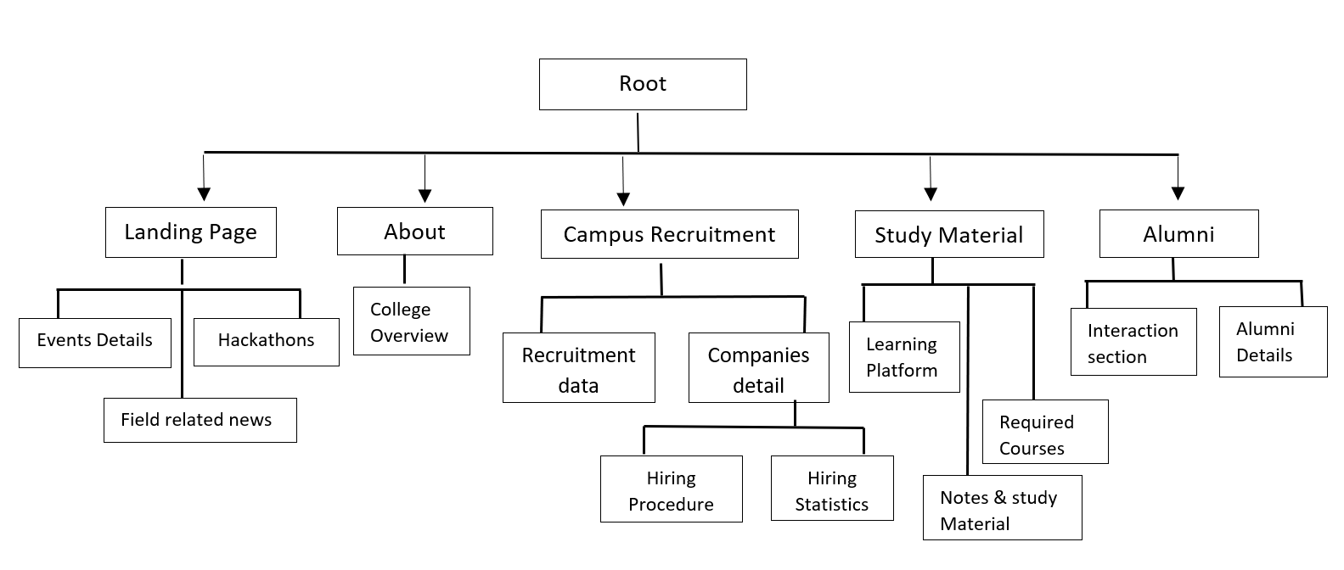
Structure

Slide 7
Architectural Diagram

Slide 8
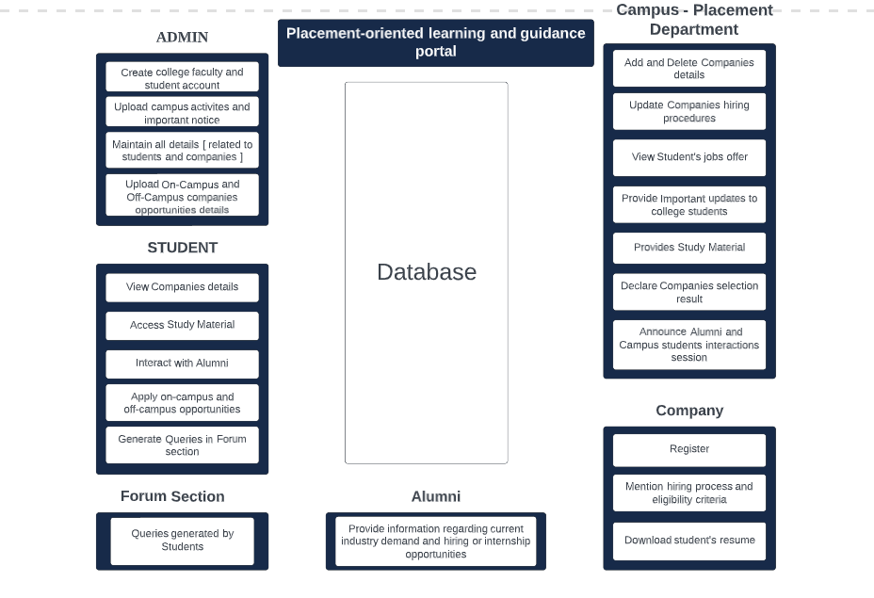

Slide 9
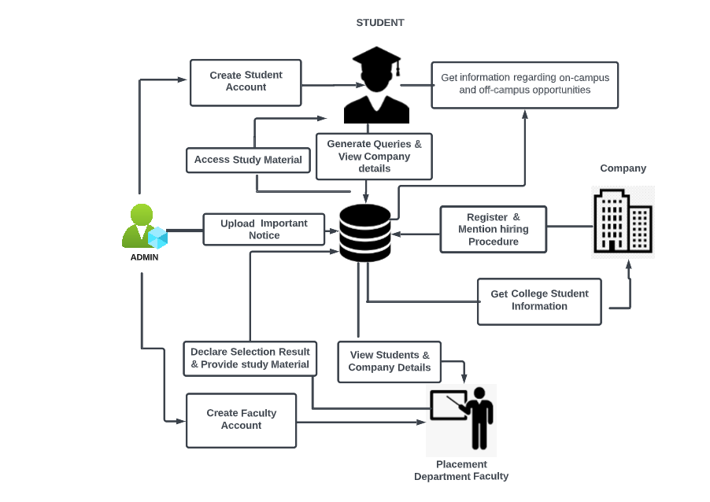
Working

Slide 10
Technology
HTML
CSS
Bootstrap
JavaScript – ReactJs
Django

Slide 11

Result

Slide 12
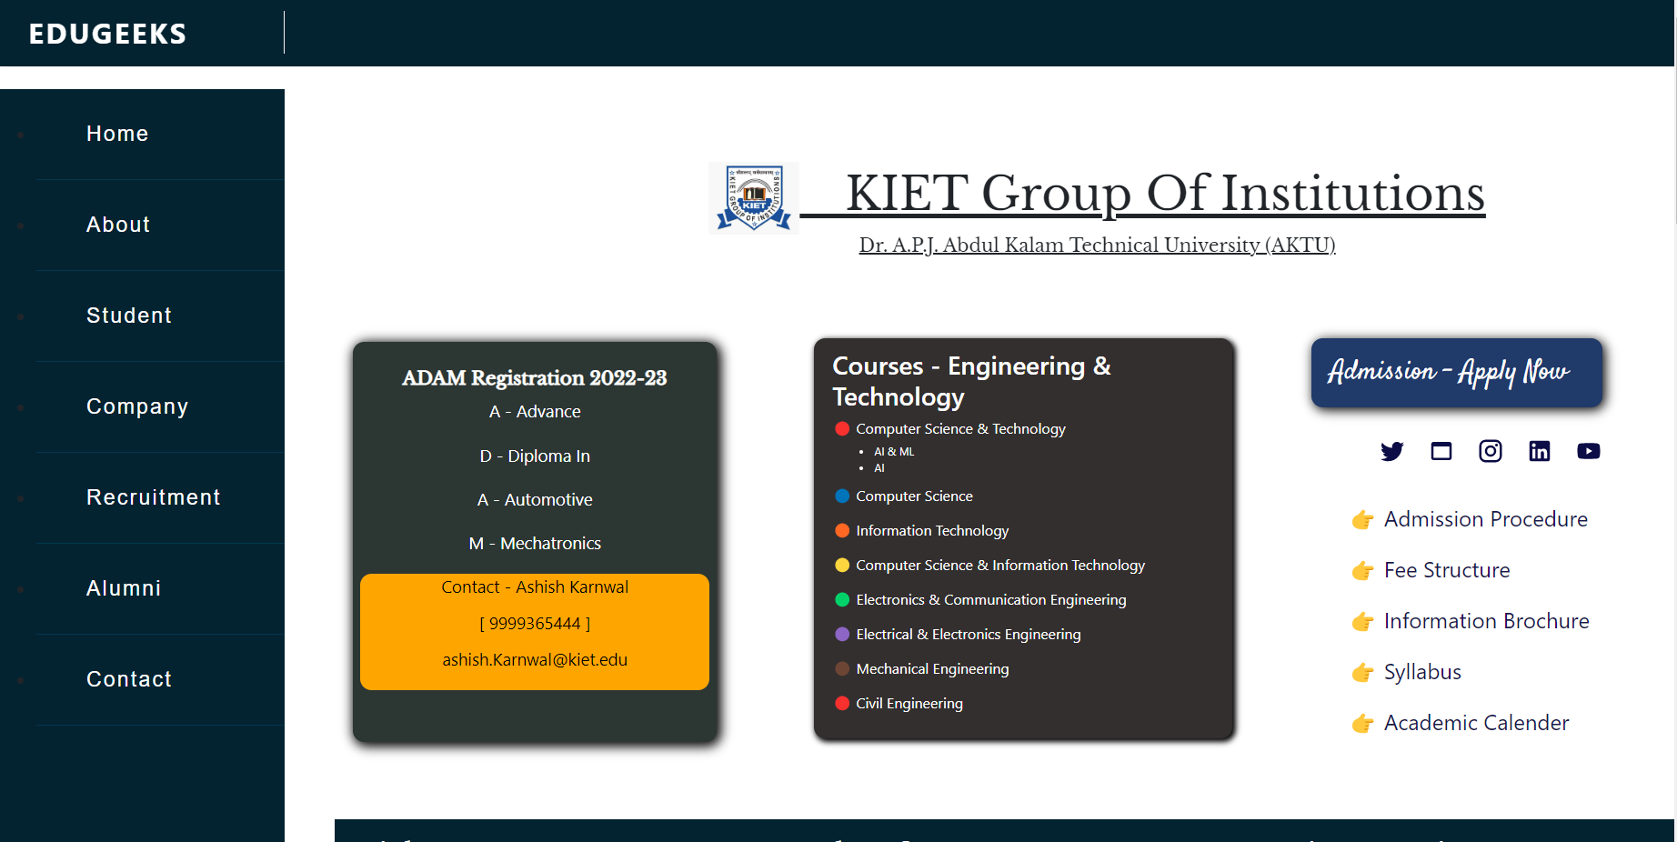
Result

Slide 13
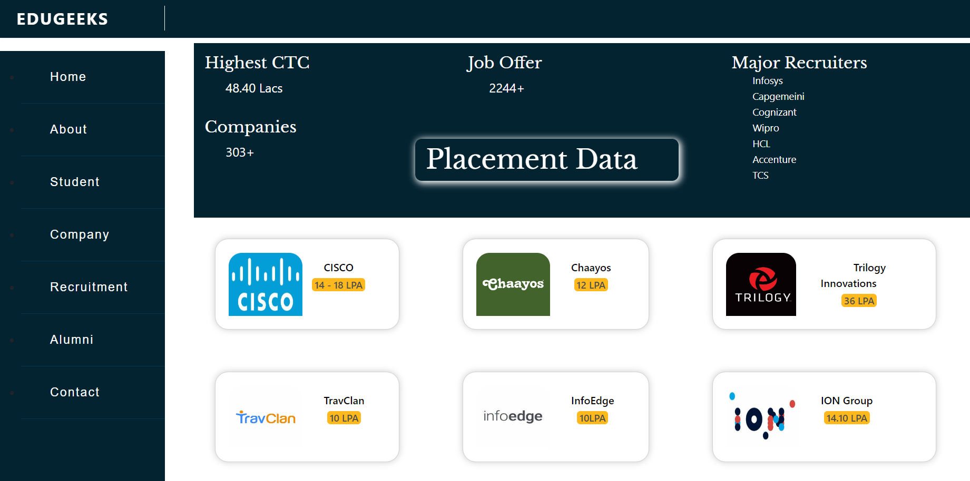
Result

Slide 14
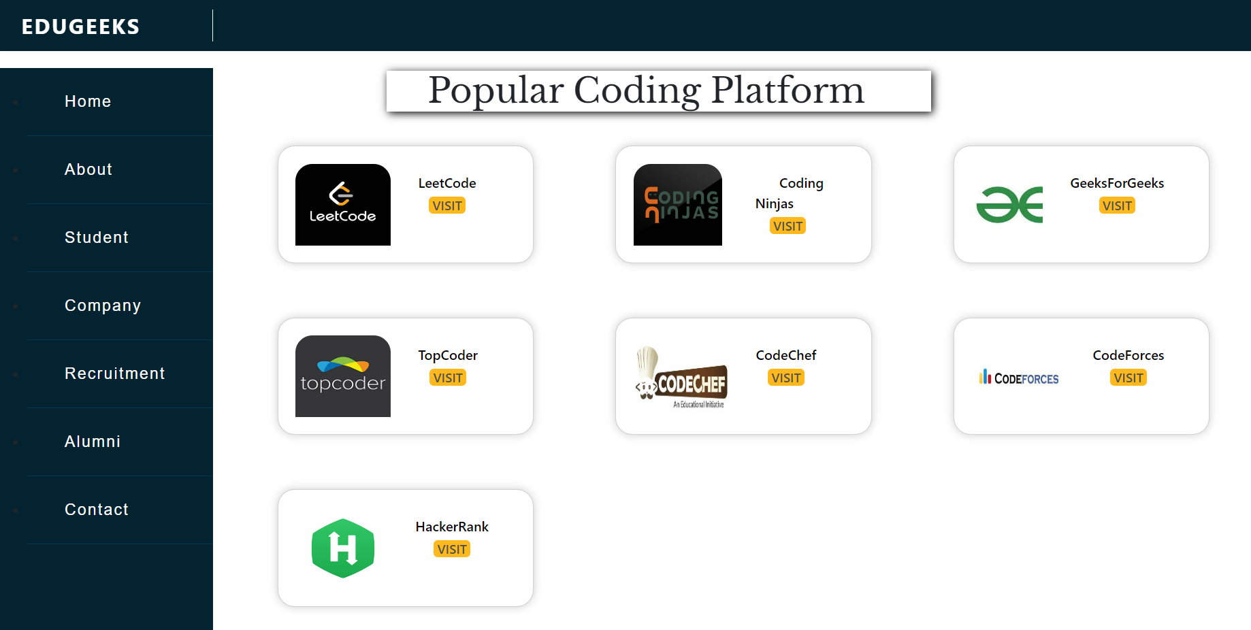
Result

Slide 15
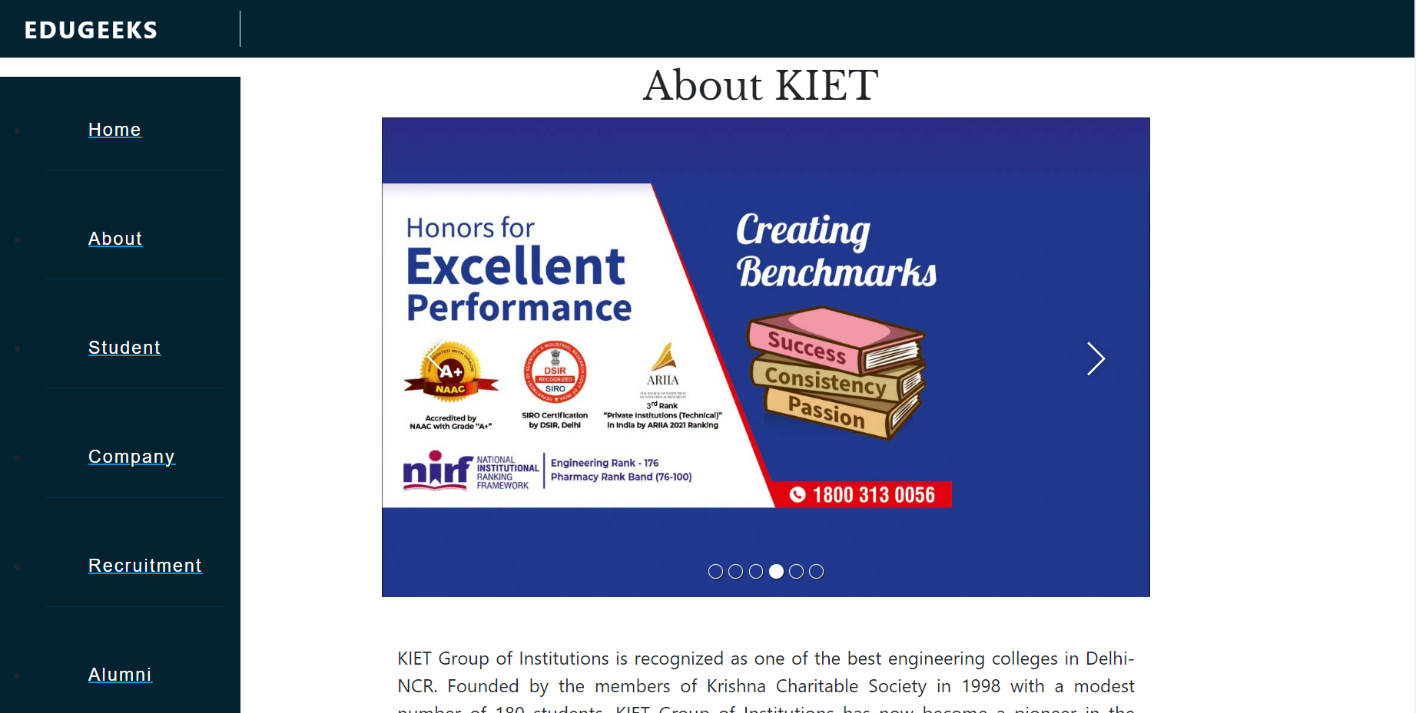
Result

Slide 16
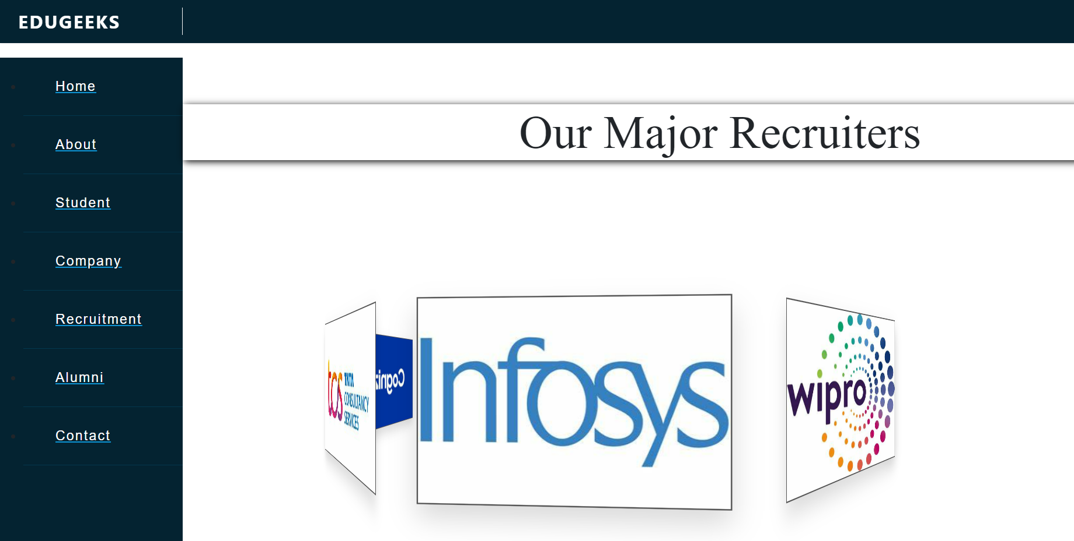
Result

Slide 17

Research
Paper

Slide 18
BVDUCOE College Alumni Portal
College students interact with Alumni to get updates about current industry trends, internship opportunities, project sponsorship, and various referrals opening in the corporate world.
This information will help campus students to grab different opportunities.
Students will get familiar with trending technologies and market demands.
Author: Rohit Singh, Rajat Singh Parmar, Saurabh Tripathi Prof. Rohini Khalkar, Prof. Sheetal Patil
Mar – Apr 2017

Slide 19
IIT Madras Placement Portal
IIT Madras provides all information in a separate student section related to eligibility criteria and registration process, resume format, placement process, and job offers.
They also provided contact information for all department faculty heads and placement cell members.

Slide 20
Advance Training and Placement Web Portal
Authorizing resumes, communicating about job opportunities, providing referrals through alumni, communication with seniors regarding trending technology, and so on, helps in improving the placement ratio in a particular campus.
It includes a feature using which students can search for company reviews, and access mock tests and mock interviews.
Authors-Swati Choudhary, Monica Landge, Shital Salunke, Swarupata Sutar, Kirti Mhamunkar
(March-April, 2016)

Slide 21
Campus Placement Prediction Techniques
The reputation and yearly admissions of an institution invariably depend on the placement it provides to its students. Previous year’s student’s data is analyzed to predict the placement chance of the current students.
The Probability of undergrad students getting placed in a company by applying classification algorithms such as Decision trees and Random Forests.
Author: Neelam Swaroopa, Pothuganti Manvitha
Number 9 (2019)

Slide 22
Changing approaches in campus placements
Earlier the success of higher education is measured by the level of knowledge and skills of the student but now providing campus placement is considered an institutional obligation and institutions are ranked based on the number of successful jobs provided by the campus.
As time progress, students must study various companies of their choice, study their business model, and their expansion opportunities.
Author: Varun Shenoy* & Dr. P. S. Aithal
2016

Slide 23
The proposed system gives placement-oriented study material verified by seniors and faculties.
It also provides students with company-wise placement information.
In the forum module, students would be able to ask their doubts related to placement activities.
Interacting with alumni can be very helpful as they can give an overview of the industry trends and projects in order to land a good career.

Slide 24
Future Scope :
We can add the functionality of the placement prediction.
Faculty can also launch their placement preparation course.
We can also add the functionality of recommending alumni based on upcoming hiring companies on the campus.
Online mock test modules and resume validator with the help of ATS.

Slide 25


