Slide 1

DEPARTMENT OF COMPUTER SCIENCE II Project Presentation (KCS 753) Home Services Provider
Guide Name: DR. AJAY KUMAR SHRIVASTAVA
Project Members Name with Roll Number & Section
1. AAVEG TOMAR(2000290120003)
2. ABHI SINGHAL (2000290120006) 3.ARPIT PURI (2000290120040)

Slide 2
Problem Statement
People usually face issue and can't afford expensive home services like plumber, electrician etc.
So they usually prefer local people to get their work done.
Finding a provider locally that also perform good work is usually hard.
Many time the broker takes extra charge that make the cost high of the person.

Slide 3
Objectives
Our website will help in finding for any service available in your local area by the local service providers only.
It will be a great help for those people who have recently shifted to the local area and don't know much about that but want good home services for any thing.
It will also be helpful for people who already live their by giving them chance to know other providers also who may be better than the currently they know.
Lastly it will help any service provider to reach out to people and show their work.

Slide 4
Features
Dynamic Pricing
According to type of customer
On the basis of distance
Recommendation Algorithm
Sub Services
Analysing the User Data
Nearest location
Chat dashboard

Slide 5
Technology Used
Front End-
REACT JS- React is a JavaScript library for building user interfaces React is used to build single-page applications. React allows us to create reusable UI components. The React.js framework is an open-source JavaScript framework and library developed by Facebook
CSS- Cascading Style Sheets (CSS) is a language used to describe the presentation of a document. CSS describes how elements should be rendered on screen, on paper, in speech, or on other media.
Material UI- React community provides a huge collection of advanced UI component framework. Material UI is one of the popular React UI frameworks. Let us learn how to use material UI library in this chapter.

Slide 6
Technology Used
BACK End-
Node.js- It is used for server-side programming, and primarily deployed for non- blocking, event-driven servers, such as traditional web sites and back-end API services, but was originally designed with real-time, push-based architectures in mind. Node.js is an open source server environment. Node.js allows you to run JavaScript on the server.
MongoDB- MongoDB is a source-available cross-platform document-oriented database program. Classified as a NoSQL database program, MongoDB uses JSON-like documents with optional schemas.

Slide 7
Literature Survey
Survey should be explained with the following parameters:
Paper title
Author name
Journal Name
Year of publishing
Followed by Summary of papers.

Slide 8
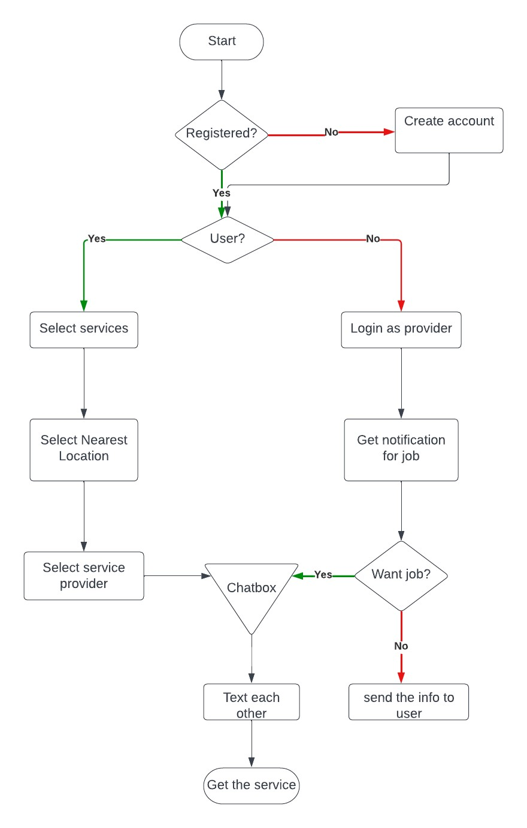
Diagrams
WORK FLOW DIAGRAM

Slide 9
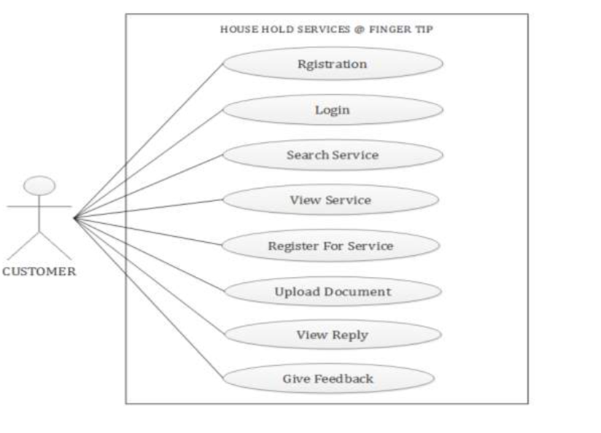
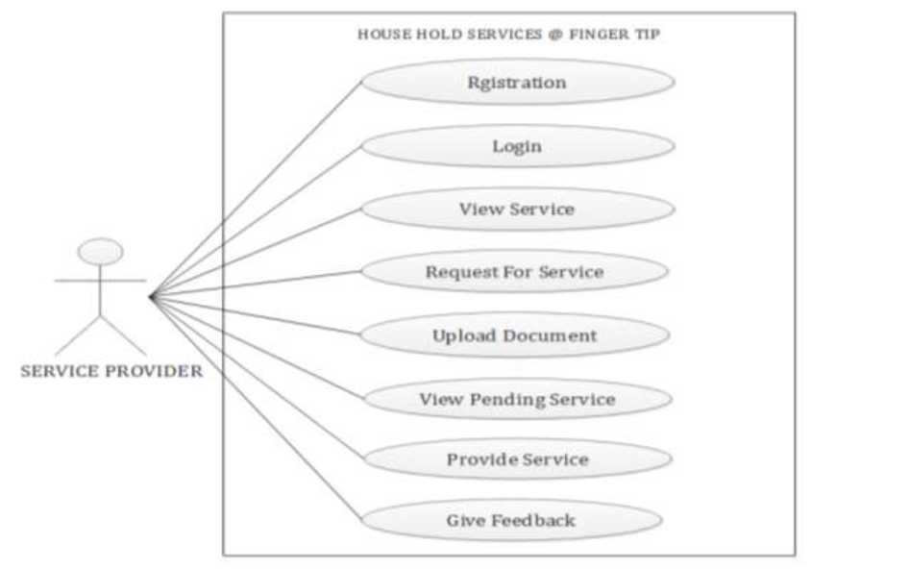
Diagrams
Use case for admin Use case for Service Provider

Slide 10
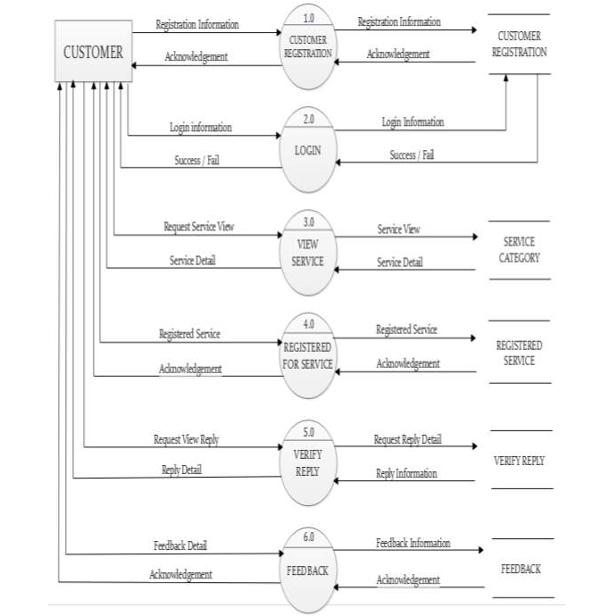
DFD LEVEL 1
For Customer

Slide 11
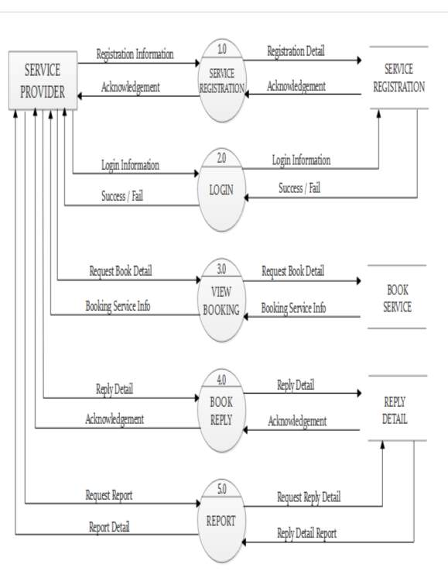
DFD LEVEL 1
For Service
Provider

Slide 12
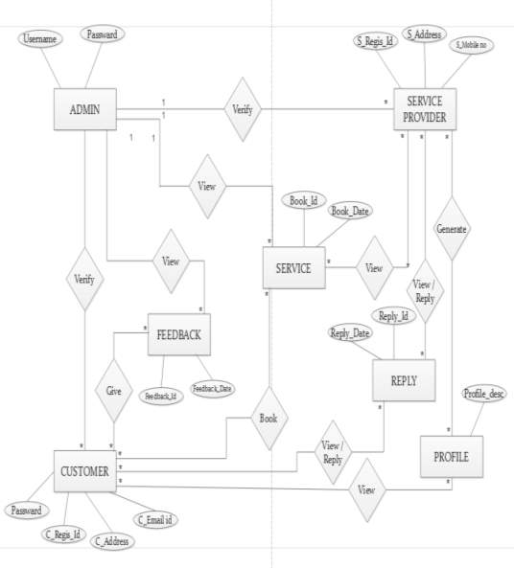
ER Diagram

Slide 13
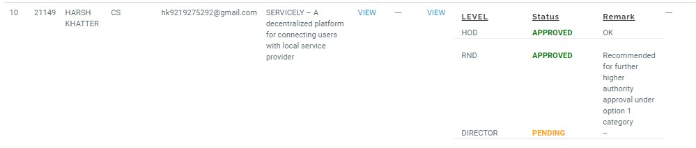
Patent Status

Slide 14
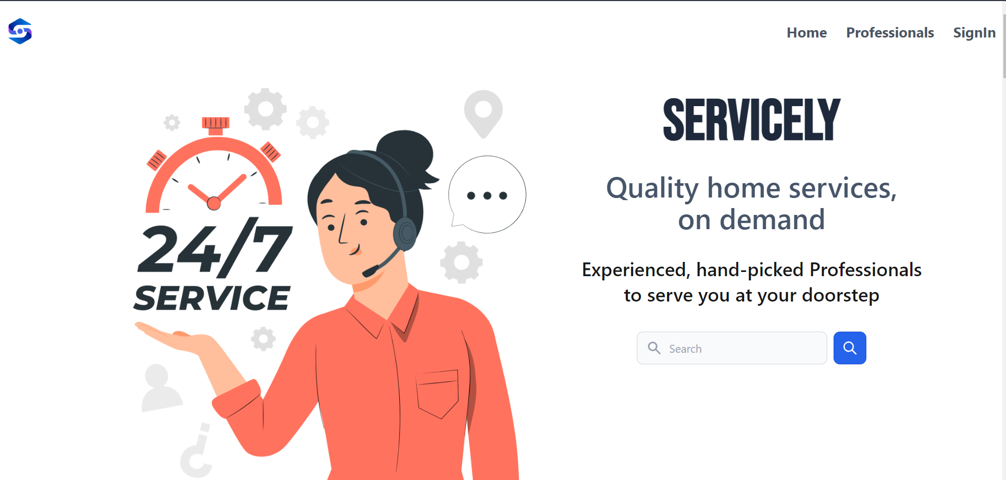
Project Status

Slide 15
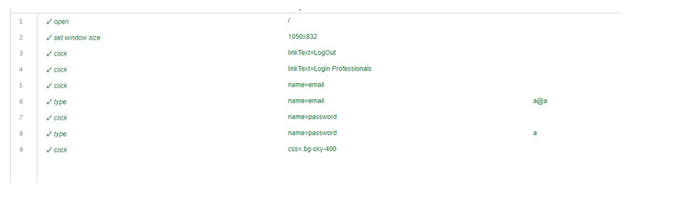
Testing Report
Automation testing – Selinium
User Login

Slide 16
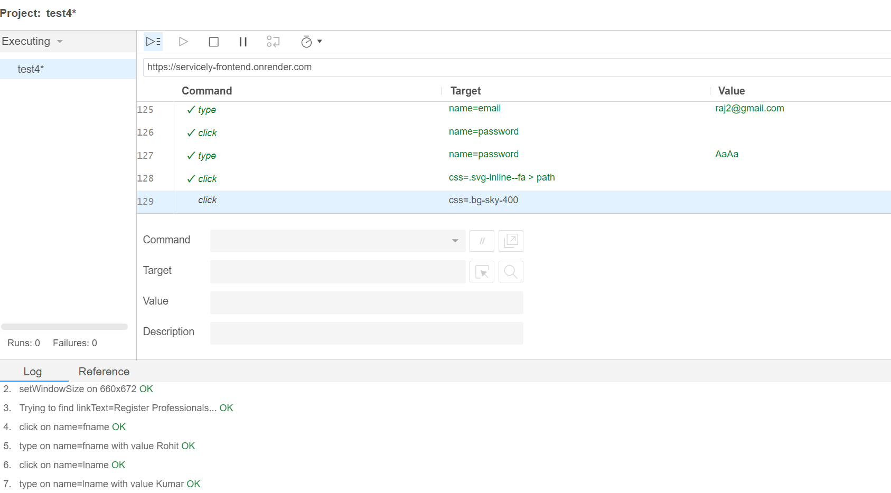
Testing Report
Provider Registration

Slide 17
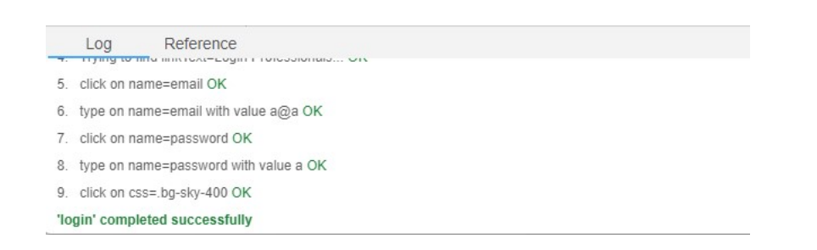
Testing Report
Provider Login

Slide 18
References
All mentioned references should be in IEEE format.

