Slide 1

DEPARTMENT OF COMPUTER SCIENCE DEPARTMENT OF COMPUTER SCIENCE Project Presentation (KCS 851) Adaptive Online Platform for Enhanced Teaching and Learning
Guide Name: Dr. Gaurav Dubey
(Professor)
Project Members :
Aniket Bhardwaj – (2000290120024), CS-8A
Amod Katiyar – (2000290120022), CS-8A
Himanshu Kumar – (2000290120076), CS-8B
PCS24-16

Slide 2
Problem Statement
In the current dynamic tech landscape, students struggle with selecting the right programming languages to pursue. This challenge stems from several factors:
Rapidly Evolving Industry: The tech sector is constantly in flux, with new programming languages emerging and existing ones evolving. This rapid change makes it difficult for students to identify languages with long-term relevance.
Information Overload: There's a vast amount of information available on programming languages. Sifting through this information to find reliable and current trends can be overwhelming for students.
Passion vs. Market Demands: Students are often passionate about specific areas of technology, but those passions might not always align with the most in-demand programming skills in the job market.
This project aims to address these challenges by creating a user-friendly platform that bridges the gap between student aspirations and industry needs.

Slide 3
Objectives
Streamline Language Selection: Empower students to make informed decisions by simplifying the process of choosing programming languages to learn.
Navigate Industry Trends: Provide real-time insights into the ever-changing tech landscape, highlighting the most relevant and in-demand programming languages.
Bridge Passion and Demand: Help students find programming languages that align with their interests while also preparing them for successful careers in the technology sector.

Slide 4
Technology Used
Front-End:
Languages: HTML5 provides the core structure and content of web pages, while CSS3 styles those pages for a consistent and visually appealing experience across various devices.
Frameworks: React.js is a JavaScript library that facilitates building modular and reusable user interface components, leading to a responsive and user-friendly platform.
Back-End:
Languages: JavaScript plays a dual role here. It's used for traditional front-end interactivity, and Node.js, a JavaScript runtime environment, empowers server-side operations like handling user requests and real-time data processing.
Frameworks: Express.js is a lightweight Node.js framework that streamlines the development process by providing essential features for building robust web applications and APIs. It manages routing, middleware (functions that execute during requests), and interactions with databases.
Database: MongoDB, a NoSQL database, stores user information, course data, and progress tracking. Its flexible schema adapts to changing data needs, and its scalability ensures smooth operation as the platform grows.
Additional Technologies:
Natural Language Processing (NLP): NLP analyzes textual data (like user inputs or job postings) to extract valuable insights. This helps the platform recommend relevant courses and learning paths based on individual needs and industry trends.
Machine Learning Algorithms (XGBoost & Decision Trees): These algorithms analyze data, forecast trends, and generate personalized course recommendations for each user.

Slide 5
Literature Survey
PAPER 1
Title: A review and analysis of technologies for developing web applications
Author: SOLOMON ANTONY
Publisher: IEEE
Year of Publication: 2012
Summary:
Object oriented approach build web applications very efficient when one can accomplish more in less time, because it uses modern processes, by this both developers and clients can benefit from this.
To develop these types of applications there are so many scripting languages and new technologies are there we don’t have to stick to one. It gives good knowledge to the developers as well as clients in choosing a web application platform

Slide 6
Literature Survey
PAPER 2
Title: Research on HTML5 in Web Development
Author: Ch Rajesh,K S V Krishna Srikanth
Publisher: IEEE
Year of Publication: 2014
Summary:
HTML5 offers new features for improved interoperability, precise element handling, and cost savings.
HTML5 has the potential to expand the web's reach across devices, from desktops to mobiles and potentially even appliances.
A potential downside of HTML5 is the increased vulnerability to malware attacks due to new functionalities.

Slide 7
Literature Survey
PAPER 3
Title: Website Development Technologies: A Review
Author: Pratiksha D Dutonde , Shivani S Mamidwar , Monali Sunil Korvate
Publisher: IEEE
Year of Publication: 2022
Summary:
Web applications break the mold of traditional software by running their code on internet servers rather than requiring installation on individual computers, laptops, or mobile devices.
This server-based approach allows users to access web applications through any internet-connected device, promoting versatility and platform independence.
The passage emphasizes "look and implementation," suggesting a potential focus on designing web applications to have user interfaces that are intuitive and user-friendly.

Slide 8
Literature Survey
PAPER 4
Title: An Analysis of Time Series Analysis and Forecasting Techniques.
Author: Malik, Pankaj & Dangi, Aditya & Singh, Aditya & Asst, Thakur & Pratap, Aditya & Parihar, Singh & Sharma, Utkarsh & Mishra, Lakshya.
Publisher: IEEE
Year of Publication: 2023
Summary:
This paper explores time series forecasting, a technique that predicts future events by analyzing past trends, assuming that future trends will mirror historical patterns

Slide 9
Literature Survey
PAPER 5
Title: Predicting Stock Prices Using Hybrid LSTM and ARIMA Model
Author: Chi Ma, Jie Wu , Hui Hu, Yue Nai Chen, Jing Yan Li,
Publisher: IEEE
Year of Publication: 2023
Summary:
This paper provides an exploration into the intersection of China's evolving financial market and the growing demand for precise financial information services.

Slide 10
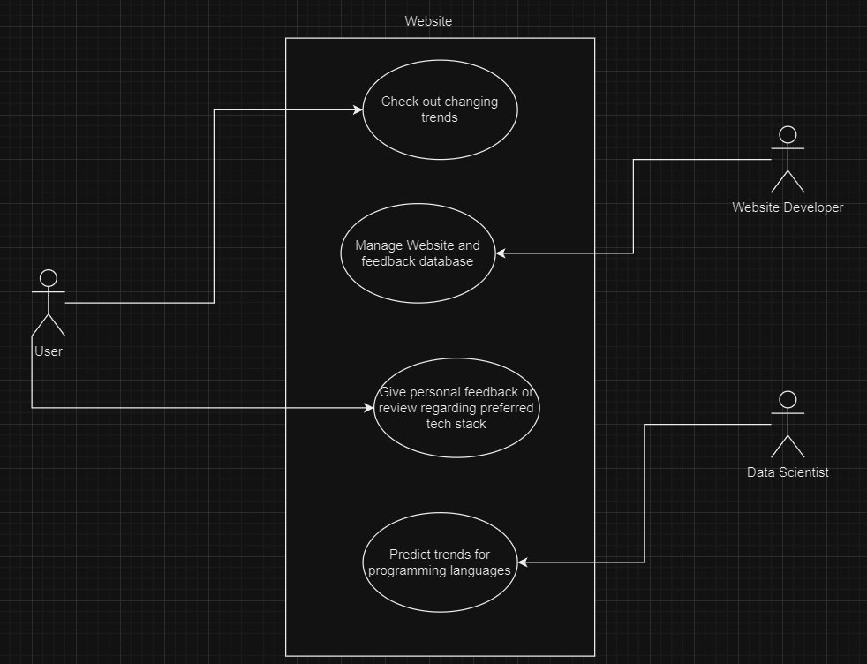
Use Case Diagram

Slide 11
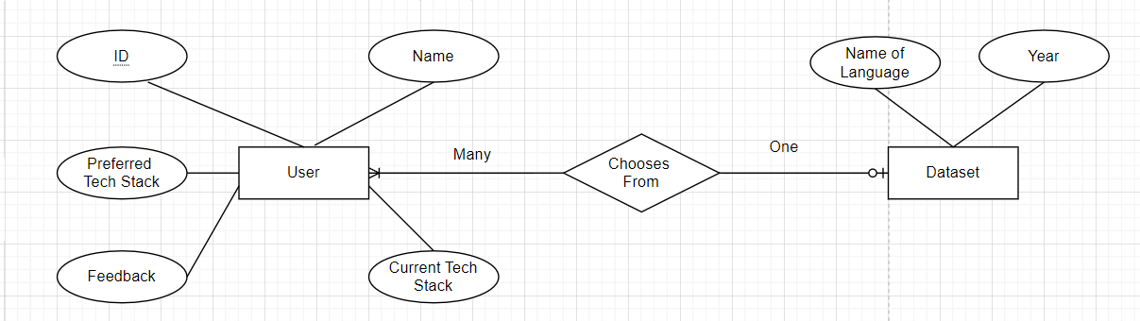
ER Diagram

Slide 12
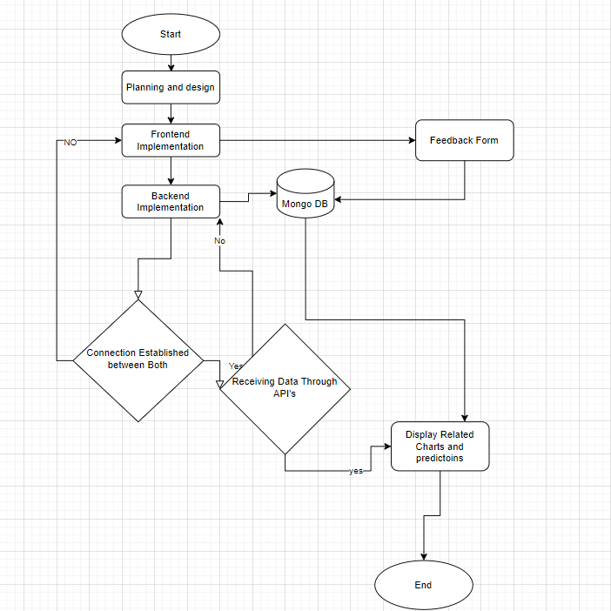
Process Flow

Slide 13
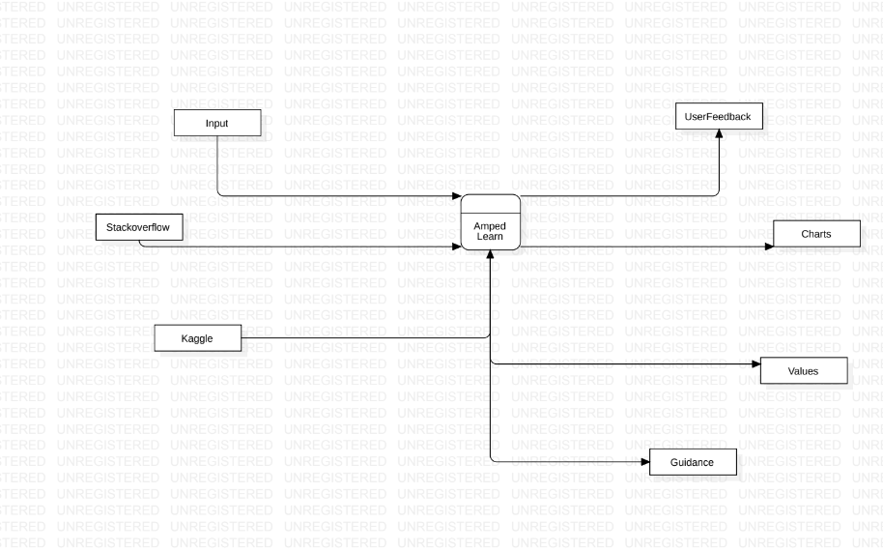
DFD (level 0)

Slide 14
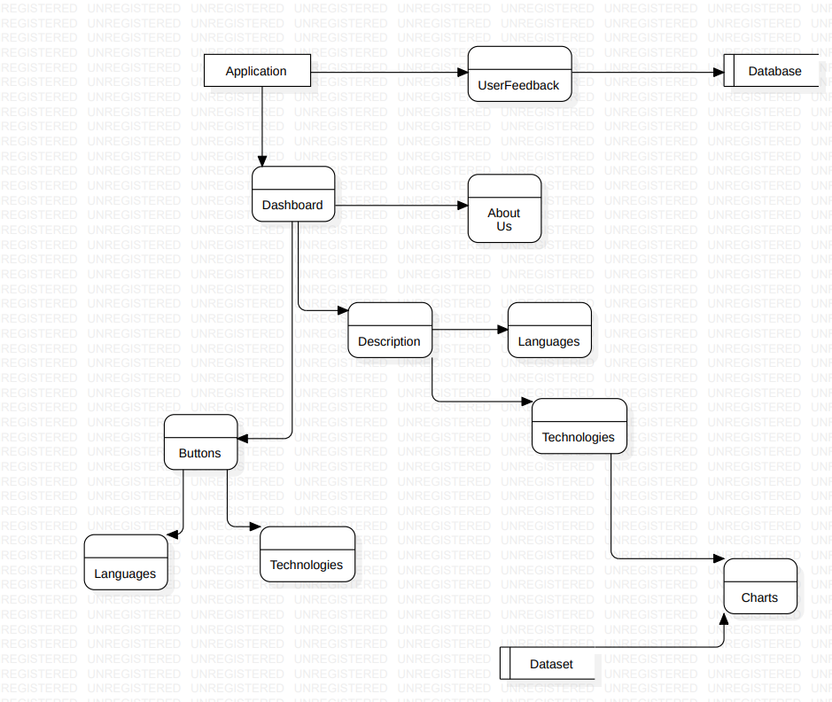
DFD (level 1)

Slide 15
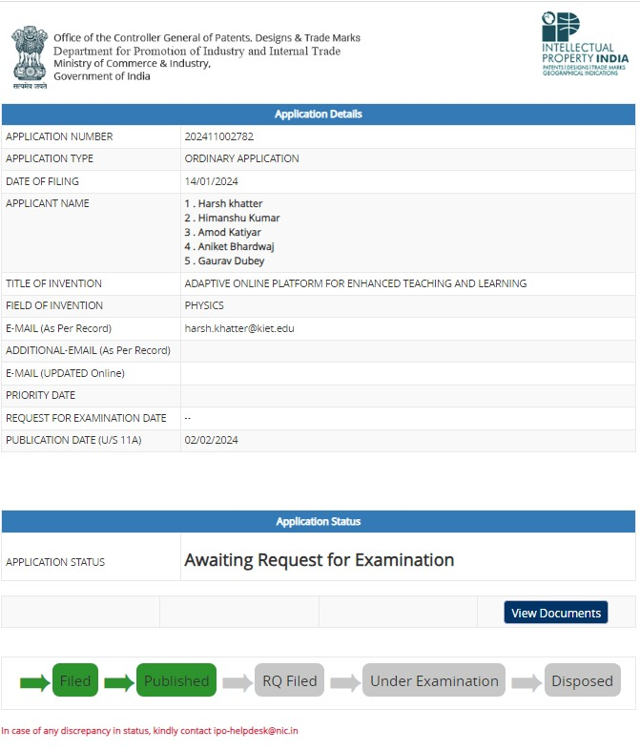
Patent Status

Slide 16
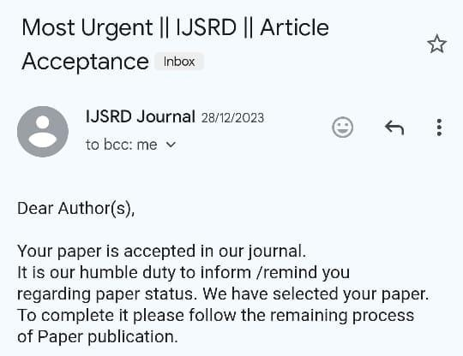
Research Paper Status
Accepted

Slide 17
Project Status
Github Link :- https://github.com/KIET-Github/CS-2024-A/tree/main/PCS24-16-Aniket

Slide 18
All documents Proofs
Testing report: https://docs.google.com/document/d/1w3Ed9ws1nBmNkc7UGpn_Ldaeh8LfQ-FO/edit?usp=sharing&ouid=102503593819451573564&rtpof=true&sd=true
Synopsis: https://drive.google.com/file/d/1o9ECuNMuhp0BrMPCtE7A0cVI1ptKUdiW/view?usp=sharing
SRS: https://docs.google.com/document/d/1-YxshFV33IdoSUKhkrnJ7H2GHeAPJ8Jv/edit?usp=sharing&ouid=102503593819451573564&rtpof=true&sd=true
Report: https://drive.google.com/file/d/1nAQ_AyB-Q4SdE9wjr9Qr0EaBPqF-qRhR/view?usp=sharing

Slide 19
References
[1] A review and analysis of technologies for developing web applications, BY-SOLOMON ANTONY
[2] Web Application Development -a study on UML Web Application Extension, Andreas Oskarsson,, Martin Kling, Tobias Norberg
[3] Research on HTML5 in Web Development, Ch Rajesh, K S V Krishna Srikanth
[4] Review of WordPress website vs coding website By-Swapnil S More
[5] Website Development Technologies: A Review By - Pratiksha D Dutonde , Shivani S Mamidwar ,Monali Sunil Korvate
[6] Wide & Deep Learning for Recommender Systems Heng-Tze Cheng, Levent Koc, Jeremiah Harmsen, Tal Shaked, Tushar Chandra, Hrishi Aradhye, Glen Anderson, Greg Corrado, Wei Chai, Mustafa Ispir, Rohan Anil, Zakaria Haque, Lichan Hong, Vihan Jain, Xiaobing Liu, Hemal Shah
[7] Research Paper Recommendation System Using Natural Language Processing Submitted in partial fulfilment of the requirements for the degree of Bachelor of Technology in Computer Science & Engineering by Siddharth Sanjay Gandhi 19BCE0005 Under the guidance of Dr. Akila Victor School of Computer Science & Engineering VIT Vellore Dr. Felix Dietrich, Department of Informatics Technical University of Munich
[8] RESEARCH ON COVID-19 EPIDEMIC BASED ON ARIMA MODEL Li Zhihao et al 2021 J. Phys.: Conf. Ser. 2012 012063
[9] Research Paper On Recommendation System Dr. Alka Singhal Assit Professor,CSE department, IPEC Ghaziabad, India Shivangi Rastogi Student, CSE department, IPEC Ghaziabad, India Nikhil Panchal Student, CSE department, IPEC Ghaziabad, India Shivani Chauhan Student, CSE department IPEC Ghaziabad, India Shradha Varshney Student, CSE department, IPEC Ghaziabad, India
[10] Forecasting with Machine Learning Dr. Osman Mohamed Abbas

Slide 20
References
[11] Dibekulu, Dawit. (2020). An Overview of Data Analysis and Interpretations in Research. 1-27. 10.14662/IJARER2020.015. 49
[12] Lubbers, Peter & Albers, Brian & Salim, Frank & Kumar, Mahesh. (2023). HTML5 -Unleashing the Power of the Web Reference By:-"HTML and CSS: Design and Build Websites" by Jon Duckett and "Pro HTML5 Programming" by. 10.13140/RG.2.2.11587.37923.
[13] Use of React.js in Modern Web Development and its Comparative Analysis Kunal Goyal, Dr. Vishal Shrivastava , Dr. Akhil Pandey, 2024
[14] React-JS: A Cutting-Edge Framework for Web Designing Navratan Mal, Dr. Vishal Shrivastava, Dr.Akhil Pandey. 2024
[15] A Comparative Analysis of Database Management Systems for Time Series Data TOVE VERNERCARLSSON VALERIO LOMANTO, 2023
[16] Malik, Pankaj & Dangi, Aditya & Singh, Aditya & Asst, Thakur & Pratap, Aditya & Parihar, Singh & Sharma, Utkarsh & Mishra, Lakshya. (2023). An Analysis of Time Series Analysis and Forecasting Techniques. IJARCCE. Vol-9. 2023.
[17] IMPLEMENTATION AND COMPARISON OF MERN STACK TECHNOLOGY WITH HTML/CSS, SQL, PHP & MEAN IN WEB DEVELOPMENT Er. Vikas Goyal, Ashish Kumar Mishra, Daljeet Singh, 2023
[18] Predicting Stock Prices Using Hybrid LSTM and ARIMA Model Chi Ma, Jie Wu* , Hui Hu, YueNai Chen, JingYan Li, 2023

