Slide 1


Project Presentation (KCS 853) (Employee Drowsiness Detection System)
KIET Group of Institutions, Ghaziabad
(An ISO – 9001: 2008 Certified & ‘A+’ Grade accredited Institution by NAAC)
Guide Name: Dr. Kalpna Sagar
Project Members Name with Roll Number & Section
1. Ashu Verma (Computer Science) 2000290120045
2. Daksh Kumar (Computer Science) 2000290120060
3. Chandan Kumar Gupta (Computer Science) 2000290120058

Slide 2
Problem Statement
In some corporate offices many projects meet failure, some due to the drowsiness. It is considered to be one of the problem through which companies faces failure of the project.
In a company if there are employee which are sleepy in nature then the productivity of company decreases, also these employee are very slow and reaction time is very low.

Slide 3
Objectives
In this project we are going to develop a Sleep Detection System that is proposed as specific counter measures to control the drowsiness that are associated with an employee.
In this system we will use different techniques for detecting employee’s drowsiness while working also it will give notification when an employee will reach at critical level of drowsiness.

Slide 4
Technology Used
Python - Programming language
Pytorch - Deep Learning Framework
Keras - Deep Learning API for Pretrained Models
Flask - Web framework
Google Cloud - Model Hosting as API.
Pillow Library - Image pre-processing.
Numpy, Pandas -Data handling and manipulation.

Slide 5
Literature Survey.
Paper title: Driver drowsiness detection system and techniques
Author name: Saini, Vandna, and Rekha Saini
Journal Name: International Journal of Computer Science and Information Technologies
Year of publishing:2020
Summary of papers.

Slide 6
In this study, the author attempts to address the issue that drivers who drive long distances without frequent breaks incur a high chance of experiencing fatigue, a condition that experts say they frequently fail to identify in time.
Attention assist has an extended speed range, can alert drivers to their current level of fatigue and the amount of time since their last break, has adjustable sensitivity, and, if a warning is issued, uses the COMAND navigation system to show the location of nearby service areas. The system conducts real-time processing of a live video feed obtained from the driver's front-facing camera

Slide 7
Literature Survey..
Paper title: Research on Machine Learning and Its Algorithms and Development
Author name: Jin, Wei.
Journal Name: Journal of Physics
Year of publishing:2020
Summary of papers….

Slide 8
The researcher investigates machine learning and its algorithms within this study, delving into the core categories including supervised learning, unsupervised learning, and reinforcement learning.
The objective is to heighten public understanding of machine learning and accelerate its adoption by developing theoretical frameworks, improving autonomous learning capabilities, integrating diverse digital technologies, and advocating for personalized services.
Artificial intelligence and science are developing at a quick pace, which has opened new development options. Integrating diverse theoretical knowledge, including statistics and algorithm complexity, into computer-based machine technology enhances the functional attributes of artificial intelligence.

Slide 9
Literature Survey…
Paper title: Enhanced Drowsiness Detection Using Deep Learning: An fNIRS Study
Author name: M. A. Tanveer, M. J. Khan, M. J. Qureshi, N. Naseer and K. -S. Hong,
Journal Name: IEEE Access
Year of publishing:2019
Summary of papers….

Slide 10
This study delves into the exploration of detecting driver drowsiness for BCI applications using fNIRS, with an emphasis on leveraging deep learning techniques.
Thirteen individuals without health complications participated to capture passive brain signals linked with drowsiness during a simulated driving scenario. Employing a continuous wave fNIRS setup, researchers measured brain activities, focusing particularly on the prefrontal and dorsolateral prefrontal cortices.
The study utilized DNN to classify between alert and drowsy states. Convolutional neural networks (CNNs) were applied to color map images for both model training and testing. The objective was to identify optimal channels for detecting brain activity across time intervals of 0-1, 0-3, 0-5, and 0-1 seconds.
The CNN achieved an accuracy of 99.3%, demonstrating its ability to discern between images representing drowsy and non-drowsy states. This suggested method shows potential in identifying drowsiness and determining the specific brain region for a passive BCI system..

Slide 11
Literature Survey….
Paper title: Facial features monitoring for real time drowsiness detection
Author name:B. N. Manu
Journal Name:International Conference on Innovations in Information Technology
Year of publishing:2019
Summary of papers….

Slide 12
This research introduces an effective three-phase sleepiness detection approach. The three stages involve eye tracking, yawning detection, and facial feature detection using the Viola-Jones method.
After facial detection, the system achieves illumination invariance by selectively isolating the skin portion and consider only the chromatic components to eliminate background interference based on skin tone. The tracking of eyes and detection of yawning are accomplished through correlation coefficient template matching.
To classify subsequent frames into tiredness and non-fatigue states, and to trigger an alarm for the former if it surpasses the threshold time, a binary linear support vector machine classifier concatenates feature vectors from each phase. Numerous real-time trials illustrate the effectiveness of the proposed strategy in identifying drowsiness and alerting the driver.

Slide 13
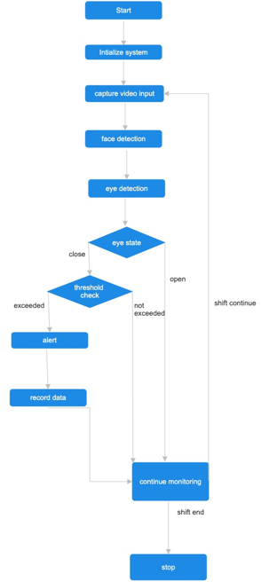
Workflow Diagram…

Slide 14
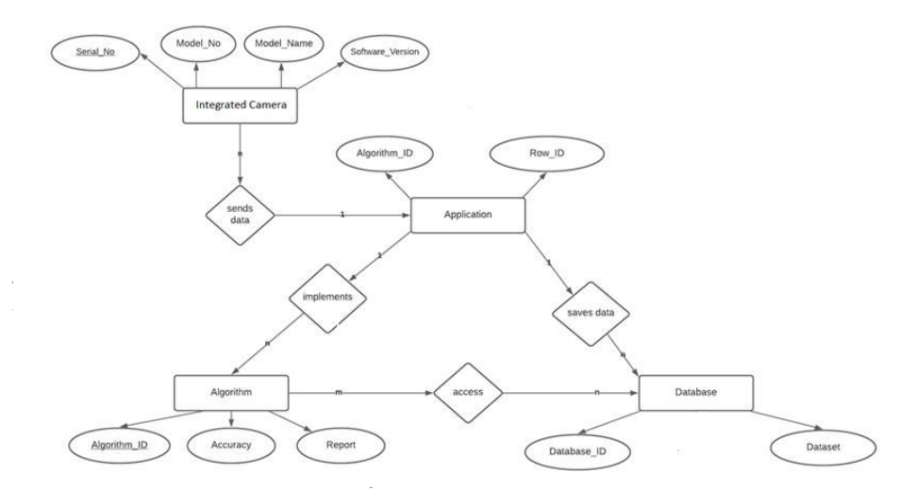
ER-DIAGRAM

Slide 15
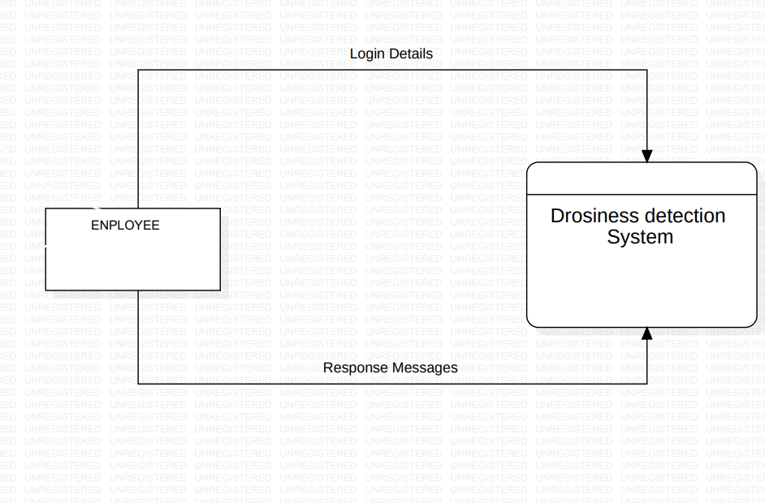
Data Flow Diagram(Level 0)

Slide 16
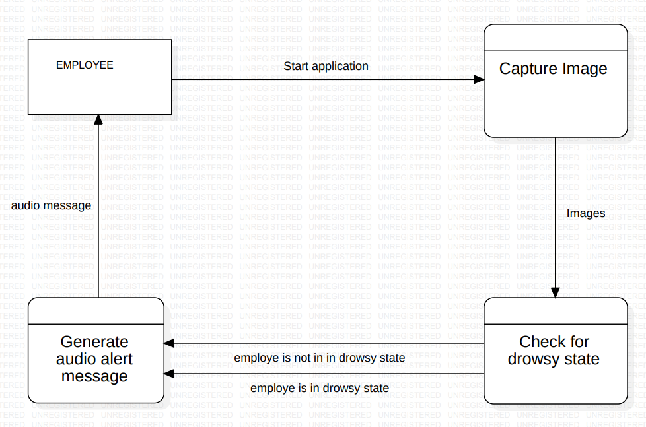
Data Flow Diagram(Level 1)

Slide 17
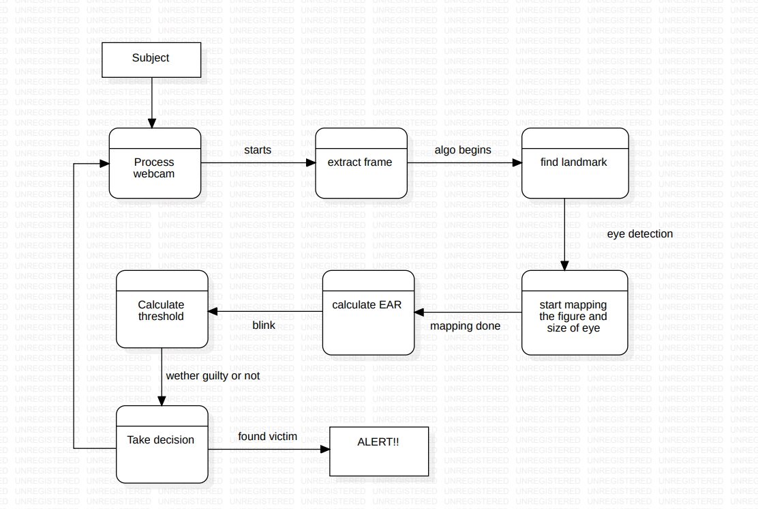
Data Flow Diagram(Level 2)

Slide 18
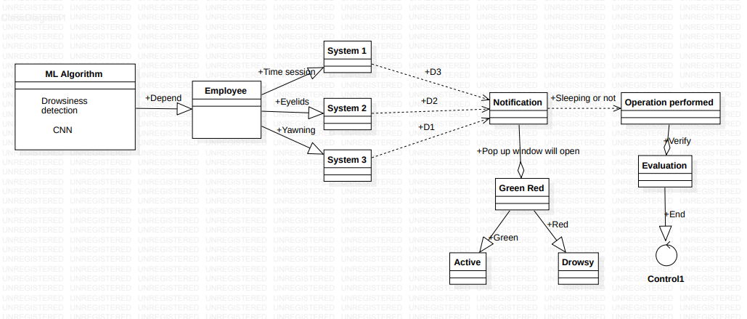
CLASS DIAGRAM

Slide 19
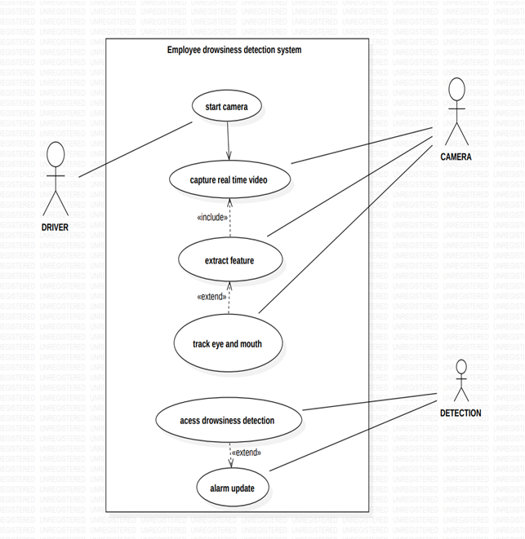
USE CASE DIAGRAM

Slide 20
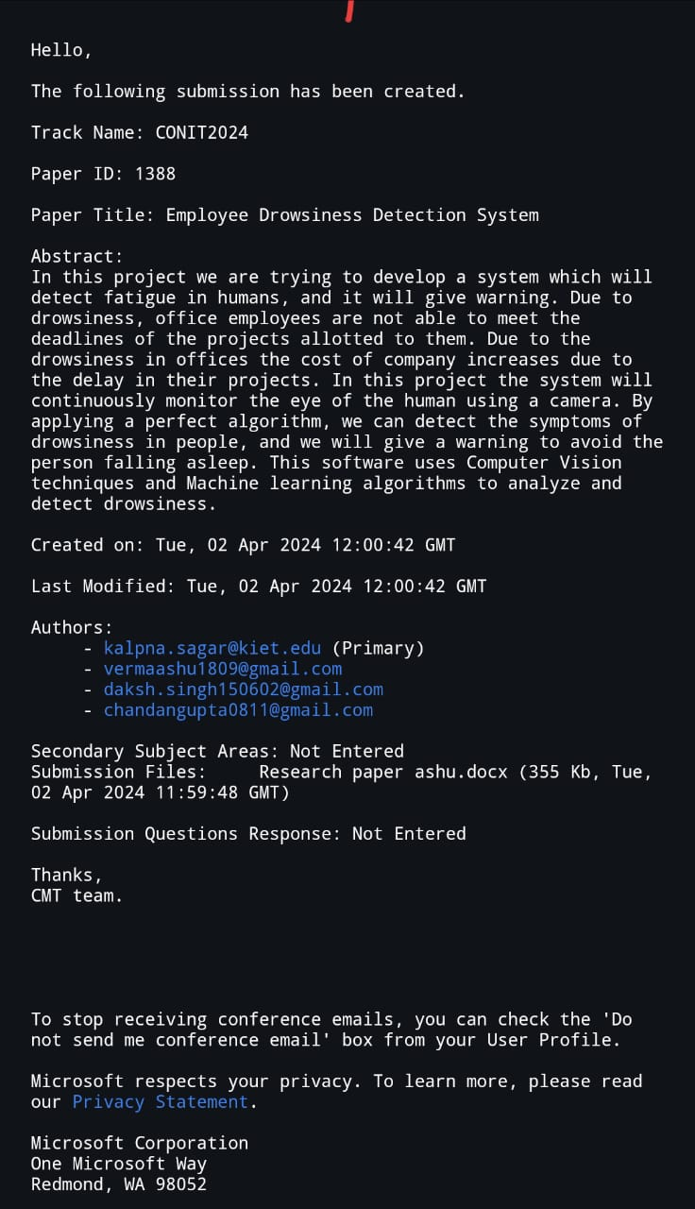
Research Paper Status…
submitted..

Slide 21
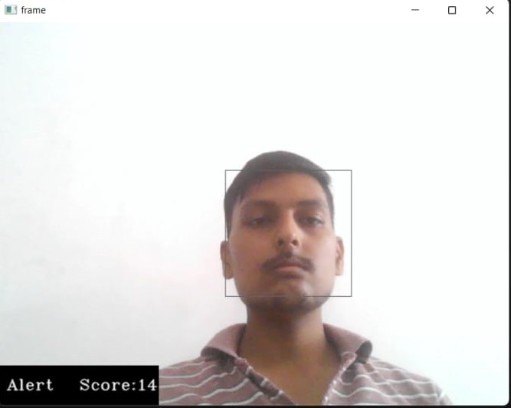
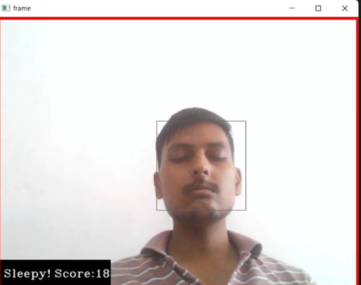
Project Status…
Project is almost completed and its in working condition…
Some screen shots of the project..

Slide 22
References
[1] Saini, Vandna, and Rekha Saini. "Driver drowsiness detection system and techniques: a review." International Journal of Computer Science and Information Technologies 5.3 (2014): 4245-4249.
[2] Jin, Wei. (2020). Research on Machine Learning and Its Algorithms and Development. Journal of Physics: Conference Series. 1544. 012003. 10.1088/1742-6596/1544/1/012003.
[3] M. A. Tanveer, M. J. Khan, M. J. Qureshi, N. Naseer and K. -S. Hong, "Enhanced Drowsiness Detection Using Deep Learning: An fNIRS Study," in IEEE Access, vol. 7, pp. 137920-137929, 2019, doi: 10.1109/ACCESS.2019.2942838.
[4] B. N. Manu, "Facial features monitoring for real time drowsiness detection," 2016 12th International Conference on Innovations in Information Technology (IIT), Al Ain, United Arab Emirates, 2016, pp. 1-4, doi: 10.1109/INNOVATIONS.2016.7880030.
[5] A. Gadde, A. Gorde, A. Bopte, N. Kapgate, A. Nevatia and S. Choudhari, "Employee Alerting System Using Real Time Drowsiness Detection," 2022 10th International Conference on Emerging Trends in Engineering and Technology - Signal and Information Processing (ICETET-SIP-22), Nagpur, India, 2022, pp. 1-5, doi: 10.1109/ICETET-SIP-2254415.2022.9791811.

