Slide 1
PROJECT PPT PLANT DISEASE RECOGNITION
GUIDE:
PROF. RAJ KUMAR
ADDL. HEAD, CS
SUBMITTED BY-
TEAM 66: (PCS24-66)
SHIVANSHU SINGH (2000290120152)
SHAKTI MADDESHIYA (2000290120141)
SAURABH MISHRA (2000290120139)

Slide 2
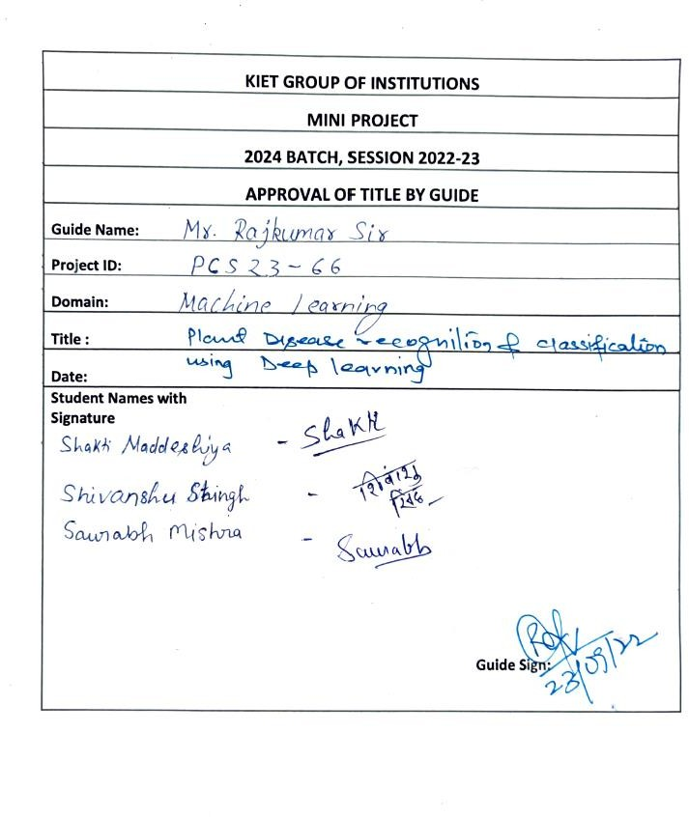
TITLE APPROVAL

Slide 3
ABSTRACT
Our project “Plant Disease Recognition and Classification Using Deep Learning” is an application which will detect the different Plant diseases by providing just images of the plant and predict and recommend about possible disease to the users.
Initially the client can either click the image using mobile camera or upload the image of the diseased plant in the application.
Once the plant disease is matched with the existing data, then this recommend the possible (matched) disease and then the effective remedial measures such as what actions should they take about the disease is provided.
The image processed for the effective remedial measures using the machine learning InceptionV3 algorithm.
In it’s current form, out application would be as a preliminary tool that could assess the users by providing some remedial measures like what type of fertilizers to use and the measures to be taken by comparing it with the datasets provided in the database.

Slide 4
INTRODUCTION
Our India is second largest populated country in the world and most of people are farmers, but farmers are not so much educated so they do not identify the different diseases of plants. The agriculture field is the backbone of Indian economy. Plant diseases are biggest ongoing challenge for smallholder farmers.
Our project was planned that to develop an application that simply take an image from user by clicking a photograph using mobile camera or just upload the image from mobile gallery with user’s permission and predict the best possible (matched from dataset) diseases that could possibly affecting that plant. So, user can get the proper information that what is the problem with the plant and what could be the reasons and could search for the proper cure that help to overcome the disease.

Slide 5
PROBLEM STATEMENT
Agriculture is an integral part of the Indian economy. The Indian agriculture sector employs nearly half of the country's workforce. India is the largest producer of pulses, rice, wheat, spices, and spice products in the world.
Now a days there is a massive problem we are facing the regular increment in pollution that is affecting us and our environment.
Our soil and environment is not that suitable and healthy for our crops as that is the only income resource for smallholder farmers, plant diseases are very common factors that can affect the crops.
Problem statement for our project is to develop a plant disease recognition and classification system using deep learning.

Slide 6
OBJECTIVE
To build a plant disease prediction system using Deep Learning.
To detect unhealthy regions of plant leaves.
Classification of plant leaf diseases using features texture.
To analyze the plant diseases/infections.
To give remedy information to user.
To make this service available on mobile application that can run on low configuration devices

Slide 7
METHODOLOGY
The project starts with importing NumPY, Pandas, Matplotlib, Pylot, Tensorflow and other libraries
Then we have to download the dataset of various images of infected leaves from kaggle website by the help of which we can train our model.
The data is than visualized using “imshow” which is used to show different types of leaves which are present in our dataset
Then we apply Train-Test split to split our dataset according to test ratio.
Then we apply Data augmentation to increase the number of labeled images. The classic data augmentation methods include vertical flipping, horizontal flipping, 90° counterclockwise rotation, 180° rotation, 90° clockwise rotation, random brightness decrease, random brightness increase.
Then we Build and Train a CNN model using various layers and kernel size.
Then we have to plot a training history graph.
Then we have to Export model to a file on disk.
Then we have to write fast API server around that model , which will help to generate working http server which we will be used in deployment in production.

Slide 8
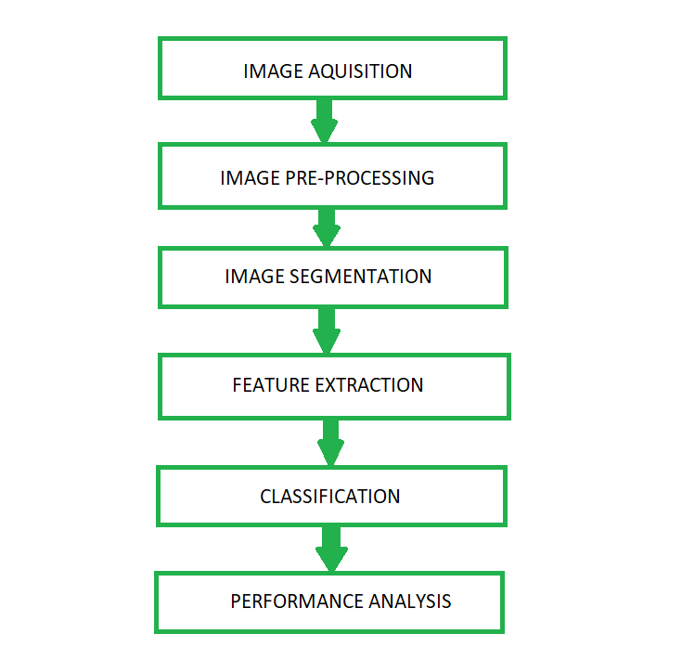
Fig.1 The basic proposed methodology

Slide 9
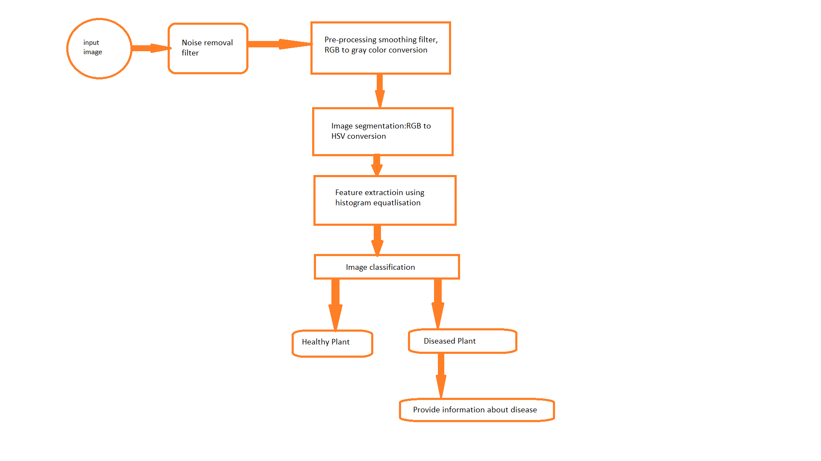
Fig.2 Block Diagram of Plant Leaf Disease Detection
(Expected Model)

Slide 10
TECHNOLOGY USED
NUMPY
PANDAS
MATPLOTLIB
TENSORFLOW
CNN
REACTJS

Slide 11
EXPECTED OUTCOME
The use of automated monitoring and management systems are gaining increasing demand with technological advancement.
In the agricultural fields loss of yield mainly occurs due to widespread disease.
Mostly the detection and identification of the disease is noticed when the disease advances to severe stage therefore, causing the loss in terms of yield, time and money.
The proposed system is capable of detecting the disease at the earlier stage as soon as it occurs on the expert to a certain extent is possible.
It can provide the help for a person having less knowledge about the disease, Depending on these goals, we have to extract the features corresponding to the disease.

Slide 12
FUTURE SCOPE
We can forecast disease in early stage, so that appropriate measures can be taken to minimize the loss in crop.
This will help farmers to detect diseases on there crops so that they can timely take proper cure for there plants.

Slide 13
THANK YOU

