Slide 1





MAJOR PROJECT
COUNTERFEIT DETECTION SYSTEM

Slide 2


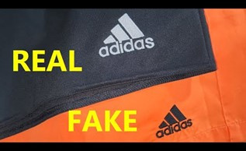
INTRODUCTION
Since we find many replicated copies of almost everything and thus it makes difficult for the consumer in deciding what is real or fake!
Hence a system is required to check the authenticity of the product.We can find out various duplicates of branded clothes are available in markets at reasonable rates. This can cause the manufacturers or the company to be in loss. So, to avoid such circumstances we have designed a system called “COUNTERFEIT DTECTION SYSTEM”.

Slide 3

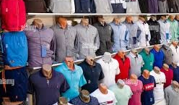
THIS FRAUD CAN LEAD TO A LOSS FOR -
CUSTOMER-NOT GIVING THEM THE AUTHENTIC PRODUCTS.
COMPANY-STEALS SALES BY UNDERCUTTING PRICES.
GOVT.-NO TAX GENERATION IN THE TRANSACTION
PROBLEM STATEMENT
At the time of shopping clothing products, there is a possibility that you are getting the fake product in the name of a renowned brand by paying the amount of the original one and sometimes it becomes difficult for the customer to decide whether it is real or fake.

Slide 4
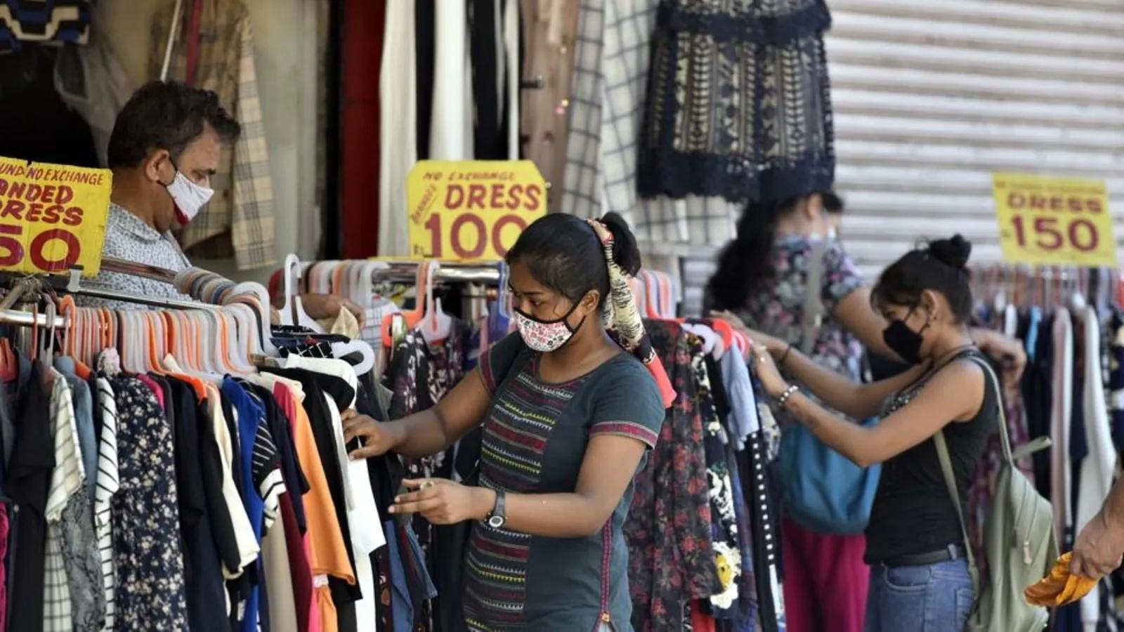
OBJECTIVES
To determine whether the product is authentic or fake.
To determine the sold status of the product so that it cannot be resold.
To reduce the loss of the company by counterfeiting clothing products.
To uphold the authentic brand’s reputation.
To ensure the government get the tax percentage by the transaction of purchase of clothing products.

Slide 5
METHODOLOGY
Phase-1
Phase-2
Phase-3
In this phase, the various details about the product like company name, brand name, characteristics of the product, size, color, price, etc. is being fed into the QR code. This would help the consumer to select the best product.
In this phase, the product is sold to the retailer with the unique product ID associated with it. At this moment, the retailer is going to sell the product to the consumer at the price decided by the company itself.
Consumer scans the QR code while buying in this phase, the consumer comes to buy the product. The consumer while buying, would scan the QR code and checks the details of the products. The consumer gets the various details of the product.
Phase-4
Phase-5
In this phase, the QR code that is scanned by the consumer is not valid or it shows the status of product is sold before, it would automatically generate an alert to the company and the company would hold enquiry against the retailer.
If the QR code is valid In this phase, if the QR code that is scanned by the consumer is valid , the consumer would be able to write reviews of the product. Hence then it would check against the replication of branded products.

Slide 6
COUNTERFEIT DETECTION SYSTEM can be used in various other industries also like in medicines, electronic devices, accessories, perfumes, toys, aircraft-parts, etc. and through this system we can detect which product is fake or real.
Since, industry world-wide loses large amounts to counterfeiters.
Governments lose out on unpaid tax and incur large costs in enforcing intellectual property rights.
SCOPE

Slide 7




Team
Archit Rajesh Shrivastava
Meet Our
2000290120039
5 A
Bhoomika Saxena
2000290120057
5 A
Ankita Jain
2000290120025
5 A

Slide 8
THANK
YOU

