Slide 1
WARDROBE PROJECTION
BY- PRACHI VERMA, PRAGATI TOMAR

Slide 2

INDEX
Abstract
Field of Invention
Objective
Methodology
Architecture
Implementation
End Users
Advantages
Summary

Slide 3
ABSTRACT
Wardrobe projection refers to trying on digitally created garments or accessories in a virtual environment. That means you can see how those items look on you, allowing you to know if something is a good fit without physically trying it on. Hence, this technology could let you try on clothing without having it shipped or even leaving your house.
Our project aims to make it possible for users to virtually try on clothing. When users upload both their own and the clothes’ photograph, we will be able to create a shot of the subject wearing the clothing.

Slide 4

Field of Invention
Virtual try-on technology has the potential to impact several industries, but it is primarily associated with the fashion and retail industries. Virtual try-on is transforming the way we shop for clothes, by providing customers with a more personalized and convenient shopping experience, and reducing the need for physical inventory. Virtual try-on can also improve the accuracy of sizing and fit recommendations, reducing the number of returns and improving customer satisfaction.
Virtual try-on can also have applications in other industries, such as the beauty industry, where it can be used to simulate the effects of makeup or hair styling, or the furniture industry, where it can be used to visualize how furniture would look in a given space. Virtual try-on can also be used in the field of medicine, where it can be used to simulate surgical procedures or visualize the effects of treatments on the human body.

Slide 5
OBJECTIVE
To allow user trying on clothes virtually
We will create a clearer photo of user wearing the intended clothing by uploading both their personal photo and the intended clothing shot.
To increase the number of angles in which the user can upload their photograph.
For instance, users can provide their images even with the side angles besides the front views.
To implement real time image capturing of the users.

Slide 6

METHODOLOGY
1.CAGAN is used to produce a preliminary result and a binary mask of where to modify from a human image and a target clothing image.
2. Simply the clothing is extracted using a transform network.
3. The segmentation stage uses the mask and output from the previous step to create a better mask that indicates where the garments should be altered.
4.The target's clothing is then changed using the mask. Our ultimate product is created by combining the changed clothing with the CAGAN result.

Slide 7
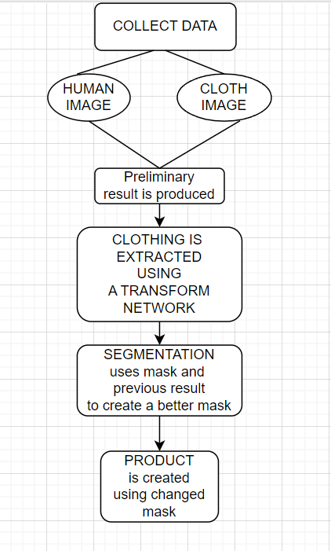
FLOWCHART

Slide 8
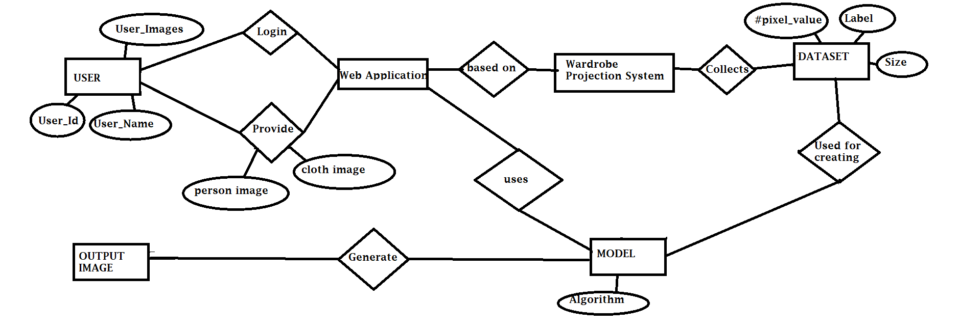
ER DIAGRAM

Slide 9
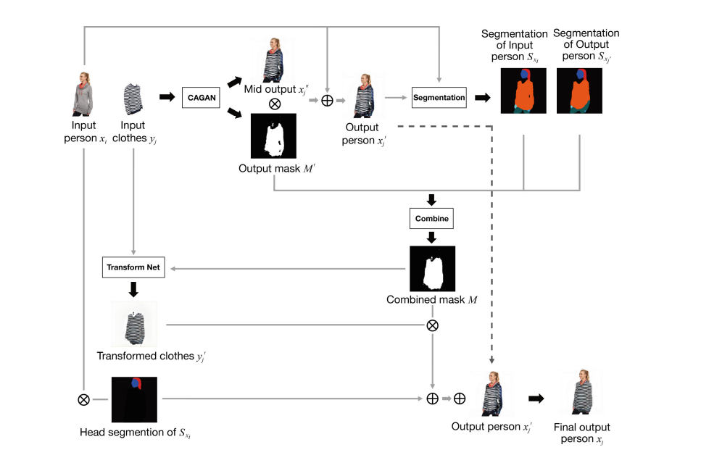
Architecture

Slide 10
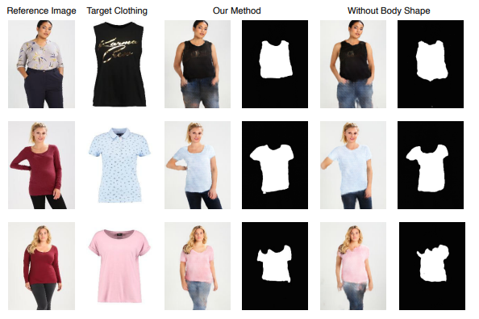
IMPLEMENTATION
TWO MODELS ARE STUDIED FOR THE PROJECT:
1.VITON

Slide 11
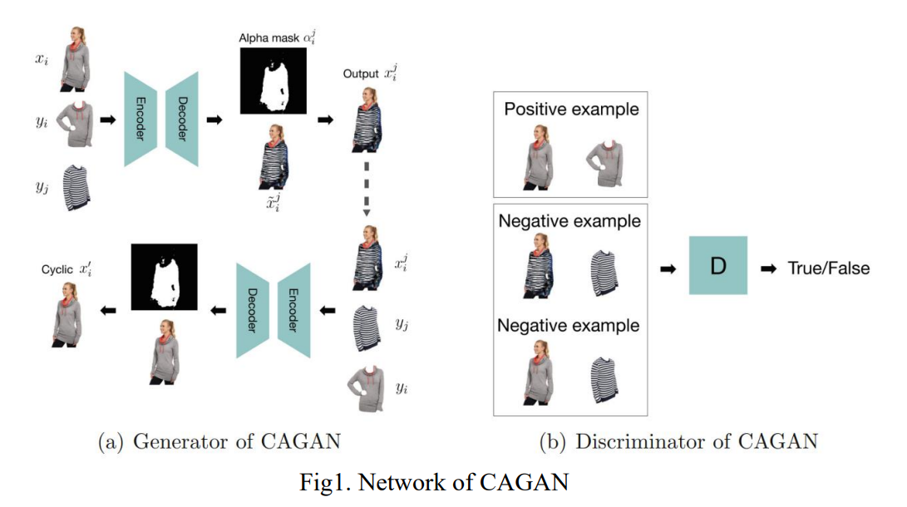
2.CAGAN

Slide 12
WHAT EXACTLY IS CAGAN?
It is a type of generative adversarial network (GAN), which consists of two neural networks: a generator and a discriminator. The generator learns to transform images from one domain to another, while the discriminator learns to distinguish between the generated images and the real images. The goal is for the generator to produce images that are indistinguishable from the real images, fooling the discriminator into thinking that the generated images are real.

Slide 13
Technology Used
Keras: Keras is a high-level neural network API written in Python. It is widely used for building deep learning models. In virtual try-on, Keras is used to build the CAGAN model.
Convolutional Neural Networks (CNNs): CNNs are deep learning models that are commonly used for image recognition and classification tasks. In virtual try-on, CNNs are used in the CycleGAN model to extract and process features from the input images.
Image Processing: Image processing techniques are used to preprocess the input images and prepare them for training the CycleGAN model. This includes techniques such as resizing, normalization, and data augmentation.

Slide 14
The term "end user" is common when it comes to technology, where it may also go by the more technical term "revenue-generating unit" or RGU. Our software, for instance, has end users that contain anybody who is a digital buyer.
END USERS

Slide 15
ADVANTAGES
Convenience: Virtual try-on allows customers to try on clothes from the comfort of their own homes, without the need to physically visit a store. This can save time and effort, especially for customers who live far from stores or have mobility issues.
Variety: Virtual try-on enables customers to try on a wide range of clothes from different brands and stores, without being limited by the physical inventory of a single store.
Cost-effective: Virtual try-on can reduce the costs associated with traditional in-store try-on methods, such as maintaining large inventories, hiring staff to assist customers, and providing changing rooms.
Personalization: Virtual try-on can provide a personalized experience for each customer, by allowing them to see how clothes would look on their specific body shape and size. This can help customers make more informed purchasing decisions and improve customer satisfaction.
Sustainability: Virtual try-on can contribute to sustainable fashion by reducing the environmental impact of traditional in-store try-on methods, such as the energy and water used to produce and clean clothes.

Slide 16
The fashion industry is experiencing a drastic change due to digital wardrobe projections, which is good for both buyers and sellers. And we are working on making that better using Machine learning algorithms not only the frontview but also side views. The users will also have the opportunity to explore choices, make adjustments, and try on a broader selection of items in less time, resulting in better conversion and spending.
This project involves building a deep learning model using cGAN architecture to generate realistic images of people wearing clothes. The model is implemented using the Keras library and trained on a dataset of fashion images and 3D garment models. The virtual try-on technology enables customers to try on clothes virtually and make more informed purchasing decisions, while also reducing the need for physical inventory and improving the accuracy of sizing and fit recommendations. The project highlights the potential of deep learning and cGANs in the fashion and retail industries, and their ability to transform the way we shop for clothes.
Summary

Slide 17

THANKYOU

