Slide 1
DESKTOP VIRTUAL ASSISTANT
Submitted by: Guide: Ms. Anshula GUPTA
Suraj Gupta
Sushant Pandey
Srijan shahi

Slide 2
INTRODUCTION
In this project, the user is just expected to give voice commands, and the rest work is done by our voice assistants which can automate the complete process and completes our task. As Virtual Assistants perform tasks as a human can. It can send emails, play music, and talk to you accordingly.
Viber voice chat API can shift between conversations, block/unblock conversations, Turn On/Off notifications, and much more. To build this functionality, We will use different libraries and modules like Tkinter, Web browser, Datetime, Requests, pyPDF2, pyautogui, pyQt, and BeautifulSoup.

Slide 3
Abstract
The Desktop Virtual Assistant is a software system designed to assist users with daily tasks, such as scheduling appointments, setting reminders, and performing web searches. The software is developed to be user-friendly and easy to interact with, using natural language processing to understand user commands and respond with relevant information. The Desktop Virtual Assistant utilizes machine learning algorithms to improve its performance over time, learning from user interactions and adapting to user preferences. The software is intended to be used on desktop computers and can be customized to meet the specific needs of individual users or organizations. With its advanced capabilities and intuitive interface, the Desktop Virtual Assistant is expected to improve user productivity and streamline daily tasks.

Slide 4
Field of Inventions
Natural Language Processing (NLP)
Machine learning algorithms are used to train virtual assistants to recognize patterns in data.
Natural Language Generation (NLG): NLG is the opposite of NLP. It involves using algorithms to generate natural language responses to user inputs. This technology is used to enable virtual assistants to provide human-like responses to user questions and commands.
Integration with other technologies: Virtual assistants must be able to interact with other technologies in order to provide a seamless user experience. For example, a virtual assistant might be integrated with a user's calendar or email, in order to provide reminders or schedule appointments.

Slide 5
PROBLEM STATEMENT/BG (reason to work)
Understanding user voice commands.
Can't read, or send SMS/Emails.
Security Issues
Not able to read Notifications
No desktop app is available
Eavesdropping Aspect (Off automatically when there are no commands from the user end)

Slide 6
OBJECTIVE
Existing Virtual Assistants have some limitations like can’t read messages, and can’t access other web applications. To overcome these limitations, we will integrate various APIs to eradicate those limitations which will save time, and enhance productivity.

Slide 7
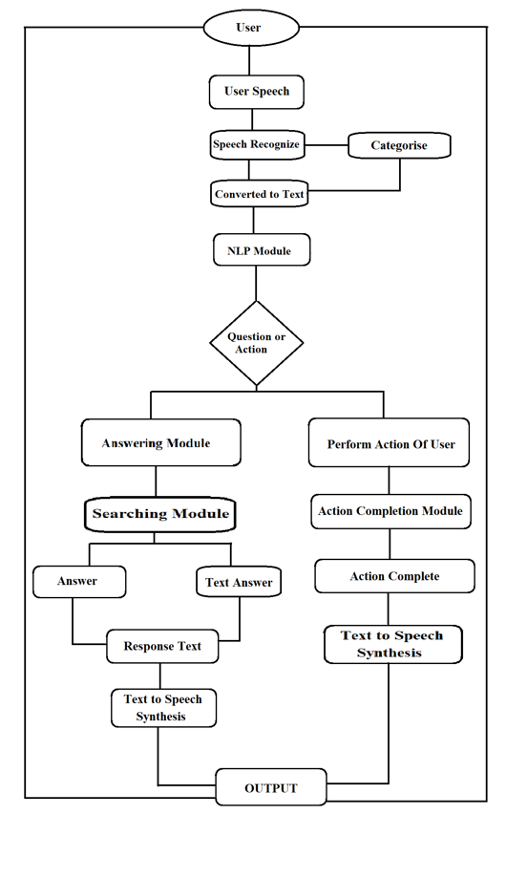
Workflow of Voice Assistant

Slide 8
User Interaction Flowchart

Slide 9
Integration Flowchart

Slide 10
Error Detection Flowchart

Slide 11
Innovative idea

Slide 12
TOOLS/LIBRARIES
pyttsx3: It is a python library that converts text to speech.
Speech Recognition: It is a python module that converts speech to text.
pywhatkit: It is a python library to send WhatsApp messages at a particular time with some additional features.
Wikipedia: It is a python module for searching anything on Wikipedia.
smtplib: Simple mail transfer protocol that allows us to send emails and route mail between mail servers.

Slide 13
PyPDF2: It is a python module that can read, split, and merge any PDF.
Web browser: It provides an interface for displaying web-based documents to users.
Pyautogui: It is a python library for the graphical user interface.
os: It represents Operating System-related functionality.

Slide 14
Hardware Requirements
Computer: A computer is the basic requirement for developing and running a virtual assistant. The computer can be a desktop or laptop computer, and should have sufficient processing power, memory, and storage capacity to run the virtual assistant software.
Microphone: A microphone is necessary for enabling voice-based interaction with the virtual assistant. The microphone can be an external microphone or built-in microphone on the computer.
Speakers: Speakers are necessary for playing back the virtual assistant's responses and other audio-based information.
Webcam: A webcam may be necessary for enabling video-based interaction with the virtual assistant, such as for facial recognition.
Display: A display is necessary for displaying the virtual assistant's interface and other visual-based information.
Internet Connection: An internet connection is necessary for accessing cloud-based resources, enabling online updates and syncing, and performing other online-based activities.
Input Devices: Input devices such as a keyboard, mouse, and touchscreen may be necessary for providing input to the virtual assistant and interacting with the computer

Slide 15
TECHNOLOGIES
NLP: The ability to understand the text and spoken words in much the same way human beings can.
NLU: Refers to the ability of a computer to use syntactic and semantic analysis to determine the meaning of text or speech.
NLG: Enables computing devices to generate text and speech from data input.
Programming Languages: The virtual assistant can be developed using a variety of programming languages, such as Python, Java, C#, and JavaScript.
Natural Language Processing (NLP) Libraries: NLP libraries such as NLTK (Natural Language Toolkit), SpaCy, and Stanford CoreNLP can be used to implement the virtual assistant's ability to understand and interpret natural language commands and queries.
Machine Learning Frameworks: Machine learning frameworks such as TensorFlow, Keras, and PyTorch can be used to train the virtual assistant to recognize patterns in user behavior and provide more personalized responses and recommendations.Web Frameworks: Web frameworks such as Flask and Django can be used to develop the web-based interface for the virtual assistant.
Cloud-Based Platforms: Cloud-based platforms such as Amazon Web Services (AWS), Google Cloud Platform (GCP), and Microsoft Azure can be used to host the virtual assistant and provide scalability, flexibility, and accessibility.
Voice Recognition Software: Voice recognition software such as Google Speech Recognition, Microsoft Speech API, and Amazon Transcribe can be used to enable voice-based interaction with the virtual assistant.
Integrated Development Environments (IDEs): IDEs such as PyCharm, Eclipse, and Visual Studio can be used to develop and test the virtual assistant's code.
Version Control Systems: Version control systems such as Git and SVN can be used to manage and track changes to the virtual assistant's code over time.

Slide 16
End user and Advantage
Professionals: Business professionals and office workers who want to increase productivity and streamline their workflow.
Students: Students who need assistance with scheduling, time management, and research. Elderly or Disabled Individuals: Individuals with disabilities or impairments that make it difficult to interact with a computer using a mouse or keyboard.
Casual Users: Casual computer users who want to simplify their interactions with their computer and access information more easily.
Multilingual Users: Users who speak multiple languages and want a virtual assistant that can understand and respond in different languages.
Tech-Savvy Users: Users who are familiar with advanced computer systems and want to use a virtual assistant to enhance their productivity and access to information.

Slide 17
Potential Industrial/Bussiness use
Cost Savings: The virtual assistant can help businesses and organizations reduce costs by automating tasks that would otherwise require manual intervention or hiring additional staff.
Competitive Advantage: The virtual assistant can help businesses differentiate themselves from their competitors by providing unique and innovative features and functionalities.
Improved Data Insights: The virtual assistant can help businesses and organizations gather and analyze data on user behavior, preferences, and interactions, which can be used to improve product design, marketing strategies, and customer service.

Slide 18
CONCLUSION
A voice assistant, without any doubt, as it saves time for the user through conversational interactions, effectiveness, and efficiency. But while working on this project, there were some limitations encountered, and also realized some scope for enhancement in the future.

Slide 19
THANK YOU!!

