Slide 1


AI Assisted Plant Disease Prediction, Crop Recommendation And Fertilization Recommendation
KIET Group of Institutions, Ghaziabad
(An ISO – 9001: 2008 Certified & ‘A+’ Grade accredited Institution by NAAC)
Guide Name : Prof. Raj Kumar
(Asst. Professor & Additional Head, CS)
By :-
1.Sejal Gupta (2000290120140)
2.Yash Srivastava (2000290120197)
3.Harsh Srivastava (2000290130076)

Slide 2
Problem Statement
The primary objective of this project is to create a robust machine learning solution that empowers farmers with real-time information on crop health and precise recommendations for crop management.
The key components of this system includes:
Crop Disease Prediction
Fertilization Recommendation
Crop Recommendation

Slide 3
OBJECTIVES
Saving Time and Effort: To reduce the time and effort required for manual disease diagnosis.
Crop Disease Identification: Develop a model to accurately identify and classify crop diseases from images.
Crop Selection Guidance: Provide recommendations for selecting suitable crops based on soil quality, climate, and historical data.
Fertilization Optimization: Create an algorithm for precise fertilization recommendations based on crop health and soil conditions.
User-Friendly Interface: Design a user-friendly interface for easy access and usability by farmers.

Slide 4
TECHNOLOGY USED
Pytorch
Scikit-learn
Keras
Numpy
Pandas
Open-CV
Flask
Html,CSS,Javascript
Google Dailogflow
Google Translate API
Open Weather API

Slide 5
Literature Survey
Title and Authors | Year of publication | Work Done | Techniques Used
Crop Recommendation System for precision agriculture | 2016 | SAD is a crop selection method that improves net yield rate by improving accuracy and classification performance. | Support Vector Machine, Random Forest, Neural Network, REPTree, Bagging, and Bayes
Crop Recommendation system using machine learning approach | 2021 | API is used to predict weather parameter. ML algorithms are used to compare the results the models. Random Forest is the algorithm used with an accuracy of 95%. | ANN, Fuzzy Network, Decision tree, KNN, Enet, Lasso and Kernel Ridge, ARMA, SARIMA and ARMAX.
Improvement of crop recommendation using Recommender system by weather forecasts | 2019 | ANNs are used to predict rainfall events and categorize them resulting in a hybrid approach with an accuracy of 96%. | ANN, DNN Layer Recurrent Networks, FFBPNs and Cascaded feed forward back propagation networks, naive bayes.

Slide 6
Agricultural Crop Recommendation System based on productivity and season | 2021 | The system uses collaborative and content-based filtering to analyse agriculture parameters using machine learning techniques. | Kmeans, Kmeans++, Naïve Bayes, neural networks, soft computing, SNN model, GIS, ANN, KNN
A Crop Recommended system for crop disease detection and yield prediction using machine learning approach | 2021 | API is used to predict weather parameter. ML algorithms are used to compare the results the models. Random Forest is the algorithm used with an accuracy of 95%. | ANN, Fuzzy Network, Decision tree, KNN, Enet, Lasso and Kernel Ridge, ARMA, SARIMA and ARMAX.
Improvement of crop recommendation using Recommender system by weather forecasts | 2020 | A system to detect disease and predict crop yield using machine learning to maximise production on a limited land resource. | ANN, KNN, SVM, Random-forest, Gradient boosted decision tree, Regularised greedy forest

Slide 7
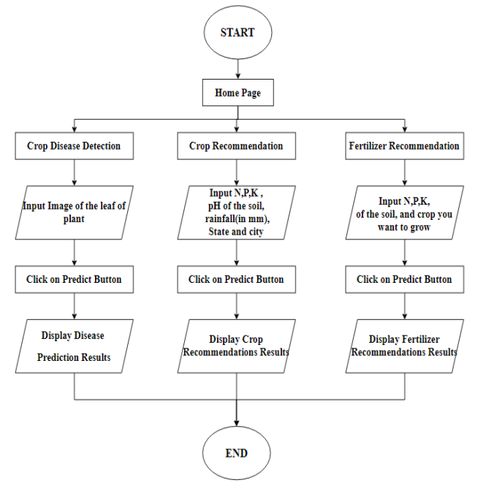
Workflow Diagram

Slide 8
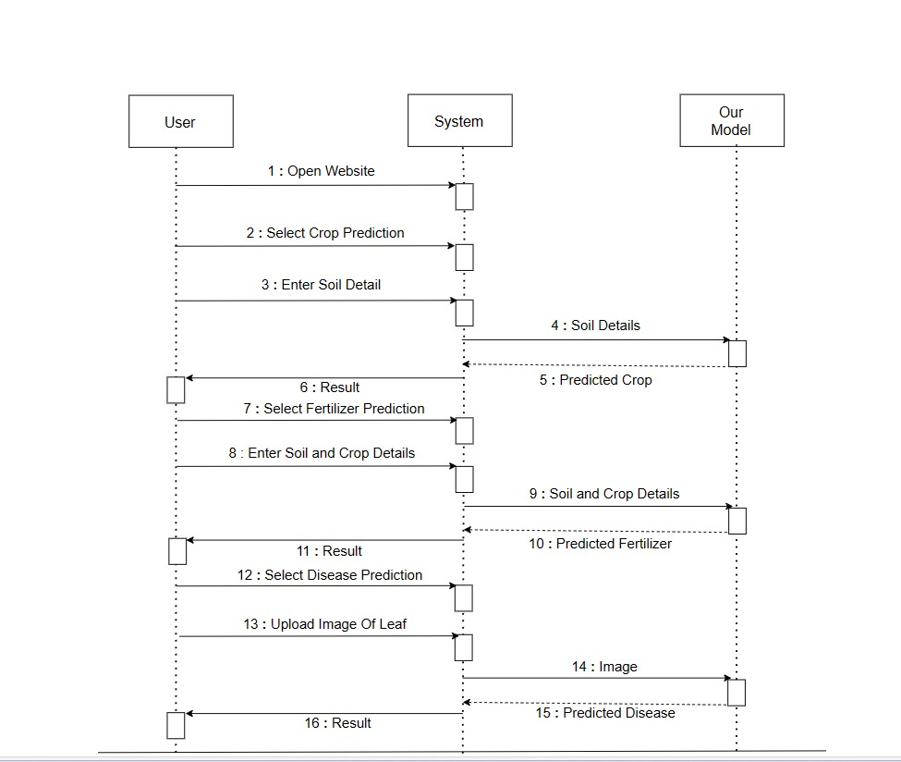
Sequence Diagram

Slide 9
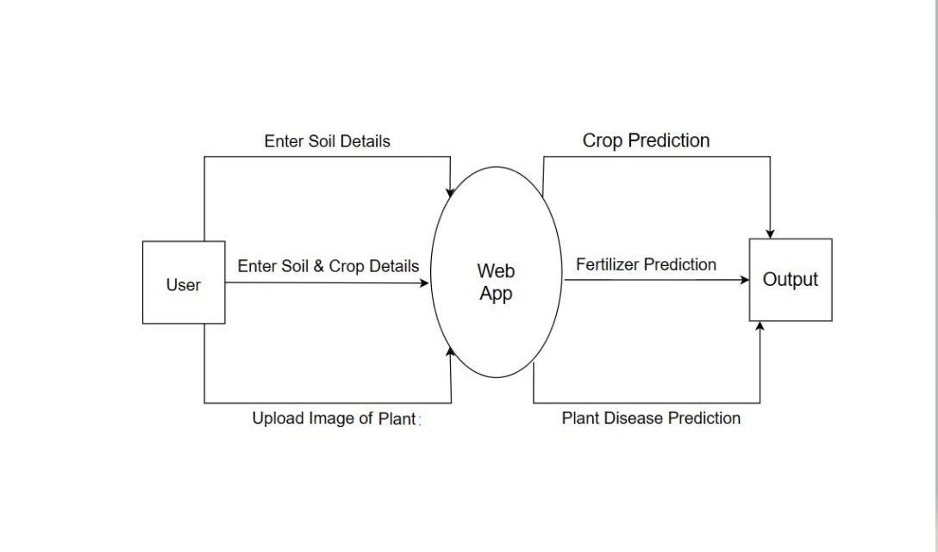
Data Flow Diagram

Slide 10
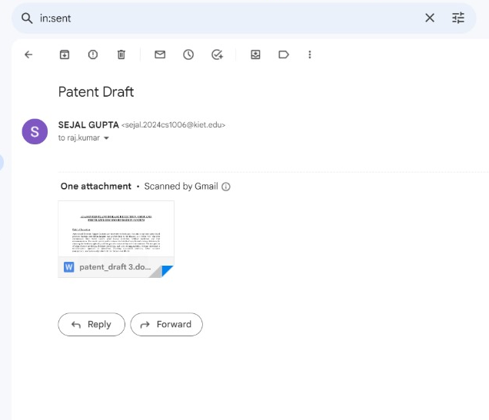
Patent Status
We have submitted our Patent Draft to our Guide Prof. Raj Kumar Sir.

Slide 11
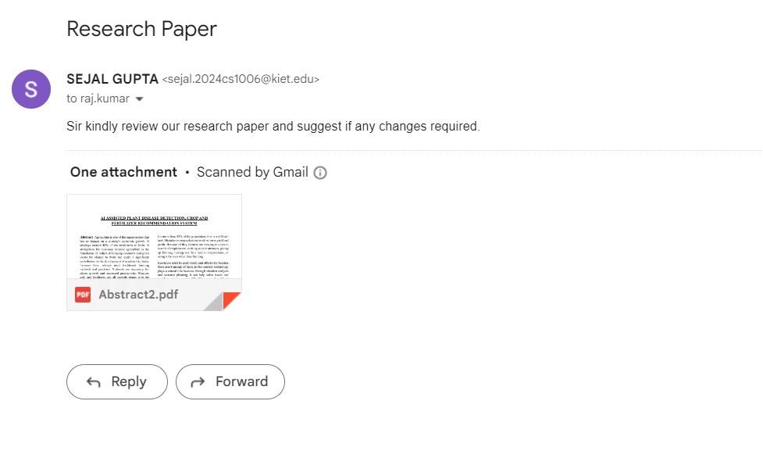
Research Paper Status
We have prepared our research paper and we have submitted it for review. Waiting for further suggestions/corrections from him.

Slide 12
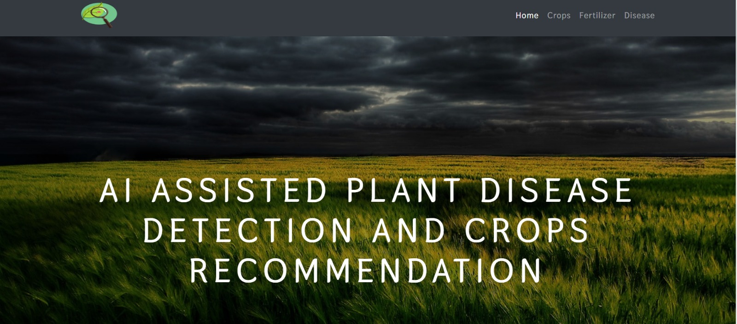
Project Status
Our Project is 90% completed Output is attached here with:

Slide 13
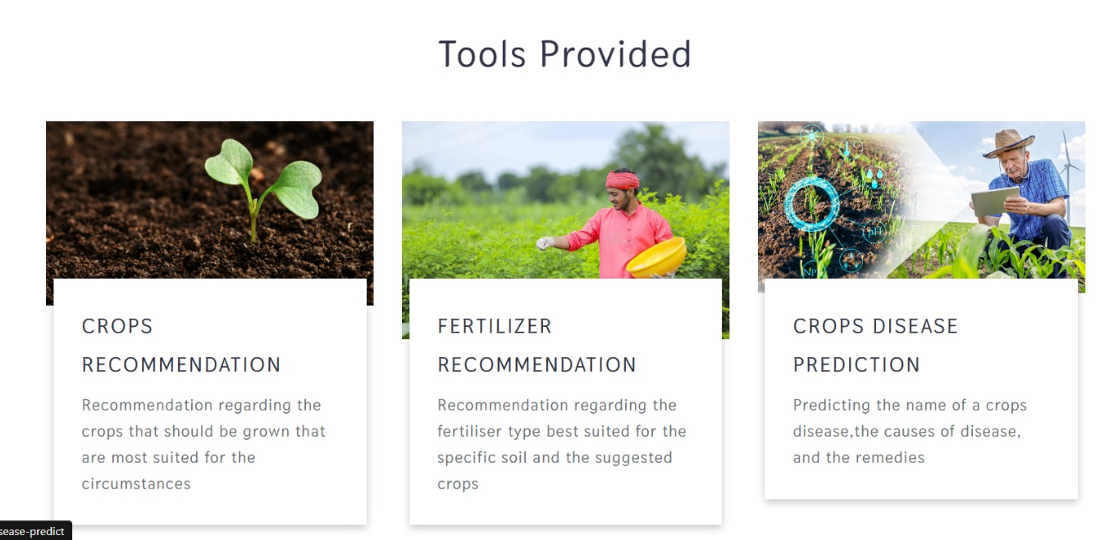

Slide 14
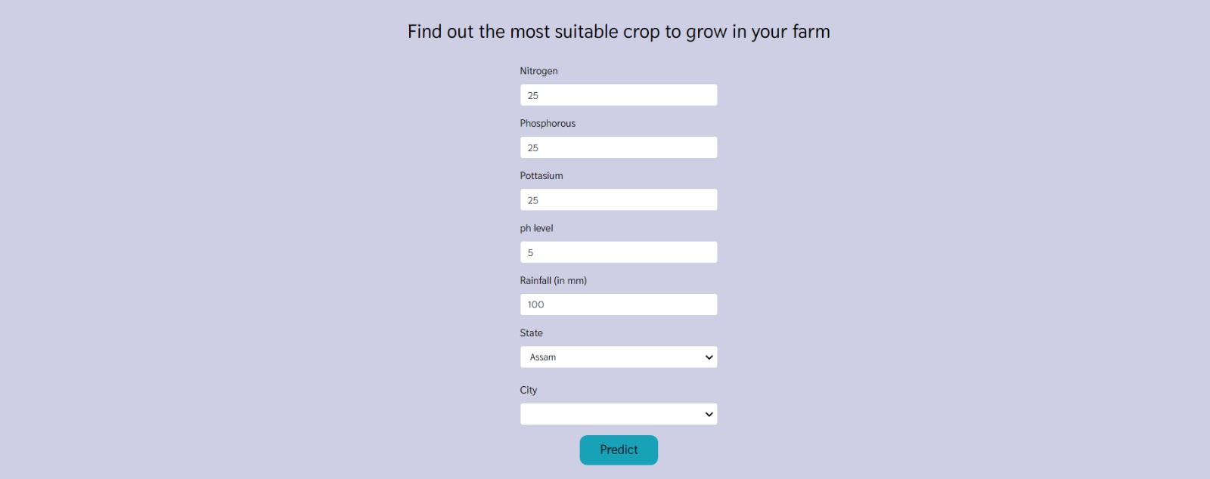
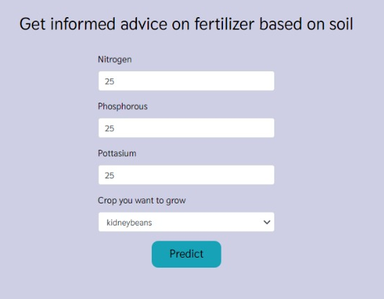
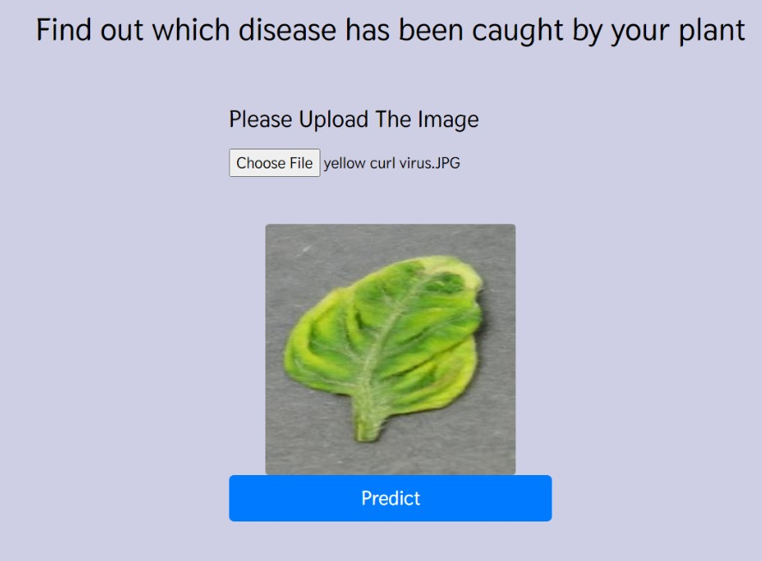

Slide 15
https://drive.google.com/drive/folders/1wDTF0B4z6o8HvcMKbNkdsbAJo02UchLq?usp=sharing Hyperlink of Test Cases

Slide 16
References
S. Pudumalar, E. Ramanujam, R. H. Rajashree, C. Kavya, T. Kiruthika and J. Nisha, "Crop recommendation system for precision agriculture," 2016 Eighth International Conference on Advanced Computing(ICoAC), January 2017.
M Goutham, Konaganti Pravalya, G.Naga Vamsi, and Royyuru Srikanth, “Crop and Fertilizer Prediction and disease detection using data science”, Iconic Research and Engineering Journals, March 2023.
Shloka Gupta, Nishit Jain, Akshay Chopade, Aparna Bhonde, “Farmer’s Assistant: A Machine Learning based Application for Agricultural Solutions” April 2022.
Prashant Wagh, Mayur Chaudhari, Paresh Rajput, Aditi Kate, “Crop Recommendation using Machine Learning” April 2022.
Akulwar Pooja, “A recommended system for crop disease detection and yield prediction using machine learning approach”, June 2020.
Dr.G.Suresh, Dr.A.Senthil Kumar, Dr.S.Lekashri, Dr.R.Manikandan, “Efficient Crop Yield Recommendation System Using Machine Learning For Digital Farming”, March 2021.

Slide 17
THANK YOU

