Slide 1

DEPARTMENT OF COMPUTER SCIENCE I Project Presentation (KCS 851 ) Trashtrekker: Smart Waste Management System
Guide Name: Dr. Gaurav Dubey
Project Members
1. Karan Agarwal (Roll no: 2000290120082) CS 8B
2. Karnik Gautam (Roll no: 2000290120083) CS 8B
3. Harsh Yadav ( Roll no: 2000290120073) CS 8B

Slide 2
Problem Statement
Nowadays, as we seen that dustbins are being overflowed and they are not being monitored properly.
This will result in serious health issues and also affecting the surrounding environment.
The Collectors are also unable to find out the overflowed dustbins and hence it hampers their work.
As a result, people tend to throw garbage in nearby surroundings and it will create a pollution in the environment.

Slide 3
Objectives
Garbage management system is a idea where we can control lots of problems which disturbs the society in pollution and diseases. The garbage management has to be done instantly else it leads to irregular movement which will have adverse effect on nature.
The main objectives of our proposed system are as follows:
Monitoring the garbage management.
Providing a smart technology for garbage system.
Reducing human time and effort .
Resulting in healthy and waste ridden environment

Slide 4
Technology Used
IOT(Sensors used): NodeMCU ESP8266 Wifi Module, Ultrasonic Sensor, IR sensor , Servo Motor.
Front End: HTML5, CSS3, Javascript
Back End: PHP, MYSQL

Slide 5
Literature Survey(Paper 1)
Paper title: A Proposed IoT Based Smart Waste Bin Management System with An OptimizedRoute: A Case Study of Ghana
In this research paper we have that because of the harmful consequences for the environment, garbage waste monitoring, collection, and management is one of the main issues of the modern day. The usual approach of manually examining and collecting trash is a tedious procedure that increases prices since it needs a large amount of time and human labour. In this work, an open IoT platform and an IoT-based waste monitoring system are proposed. An Arduino microcontroller, an ultrasonic sensor, a load cell, and a Wi-Fi module comprise up the system.

Slide 6
Literature review (Paper 2)
Paper title: IoT-Based Smart Waste Bin Monitoring and Municipal Solid Waste Management System for Smart Cities
Due to incredibly large population growth and globalization, increasing waste generation has become a major problem in developing nations. Several problems have been examined from the literature that suggest a significant correlation between the surge in waste production and challenges involved to handle it in a smart city. Inadequate waste material collection and disposal techniques, rising migratory patterns to urban areas, and a lack of sophisticated equipment supporting the municipal solid waste management system are the roots of these problems. As a consequence of the large amount of waste that is left lying around, management of waste has become challenging.

Slide 7
Literature review (Paper 3)
Paper title: An Internet of Things Based Smart WasteManagement System Using LoRa and Tensorflow Deep Learning Model
Waste management is an expensive endeavor as it necessitates a great deal of time and resources. The development of the recyclable bin and the launch of the 3Rs campaign are instances of measures the authorities have taken to boost waste management systems (recycle, reuse and reduce). The present waste management system has been enhanced thanks to advancements in IoT.

Slide 8
Literature review (Paper 4)
Paper title: Smart Waste Management System using IoT
The difficulties with sanitation and trash management are becoming progressively worse. It causes unhygienic conditions for the local populations, which accelerates the spread of infectious diseases and illnesses. IoT-based "Smart Waste Management" is the most effective and popular alternative to address this issue. The proposed system will equip public garbage cans with embedded equipment that allows for real-time monitoring of the level of garbage within the garbage cans.

Slide 9
Smart Waste Management System using IoT
The difficulties with sanitation and trash management are becoming progressively worse. It causes unhygienic conditions for the local populations, which accelerates the spread of infectious diseases and illnesses. IoT-based "Smart Waste Management" is the most effective and popular alternative to address this issue. The proposed system will equip public garbage cans with embedded equipment that allows for real-time monitoring of the level of garbage within the garbage cans.
The integration of moisture sensors and load sensors will enhance the accuracy of data relevant to garbage level and waste segregation in a dust bin, correspondingly. The information on which dumpster should be placed in which location by their corresponding ids will be maintained in a database.
The dustbin incorporates a humidity sensor to differentiate among wet and dry garbage, along with UV and load sensors for level determination.

Slide 10
Diagrams
Diagram to show the process involved in the project.
Architectural Diagram
USE CASE Diagram
Process Flow Diagram
ER Diagram
Data Flow Diagram

Slide 11
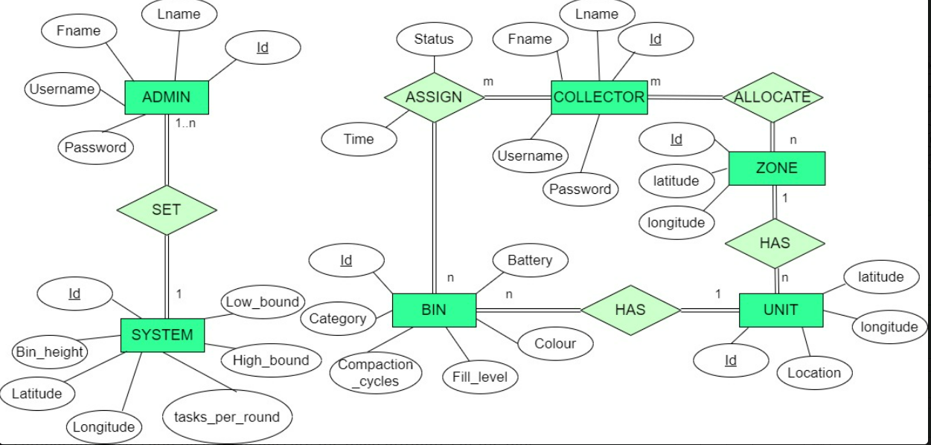
ER Diagram

Slide 12
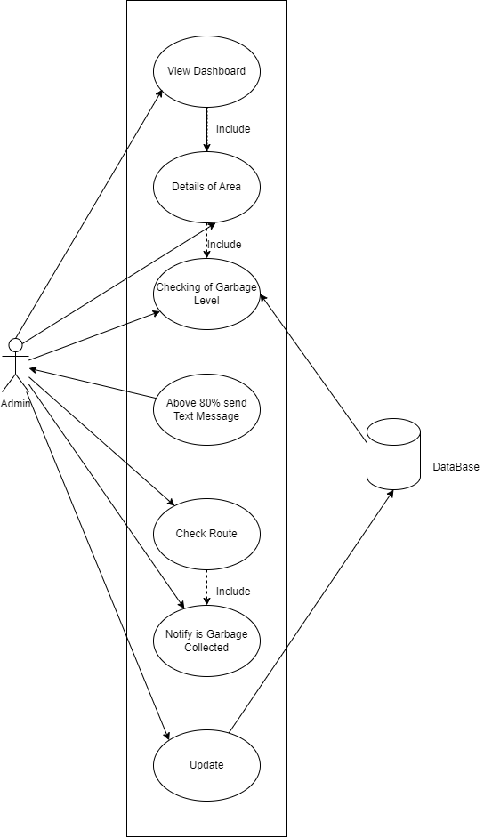
Use case diagram

Slide 13
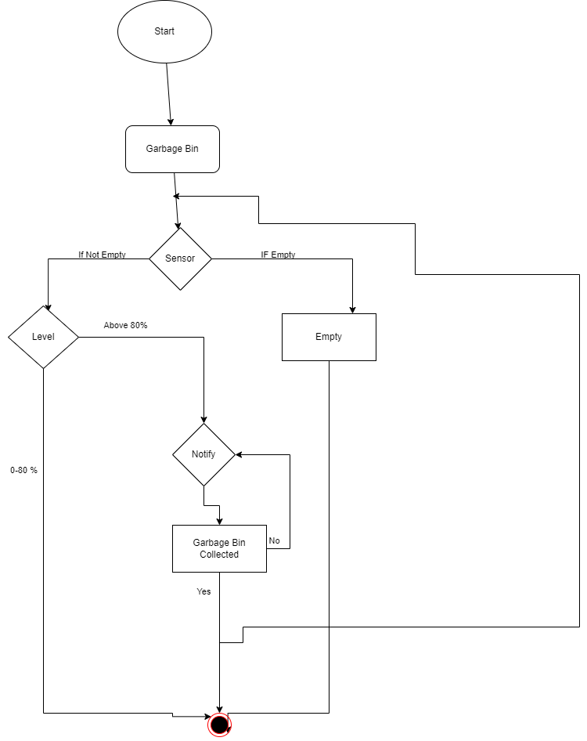
workflow Chart diagram

Slide 14
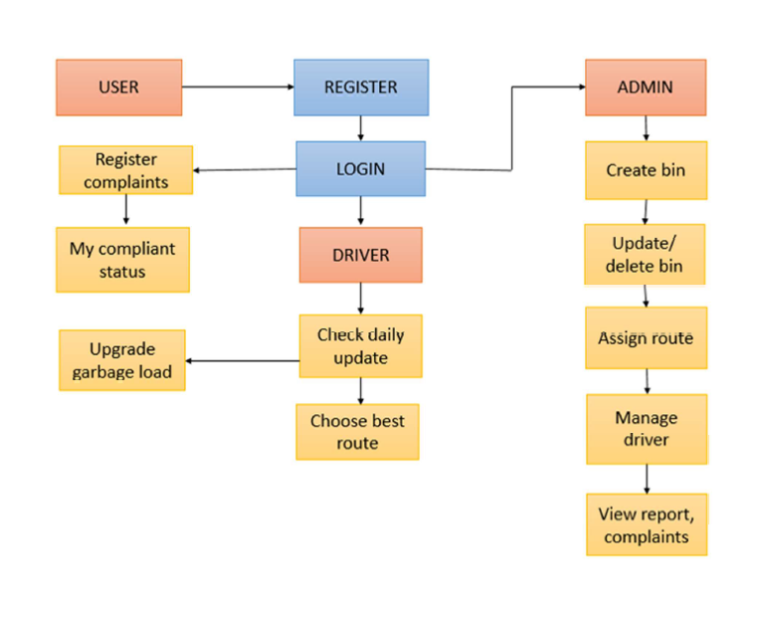
Architectural Diagram

Slide 15
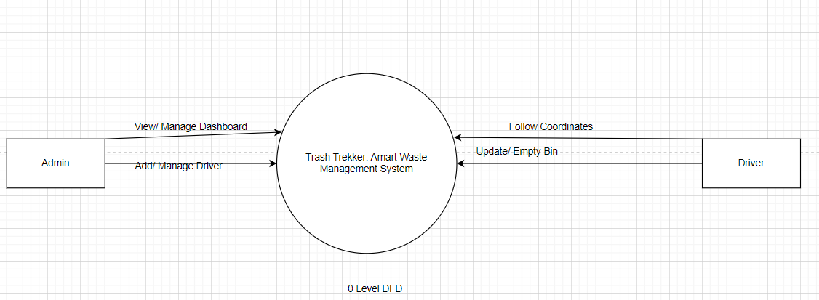
Level 0 DFD

Slide 16
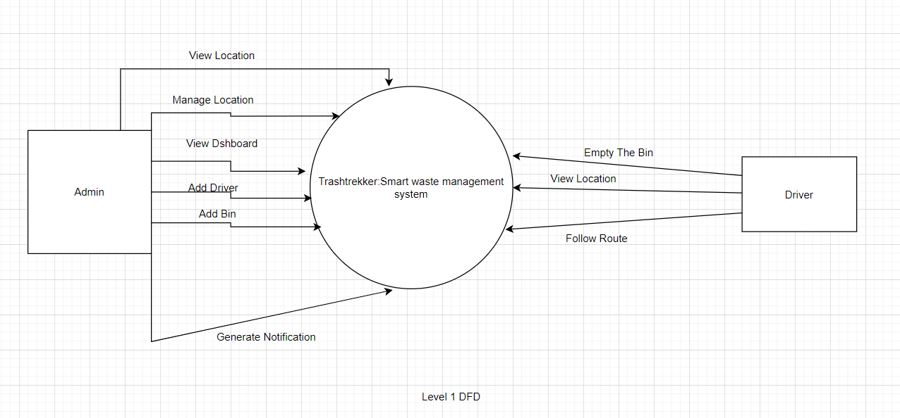
Level 1 DFD

Slide 17
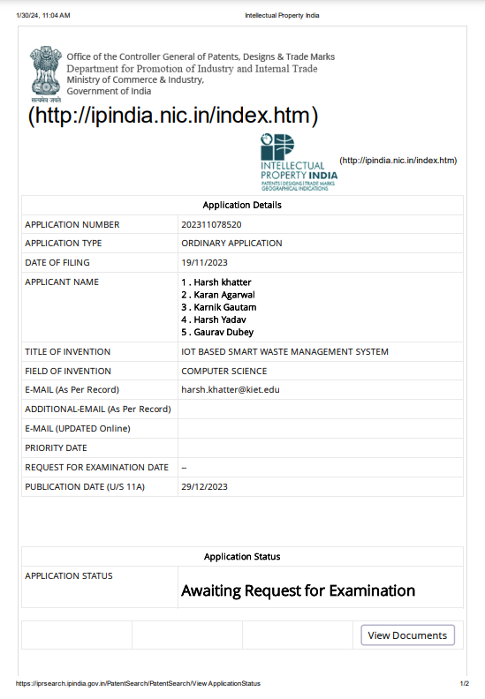
Patent Status
Draft submitted.
Patent Submission : Yes
Patent Published: Yes

Slide 18
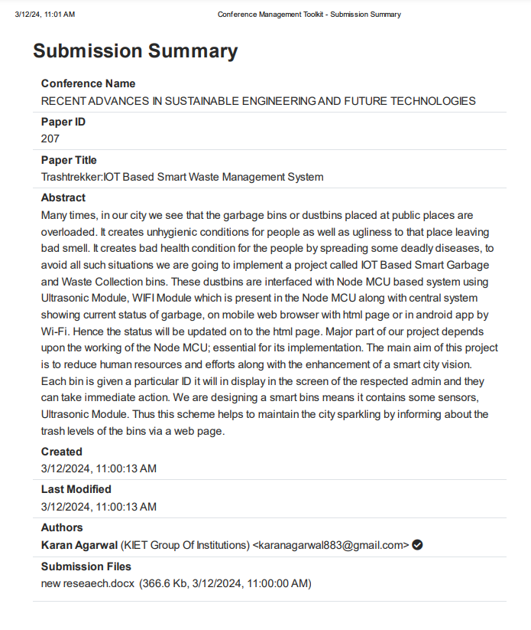
Research Paper Status
Draft completion status: Completed
Research Paper Hyperlink: Hyperlink
Research Paper Status: Submitted

Slide 19
Project Status
90% project is completed.
Implementation and code for IOT part is completed.
Implementation of front end is completed.
Implementation of backend is ongoing.

Slide 20
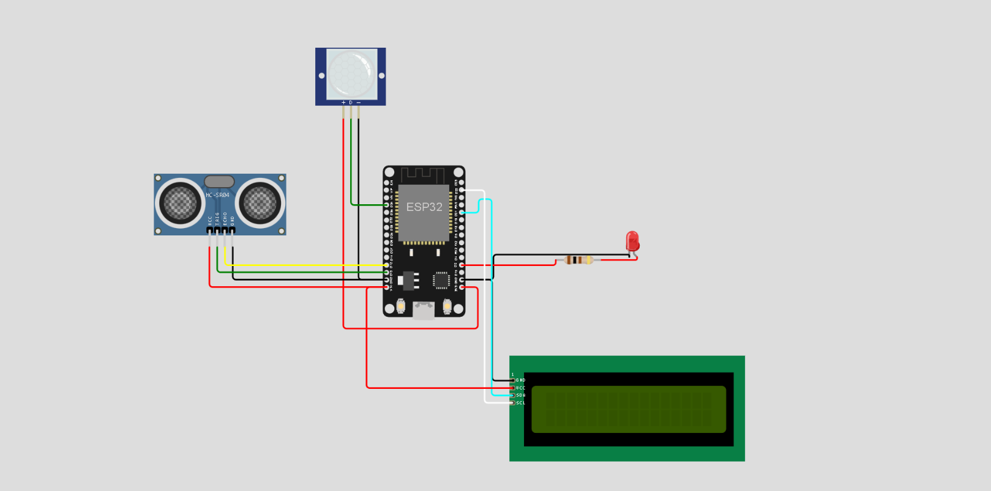
SCREENSHOTS (Project Output)

Slide 21
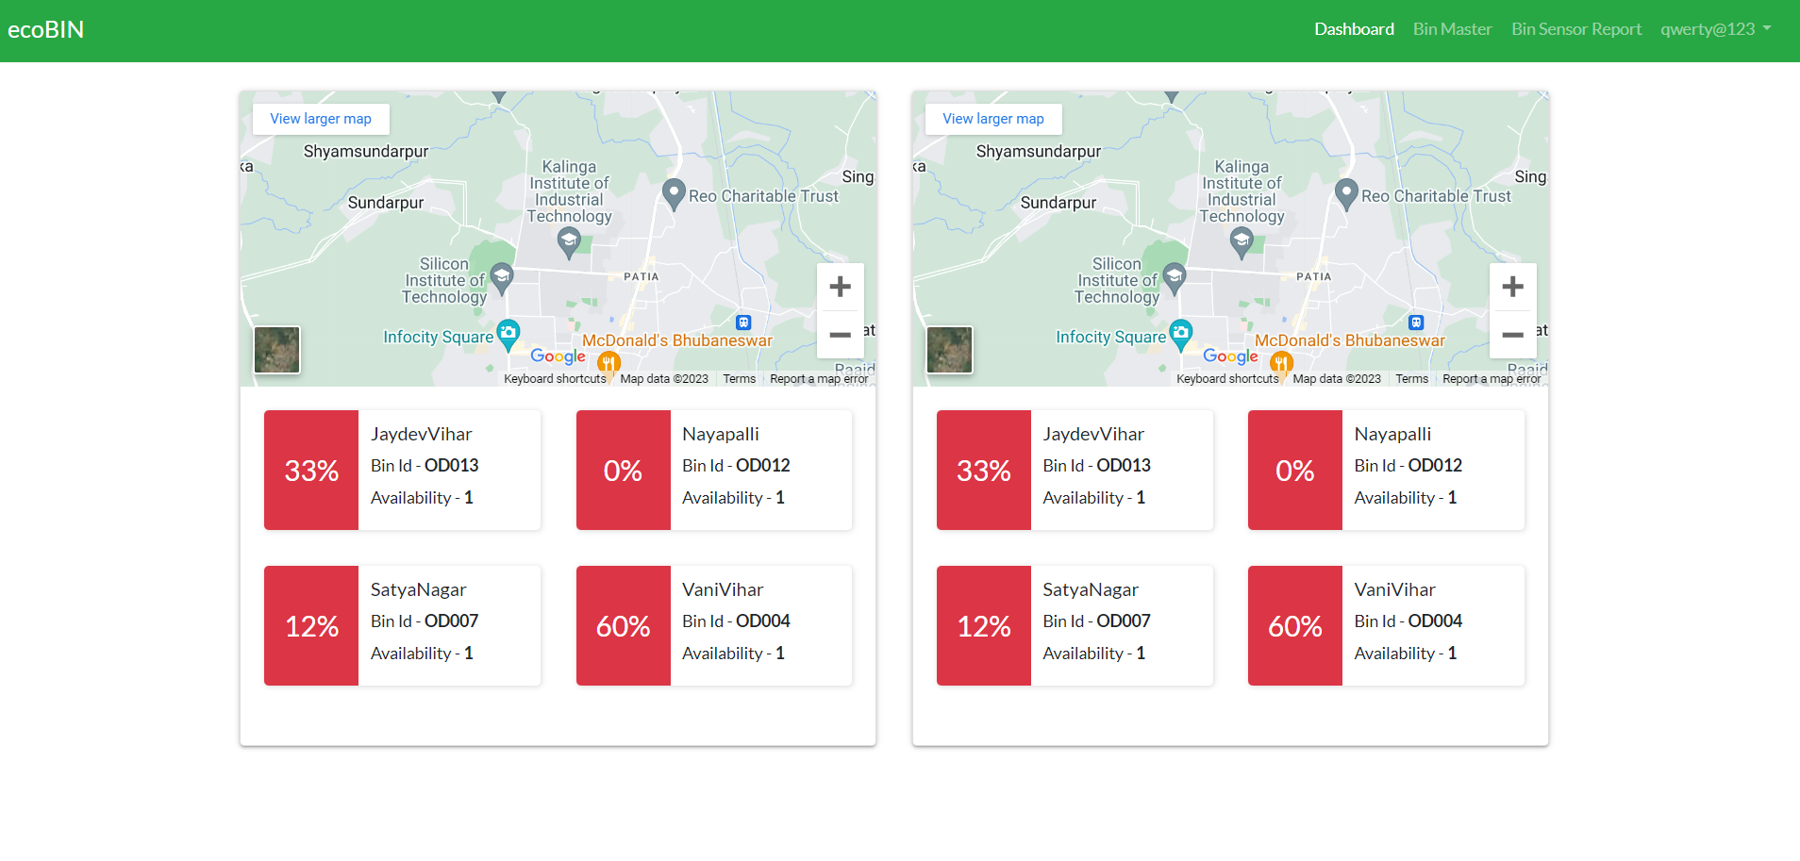
Screenshot (Admin View)

Slide 22
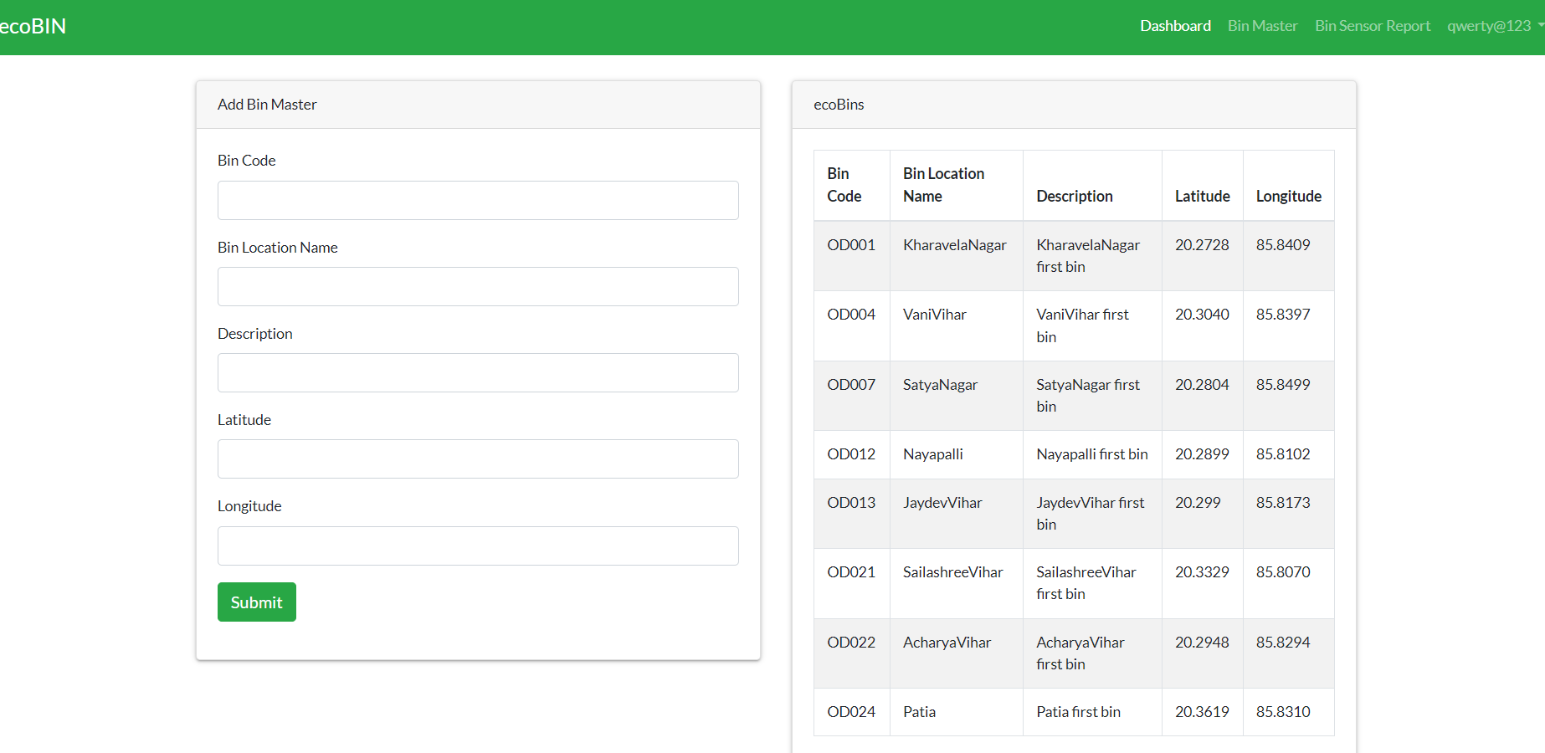
Bin Master

Slide 23
Bin Sensor Report

Slide 24
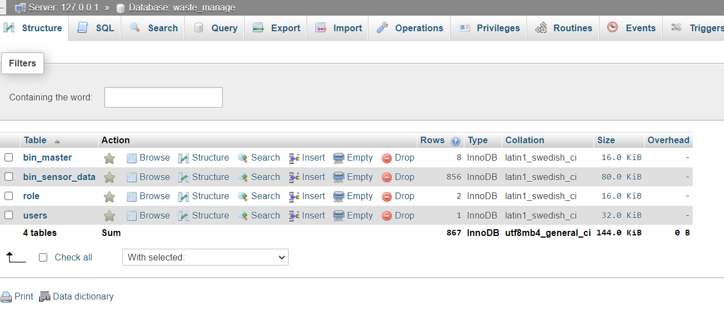
Database

Slide 25
Testing Report
Hyperlink of test report:
Test Report Hyperlink

Slide 26
References
M. A. Al Mamun, M. A. Hannan, and A. Hussain, “Real timesolid waste bin monitoring system framework using wirelesssensor network,” 13th Int. Conf. Electron. Information, Commun.ICEIC 2014 - Proc., pp. 1–2, 2014.
A. S. Wijaya, Z. Zainuddin, and M. Niswar, “Design a smartwaste bin for smart waste management,” Proc. 2017 5th Int. Conf.Instrumentation, Control. Autom. ICA 2017, pp. 62–66, 2017.
T. P. Fei et al., “SWM: Smart waste management for greenenvironment,” 6th ICT Int. Student Proj. Conf. Elev. CommunityThrough ICT, ICT-ISPC 2017, vol. 2017-January, pp. 1–5, 2017.
S. S. Chaudhari and V. Y. Bhole, “Solid Waste Collection as aService using IoT-Solution for Smart Cities,” 2018 Int. Conf.Smart City Emerg. Technol. ICSCET 2018, pp. 1–5, 2018.

