Slide 1


PRODUCT AUTHENTICATION USING BLOCKCHAIN (Project Presentation, KCS 753)
KIET Group of Institutions, Ghaziabad
(An ISO – 9001: 2008 Certified & ‘A+’ Grade accredited Institution by NAAC)
Guide Name: Ms. Shivani
Project Members
Abhishek Singh Yadav (2000290120011), CS-7A
Aditi Batra (2000290120012), CS-7A
Anurag Tripathi (2000290120036), CS-7A
Kshitij Pal (2000290310092), ECE-7B
PCS24-12

Slide 2
Last time suggestion
Why our project is better??
Tamper-Proof Records
Decentralized Trust
Transparent Transactions
Smart Contracts for Automation

Slide 3
Problem Statement
The problem of counterfeiting is a widespread issue.
Customers can’t distinguish between real and phony goods.
Blockchain is the solution as it is a transparent, immutable, and secure record.

Slide 4
Objectives
To address the problem of counterfeit goods being marketed to unwary customers
Reduce the negative impact on consumers and businesses.
The system aims to:
provide reliable means for consumers
to verify the authenticity of products they are purchasing
businesses to authenticate the products and protect the reputation.
increase transparency in the supply chain, allowing for better monitoring and regulation of counterfeit products.
Producer-consumer relations will be better.

Slide 5
LITERATURE SURVEY
Blockchain Adoption for Combating Deceptive Counterfeits
Authors: Hubert Pun, Jayashankar M. Swaminathan, Pengwen Hou
Year: 2021
2. A NewProducts’Anti-CounterfeitingBlockchain Using a Truly Decentralized, Dynamic Consensus Protocol
Authors: Naif Alzahrani, Nirupama Bulusu
Year: 2019
3. Product Authentication Technology Integrating Blockchain and Traceability Structure
Authors: Xiao Gao, Wenyin Zhang, Jiqun Zhang, YilongGao
Year: 2022

Slide 6
LITERATURE SURVEY
4. Detection of counterfeit products using Blockchain
Authors: Kunal Wasnik ,Isha Sondawle, Rushikesh Wani, Namita Pulgam
Year: 2022
5. A Blockchain-Based Application System for Product Anti-Counterfeiting
Authors: Jinhua Ma, Shih-Ya Lin, Xin Chen, Hung-Min Sun, Huaxiong Wang
Year: 2020

Slide 7
Technology used
BACKEND
Blockchain
Ganache: personal blockchain
FRONTEND
HTML
CSS
JAVASCRIPT

Slide 8
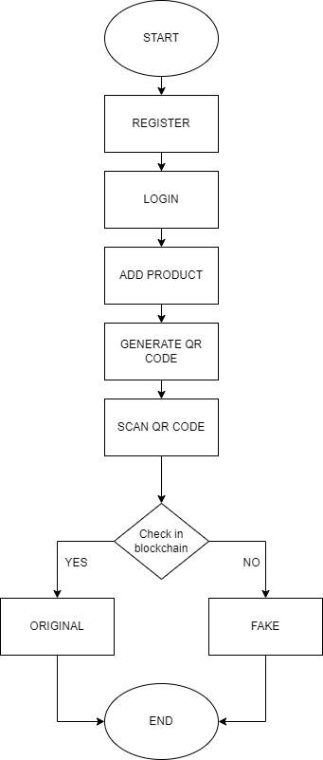
WORKFLOW
DIAGRAM

Slide 9
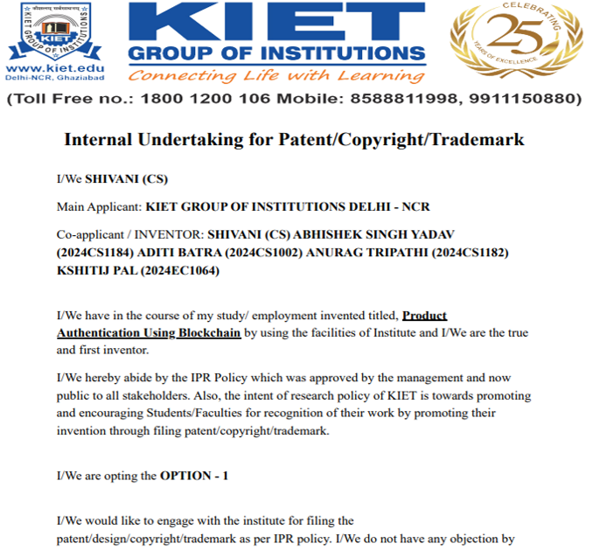
Patent Status
Payment done

Slide 10
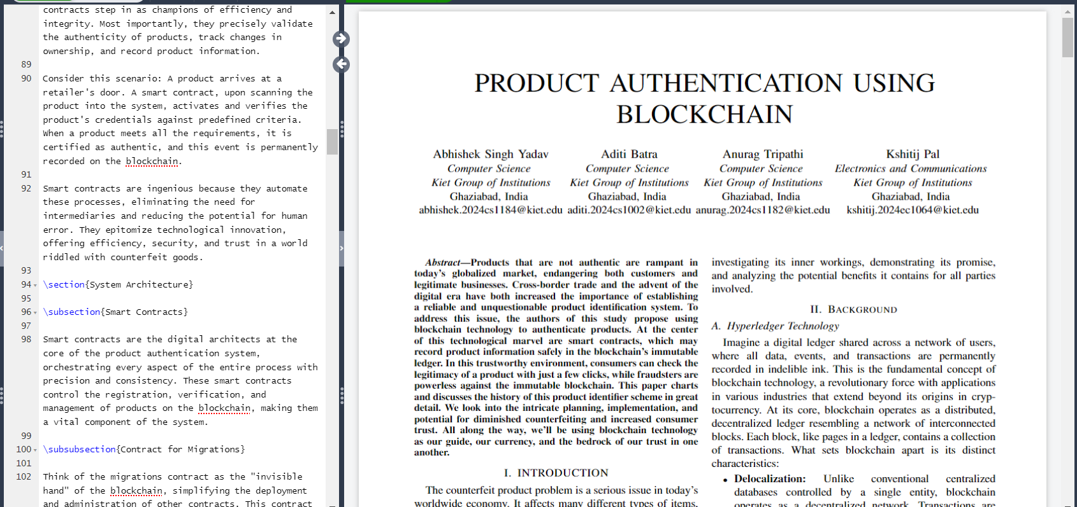
Research Paper Status (in progress) link

Slide 11
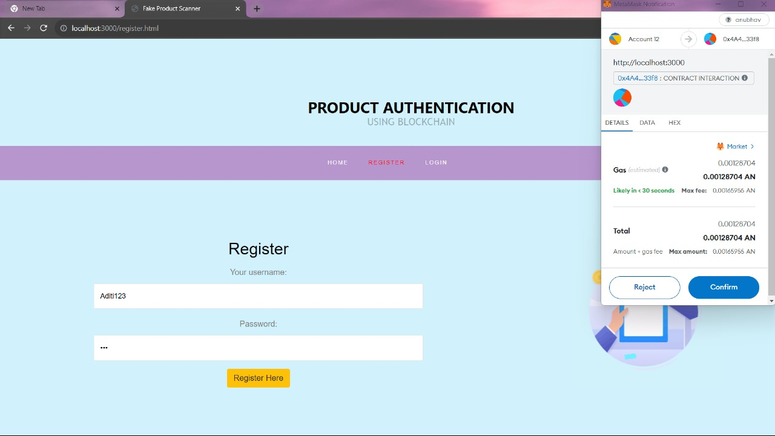

Slide 12
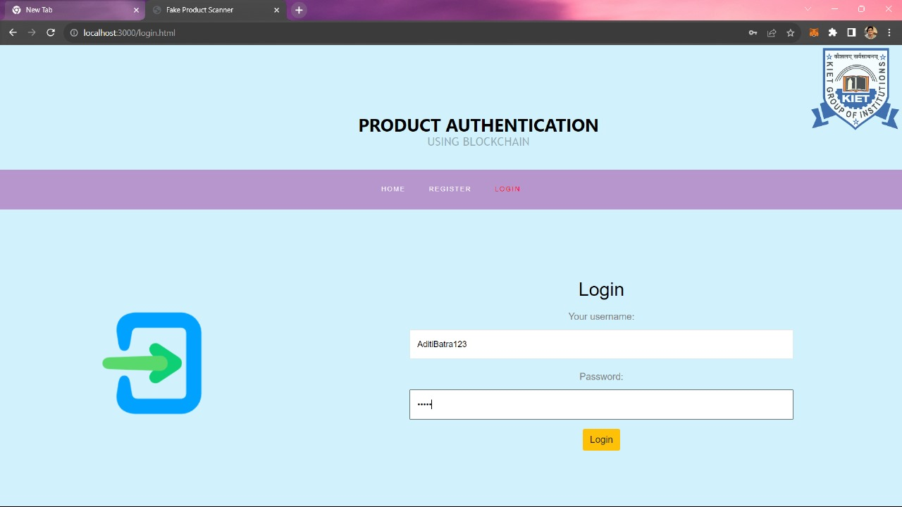

Slide 13
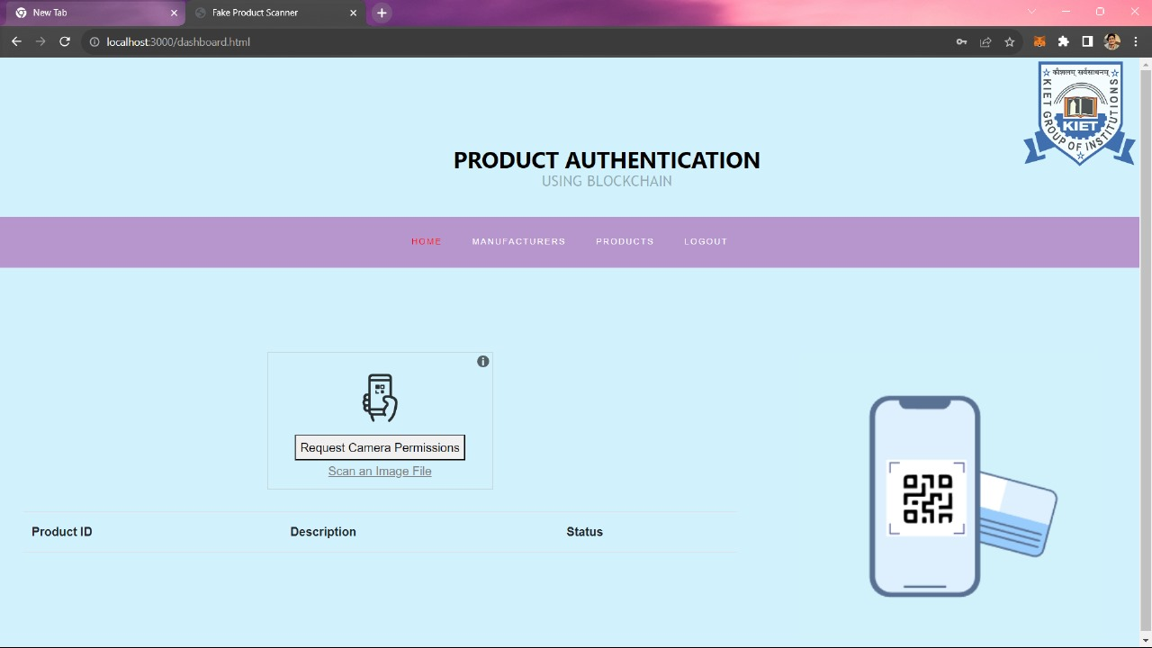

Slide 14
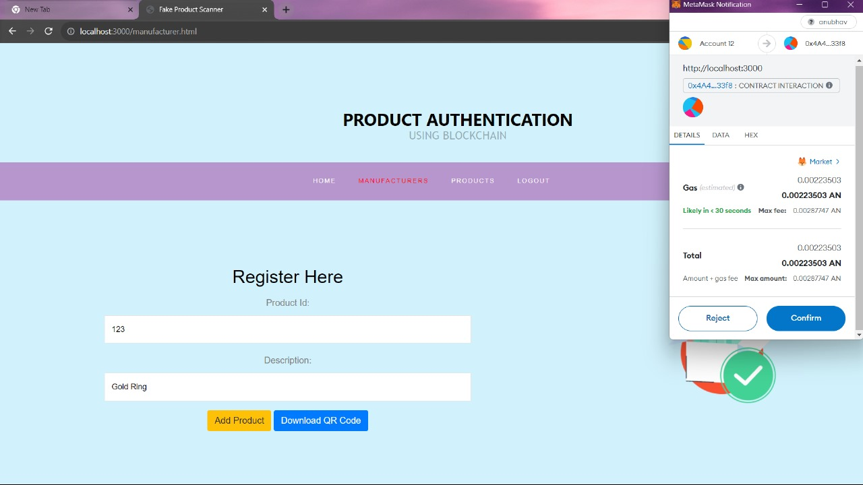

Slide 15
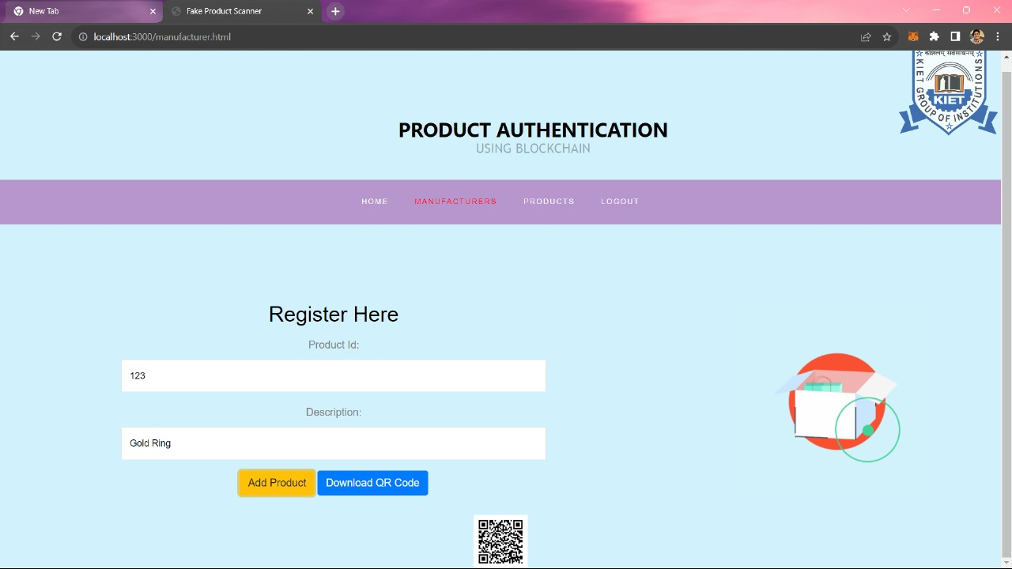

Slide 16
