Slide 1
PCOcare: PCOS Detection and Prediction using Machine Learning Algorithm

Slide 2

COMPUTER SCIENCE DEPARTMENT
Team Members:
Aditi Singh
R.No:2100290129001
Pooja Kumari
R.no:2000290120107
Kirti Jayant
R.No:2000290120087
Project Guide:
Prof. Pawan Kumar Pal

Slide 3
Acknowledgement
We’ve got this golden opportunity to express our kind gratitude and sincere thanks to my Head of Institution, KIET Group of Institutions of Engineering and Technology, and Head of Department of “Computer Science” and our Project Guide Prof. Pawan Kumar Pal Sir for their kind support and necessary counselling in the preparation of this internship report. I’m also indebted to each and every person responsible for the preparation of this project directly or indirectly.
We must also acknowledge or deep debt of gratitude each one of my colleague who led this projecn presentation come out in the way it is. It’s our hard work and untiring sincere efforts and mutual cooperation to bring out the project work. Last but not the least, we would like to thank our parents for their sound counselling and cheerful support. They have always inspired us and kept our spirit up.
Aditi Singh
Pooja Kumari
Kirti Jayant
CS-5B

Slide 4
Certificate
This is to certify that Project Report entitled “PCOcare” which is submitted by Aditi Singh, Pooja Kumari, Kirti Jayant in partial fulfilment of the requirement for the award of degree B. Tech. in Department of Computer Science of Dr A.P.J. Abdul Kalam Technical University, Lucknow is a record of the candidates own work carried out by them under my supervision. The matter embodied in this report is original and has not been submitted for the award of any other degree.
Date:14th of November,2022 Supervisor name:
Prof. Pawan Kumar Pal
CS Department

Slide 5
Abstract
Polycystic Ovary Syndrome (PCOS) is a medical condition which causes hormonal disorder in women in their childbearing years. The hormonal imbalance leads to a delayed or even absent menstrual cycle. Women with PCOS majorly suffer from excessive weight gain, facial hair growth, acne, hair loss, skin darkening and irregular periods leading to infertility in rare cases. The existing methodologies and treatments are insufficient for early-stage detection and prediction. To deal with this problem, we propose a system which can help in early detection and prediction of PCOS treatment from an optimal and minimal set of parameters. To detect whether a woman is suffering from PCOS, 5 different machine learning classifiers like Random Forest, SVM, Logistic Regression, Gaussian Naïve Bayes, K Neighbours have been used. Out of the 41 features from the dataset, top 30 features were identified using CHI SQUARE method and used in the feature vector. We also compared the results of each classifier and it has been observed that the accuracy of the Random Forest Classifier is the highest and the most reliable.

Slide 6
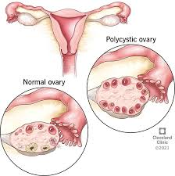
Introduction
PCOS- Polycystic Ovary Syndrome
It is a medical condition which causes hormonal disorder in women in their childbearing years. The hormonal imbalance leads to a delayed or even absent menstrual cycle. Women with PCOS majorly suffer from excessive weight gain, facial hair growth, acne, hair loss, skin darkening and irregular periods leading to infertility in rare cases. In the past few decades, technology has revolutionized our universe and affected our lives, making them easier day by day. These days, machine learning, a field of study that gives computers to learn without being explicitly programmed, is playing a key role in the healthcare sector. Machine learning can deal with obscenely huge datasets, convert analysed data into clinical insights and help in the diagnosis of various ailments. From 1 in 10 women suffering from PCOS worldwide to currently 3-4 in 10 women, PCOS is now exponentially increasing among women due to an unhealthy lifestyle. The literature says that 1 in every 5 women in India suffers from PCOS. PCOS symptoms differ in every patient.

Slide 7
Problem Statement
In order to be deal with the consequences of PCOS we are trying to develop an application which will detect and predict PCOS with the help of Supervised Learning Algorithm

Slide 8
Algorithm
The formulation of a good machine learning model is an important aspect of project design. Having the correct patient data is very important because one cannot afford mistakes while devising healthcare services. We have used multiple machine learning models to check which model gives us the most accurate results. To support our claims and results obtained, use of plots and evaluation metrics has been made.

Slide 9
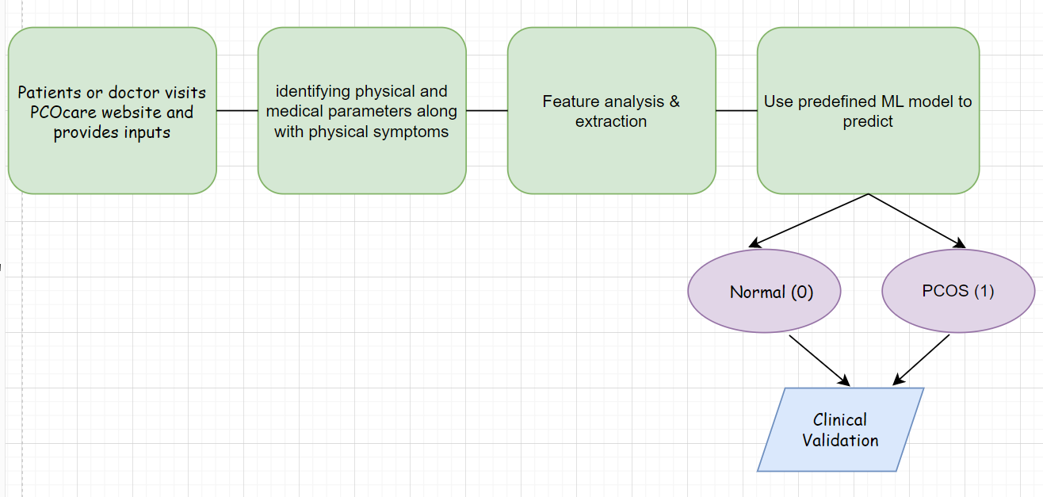

Slide 10
Methodologies Used
1.Machine Learning
Support Vector Machine,
Logistic Regression
Gaussian Naive Bayes
Chi-Square
2. Flutter

Slide 11
Previous work done on the same
If we give a look to some previous works on PCOS we can find many research work on it- importantly it’s cause, cure, symptoms, preventive measures etc. , but when we talk about a full fledged app or website in the field there are hardly some which only focuses on details about the disease and its consequences.
Some common apps present on play store are :
PCOS Diva
Paloma

Slide 12
Future Scope
As, we all know PCOS has become on of the most common diseases in women of childbearing years. In India 2 out of 5 women are suffering from this syndrome and the main reason for this is lack of information and several misconceptions. Our work in this field is building an full fledged app for guidance, instructions, detection, prevention from PCOS and guidelines for a healthy lifestyle.

Slide 13


