Slide 1
INTERNSHIP PRESENTATION
BY- PRACHI VERMA, PRAGATI TOMAR

Slide 2

INDEX
Project Description
Objective
Scope
Methodology
Architecture
References

Slide 3
PROJECT DESCRIPTION
Wardrobe projection refers to trying on digitally created garments or accessories in a virtual environment. That means you can see how those items look on you, allowing you to know if something is a good fit without physically trying it on. Hence, this technology could let you try on clothing without having it shipped or even leaving your house.
Our project aims to make it possible for users to virtually try on clothing. When users upload both their own and the clothes’ photograph, we will be able to create a shot of the subject wearing the clothing.

Slide 4
OBJECTIVE
To allow user trying on clothes virtually
We will create a clearer photo of user wearing the intended clothing by uploading both their personal photo and the intended clothing shot.
To increase the number of angles in which the user can upload their photograph.
For instance, users can provide their images even with the side angles besides the front views.
To implement real time image capturing of the users.

Slide 5
SCOPE
We will be able to use our project for a better user experience while shopping online.
We will be able to decide what looks good on us digitally.
It will help the sellers to get the trust of users.

Slide 6
METHODOLOGY
1.CAGAN is used to produce a preliminary result and a binary mask of where to modify from a human image and a target clothing image.
2. Simply the clothing is extracted using a transform network.
3. The segmentation stage uses the mask and output from the previous step to create a better mask that indicates where the garments should be altered.
4.The target's clothing is then changed using the mask. Our ultimate product is created by combining the changed clothing with the CAGAN result.

Slide 7
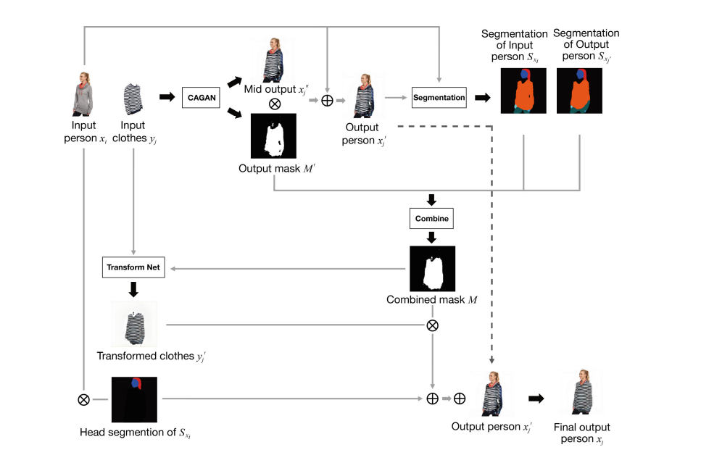
Architecture

Slide 8

\
THANK YOU

