Slide 1

Presentation on: Signature and ML based Web Application Firewall
.

Slide 2
Project Supervisor: -Mr. Abhishek Goyal, Assistant Professor CS Department KIET Group of Institutions
Team members:
Prachi sharma (2000290120108), Section B
Manya Varshney (2000290120093), Section B

Slide 3
Presentation Outline
Introduction
Objectives
Technology Used
Methodology
Implementation
Future Work
Conclusion

Slide 4
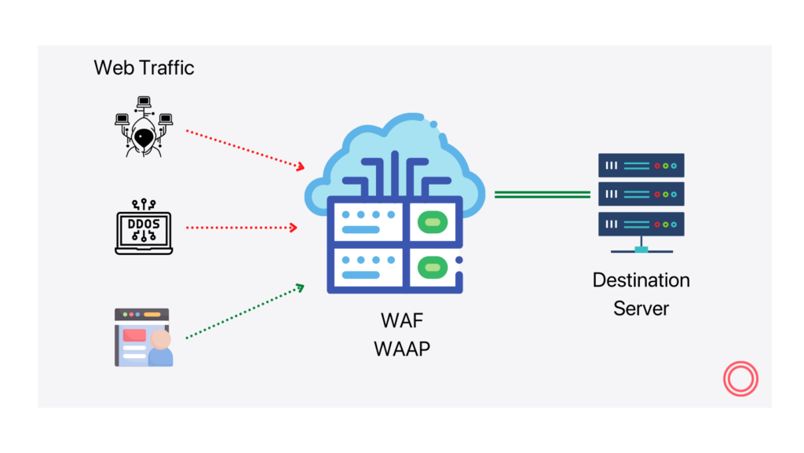
Introduction
A WAF protects your web apps by filtering, monitoring, and blocking any malicious HTTP/S traffic traveling to the web application, and prevents any unauthorized data from leaving the app. It does this by adhering to a set of policies that help determine what traffic is malicious and what traffic is safe. Just as a proxy server acts as an intermediary to protect the identity of a client, a WAF operates in similar fashion but in the reverse—called a reverse proxy—acting as an intermediary that protects the web app server from a potentially malicious client.

Slide 5
Objectives
The purpose of this project is to:
Protect data
customers and organizations from data theft
interruptions in business continuity
other harmful results of cybercrime.

Slide 6
Technology Used:
Python
Anaconda Distribution
Tensorflow, Keras
Oracle
Database Management System

Slide 7
Methodology
Generally, there are various techniques to detect attacks but they are not effective against the unknown intrusion detection .So, we have used the signature-based method, which is to look for specific attack patterns in requests; The second is anomaly based which is to establish normal request profiles so that anomalous requests can be discriminated from normal ones.

Slide 8
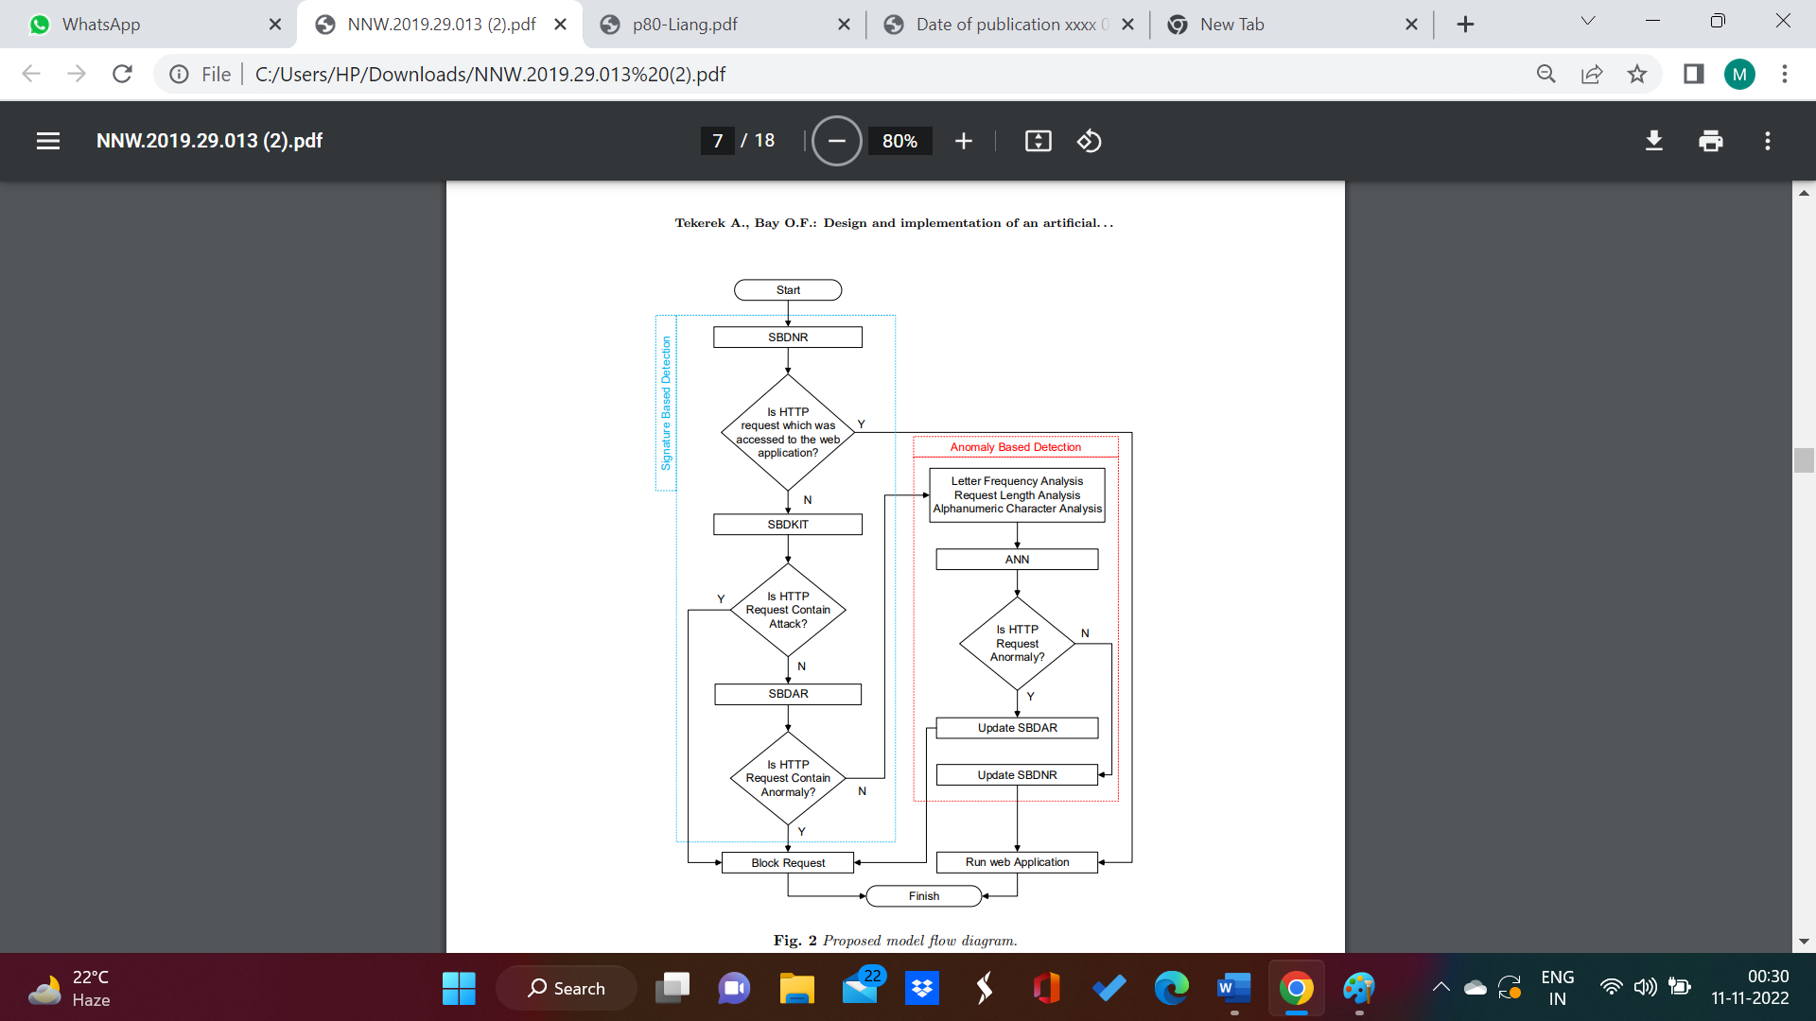
Flowchart

Slide 9
Implementation of Signature based detection
Signature based detection is implementation in two phases:
Parsing of http request
Pattern matching

Slide 10
Parsing of http Request
A HTTP request can be said to be composed of different parts all of which occurring in a certain order. So, a normal HTTP request is seen as:
Request ⇒Request Line∗ ((GeneralHeader|RequestHeader|EntityHeader)CRLF)
CRLF
[MessageBody]
The request line is of the form of:
Request Line ⇒ Method SP Request URL SP HTTP version

Slide 11
Pattern Matching
We will match the parsed http request with regular expression. These regular expression are formed after the deep study of the structure of http requests for known intrusion type.
For eg.
Regular expression for SQLi : /(=)[^\n]*((\’)|(\-\-)|(;))/I
Regular expression for XSS : /(<)(i)(m)(g)[^\n]+(>)/ix

Slide 12
Anomaly Based Detection
Anomaly HTTP requests behave differently than normal HTTP data. Learning-based ABD is implemented by using Artificial Neural Networks (ANN). Thus, an adaptation of the model against zero-day attacks is ensured by learning-based ABD by using ANN. a. In this project, we used methods based on deep-neural-network and parallel-feature-fusion that features engineering as an integral part of them and plays the most important role in their performance. The proposed methods use stacked autoencoder and deep belief network as feature learning methods.

Slide 13
Artificial Neural Network(ANN)
To implement learning-based ABD, the best ANN learning model is produced by using HTTP datasets. Firstly, ANN input and output data were normalized by using min-max method linearly between 0-1. The purpose of ANN training is to reach minimum error rate, by using the lowest number of hidden layers and neurons. In the training of ANN weights, a feedforward backpropagation algorithm is selected.
The most important process at this stage is the process of determining the number of hidden layers, the number of neurons in the hidden layers, and the activation function. Hyperbolic tangent is used as the activation function. The hidden layer and neuron numbers are determined experimentally to obtain the best ANN result.

Slide 14
Why ANN?
ANNs have some key advantages that make them most suitable for certain problems and situations:
ANN have the ability to learn and model non-linear and complex relationships.
ANN can generalize — After learning from the initial inputs and their relationships, it can infer unseen relationships on unseen data as well, thus making the model generalize and predict on unseen data.
Unlike many other prediction techniques, ANN does not impose any restrictions on the input variables (like how they should be distributed).

Slide 15
Feature extraction and selection
In order to carry out detection of HTTP requests which do not conform to the normal HTTP request structure, three features have been selected.
Letter Frequency Analysis: In this study, letter frequency analysis is performed to determine the total number and average value of each character in the incoming HTTP requests.
Request Length Analysis: Requests coming to web applications have a specific request structure depending on the developing structure of the web application. Request length values of memory overflow and cross-site scripting attacks are different to normal requests.
Alphanumerical Character Analysis: It is a cluster of definitions generated to allow for optimum memory use during data storage of computers. HTTP Requests coming to the web application have a specific character sequence.

Slide 16
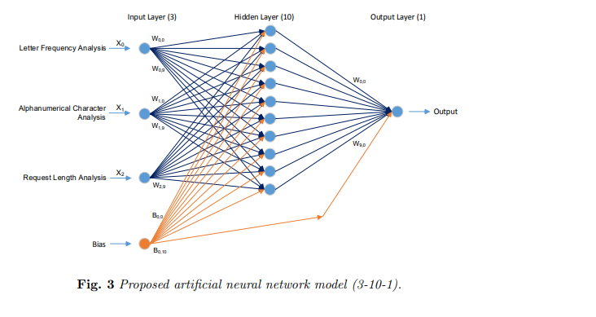
In order to train the network, 80 % of all datasets were determined as training data, and 20 % of the dataset as test data. The network has one hidden layer and ten neurons in that hidden layer.

Slide 17
Future Scope
The future of firewalls is robust. Firewalls must be a fundamental component of your organization’s security strategy, integrated alongside other protocols that can help defend against virtual threats.
There are various parameters like emails, offsite servers, social media, and other sources of outside information that could contain threats. As a result, firewall protects the data across multiple points of connection.
Incorporating Firewalling Systems into Your Security Platform

Slide 18
Conclusion
We would be able to implement a Web Application Firewall on a proxy server. It allows or blocks HTTP traffic based on the pattern matching by regular expression.. Apart from it, Artificial Intelligence based intrusion detection system is implemented on the WAF which divides the packets into clusters and later categorizes them into normal packets or intrusion. Moreover, a new Zero Day Attack detection technique was also implemented by calculating the abruptness of increase in the intrusion packets.

Slide 19


