Slide 1

PRODUCT AUTHENTICATION
KCS 753
USING BLOCKCHAIN
Guide Name: Ms. Shivani
Members:
Abhishek Singh Yadav (2000290120011)
Aditi Batra (2000290120012)
Anurag Tripathi (2000290120036)
Kshitij Pal (2000290310092)

Slide 2

TABLE OF CONTENT
Problem Statement
Objectives
Technology Used
Literature Survey
Flowchart
Advantages
End users
Patent Status
Research Paper Status
Project Screenshots

Slide 3
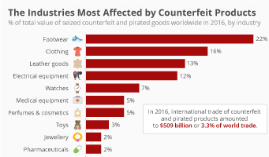
PROBLEM STATEMENT
The problem of counterfeiting is a widespread issue.
Customers can’t distinguish between real and phony goods.
Blockchain is the solution as it is transparent, immutable, and secure record.

Slide 4
OBJECTIVES
To address the problem of counterfeit goods being marketed to unwary customers
Reduce the negative impact on consumers and businesses.
The system aims to:
provide reliable means for consumers
to verify the authenticity of products they are purchasing
businesses to authenticate the products and protect the reputation.
increase transparency in the supply chain, allowing for better monitoring and regulation of counterfeit products.
Producer-consumer relations will be better.

Slide 5

TECHNOLOGY USED
BLOCKCHAIN
A digital ledger of transactions
distributed across the entire network of computer systems.
Ethereum is a blockchain-based computing platform, that enables developers to build and deploy decentralized applications.
FRONTEND
HTML
CSS
JAVASCRIPT

Slide 6
LITERATURE SURVEY
Blockchain Adoption for Combating Deceptive Counterfeits
Authors: Hubert Pun, Jayashankar M. Swaminathan, Pengwen Hou
Year: 2021
2. A NewProducts’Anti-CounterfeitingBlockchain Using a Truly Decentralized, Dynamic Consensus Protocol
Authors: Naif Alzahrani, Nirupama Bulusu
Year: 2019
3. Product Authentication Technology Integrating Blockchain and Traceability Structure
Authors: Xiao Gao, Wenyin Zhang, Jiqun Zhang, YilongGao
Year: 2022

Slide 7
LITERATURE SURVEY
4. Detection of counterfeit products using Blockchain
Authors: Kunal Wasnik ,Isha Sondawle, Rushikesh Wani, Namita Pulgam
Year: 2022
5. A Blockchain-Based Application System for Product Anti-Counterfeiting
Authors: Jinhua Ma, Shih-Ya Lin, Xin Chen, Hung-Min Sun, Huaxiong Wang
Year: 2020

Slide 8
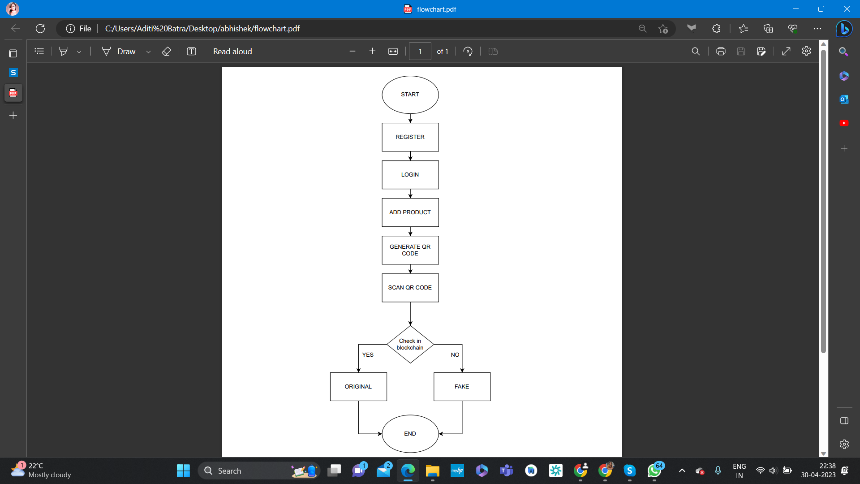
FLOWCHARTOWCHART

Slide 9
ADVANTAGES
Cost Savings
system can help reduce the costs associated with counterfeit products, such as lost revenue, legal fees, and damage to brand reputation.
Better Customer Trust
A reliable product authentication system can increase customer trust in a brand, leading to increased loyalty and sales.
Increased Security
Help to prevent the sale of counterfeit goods and protect consumers from fraudulent products.
Improved Transparency
Enables the consumers to trace a product's history and verify its authenticity.

Slide 10
END USERS
Consumers and Businesses
Consumers: who purchase products online or in physical stores can use the system to verify the authenticity of the product, giving them confidence and reducing the risk of buying counterfeit goods.
Businesses: that manufacture and sell products can also use the system to authenticate their products and protect their brand reputation from the negative impacts of counterfeiting.
Other potential end users include:
regulatory bodies, law enforcement agencies, and supply chain management companies who can use the system to monitor and regulate the supply chain for counterfeit products.

Slide 11
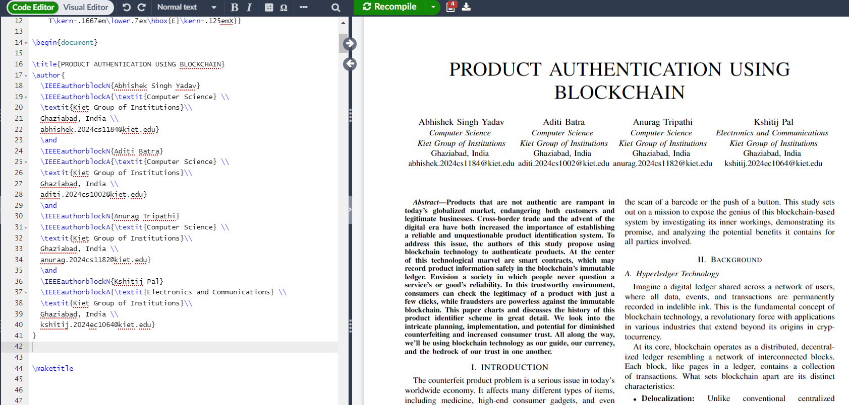
RESEARCH PAPER STATUS- Ongoing

Slide 12
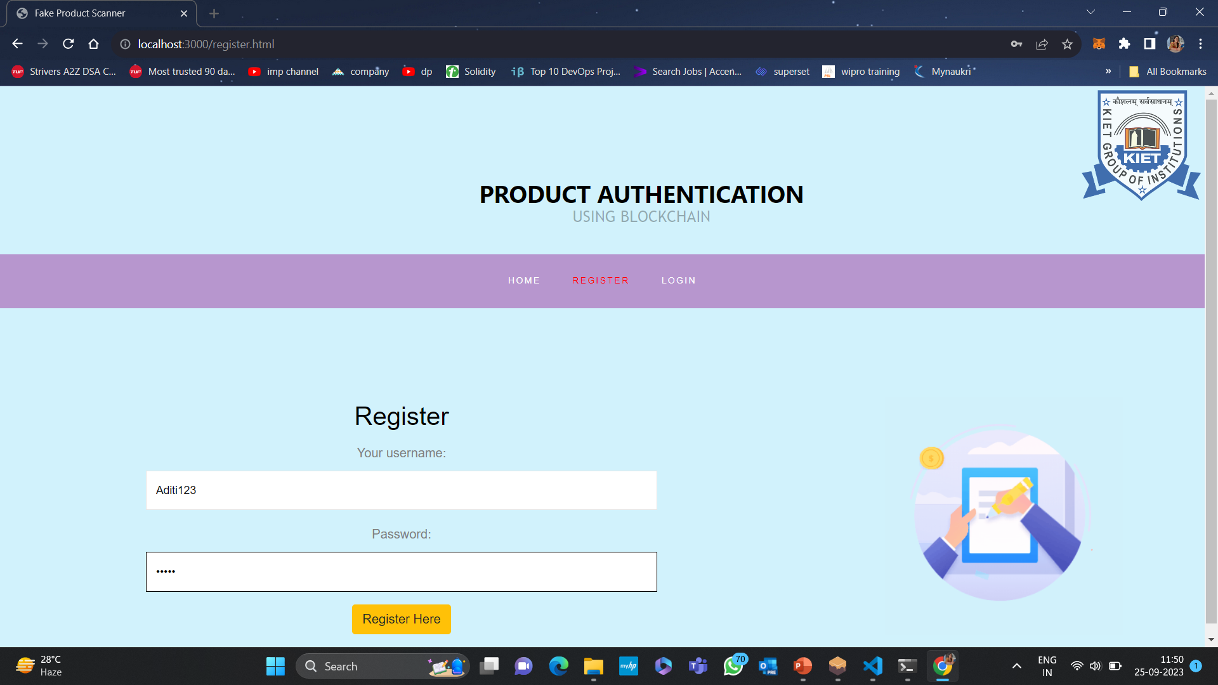

Slide 13
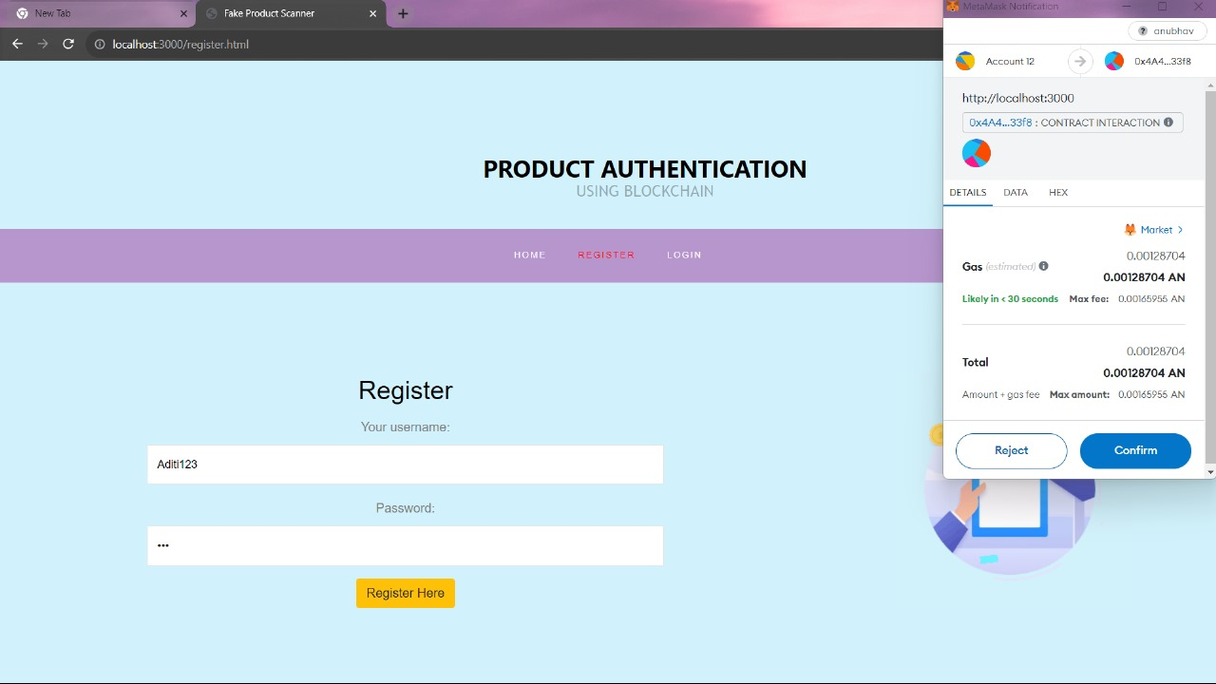

Slide 14
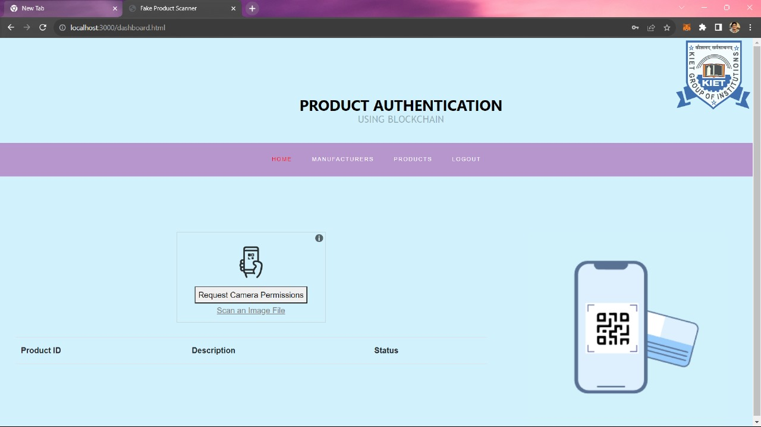

Slide 15
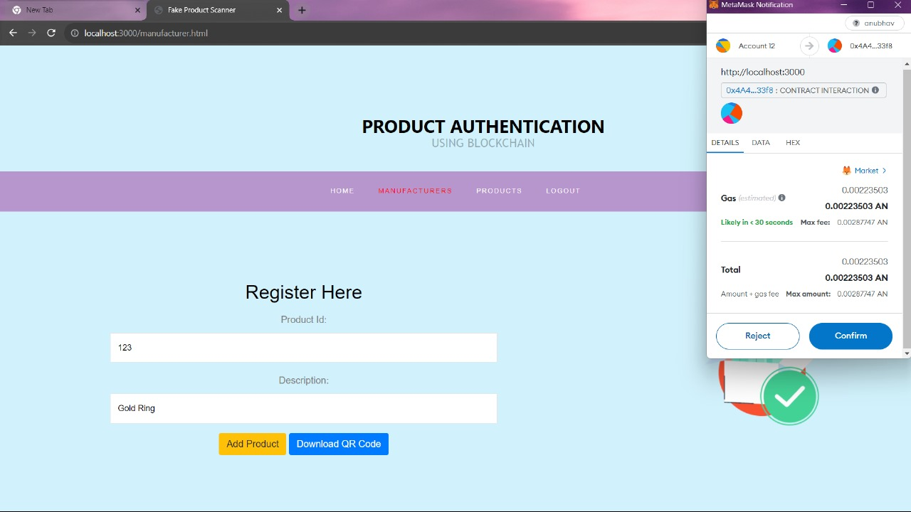

Slide 16
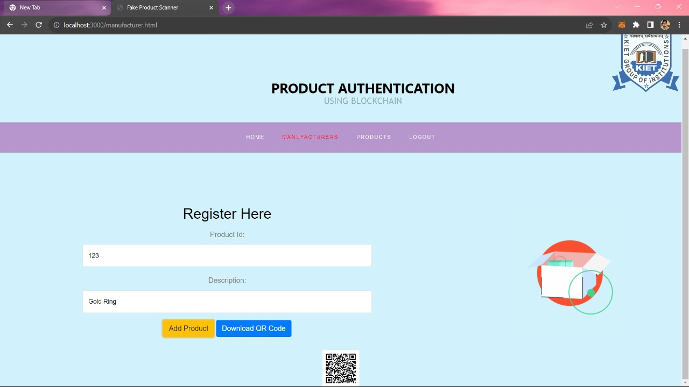

Slide 18
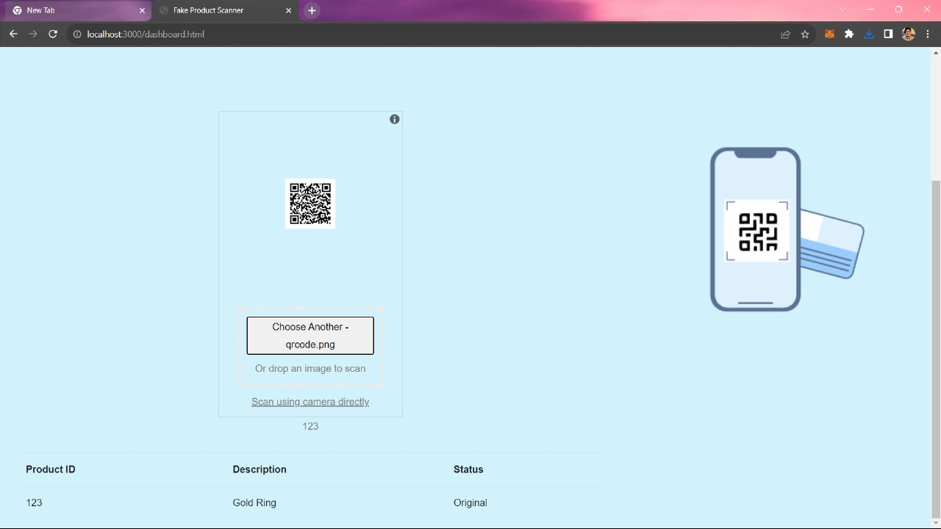

Slide 19
THANK YOU
Abhishek Singh Yadav (2000290120011)
Aditi Batra (2000290120012)
Anurag Tripathi (2000290120036)
Kshitij Pal ( 2000290310092)

