Slide 1

DEPARTMENT OF COMPUTER SCIENCE Project Presentation (KCS 851) Cryptocurrency Analysis WebApp
Guide Name: Prof. Vivek Kumar Sharma (Assistant Professor)
Project Members
1. Akanksha Mishra 2000290120017 A
2. Anshul Sharma 2000290120031 A
3. Anushraya Sharma 2000290120037 A

Slide 2
Table Of Contents
Problem Statement
Objectives
Technology Used
Literature Survey
Workflow Diagram
Patent Status
Research Paper Status
Project Status
References

Slide 3
Problem Statement
Cryptocurrencies form an economic aspect and part of our economy and as it is a fairly new emerging domain, the information resources are widely scattered. This proves to be a major hurdle for potential and new investors as well who want to learn about this domain.
Combining information from multiple resources- evaluating which ones to trust at the same time, and doing all this at regular intervals of time (considering the volatility of cryptos) increases the slope of the learning curve involved even more.

Slide 4
Objectives
The objective is to create a web app that aims to solve this problem it is designed to present all information in a structured and centralized manner.
Perform analysis of past performance and make reliable predictions about future dips and rises.
Provide handy tools like real-time value, local currency conversions, monitoring of top-performing currencies, and other performance statistics.

Slide 5
Technology Used
Frontend-
React JS
Material UI
Chart JS
CSS
JavaScript
Context API
Coin Gecko API
Meta Mask
Backend-
Firebase
Docker

Slide 6
Literature Survey
An Analysis of Cryptocurrency, Bitcoin, and the Future, Peter D. DeVries, International Journal of Business Management and Commerce, 2016
Bitcoin, the world’s most common and well-known cryptocurrency, has been increasing in popularity. It has the same basic structure as it did when created in 2008, but repeat instances of the world market changing has created a new demand for cryptocurrencies much greater than its initial showing. By using a cryptocurrency, users are able to exchange value digitally without third party oversight. Cryptocurrency works on the theory of solving encryption algorithms to create unique hashes that are finite in number[1]. Combined with a network of computers verifying transactions, users are able to exchange hashes as if exchanging physical currency. Bitcoin does not have intrinsic value like gold in that it cannot be used to make physical objects like jewelry that have value. Nevertheless, value continues to exist due to trust and acceptance. Transaction increase is an indicator of user acceptance growing.

Slide 7
Literature Survey
Understanding Cryptocurrency and its Dynamics, M. Ajith Kumar, The International Conference on Fintech: Digital Transformation of Financial Services, 2023
Cryptocurrency is a mysterious industry. With time, more and more people show interest in it and testing their fortune by investing in digital currencies, such as Bitcoin, Ethereum, Litecoin, Cardano, Polkadot, Stellar, Dogecoin, Biance Coin, Tether, Monero and so on[2]. Where Cryptocurrency is a type of digital or virtual currency that uses cryptography to safeguard transactions, it is a peer-to-peer payment system that allows anyone from anywhere to send and accept payments. One of crypto's most notable features is that it can be used to transfer value between two parties. This is done without the involvement of a third party, resulting in a more open and censorship- resistant transaction[8].While the price of a cryptocurrency can spike to dizzying highs, they can crash to terrifying lows just as quickly. Nowadays, all have been pushed back by Crypto currency. But Crypto currency is different, where no tax or commission is charged on this.

Slide 8
Literature Survey
Security and Trust in Cryptocurrencies, Jozef Bucko, Dana Palova, Martin Vajacka, Central European Conference in Finance and Economics, 2015
The term of cryptocurrency is phenomenon of recent years, standing for digital currency based on principles of cryptography. General public may confuse this term with Bitcoin, but many other cryptocurrencies arose. Bitcoin was first cryptocurrency introduced and still it is the most popular. There are two types of Bitcoin users: basic ordinary users and so called “miners”. Ordinary Bitcoin users use digital wallet similar to electronic banking for management of Bitcoin cash and transferring payments in bitcoins[3]. Access to these data has only the holder of cryptographic private key. If the wallet data is lost (e.g. the wallet data file is inadvertently corrupted or deleted), then the bitcoins contained in this wallet are lost forever (when file was not backed up). The public address of the wallet still exists, but it can only be accessed by the private key, which has been deleted. And breaking Bitcoin’s impossible using common computational force of personal computer in timely manner.

Slide 9
Literature Survey
Cryptocurrency trading: A comprehensive survey, Fan Fang, Carmine Ventre Turing Intelligence Technology Limited, 2022
In recent years, the tendency of the number of financial institutions to include cryptocurrencies in their portfolios has accelerated. Crypto currencies are the first pure digital assets to be included by asset managers. Although they have some commonalities with more traditional assets, they have their own separate nature and their behavior as an asset is still in the process of being understood [4]. This paper provides a comprehensive survey of cryptocurrency trading research, by covering 146 research papers on various aspects of cryptocurrency trading (e.g., cryptocurrency trading systems, bubble and extreme condition, prediction of volatility and return, crypto-assets portfolio construction, technical trading and others)[7]. This paper also analyses datasets, research trends and distribution among research objects (contents/properties) and technologies, concluding with some promising opportunities that remain open in cryptocurrency trading.

Slide 10
Literature Survey
Cryptocurrency research: future directions, Andrew Urquhart, Larisa Yarovaya, The European Journal Of Finance, 2023
In the financial world, cryptocurrencies are posing a serious threat to established structures and drawing attention from academics, investors, and decision-makers alike. Since the launch of Bitcoin in 2009, the market for cryptocurrencies has grown at an unprecedented rate, stimulating research and innovation in a wide range of fields[6]. With the use of blockchain technology, numerous cryptocurrencies with distinct features and applications have been created. Scholars have delved deeply into the fundamental concepts of blockchain technology, cryptographic algorithms, and consensus mechanisms in order to classify cryptocurrency assets according to their technological features and applications[5]. Extreme price volatility has drawn the attention of investors and researchers to the cryptocurrency industry. A lot of research has been done on the integration of cryptocurrencies into established financial markets, looking at factors such market performance, efficiency, liquidity, and anomalies.

Slide 11
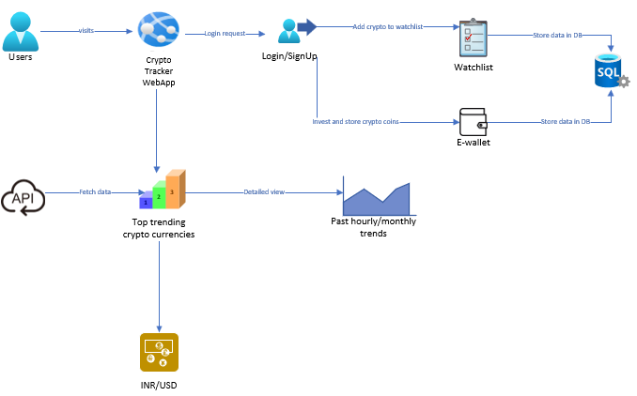
Process Flow Diagram

Slide 12
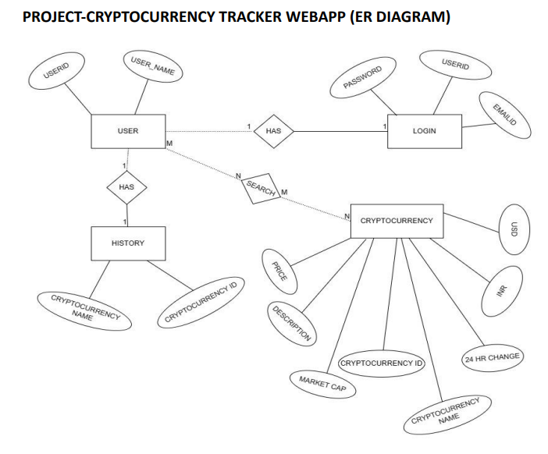
ER Diagram

Slide 13
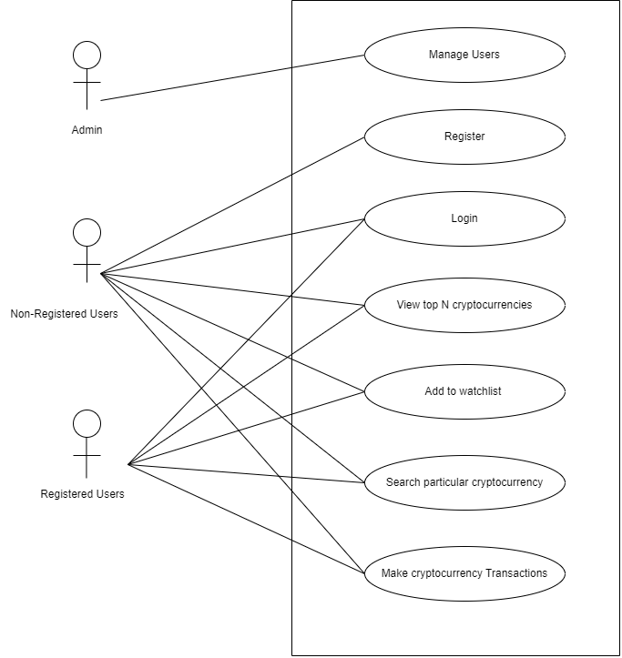
USE CASE Diagram

Slide 14
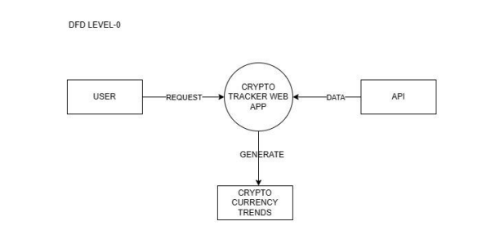
DFD Level-0

Slide 15
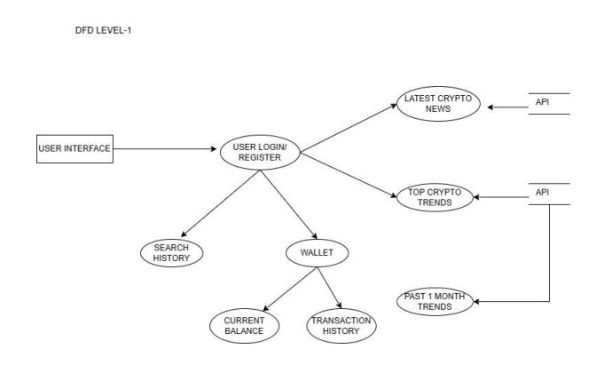
DFD Level-1

Slide 16
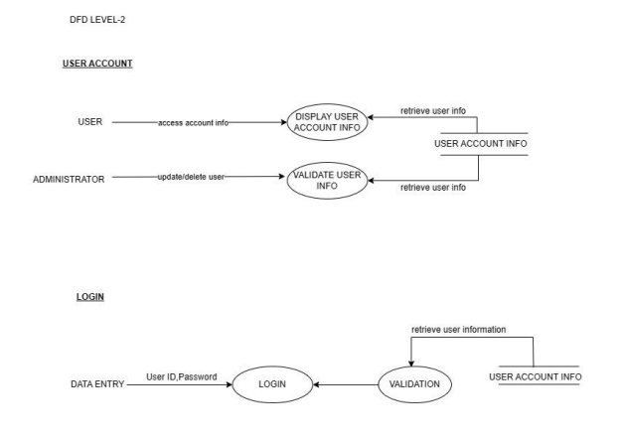
DFD Level-2

Slide 17
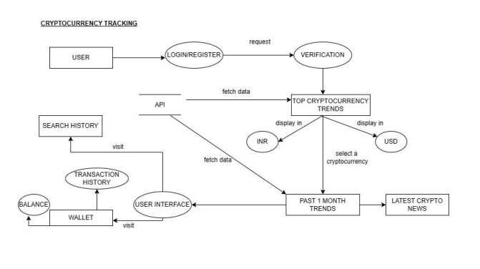
DFD Level-2

Slide 18
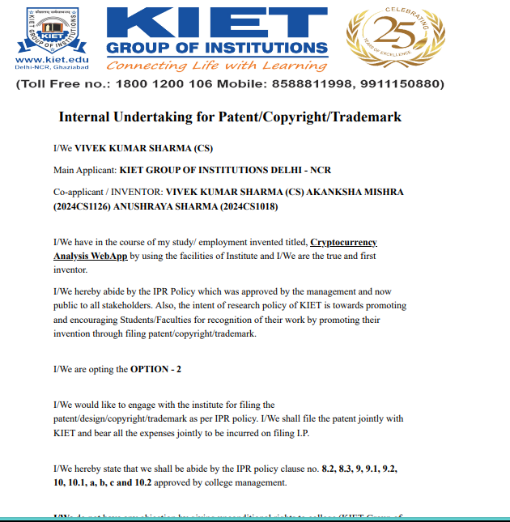
Patent Status
Submitted-

Slide 19
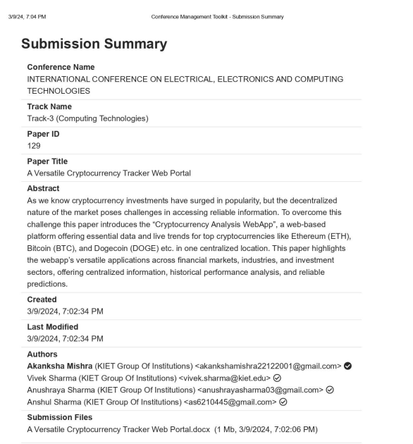
Research Paper Status
Communicated-

Slide 20
Research Paper Status
Research Paper Link-
https://drive.google.com/file/d/1rL1_7fOY2yaqZZArW6Ve7PwgYoYlC6WH/view?usp=sharing

Slide 21
Project Status
GitHub Link-
https://github.com/KIET-Github/CS-2024-C/tree/main/PCS24-2-Akanksha/Cryptocurrency%20Tracker%20WebApp

Slide 22
All documents Proofs (GitHub and Drive)
Testing report-
GitHub-CS-2024-C/PCS24-2-Akanksha at main · KIET-Github/CS-2024-C · GitHub
Drive-https://drive.google.com/file/d/15Kfiafs_UwV9GbAzOlTGu_BoY9Vigeab/view?usp=sharing
Synopsis-
GitHub-CS-2024-C/PCS24-2-Akanksha at main · KIET-Github/CS-2024-C · GitHub
Drive-https://drive.google.com/file/d/10Hj3Qfsm3L-HoY4ZY7h2Ao0DNxoNfd9N/view?usp=sharing
SRS-
GitHub-CS-2024-C/PCS24-2-Akanksha at main · KIET-Github/CS-2024-C · GitHub
Drive-https://drive.google.com/file/d/1ZAlmsy9gl0G6BbnA7l2kN9mF8HP04_c2/view?usp=sharing
Report-
GitHub-CS-2024-C/PCS24-2-Akanksha at main · KIET-Github/CS-2024-C · GitHub
Drive-https://drive.google.com/file/d/1njJRLTg_SSszY6PfbdoRf8qRfEvw44NJ/view?usp=sharing

Slide 23
References
[1] S. Nakamoto, "Bitcoin: A peer-to-peer electronic cash system," [Online]. Available:https://bitcoin.org/bitcoin.pdf.
[2] D. Yermack, "Is Bitcoin a real currency? An economic appraisal,"Contemporary Economic Policy”, vol.24, no. 2, pp. 242-255, 2013.
[3] W. Mougayar, “The business blockchain: Promise, practice, and application of the next internet technology”. John Wiley & Sons, 2016.
[4] M. Swan, “Blockchain: Blueprint for a new economy”. O'Reilly Media, Inc., 2015.
[5] D. Tapscott and A. Tapscott, “Blockchain revolution: How the technology behind bitcoin is changingmoney, business, and the world”. Penguin, 2016.
[6] E. T. Cheah and J. Fry, "Speculative bubbles in Bitcoin markets? An empirical investigation into the fundamental value of Bitcoin," “Economics Letters”, vol. 130, pp. 32-36, 2015.

Slide 24
References
[7] F. Glaser et al., "Bitcoin-asset or currency? Revealing users’ hidden intentions," in “Proceedings of the Twenty Second European Conference on Information Systems (ECIS)”, Tel Aviv, 2014.
[8] V. Buterin, "A next-generation smart contract and decentralized application platform," White paper,[Online]. Available: https://github.com/ethereum/wiki/wiki/White-Paper.
[9] K. Croman et al., "On scaling decentralized blockchains," in “Proceedings of the 3rd Workshop on Bitcoin and Blockchain Research”, pp. 106-125, 2016.
[10] X. Li et al., "A survey on the security of blockchain systems," “Future Generation Computer Systems”,vol. 82, pp. 395-411, 2018

