Slide 1

Project Presentation (KCS 851) Automated Retail Checkout System using YOLOv5 in Computer Vision Project Id: PCS24-30
Department of Computer Science
Guide Name: Mr. Anmol Jain
Team Members:
Kshiteesh Kumar (2000290120088) – 8B
Kumari Bhavya Chaubey (2000290120089) – 8B
Nandita Yadav (2000290120100) – 8B

Slide 2
Table of Contents
Problem Statement
Objectives
Technology Used
Literature Review
Diagrams
Patent Status
Research Paper Status
Project Status
Documents Proof
References

Slide 3
Problem Statement:
With the advent of technology, it has been noticed that tasks are now performed without human intervention at a larger scale.
In retail stores, it has been observed that there are longer queues for customers to checkout and pay the bills for the bought items.
Though security cameras and high-level automated machines that scans the barcode are present in today’s market, these are cost ineffective.
Amazon Go, which was launched in 2017, eased the process of checkout but in a much sophisticated way. It degraded the customer-employee experience and is too costly.
Hence there needs to be a system that is cost effective and can easily generate the bill without much human effort.

Slide 4
Objectives:
To automate the checkout process to reduce waiting times for customers, leading to improved customer satisfaction.
To ensure accurate identification and detection of items being purchased, minimizing errors in the checkout process and reducing the need for manual intervention.
To enhance the overall shopping experience by streamlining the checkout process and reducing queues.
To build a system that can adapt to different retail environments, handle various types of products, and accommodate changes in store layout or configuration
To pre-process the dataset and convert it into required .yaml format.
To prepare YOLOv5 model using Roboflow.
To provide a user-interface through Python GUI-Tkinter.
To empirically evaluate the outcomes of the proposed model.

Slide 5
Technology Used:
Language:
Python
Toolkit:
Roboflow: It is a Computer Vision developer framework used for better data collection, pre-processing, and model training techniques.
YOLOv5: It is a novel convolutional neural network (CNN) that detects objects in real-time with great accuracy. This approach uses a single neural network to process the entire picture, then separates it into parts and predicts bounding boxes and probabilities for each component.
User Interface:
Tkinter: It is the standard GUI library for Python.

Slide 6
Literature Survey 1
Title – How Computer Vision Provides Physical Retail with a Better View on Customers.
Authors: Daniel Mora, Oliver Nalbach and Dirk Werth
Year of publishing: 2020
Summary:
The authors introduced a conceptual tracking system for offline retail stores.
Its purpose was to generate movement tracks over time for individual customers from the customer entered the market and till they left.

Slide 7
Literature Survey 2
Title - Shop and Go: An innovative approach towards shopping using Deep Learning and Computer Vision
Authors: Narendra Shekokar, Anchal Kasat , Sanjay Jain, Pranjal Naringrekar and Monil Shah
Year of publishing: 2020
Summary:
The authors implemented an App named “Shop and Go” which is secured as it uses barcode authentication. It makes use of deep leaning and sensor fusion. Deep learning is used to improve the algorithm performance of detecting images while an item is kept or picked from the shelf. Sensor fusion makes use of a combination of multiple weight sensors that are kept on shelves to detect a change in weight if item is picked or kept back. The final bill is displayed to the user when they checkout and the final amount is deducted from their wallet.

Slide 8
Literature Survey 3
Title – Product Stock Management using Computer Vision.
Authors: Muhammad Adib Majdi, Bima Sena Bayu Dewantara, Mochamad Mobed Bachtiar
Year of publishing: 2020
Summary: The purpose of this study was to identify products that were missing or almost empty from a supermarket's display management system. They employed a camera, positioned in front of the rack in order to record every item that is on exhibit there. Each product was identified and detected using deep learning. The management of the supermarket had previously created a preconfigured product mapping, which was compared to all of the discovered products. The responsible staff was then notified of the findings of the product's identification and recognition. If the product matches the mapping location, its existence is correct.
There has been development in labelling image collections, snapping photographs on shelves, gathering product recognition data utilising small YOLOv3, and all of these areas. Virtual lines were used in the shelf segmentation process to recalculate the number of product lines in a horizontal fashion. 76.67% accuracy for misplacement detection and 97.61% accuracy for product recognition and nearly empty detection.

Slide 9
Literature Survey 4
Title – Real-time Scene Change Detection with Object Detection for Automated Stock Detection.
Authors: Sandeep Kumar Yedla, V.M. Manikandan, Panchami V
Year of publishing: 2020
Summary:
The authors introduced a computer vision-based automated system for stock management in the supermarkets.
The key idea behind the proposed scheme is that a few low-cost cameras will be placed in the supermarket which will help to capture the videos of the product racks in the supermarket. The presence of human beings are identified b y u sing a structural similarity index (SSIM) based scene change detection technique, further, an object detection technique will be used to count the number of items present in the specific product rack. If t he number of items present in a particular rack goes below a threshold limit, a short message service (SMS) and/or email will go the concerned authority.

Slide 10
Literature Survey 5
Title: Computer vision based automated billing system for fruit stores.
Authors: M Sugadev, Kudapa Sucharitha, I.Rexline Sheeba and Balamurugan Velan
Year of publishing: 2020
Summary:
The authors have proposed a method that uses the deep learning neural network approach for classification of fruits and strain gauge type load cell to estimate the weight of the fruit items kept in the basket. The neural network takes input image in the form of clusters and this cluster forms a centroid that is processed to classify fruits like Apple, Banana, Granny Smith, etc. The image processing and weight computation algorithms are implemented in RaspberryPi board with tensor flow and openCV library functions. The proposed system automatically recognize the type of fruits, finds the weight of the fruit in grams, computes the total cost and prints the bill statement.

Slide 11
Literature Survey 6
Title – Fraud Detection at Self Checkout Retail using Data Mining.
Authors: Hafiz Yoza Putra
Year of publishing: 2020
Summary:
The author predicted fraud in one retail self check out using classification techniques and visualize the results to obtain new insight. The results of this study were oversampling on unbalanced data that could improve the performance of a model. The model with the best performance is J48 with F-measure 0.981. New insight from the visualization of prediction results was that customers with low trust levels are vulnerable to fraud.

Slide 12
Literature Survey 7
Title – Object Detection in Shelf Images with YOLO.
Authors: Ceren Gulra Melek, Elena Battini Sonmez and Songul Albayrak
Year of publishing: 2020
Summary: The authors’ study aims to detect object in shelf images with deep learning algorithms. Firstly, object detection algorithms and datasets were examined in the literature. Then, experimental study was performed using Coca Cola images obtained from Imagenet and Grocery dataset with YOLO (You Only Look Once) algorithm. Results of the study were discussed from different sides such as number of classes, threshold values and number of iteration. According to the experimental results obtained by using YOLOv2 algorithm with the Grocery Dataset and Coca-Cola Images from ImageNet Dataset: The number of iterations of the algorithm is important. The total loss value is decreased by increasing the number of iteration. But at this point, overfitting should also be considered. The threshold value is important to detect all correct objects in the image. If the threshold value is too big, the algorithm cannot catch the objects. On the other hand, if the threshold value is too small, algorithm can detect a wrong object. Increasing the number of class results in a higher number of iteration and higher training time.

Slide 13
Literature Survey 8
Title – A Comprehensive Analysis of Methodologies used for Object Detection and Localization
Authors: D. Triphena Delight and V. Karunakaran
Year of publishing: 2020
Summary: —In this paper, the authors have analyzed various methodologies used for object detection and localization. In this paper, a comprehensive survey of object localization and detection techniques has been detailed. This paper also compared performance metrics and discusses the limitations of models used for object detection and object localization.

Slide 14
Literature Survey 9
Title –A Unified Object Detection Framework for Intelligent Retail Container Commodities.
Authors: Linyu Zhao, Jian Yao, Hongyu Du, Jinjie Zhao and Ruijie Zhang
Year of publishing: 2020
Summary: Motivated by commodity detection in retail, this paper studied the problem of generating object bounding boxes in retail images. The existing object detection algorithms were not suitable due to the characteristics of the intensive distribution of commodities in intelligent retail containers. Therefore, the authors presented a unified object detection framework used for dense scenarios in retail images, which consisted of the hierarchical labeling pattern, the Similarity Recognition Network (SRN) subnetwork and the optimized NMS algorithm on the basis of YOLOv3. Three datasets were built to verify the effectiveness of the proposed framework, two of which were used for training the object detection network, and the other one was used for training the SRN subnetwork. The experimental results show that the proposed framework achieves a significant improvement for dense scenario in retail images compared with the traditional object detection algorithms.

Slide 15
Literature Survey 10
Title – Detection of Objects from Noisy Images.
Authors: Al-Akhir Nayan, Joyeta Saha, Khan Raqib Mahmud, Abul Kalam Al Azad and Muhammad Golam Kibria
Year of publishing: 2020
Summary: The paper compared the accuracy of detecting noisy image objects with well-established models like YOLO V2, RCNN, ResNet, RetinaNet, SSD 300 and also the SSD 512 original model. The authors have discussed the detection of objects in noisy images and suggested a new low-cost technique to detect image objects from noisy images. Receiving the benefits of the Single Shot MultiBox Detector (SSD), we have presented an extensive experimental assessment with conventional detectors retrained on noisy images. Results were provided for the prevalent benchmark for object detection Pascal Visual Object Classes. Comparing with other image detection approaches, their technique has provided satisfactory performance at the time of detecting image objects from noisy images. The method can be very effective to the autonomous industries to resolve the object detection related difficulties created by insufficient lighting and lower regulation pictures.

Slide 16
Literature Survey 11
Title – Object Recognition and Detection in Remote Sensing Images: A Comparative Study.
Authors: Syed Aley Fatima, Ashwani Kumar, Ajay Pratap and Syed Saba Raoof
Year of publishing: 2020
Summary: In this paper, the authors have provided a brief literature survey of object recognition & detection in remote sensing. These scene recognition images have more components and more challenging issues in the range of aerial image resolutions. It also shows a critical act as a limited area based on functions. The object detection in optical remote sensing has the best critical part of over supposing conditions of characteristic against affecting a model inputs. Certain moving characteristic act as a set of quality to define a based on personal action. This paper provided a brief summary of different object detection in remote sensing images and also discussed about their strength and limitation. The main focus of this review paper was on the satellite image. A subsists in patent of scene recognition of current model act on a freshly process. Interrelates to the land uses analysis system, their model analysis process as well as turn to the appropriate function. They have also discussed the problems and advancement of current scenario and give three research directions for deep learning for medical image recognition, image classification, and health care.

Slide 17
Literature Survey 12
Title – A Sample Update-Based Convolutional Neural Network Framework for Object Detection in Large-Area Remote Sensing Images
Authors: Yuan Hu, Xiang Li, Nan Zhou, Lina Yang, Ling Peng , and Sha Xiao
Year of publishing: 2020
Summary: In this paper, the authors addressed the issue of accurate object detection in large-area remote sensing images. Although many convolutional neural network (CNN)-based object detection models can achieve high accuracy in small image patches, the models perform poorly in large-area images due to the large quantity of false and missing detections that arise from complex backgrounds and diverse groundcover types. To address this challenge, this letter proposed a sample update-based CNN (SUCNN) framework for object detection in large-area remote sensing images. The proposed framework contains two stages. In the first stage, a base model—single-shot multibox detector—is trained with the training data set. In the second stage, artificial composite samples are generated to update the training set. The parameters of the first-stage model are fine-tuned with the updated data set to obtain the second-stage model. The first- and second-stage models are evaluated using the large-area remote sensing image test set. Comparison experiments show the effectiveness and superiority of the proposed SUCNN framework for object detection in largearea remote sensing images.

Slide 18
Literature Survey 13
Title – A Compound Technique for Multiple Objects Detection Based on Markov Clustering Networks and Viola-Jones Algorithm
Authors: Teddy Hendra, Riccardo Spolaor and Zhenxiang Chen
Year of publishing: 2020
Summary: —In this paper, the authors presented a computer vision technique for detecting multiple objects simultaneously. In particular, their proposal specifically aims to detect the presence of faces and text within an image. To achieve this goal, our technique relies on Markov Clustering Networks (MCN) and Viola-Jones algorithm. These algorithms perform object detection without prior consideration of the external factors, such as the image size, gradient, orientation, and characters. While we identify the presence of such objects within a single image, their technique is also able to detect multiple lookalike faces (e.g. doll, mask) and multiple textual objects with different orientation. As a result of the experimental evaluation, our proposed technique able to detect image with frontal face and text with 90% accuracy and around 80% accuracy for images with non-frontal face and text. Finally, theri technique achieves a new state of the art performance with an average precision of 88%, performs real-time inference with a frame rate of above 50 Frame Per Second (FPS) and has a faster computation time when compared with other techniques.

Slide 19
Literature Survey 14
Title – YOLO-compact: An Efficient YOLO Network for Single Category Real-time Object Detection
Authors: Yonghui Lu1, Langwen Zhang2, Wei Xie
Year of publishing: 2020
Summary: — In this paper, an efficient YOLO-compact network designed for single category real-time object detection is proposed. This paper first explored a series of methods for converting a large and deep network to a compact and efficient network, through a series of ablation experiments. Then these methods were assembled to YOLOv3 network, which obtains the YOLO-compact’s infrastructure. A network structure design approach that separates the down sampling layer from all network modules was proposed, which facilitates the modular design of the network. The shortcut structure in the RFB module is changed to the direct connection structure, and the 1x3+3x1+3x3 convolution structure is used instead of 5x5 convolution, which obtains efficient RFB-c module. The residual bottleneck block has been improved, by removing the last 1x1 convolution layer and using 3x3 depth wise separable convolution. Since pedestrian is the most representative object in practical applications, this paper uses the result on person category in VOC2007 test set to represent the network performance. The model size of YOLO-compact is only 9MB, which is 3.7 times smaller than tiny-yolov3, 6.7 times smaller than tiny-yolov2, and 26 times smaller than YOLOv3. The AP result of YOLO-compact is 86.85%, which is 37% higher than tiny-yolov3, 32% higher than tiny-yolov2, and even 2.7% higher than the YOLOv3

Slide 20
Literature Survey 15
Title – You Only Look Once:Unified, Real-Time Object Detection
Authors: Joseph Redmon , Santosh Divvala, Ross Girshick, and Ali Farhadi
Year of publishing: 2016
Summary: —In this paper, the authors presented YOLO, a new approach to object detection. Prior work on object detection repurposes classifiers to perform detection. Instead, they framed object detection as a regression problem to spatially separated bounding boxes and associated class probabilities. A single neural network predicts bounding boxes and class probabilities directly from full images in one evaluation. Since the whole detection pipeline is a single network, it can be optimized end-to-end directly on detection performance. The unified architecture is extremely fast. Base YOLO model processes images in real-time at 45 frames per second. A smaller version of the network, Fast YOLO, processes an astounding 155 frames per second while still achieving double the mAP of other real-time detectors. Compared to state-of-the-art detection systems, YOLO makes more localization errors but is less likely to predict false positives on background.

Slide 21
Literature Review - Table
Sr. No | Reference | Author | Year | Research Focus | Methodology | Key Findings
1 | Hernandez, Nalbach and D. Werth, 2019 | Hernandez, Nalbach and D. Werth | 2019 | To bridge the gap between offline and online retail stores. | Computer Vision and Data Analytics | Proposed a Conceptual Visual data acquisition tracking system for offline retail stores.
2 | Shekokar, Kasat, Jain, Naringrekar, and Shah, 2020 | Shekokar, Kasat, Jain, Naringrekar, and Shah | 2020 | To propose a Shop & Go technology for improving shopping experience. | Deep Learning, Convolutional Neural Network (CNN) and Sensor Fusion | Prepared an innovative model ‘Shop and Go’ which makes use of deep learning and sensor fusion
3 | Majdi, Dewantara, and Bachtiar, 2020 | Majdi, Dewantara, and Bachtiar, 2020 | 2020 | Product stock management using computer vison | YOLOv3, deep learning and Computer Vision | Proposed a system to find out which goods were nearly empty and misplaced at shelves.
4 | Yedla, Manikandan, and Panchami, 2020 | Yedla, Manikandan, and Panchami | 2020 | Optimizing the processing of video frames by using SSIM based object detection technique for stock verification. | Structural Similarity Index (SSIM) based object detection technique. | Proposed a novel approach for real-time scene change detection with object detection for automated stock verification.

Slide 22
Literature Review - Table
Sr. No | Reference | Author | Year | Research Focus | Methodology | Key Findings
5 | Sugadev, Sucharitha, Sheeba, and Velan, 2020 | Sugadev, Sucharitha, Sheeba, and Velan | 2020 | To propose a method that uses the deep learning neural network approach for classification of fruits and strain gauge type load cell to estimate the weight of the fruit items kept in the basket. | Tensorflow and OpenCV | Proposed the design and implementation of a hardware-based automated billing system aimed for fruit shops, achieving the Granny Smith Accuracy of 98.896%,
6 | H. Y. Putra, 2020 | H. Y. Putra | 2020 | To predict fraud in one retail self- check out using classification techniques and visualize the results to obtain new insight | Visualization, J48 and SMOTE | The model with the best performance is J48 with F-measure 0.981.
7 | Melek, Sonmez, and Albayrak, 2020 | Melek, Sonmez, and Albayrak | 2020 | To detect object in shelf images with deep learning algorithms. | YOLOv2, deep learning and Computer Vision | YOLOv2 was chosen as one of the most appropriate object detection algorithm in terms of performance and speed for product recognition.
8 | Triphena and Karunakaran, 2021 | Triphena, and Karunakaran | 2021 | To analyze various methodologies used for object detection and localization. | Deep Learning, Computer Vision and RCNN. | Faster RCNN gives better accuracy. Mask RCNN has better performance, but detection accuracy is comparably low.

Slide 23
Literature Review - Table
Sr. No | Reference | Author | Year | Research Focus | Methodology | Key Findings
9 | Zhao, Yao, Hongyu Du, J. Zhao and Ruijie Zhang, 2020 | Zhao, Yao, Hongyu Du, J. Zhao and Ruijie Zhang | 2020 | To study the problem of generating object bounding boxes in retail images. | Similarity Recognition Network (SRN) subnetwork and optimized NMS algorithm. | Presented a unified object detection framework used for dense scenarios in retail images, which consisted of the hierarchical labeling pattern, the Similarity Recognition Network (SRN) subnetwork and the optimized NMS algorithm on the basis of YOLOv3.
10 | Nayan, Saha, Raqib Mahmud, Abul Al Azad and Kibria, 2020 | Nayan, Saha, Raqib Mahmud, Abul Al Azad and Kibria | 2020 | To discuss the detection of objects in noisy images and suggest a new low-cost technique to detect image objects from noisy images. | Single Shot MultiBox Detector (SSD) | The paper compared the accuracy of detecting noisy image objects with well-established models like YOLO V2, RCNN, ResNet, RetinaNet, SSD 300 and also the SSD 512 original model. .
11 | Fatima, A. Kumar, A. Pratap and Raoof, 2020 | Fatima, A. Kumar, A. Pratap and Raoof, | 2020 | To provide a brief literature survey of object recognition & detection in remote sensing | CNN | Provided different techniques to detect the object in remote sensing images.
12 | Hu, Li, Zhou, Yang, Peng, and Xiao, 2020 | Hu, Li, Zhou, Yang, Peng, and Xiao, | 2020 | To address the issue of accurate object detection in large-area remote sensing images | Sample update-based CNN (SUCNN) | Comparison experiments show the effectiveness and superiority of the proposed SUCNN framework for object detection in large area remote sensing images

Slide 24
Literature Review - Table
Sr. No | Reference | Author | Year | Research Focus | Methodology | Key Findings
13 | Hendra, Spolaor and Chen, 2020 | Hendra, Spolaor and Chen | 2020 | To present a computer vision technique for detecting multiple objects simultaneously. | Markov Clustering Networks (MCN) and Viola-Jones algorithm | Proposed technique able to detect image with frontal face and text with 90% accuracy and around 80% accuracy for images with non-frontal face and text. It achieved the art performance with an average precision of 88%, performs real-time inference with a frame rate of above 50 Frame Per Second (FPS) and has a faster computation time when compared with other techniques.
14 | Yonghui Lu1, Langwen Zhang2, Wei Xie, 2020 | Yonghui Lu1, Langwen Zhang2, Wei Xie | 2020 | To propose an efficient YOLO-compact network designed for single category real-time object detection. | YOLO-compact | The model size of YOLO-compact is only 9MB, which is 3.7 times smaller than tiny-yolov3, 6.7 times smaller than tiny-yolov2, and 26 times smaller than YOLOv3.
15 | Redmon, Divvala, Girshick, and Farhadi, 2016 | Redmon, Divvala, Girshick, and Farhadi | 2016 | To presente YOLO, a new approach to object detection. | YOLO | YOLO outperforms other detection methods, including DPM and R-CNN, when generalizing from natural images to other domains like artwork.

Slide 25
DIAGRAMS

Slide 26
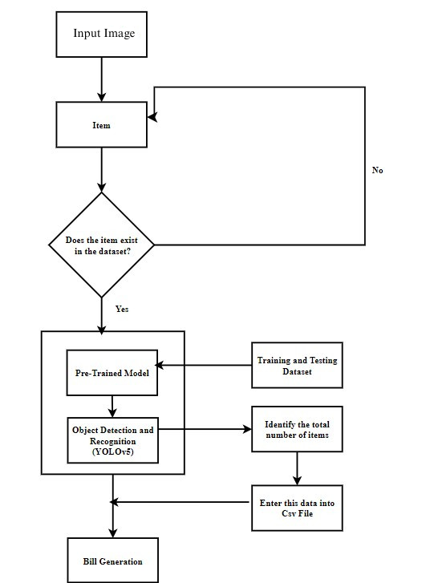
Process Flow Diagram
Process flow for generating the bill

Slide 27
ER Diagram
Name
Email
User_Id
User
Address
1
Phone_number
Product_name
has
Image_Id
Product_id
1
Items Image
has
Products
1
N
format
1
Is input to
Total amount
N
Object Detection and Recognition (YOLOv5)
generate
Bill
LastTrained
Bill_id
Training Dataset
quantity
ER Diagram for Checkout Process

Slide 28
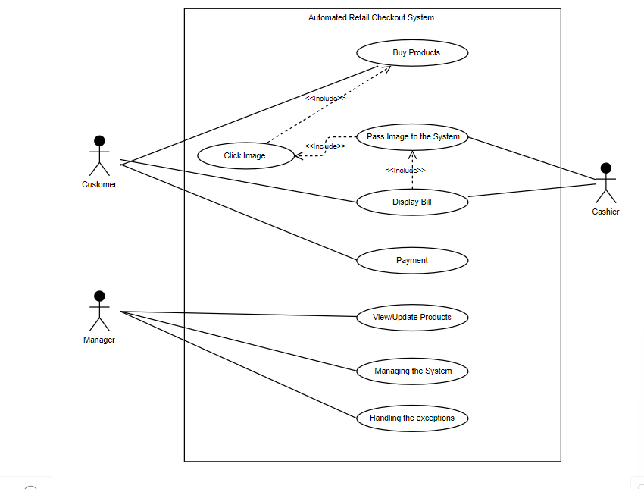
Use Case Diagram
Use Case Diagram for Checkout Process

Slide 29
DFD Diagram (0 Level )
Employee
Customer
Products
Cashier
Checkout Process
Bill
Receipt
O Level DFD of Checkout System

Slide 30
DFD Diagram (1 Level)
Buy Products
Employee
Items
Click Image
Customer
.jpeg/.png
Receipt
Pass Image to the System
Object Detection and Recognition
Dataset
Generate Bill
Cashier
Bill
1 Level DFD of Checkout System

Slide 31
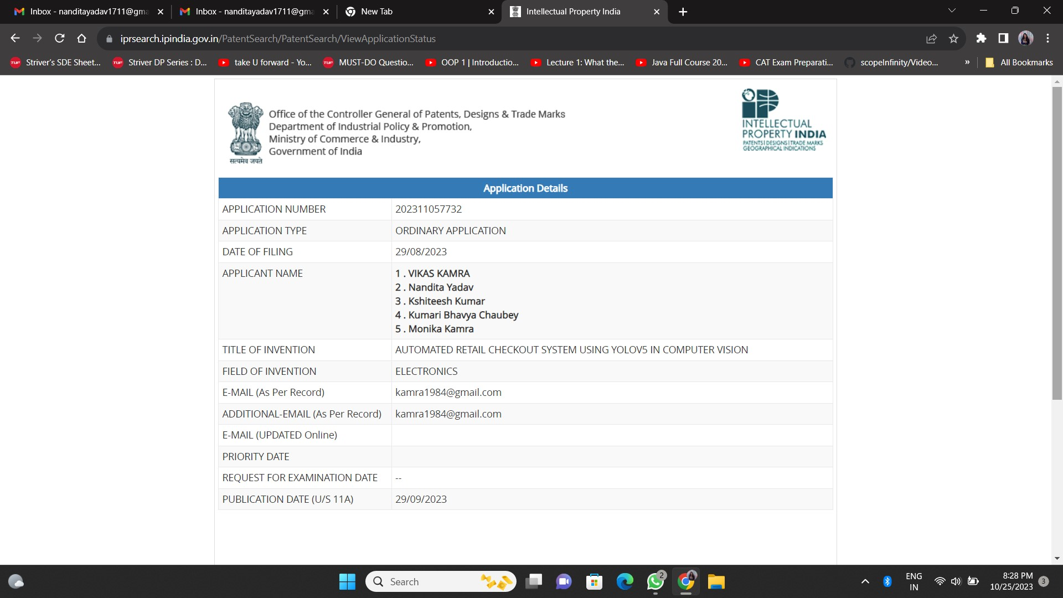
Patent Status: Published
Patent Published

Slide 32
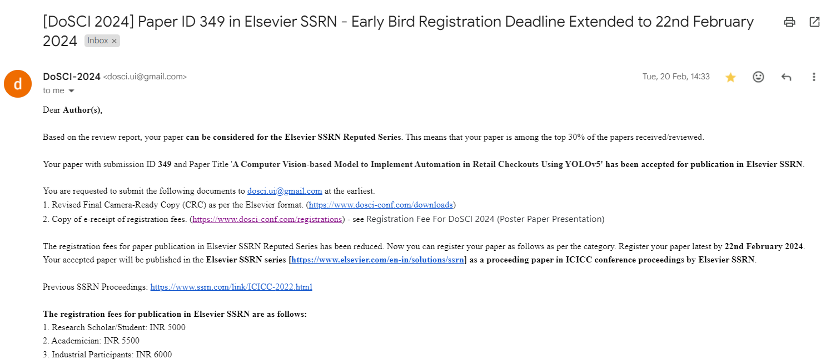
Research Paper Status
Conference: 5th Doctoral Symposium of Computational Intelligence (DoSCI-2024)
Status: Presented
Link

Slide 33
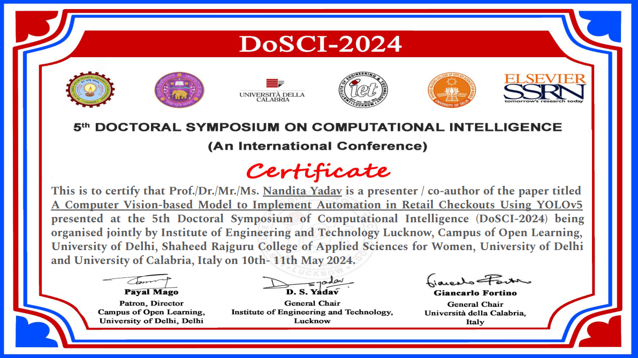
Research Paper Presentation Certificate

Slide 34
Project Status
Status: 100% completed
Link

Slide 35
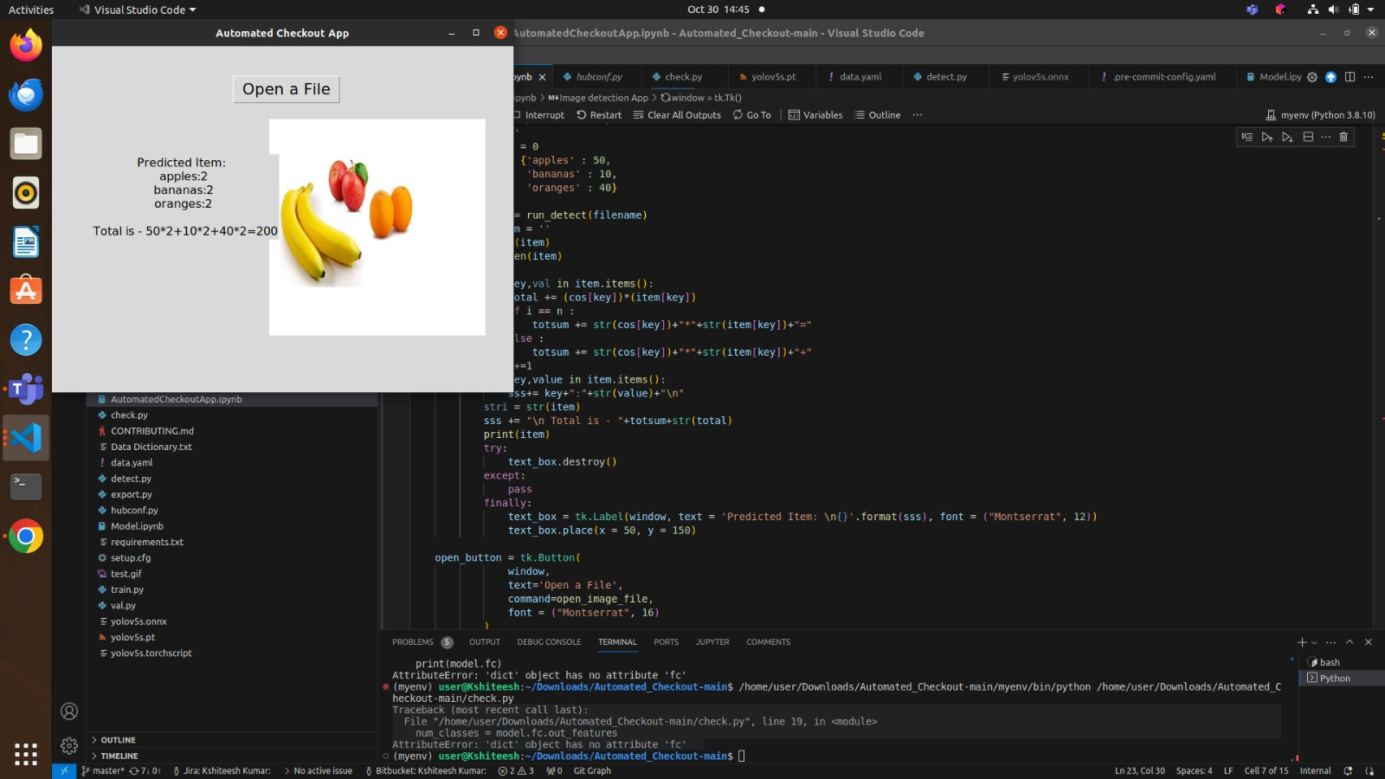

Slide 36
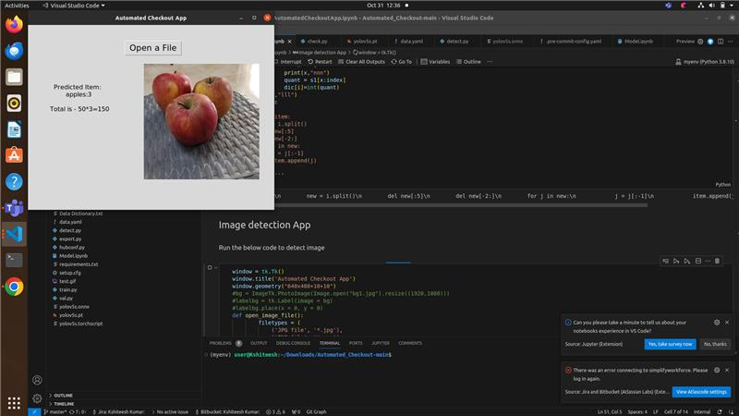

Slide 37
Documents Proof
Project Synopsis
Software Requirement Specification (SRS)
Testing Report
Project Report
Drive Link
Github Link

Slide 38
References
[1] D. A. Mora Hernandez, O. Nalbach, and D. Werth, “How computer vision provides physical retail with a better view on customers,” in Proceedings - 21st IEEE Conference on Business Informatics, CBI 2019, Institute of Electrical and Electronics Engineers Inc., Jul. 2019, pp. 462–471. doi: 10.1109/CBI.2019.00060
[2] N. Shekokar, A. Kasat, S. Jain, P. Naringrekar, and M. Shah, “Shop and go: An innovative approach towards shopping using deep learning and computer vision,” in Proceedings of the 3rd International Conference on Smart Systems and Inventive Technology, ICSSIT 2020, Institute of Electrical and Electronics Engineers Inc., Aug. 2020, pp. 1201–1206. doi: 10.1109/ICSSIT48917.2020.9214256
[3] M. A. Majdi, B. Sena Bayu Dewantara, and M. M. Bachtiar, “Product stock management using computer vision,” in IES 2020 - International Electronics Symposium: The Role of Autonomous and Intelligent Systems for Human Life and Comfort, Institute of Electrical and Electronics Engineers Inc., Sep. 2020, pp. 424–429. doi: 10.1109/IES50839.2020.9231673.
[4] S. K. Yedla, V. M. Manikandan, and V. Panchami, “Real-Time Scene Change Detection with Object Detection for Automated Stock Verification,” in ICDCS 2020 - 2020 5th International Conference on Devices, Circuits and Systems, Institute of Electrical and Electronics Engineers Inc., Mar. 2020, pp. 157–161. doi: 10.1109/ICDCS48716.2020.243571.
[5] M. Sugadev, K. Sucharitha, I. R. Sheeba, and B. Velan, “Computer vision based automated billing system for fruit stores,” in Proceedings of the 3rd International Conference on Smart Systems and Inventive Technology, ICSSIT 2020, Institute of Electrical and Electronics Engineers Inc., Aug. 2020, pp. 1337–1342. doi: 10.1109/ICSSIT48917.2020.9214101.

Slide 39
References
[6] H. Y. Putra, “Fraud detection at self checkout retail using data mining,” in 2020 International Conference on Information Technology Systems and Innovation, ICITSI 2020 - Proceedings, Institute of Electrical and Electronics Engineers Inc., Oct. 2020, pp. 211–216. doi: 10.1109/ICITSI50517.2020.9264919.
[7] Shandong da xue, Asia-Pacific Signal and Information Processing Association, and Institute of Electrical and Electronics Engineers, 2019 2nd IEEE International Conference on Information Communication and Signal Processing (ICICSP 2019) : September 28-30, 2019, Weihai, China.
[8] D. Triphena Delight and V. Karunakaran, “A Comprehensive Analysis of Methodologies used for Object Detection and Localization,” in 2021 7th International Conference on Advanced Computing and Communication Systems, ICACCS 2021, Institute of Electrical and Electronics Engineers Inc., Mar. 2021, pp. 448–453. doi: 10.1109/ICACCS51430.2021.9441916
[9] Anhui da xue et al., Proceedings of the 32nd Chinese Control and Decision Conference (CCDC 2020) : 22-24 August 2020, Hefei, China.
[10] A. Nayan, J. Saha, R. Mahmud, A. Azad and G. Kibria, “Detection of Objects from Noisy Images,” in 2020 2nd International Conference on Sustainable Technologies for Industry 4.0 (STI), 19-20 December, Dhaka app. 448–453. doi: 10.1109/ST150764.2020.935201

Slide 40
References
[11] A. Fatima, A. Kumar, A. Pratap and S. Raoof, “Object Recognition and Detection in Remote Sensing Images: A Comparative Study,” 2020 International Conference on Artificial Intelligence and Signal Processing (AISP). 6, pp. 907–951 May 2020, doi: 10.1109/AISP.2020.2878647.
[12] Y. Hu, X. Li, N. Zhou, L. Yang, L. Peng, and S. Xiao, “A Sample Update-Based Convolutional Neural Network Framework for Object Detection in Large-Area Remote Sensing Images,” IEEE Geosci. Remote Sens. Lett., vol. 16, no. 6, pp. 947–951, Jun. 2020, doi: 10.1109/LGRS.2020.2889247.
[13] T. Hendra, R. Spolaor and, Z. Chen, “ A Compound Technique for Multiple Objects Detection Based on Markov Clustering Networks and Viola-Jones Algorithm ” 2019 2nd IEEE International Conference on Information Communication and Signal Processing: September 28-30, 2019, Weihai, China.
[14] Y. Lu, L. Zhang, W. Xi, “YOLO-compact: An Efficient YOLO Network for Single Category Real-time Object Detection,” in 2020 10th International Conference on Advanced Computing and Communication Systems, ICACCS 2021, Institute of Electrical and Electronics Engineers Inc., Mar. 2021, pp. 448–453. doi: 10.1109/ICACCS51430.2021.9441916
[15] J. Redmon, S. Divvala, R. Girshick, and A. Farhad, “You Only Look Once: Unified, Real-Time Object Detection,” in 2016 International Conference on Information Technology Systems and Innovation, ICITSI 2020 - Proceedings, Institute of Electrical and Electronics Engineers Inc., May. 2016, pp. 211–216. doi: 10.1109/ICITSI50517.2020.9264919.

Slide 41
Thank You

