Slide 1

DEVELOPMENT AND IMPLEMENTATION OF AN INTEGRATED WEB BASED OFFICE DOCUMENT MANAGEMENT SYSTEM
By Sakshi Gupta Saket Tiwari Aryan Tiwari Ashutosh Giri
Our mentor : Akash Goel

Slide 2
Project Abstract
Overview
The "Development and Implementation of an Integrated Web-Based Office Document Management System" aims to create a streamlined solution for managing and accessing office documents. Traditional document management practices often involve scattered storage systems, limited access controls, and lack of version management, leading to inefficiencies in collaborative workflows and document retrieval. By developing an integrated web-based system, this project seeks to centralize document storage, enhance accessibility, and enable seamless document sharing across office environments.

Slide 3
Project Abstract
Key Objective
The primary objective of this project is to design and implement a user-friendly, secure, and centralized platform that supports efficient document management processes. The system will facilitate document uploading, categorization, version tracking, searchability, and secure access control for various departments within an organization. Additionally, it will support role-based access to enhance security and allow seamless collaboration among teams. Overall, this solution intends to improve productivity, data integrity, and information-sharing practices in office environments.

Slide 4
Project Abstract
Approach
The project follows a modular development approach, beginning with a requirement analysis phase to understand the document management needs specific to office environments. Based on these requirements, the system architecture is designed to support scalability, flexibility, and security. The system is implemented using modern web technologies and frameworks, ensuring compatibility across different devices and operating systems. A database system will store document metadata, and access control will be enforced through a secure, role-based system. User feedback is iteratively integrated to refine system functionality, and extensive testing ensures reliability and usability. The final product is a robust, integrated document management solution adaptable to a variety of office settings.

Slide 5

Project Goals and Objectives
Centralized Document Storage
Create a centralized repository where all office documents can be securely stored, organized, and accessed.
1
2
Improved Collaboration
Facilitate seamless collaboration among employees by providing tools for document sharing, version control, and real-time updates.
Enhanced Security
Implement secure control mechanisms to ensure that sensitive documents are protected, and only authorized users can access or modify them.
3

Slide 6
Project Goals and Objectives
Document Upload and Categorization:
Allow users to upload documents, assign appropriate categories, and maintain a well-organized repository for
easy retrieval.
4
5
Document Search and Retrieval
Develop an efficient search algorithm that can filter documents based on content, metadata, and tags to enhance document retrieval.
Audit and Activity Tracking
Implement an activity log to track document access, edits, and user interactions for accountability and transparency
5

Slide 7
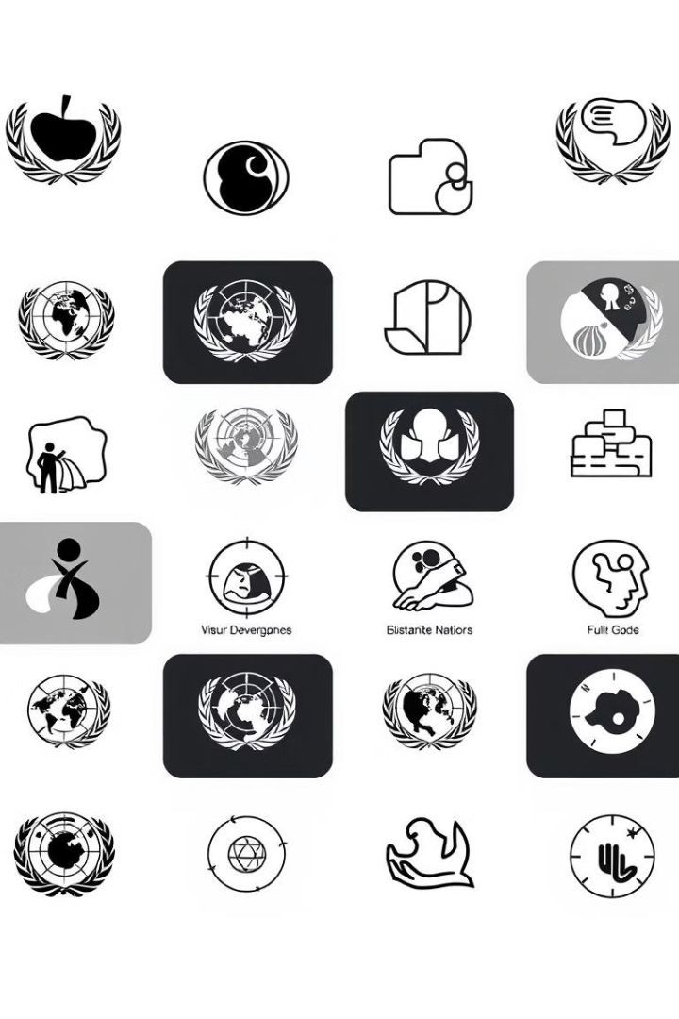
Alignment with UN Sustainable Development Goals (SDGs)
SDG 9 –
Industry, Innovation, and Infrastructure
This project supports SDG 9 by creating a robust digital infrastructure for document management, fostering innovation in workplace efficiency, and enhancing operational productivity through technology. By digitizing and centralizing documents, it reduces reliance on paper, minimizes waste, and promotes a more sustainable approach to office resource management.

Slide 8


Methodology and Approach
Requirement Analysis
Gather requirements through surveys and interviews to identify key features like document categorization, version control, and integration needs
System Design and Architecture
Design a three-tier, modular architecture for scalability and efficient maintenance, separating the UI, business logic, and data storage layers.
Agile Development
Use Agile methodology to develop features in iterative sprints, allowing for continuous feedback and incremental improvements.
User Interface (UI) and User Experience (UX) Design
Develop a user-friendly, responsive interface with intuitive navigation, ensuring accessibility across devices for a seamless user experience.

Slide 9
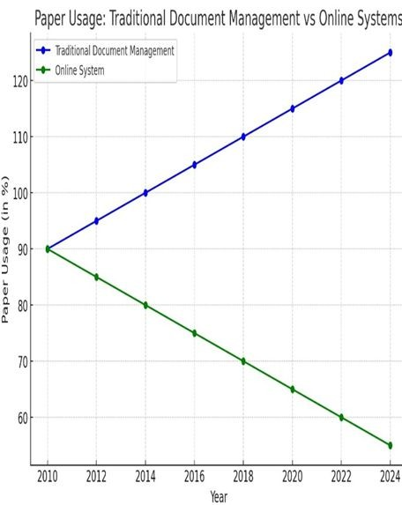
Expected Outcomes and Impact
Improved Document Management Efficiency:
The system will provide centralized storage, streamlined categorization, and efficient search capabilities, significantly reducing time spent locating and managing documents.

Slide 10
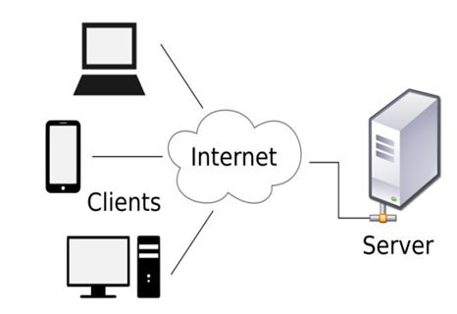
Expected Outcomes and Impact
Increased Security and Compliance:
Role-based access control and robust security features will protect sensitive information, ensuring compliance with data protection standards and organizational policies.

Slide 11
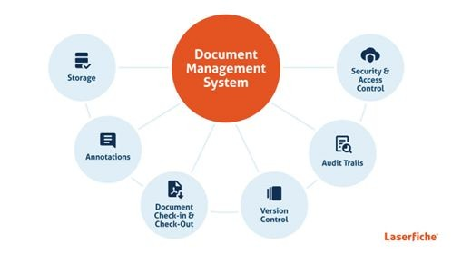
Expected Outcomes and Impact
Reduced Environmental Impact:
By digitizing documents, the system minimizes paper usage, contributing to a reduction in office waste and supporting sustainable practices aligned with SDG goals.

Slide 12
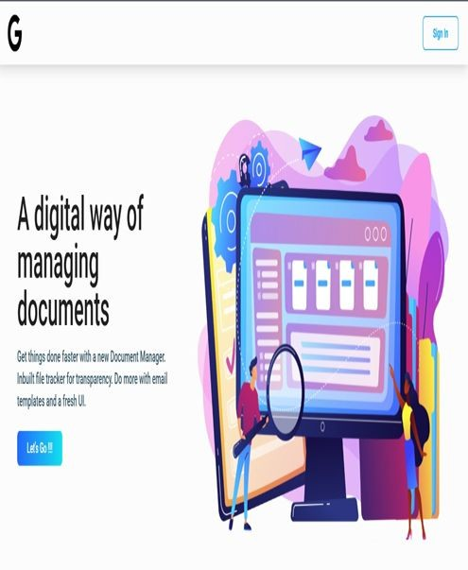
Expected Outcomes and Impact
Cost Savings:
Reduced reliance on physical storage and streamlined workflows will result in long-term cost savings related to storage, resource management, and administrative tasks.

Slide 13
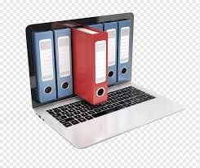
Key Project Deliverables
Unified Document
Storage System
A centralized, secure storage repository
that organizes and categorizes
documents, ensuring they are easy to
access, retrieve, and store within the system.
Document Tracking and
Management Module:
A module that includes features for
document version control, activity tracking, and status updates, allowing
users to monitor changes and manage
documents efficiently

Slide 14

Key Project Deliverables
User-Friendly
Interface Design
An intuitive and easily navigable UI
designed to cater to users of varying
technical skills, complete with clear
labels, simple forms, and accessible menus.
Interactive Dashboard
A customizable dashboard providing
real-time insights into document
activity, system metrics, and user
interactions, helping users monitor
workflows and access key information
at a glance.

Slide 15
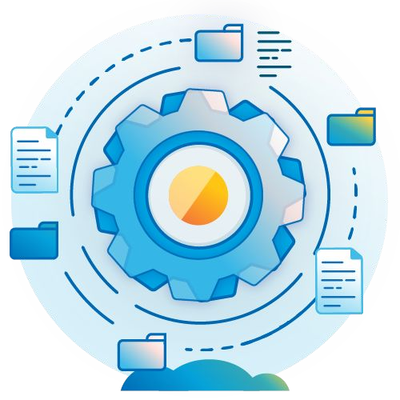
Conclusion
This project aims to create an efficient, secure, and
user-friendly web-based document management system that will centralize document storage, streamline tracking, and improve accessibility through an intuitive interface and interactive dashboard. With robust security, ease of use, and scalability as core principles, the system will foster a more organized, productive, and environmentally sustainable approach to document management.
Implementing this solution will not only meet current organizational needs but also support long-term growth and adaptation.

