Slide 1


KIET School of Engineering & Technology, Ghaziabad
Department of Computer Science
Major Project Presentation
BLOCKCHAIN BASED VOTING SYSTEM
Group Number:
ABHISHEK GUPTA (2100290120006)
AYUSHI CHAUHAN (2100290120063)
ABHAS CHAUDHARI (2100290120004)
ARAMBH TRAYAMBAK (2100290120044)
Guide name :
MS. SHREELA PAREEK

Slide 2
Major Project presentation
Table of Content
Problem statement
Objectives
Literature Review
Technology used
Methodology
Implementation
Result
Conclusion
References

Slide 3
Major Project presentation
Problem Statement
The current voting systems suffer from several drawbacks, including but not limited to:
Vulnerability to manipulation and fraud.
Lack of transparency in the vote counting process.
Inefficiencies in the tallying and result declaration process.
Limited accessibility for remote or disabled voters.
Developing a blockchain-based voting system can mitigate these issues by providing a secure, transparent, and efficient platform for conducting elections.

Slide 4
Major Project presentation
Objectives
The primary objective of this project is to design and implement a blockchain-based voting system that addresses the shortcomings of traditional voting systems. The system aims to provide :
Enhanced security through the use of blockchain technology.
Transparency in the voting and vote-counting process.
Efficiency in tallying and declaring election results.
Accessibility for remote or disabled voters.

Slide 5
Major Project presentation
Technology used
Solidity
Ethereum Blockchain
Encryption Algorithms
Blockchain
Web3
Node.js
Express.js
CORS(Cross-Origin)
HTML/CSS
JavaScript

Slide 6
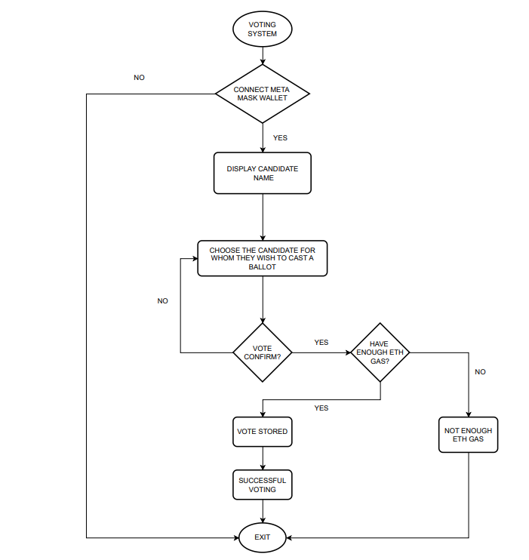
Major Project presentation
Methodology

Slide 7
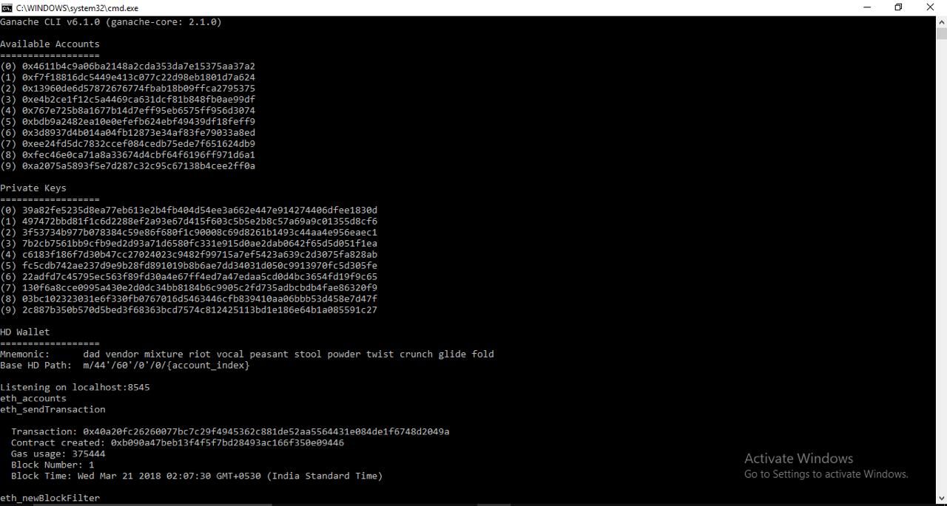
Major Project presentation
Implementation

Slide 8
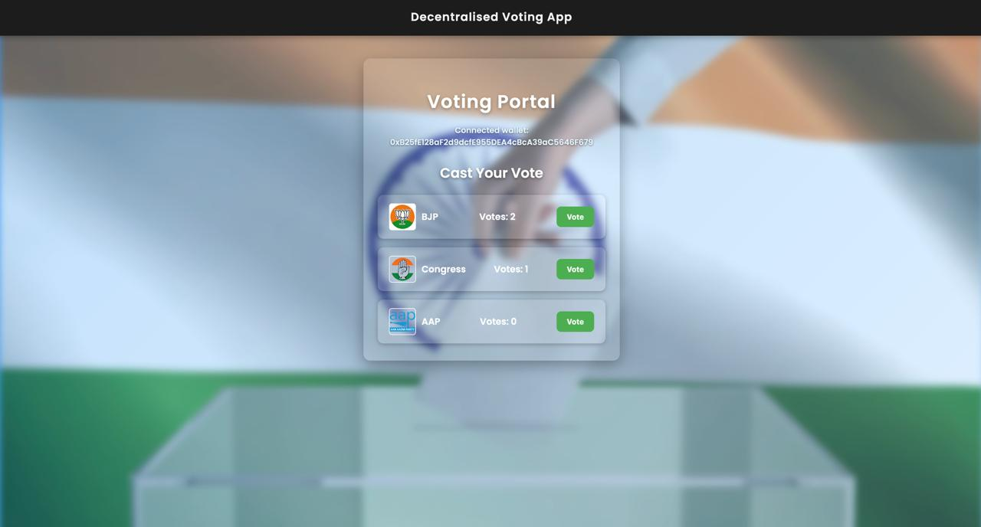
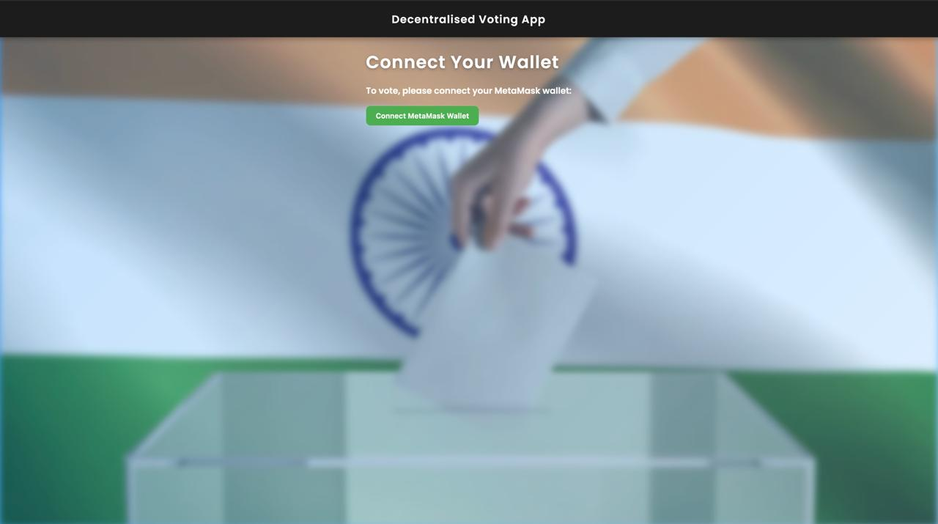
Major Project presentation

Slide 9
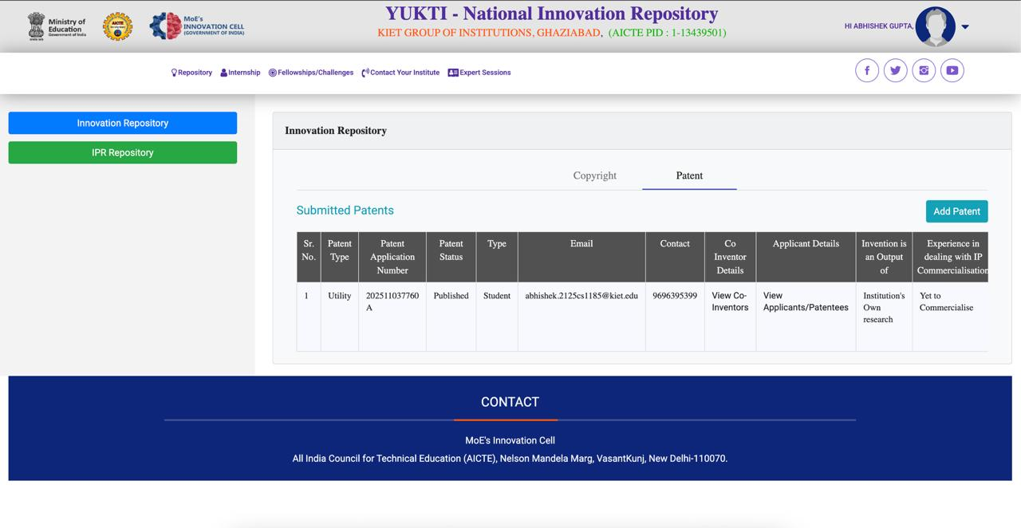
Major Project presentation
Yukti Portal Proof:

Slide 10
Major Project presentation
Conclusion
The blockchain-based voting system presented in this project demonstrates the potential of blockchain technology to revolutionize the voting process.
By leveraging the security and transparency of the Ethereum blockchain, the system ensures the integrity of the election process while providing a user-friendly interface for voters.
One of the key strengths of the system is its ability to securely store and tally votes using smart contracts.
The use of encryption algorithms ensures the confidentiality of votes, while the blockchain's immutability guarantees that the voting data cannot be tampered with.
Overall, the blockchain-based voting system offers a secure, transparent, and efficient solution for conducting elections. With further development and implementation, this technology has the potential to transform the way elections are conducted, ensuring trust and integrity in the democratic process.

Slide 11


Major Project presentation
Alignment with UN Sustainable Development Goals (SDG)
Blockchain-based voting systems enhance transparency, security, and efficiency, supporting sustainable development by fostering innovation in infrastructure, ensuring trust in electoral processes, and reducing corruption in governance.
Blockchain-based voting systems can strengthen sustainable cities by promoting transparent, secure, and inclusive electoral processes, fostering civic participation, and enhancing community trust in local governance and decision-making.

Slide 12
Major Project presentation
Thank You

