Slide 1




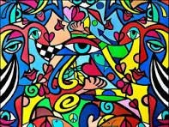
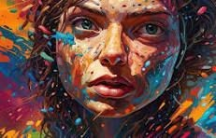
MAJOR PROJECT :-
NFT E -COMMERCE WEBSITE FOR DIGITAL ART

Slide 2

NFT ARTHUB TEAM MEMBERS:-
ANKIT KUMAR MISHRA :-TEAM LEAD ANIKET SINGH
AYUSH MISHRA ANNU
GUIDE:-D.R. HARSH KHATTER

Slide 3
PROBLEM STATEMENT
In the realm of digital art, there exists a significant barrier for artists to monetize their creations in a secure and decentralized manner.
Traditional online marketplaces lack the infrastructure to authenticate and protect the ownership of digital artworks, leading to issues of copyright infringement and the inability for artists to receive fair compensation for their work.
Moreover, the absence of a dedicated platform for trading digital art as Non-Fungible Tokens (NFTs) results in a fragmented market with limited accessibility for both creators and collectors.
Existing NFT marketplaces often suffer from issues such as high transaction fees, limited discoverability for emerging artists, lack of curation, and inadequate tools for artists to manage their portfolios effectively. This inhibits the growth and sustainability of the digital art ecosystem, hindering artists' ability to monetize their work and connect with their audience
There is an urgent need for a novel digital art marketplace, providing a trusted and transparent environment for artists to tokenize their creations, establish ownership rights, and engage with a global community of art enthusiasts.

Slide 4
PROBLEMS TO BE SOLVED
Monetization Struggles for Digital Artists:
Artists face challenges in monetizing their digital creations due to piracy and unauthorized distribution.
Lack of a standardized provenance system diminishes the perceived value and resale potential of digital artworks.
2. Limitations of Centralized E-commerce Platforms:
Current platforms impose high fees on artists, creating financial barriers to entry.
Artists experience delayed payments and have limited control over their intellectual property.
3. Buyer Trust Issues in the Marketplace:
Buyers struggle to verify the authenticity and rarity of digital art pieces, leading to trust concerns.
Lack of transparency in transactions further exacerbates trust issues within the marketplace.
4. Revolutionizing the Digital Art Market with "Decentralized Canvas":
Proposal for a decentralized NFT-based e-commerce platform to address existing challenges.
Utilizing blockchain technology and smart contracts for secure, transparent, and fair transactions.
5. Empowering Artists and Enhancing Trust:
Implementation of automated royalty payments through smart contracts to incentivize artists.
Aim to eliminate unauthorized duplication, fostering a transparent and trustworthy digital art marketplace

Slide 5
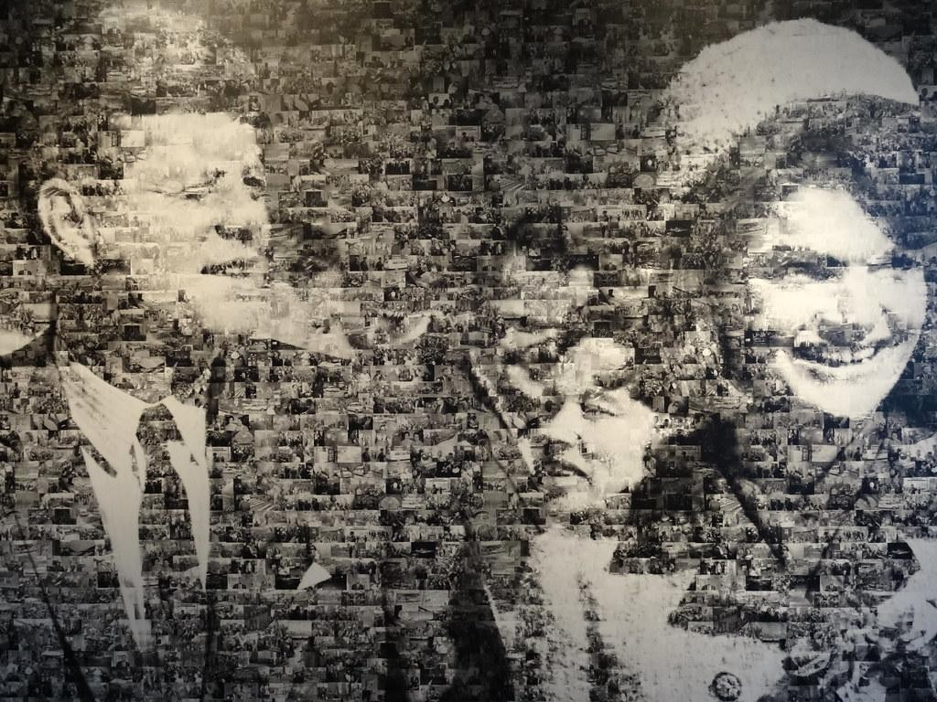
BACKGROUND
"The Digital Art Revolution
Rise of Digital Art:
"Digital art has transcended boundaries, gaining prominence as a vibrant and expressive medium."
Democratization of Creativity:
"Artists worldwide are empowered to create, share, and thrive in a borderless digital landscape."
Transformation of the Art Market:
"Witness the metamorphosis of the traditional art market as it embraces the limitless possibilities offered by the digital realm."
ArtNFT Marketplace’s Impact:
"ArtNFT Marketplace serves as a catalyst, bridging the traditional and digital art worlds, empowering artists to reach a global audience."

Slide 6
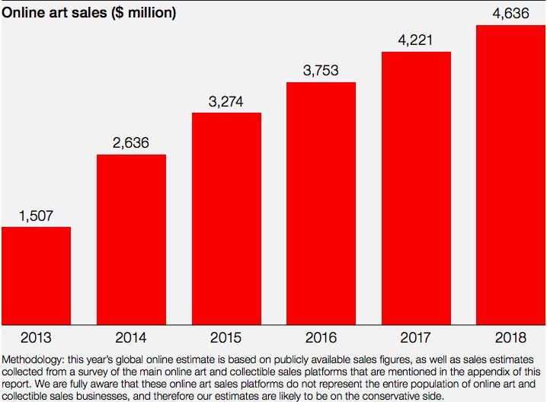
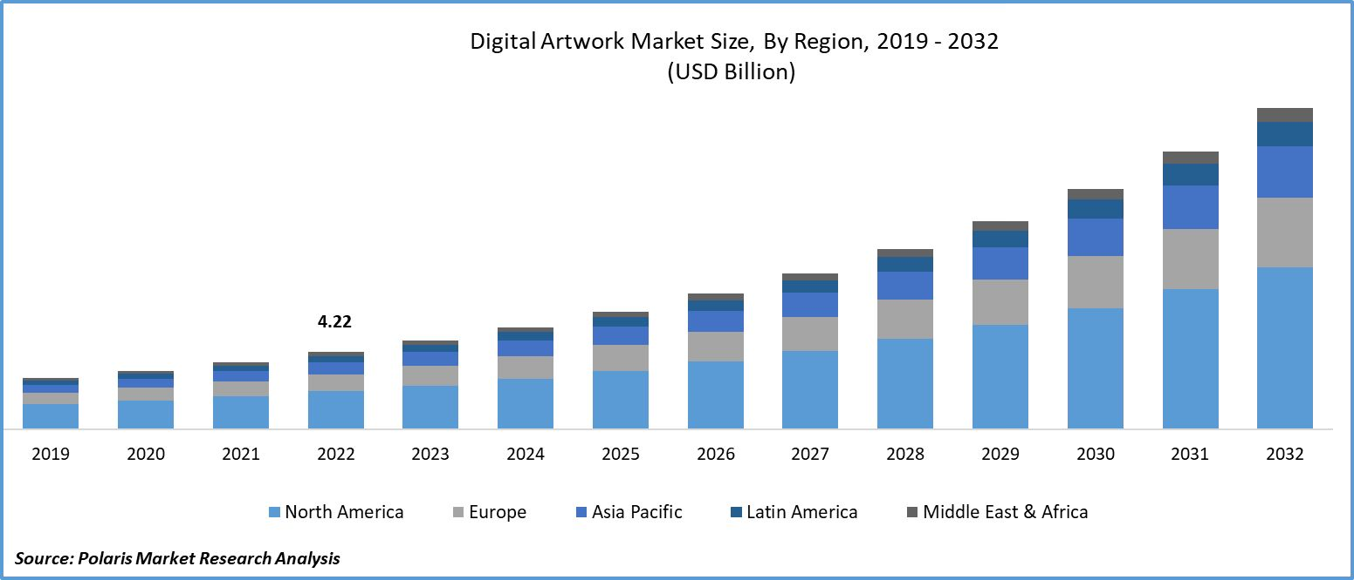
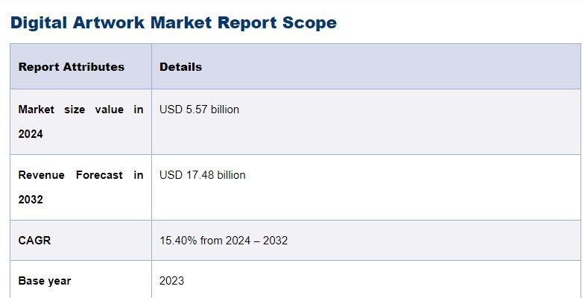

Slide 7
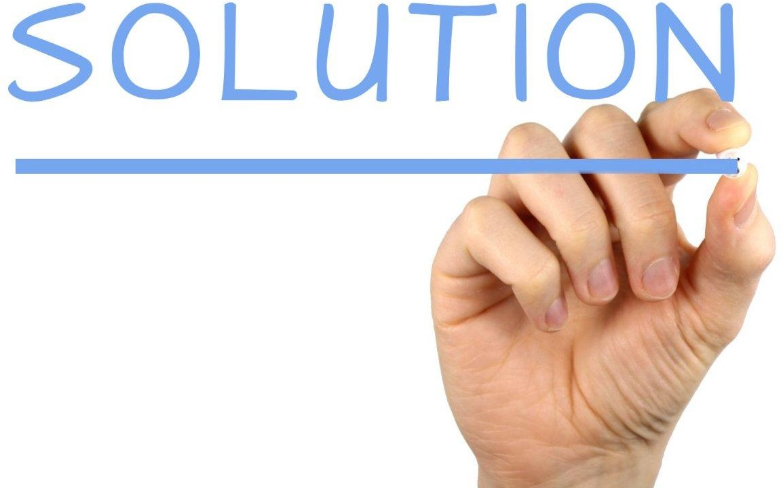
OUR PLATFORM:- NFT ARTHUB
"Empowering Artists, Connecting Collectors, Ensuring
Security"

Slide 8
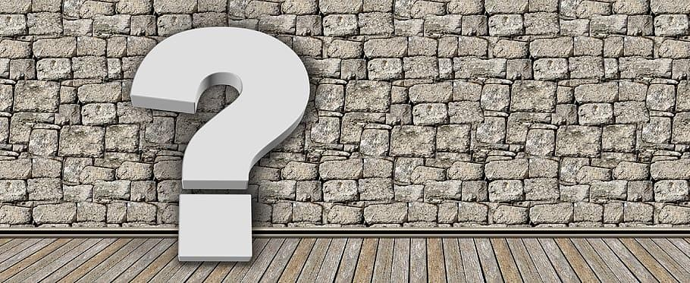
Introduction
Welcome to the future of art commerce!"
Welcome to ArtNFT Marketplace, where cutting-edge technology meets artistic innovation."
"Explore the next frontier of digital art ownership, connecting artists directly with a global community of collectors."
"Our platform prioritizes security, ensuring safe and authenticated transactions ."

Slide 9

OBJECTIVES
OBJECTIVES:
Empower Artists: Provide global exposure and fair monetization for
emerging talents through a transparent platform.
Revolutionize Art Market: Disrupt traditional models with secure, transparent blockchain transactions for buying, selling, and trading digital art.
User-Friendly Interface: Develop an intuitive platform for artists and buyers, enhancing the overall experience of discovering, owning, and trading digital art.
Global Reach: Break down geographical barriers, connecting artists with a diverse international audience.

Slide 10
OBJECTIVES:
Community Building: Foster collaboration and networking among artists, collectors, and enthusiasts through engaging features.
Security and Transparency: Implement blockchain for secure and transparent transactions, addressing concerns related to authenticity and provenance.
Continuous Innovation: Stay at the forefront of technology and market trends, adapting to evolving preferences in the digital art space.
Democratize Art Industry: Contribute to the decentralization of the art industry, creating a sustainable and trustworthy ecosystem for creators worldwide.

Slide 11

NFT ARTHUB
"Empowering Artists, Connecting Collectors, Ensuring Security"
FEATURES:
User-Friendly Interface:
"Intuitive design for seamless navigation and user-friendly experience."
Secure NFT Transactions:
"Built on robust blockchain technology, ArtNFTHub ensures secure and tamper-proof NFT transactions, prioritizing the integrity of each digital art piece."
Global Artist Exposure:
"Artists gain unparalleled exposure to a worldwide audience, fostering a diverse and inclusive art community.

Slide 12
"Empowering Artists, Connecting Collectors, Ensuring Security"
Digital Ownership: NFTs provide true ownership of digital assets.
Proven Scarcity: Limited supply makes NFTs desirable. Global Accessibility: Accessible to a worldwide audience.
Immutable Ownership: Ownership records are tamper-proof.
Smart Contracts: Automate processes like royalty payments,

Slide 13




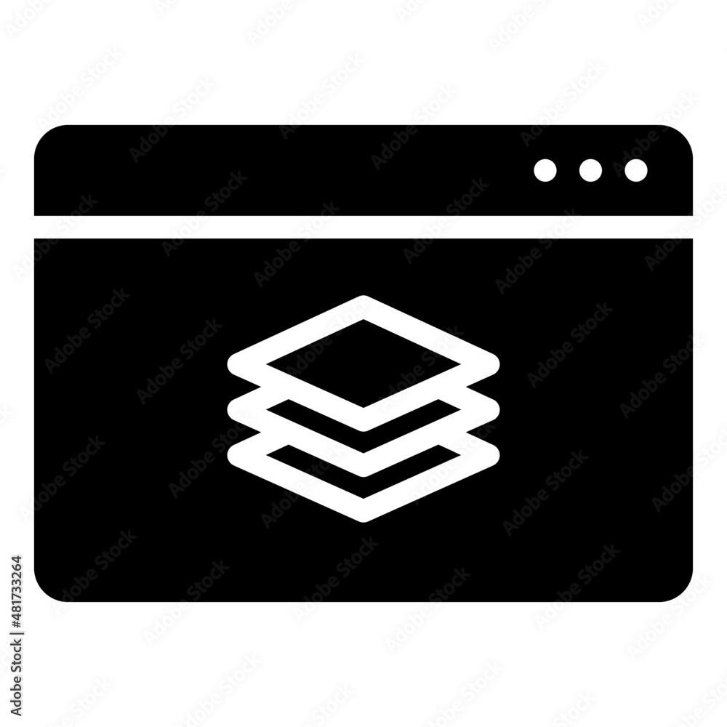
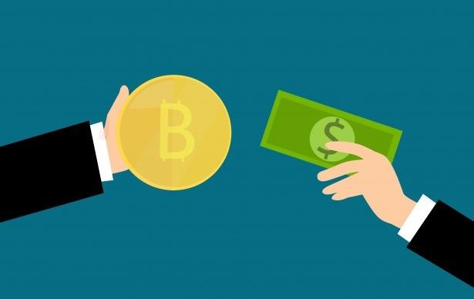
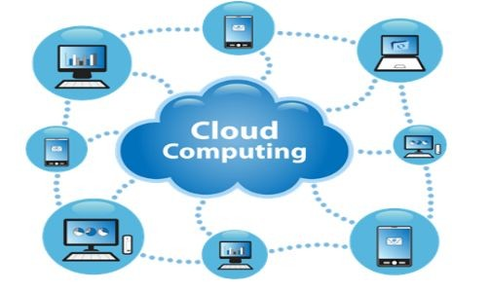


Tech Proficiency of member
ANKIT kumar mishra
Front-end+
Cloud
ANNU
Database Mangaemet and Security
-Compliance
ANIKET SINGH
Full Stack
AYUSH MISHRA
Block-chain
and etherum platform

Slide 14

Flow of work
NFT Creation and Ownership:
Artists upload digital creations, triggering unique NFT creation through smart contracts.
Smart contracts ensure authenticity, provenance, and immutable ownership records.
Blockchain as a Decentralized Ledger:
Blockchain serves as a transparent ledger, recording NFT transactions and ownership changes.
Cryptographically signed transactions provide a tamper-proof audit trail.
Transaction Initiation:
Backend server initiates a secure blockchain transaction for NFT ownership transfer.
Smart contracts execute ownership transfer functions.
Ownership Transfer:
NFT purchases initiate blockchain transactions for secure and transparent ownership transfers.
Smart contracts automatically update ownership records reliably.

Slide 15
Decentralized Storage for Metadata:
Metadata (title, description, image URLs) stored in decentralized solutions linked to the blockchain.
Ensures accessible, veriﬁable, and censorship-resistant metadata, enhancing transparency.
Data Integrity and Security:
Blockchain employs cryptographic hashing and consensus mechanisms for secure NFT data.
Transactions are cryptographically secured, establishing a tamper-proof and trustless art commerce environment.
Royalty Payments and Smart Contracts:
Smart contracts within NFTs include royalty payment mechanisms.
Artists receive fair compensation through automatic enforcement of royalty agreements during resales.

Slide 16

Challenges
Key Challenges:
Scalability:
"Addressing the need for scalable infrastructure to accommodate a growing community of artists and collectors."
Regulatory Landscape:
"Navigating the evolving regulatory environment surrounding NFTs and digital assets."
Educating the Community:
"Ensuring artists and collectors are well-informed about the beneﬁts and risks of NFTs."
Environmental Concerns:
"Mitigating the environmental impact of blockchain technology, exploring sustainable solutions."
User Security:
"Enhancing user security measures to protect against potential cyber threats and ensure a safe platform."

Slide 17
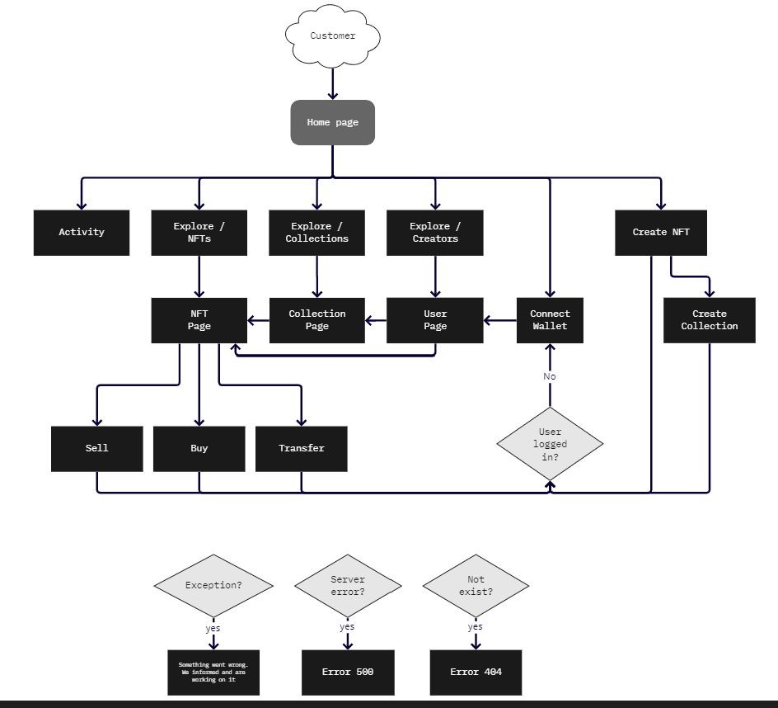
Schematic Diagram for User interface

Slide 18
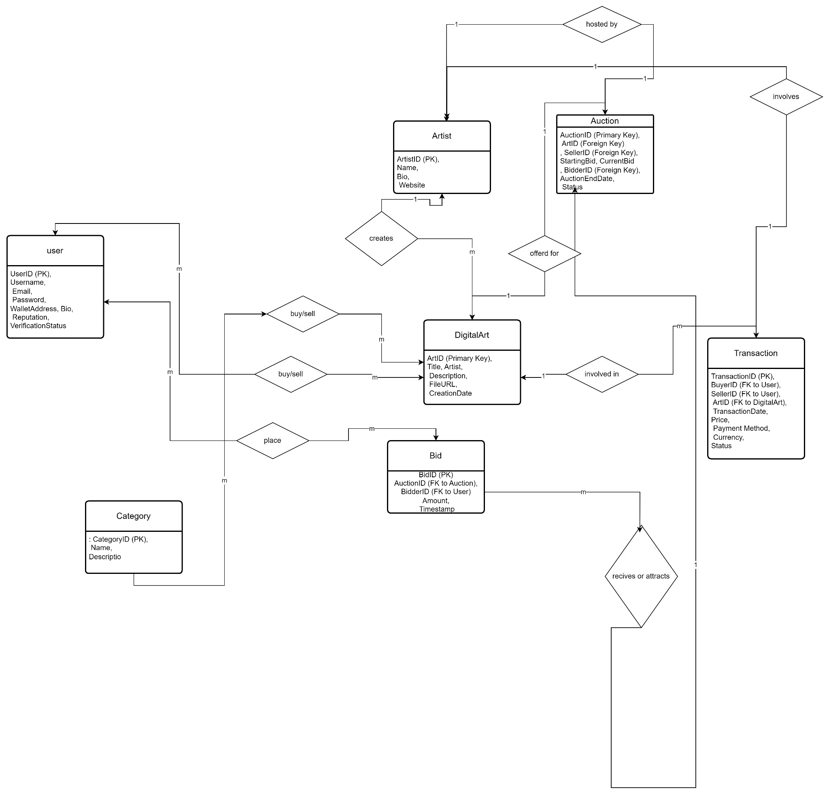
ER DIAGRAM

Slide 19



Roadmap
Q1
Q2
Q3
Q4
Task -1
Project Selection and creating a schematic prototype
Task - 2
Working on Frontend part and User Interface (Yet Worked Now).
Task - 3
Backend Part and Storage Platforms, DB Implementation using Frameworks as Node, React, MongoDB etc.
Task - 4
Work on Blockchain components, NFT marketplace, smart contracts, Ethereum and web3.

Slide 20


