Slide 1


Heritage Identification Of Monuments Through Deep Learning Techniques
KIET Group of Institutions, Ghaziabad
(Certified & ‘A+’ Grade accredited Institution by NAAC)
Guide Name: Dr. Rishabh
1. Shivam Kumar (2100290120156)
2. Vipin Chauhan(2100290120191)
3. Ujjwal Sharma(2100290120178)
4. Sukriti (2100290120166)

Slide 2
Problem Statement
TO IDENTIFY THE MONUMENTS FROM DYNAMIC IMAGES USING DEEP LEARNING AND INTEGRATION OF INTERPRETABILITY FOR THE PREDICTED OUTCOMES.

Slide 3
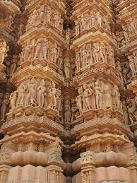
Project Goals and Objectives
Automate Heritage Identification: Develop a deep learning model capable of automatically identifying and classifying monuments and heritage sites from images.
Enhance Accuracy: Improve the accuracy and reliability of heritage site recognition by training the model on diverse and extensive datasets.
Facilitate Preservation Efforts: Support historians, archaeologists, and conservationists in preserving cultural heritage by providing a tool that quickly and accurately identifies at-risk sites.
Create a User-Friendly Interface: Implement a user-friendly interface using Streamlit to make the technology accessible to non-experts, allowing for broader use in heritage conservation.
Promote Digital Documentation: Contribute to the digital archiving of cultural heritage by enabling the creation of detailed and accurate records of identified sites.
Minimize Manual Effort: Reduce the manual effort required in heritage identification, freeing up resources for other preservation activities.
Encourage Public Engagement: Increase public awareness and engagement in cultural heritage preservation by providing accessible tools and information.

Slide 4
SDG Goals
SDG 11: Sustainable Cities and Communities
By preserving cultural heritage, this project supports the protection of world heritage sites, contributing to sustainable cities and communities.
SDG 9: Industry, Innovation, and Infrastructure
Utilizing advanced deep learning technology, the project encourages innovation in heritage preservation and infrastructure for cultural conservation.
SDG 17: Partnerships for the Goals
This project can foster collaboration among cultural organizations, educational institutions, and promoting global partnerships for heritage preservation.
SDG 8: Decent Work and Economic Growth
By promoting heritage tourism, the project supports local economies, generating opportunities in cultural tourism and conservation jobs.

Slide 5
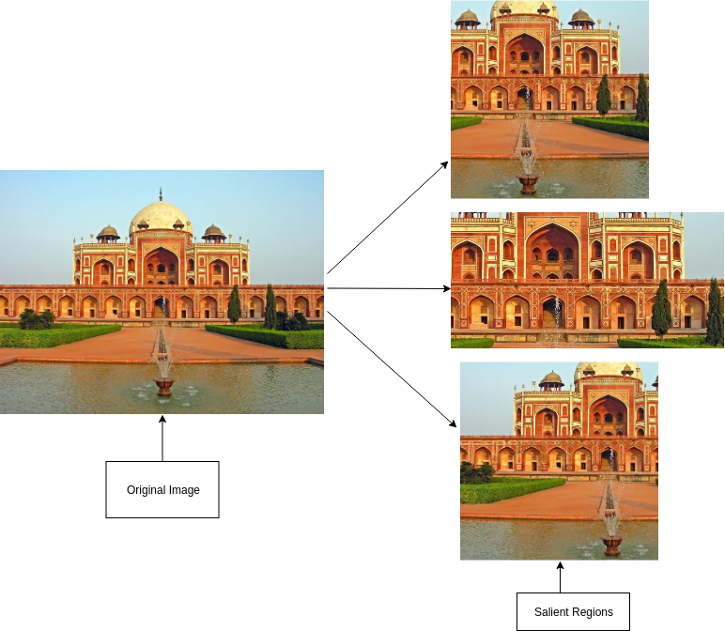
Technology Used
Python
TensorFlow
Python libraries: OpenCV, matplotlib, GeoPy
CNN
Kaggle Dataset
Streamlit
LabelImg

Slide 6
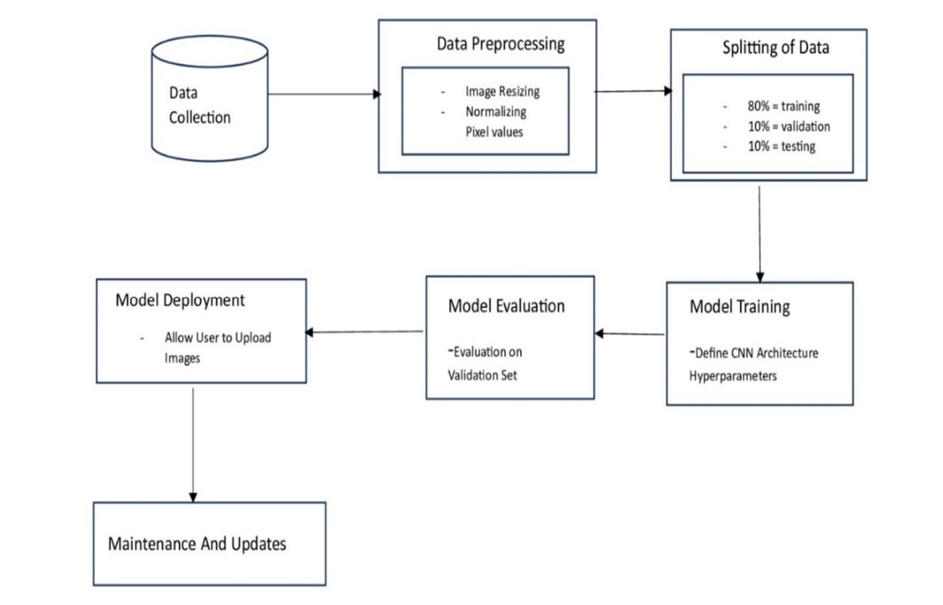
Workflow Diagram

Slide 7
Methodology
Data Collection Collected images of various Indian heritage monuments from open datasets and online sources.
Data Annotation Labeled images using LabelImg to mark regions of interest and assign class labels to each monument.
Preprocessing Resized and normalized images to ensure consistency for model training.
Model Development Trained a Convolutional Neural Network (CNN) using TensorFlow/Keras to classify the monuments based
on image features.
Model Optimization Applied transfer learning and tuning techniques to improve accuracy and reduce computational load.
Interface Development Built a Streamlit web application that allows users to upload images and get real-time monument identification.
Deployment (Local) Integrated the trained model into the Streamlit app for seamless offline/localhost use.

Slide 8
Expected Outcomes
Accurate Monument Classification The model will accurately identify and classify Indian heritage monuments using deep learning, ensuring high precision through transfer learning and CNN-based architectures.
User-Friendly Web Interface A fully functional web application built with Streamlit, enabling users to upload monument images and receive classification results with visual explanations (e.g., bounding boxes, labels).
Dataset with Labeled Annotations A curated and labeled dataset of Indian monuments using LabelImg, which can be reused or extended by future researchers or institutions.
Preservation of Cultural Heritage By automating monument identification, this project contributes to digital preservation efforts and helps in cataloging lesser-known heritage sites.

Slide 9
Literature Survey
Title: "Deep Learning for Classification and Restoration of Historical Photographs"
Authors: A. Gebru, D. Gordon, M. Li, L. Carin
Title: "Heritage Image Classification Using Convolutional Neural Networks"
Authors: A. Ali, M. M. Hussain, M. H. A. Khan, S. A. Madani

Slide 10
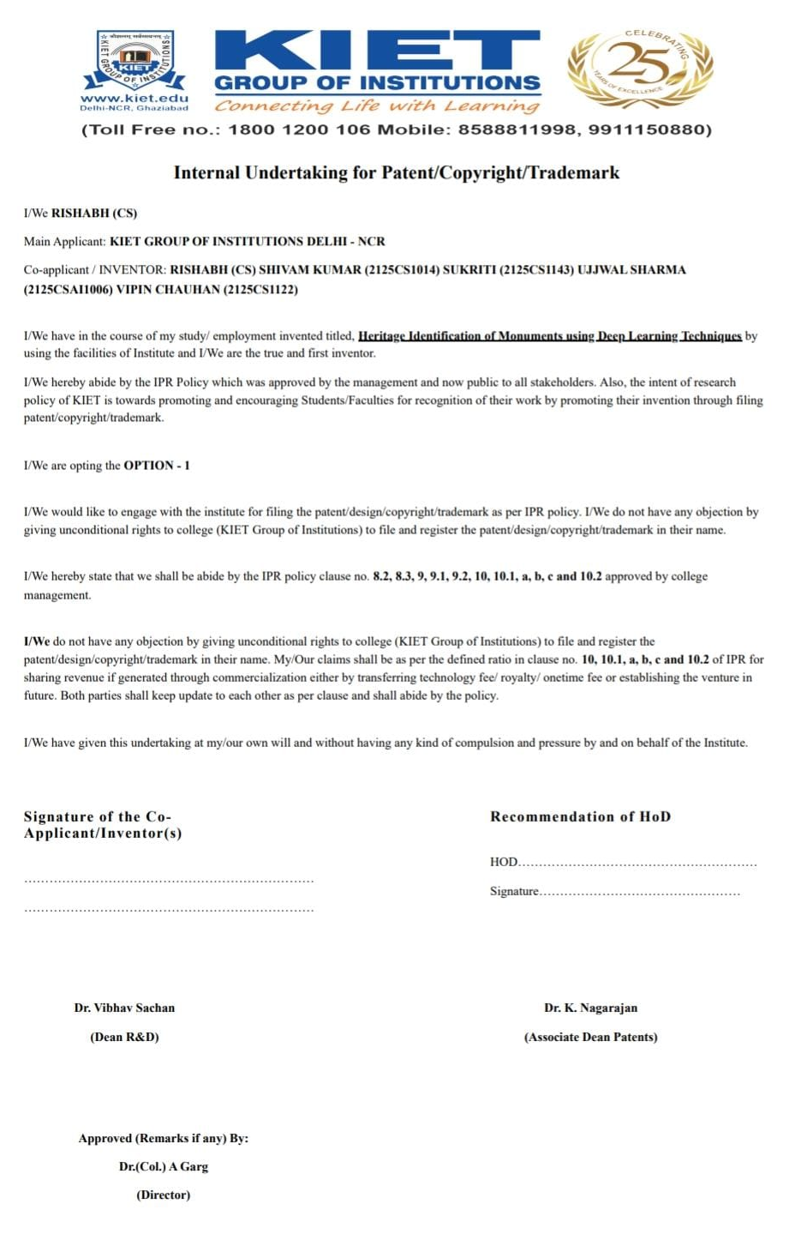
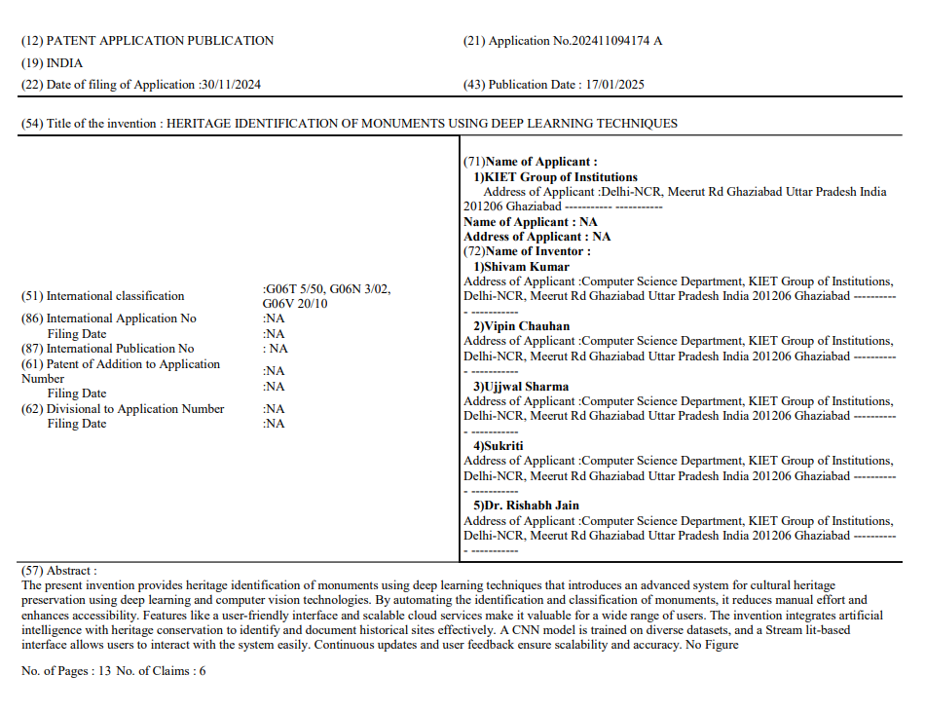
Patent Status
Published

Slide 11
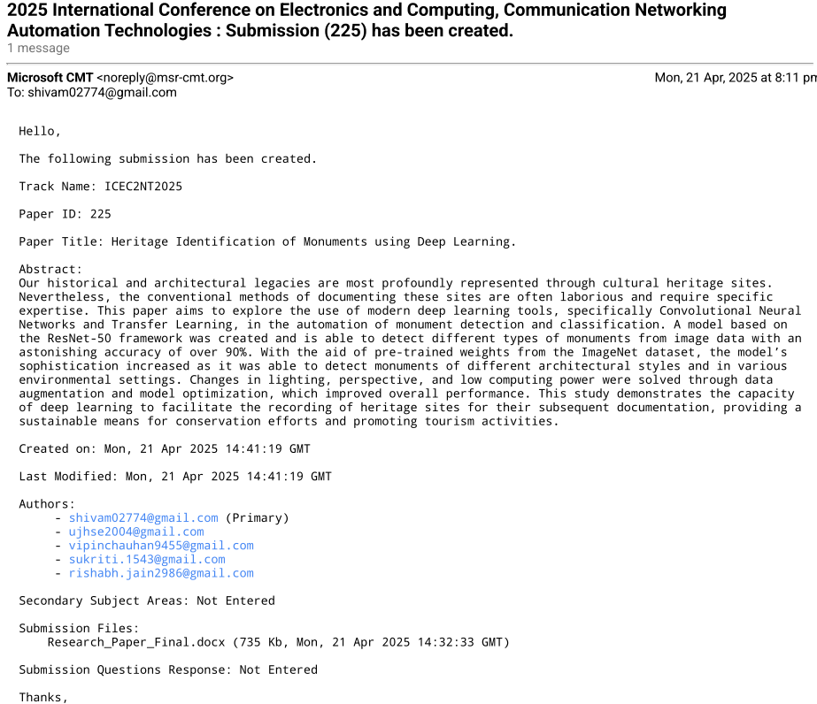
Research Paper Status
Submitted

Slide 12
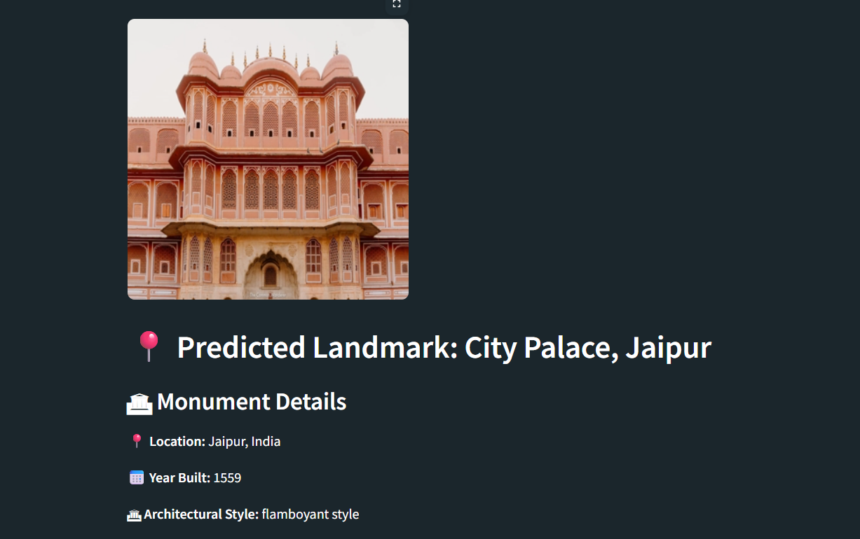
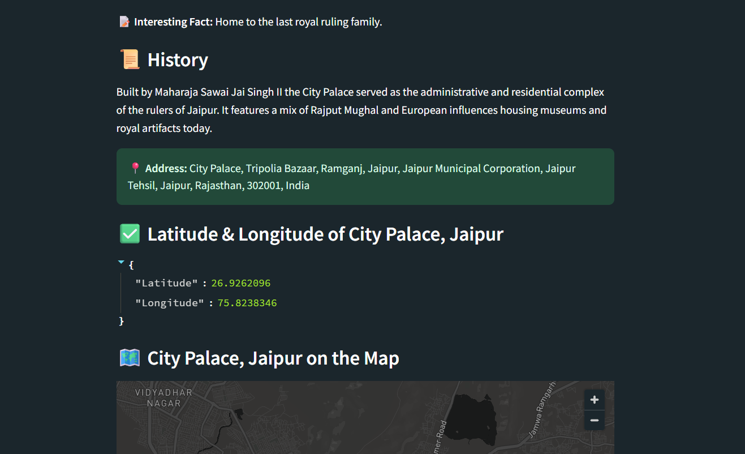
Project Status
Completed

Slide 13
References
Voulodimos, Athanasios, et al. "Deep learning for computer vision: A brief review." Computational Intelligence and Neuroscience, vol. 2018, Article ID 7068349, 13 pages, 2018.
Goh, Say Wei, et al. "Deep learning architectures for monuments identification." Proceedings of the 2019 International Conference on Computer Vision, pp. 456-465, Seoul, Korea, October 2019.
Goodfellow, Ian, Yoshua Bengio, and Aaron Courville. Deep Learning. MIT Press, 2016.

