Slide 1

The Department of Computer Science
PCS25-26 Heritage Identification of Monuments
through Deep Learning Techniques
TEAM MEMBERS:
Shivam Kumar 2100290120156
Sukriti 2100290120166
Ujjwal Sharma 2100290120178
Vipin Chauhan 2100290120191
TEAM MENTOR:
Dr. Rishabh

Slide 2

HERITAGE Identification of Monuments through Deep Learning Techniques

Slide 3
PROBLEM STATEMENT
TO IDENTIFY THE MONUMENTS FROM SATELLITE IMAGES USING DEEP LEARNING AND INTEGRATION OF INTERPRETABILITY FOR THE PREDICTED OUTCOMES.

Slide 4
OBJECTIVES
The objective of heritage identification of monuments using deep learning techniques is to develop efficient and accurate methods for automatically identifying and categorizing monuments based on their architectural features, styles, and historical significance.
By leveraging deep learning algorithms, this approach aims to streamline the process of heritage identification, enabling faster and more reliable identification of monuments, even in cases where traditional methods may be impractical or time-consuming.
Ultimately, the goal is to help preserve and protect cultural heritage by facilitating better documentation, conservation, and management of monuments around the world.

Slide 5
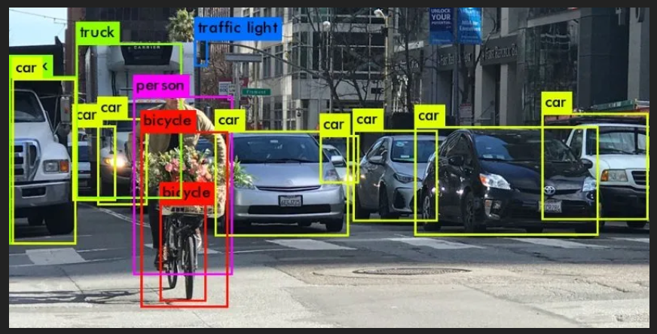
STEPS INVOLVED
Data Collection
Data Preprocessing
Model Selection
Model Training
Model Evaluation
Model Deployment
Monitoring and Maintainance

Slide 6
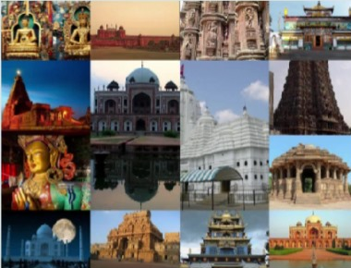
WHY WE NEED IT ?
-There is a need to digitally recognize and archive the monument as an important historical and cultural heritage site
- This poses as an impactful feature not only for tourists but also for the local people in order to gain knowledge regarding their own cultural heritage

Slide 7
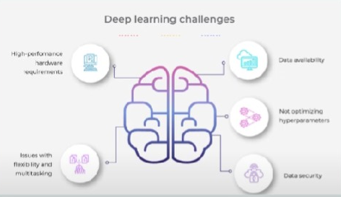
Dependency and Challenges during Implementation:
1. A model, no matter how well parameterized, still sometimes tends to display incorrect outputs. It may display the wrong name for the provided input monument, or may not even be able to detect if it's monument, depending upon the quality of the image that was provided.
2. The more the number of parameters and number of epochs defined for increased chances of accuracy, the more time consuming the process of prediction is. Pickling the model by saving its parameters and simply using it might help, but it's at the cost of accuracy.
3. Images provided by a satellite are often hazy due to atmospheric conditions. This hampers the accuracy of the model, as the model cannot make out the features of the monument as clearly as it should have.

Slide 8

Deep Learning Techniques Used in Your Project
Convolutional Neural Networks (CNNs): CNNs are widely used for image recognition tasks due to their ability to learn hierarchical features from images.
2. Transfer Learning: Transfer learning involves using a pre-trained neural network for a similar task as a starting point and fine-tuning it on a new dataset.
3. Object Detection: Object detection is a technique used to locate and classify objects within images.

Slide 9
TECHNOLOGY USED
1. Python
2. Tenserflow
3. Python libraries: Opencv,matplotlib
4. CNN
5. Ml model : yolo v5
6. Kaggle dataset
7. LabelImg
8. Android studio: JAVA , XML , Firebase
9. Figma

Slide 10
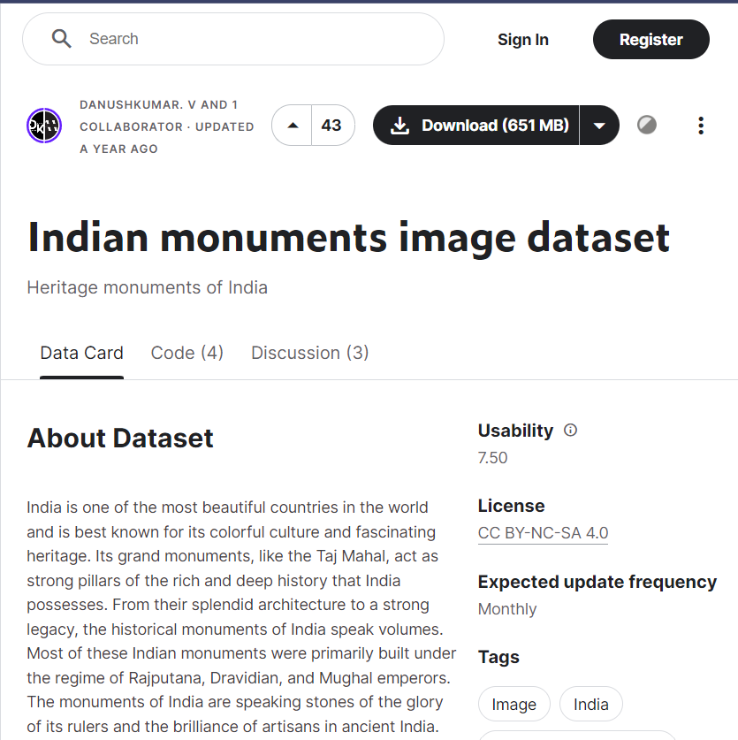
Dataset used, its sources, and any preprocessing steps.
For the project on heritage identification of monuments through deep learning techniques, I used a dataset of images of monuments collected from various sources, including public databases, online repositories, and personal contributions. Before using the dataset for training the deep learning models, I performed several preprocessing steps to ensure the quality and consistency of the data:
1. Image Resizing: I resized all images to a uniform size to ensure consistency across the dataset and to facilitate processing by the deep learning models.
2.Image Augmentation: To increase the diversity of the dataset and improve the robustness of the models, I applied various image augmentation techniques such as rotation, flipping, and scaling.
3.Labeling: Each image in the dataset was labeled with the corresponding class or category of the monument it represented. This labeling was crucial for the supervised learning process used in training the deep learning models.
4.Data Splitting: I split the dataset into training, validation, and test sets to evaluate the performance of the models.

Slide 11
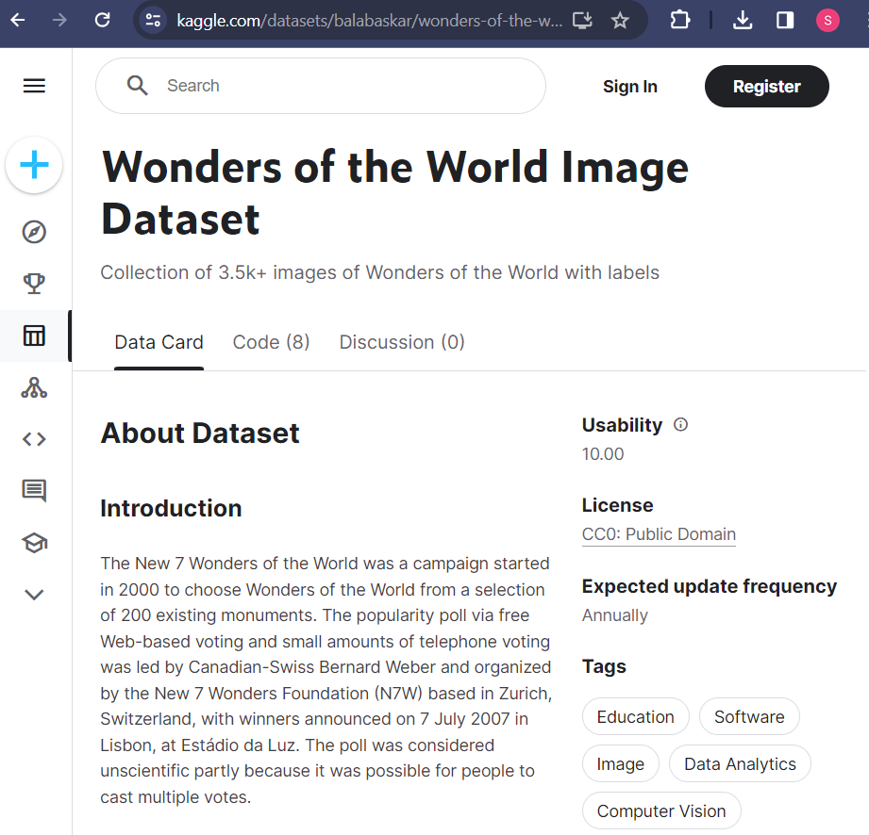
CONCLUTION
Recap the importance of Heritage Identification Summary of Deep Learning techniques used call to action for continued research and application of deep learning in heritage conservation.

