Slide 1


FLOOD INUNDATION PROBABILITY MAPPING
Mentor-
Mr. ANURAG MISHRA
PRESENTED BY:-
RITIK SHARMA
PRAJJWAL DWIVEDI
ANUBHAV KUMAR
ADARSH CHAUDHARY

Slide 2

PROBLEM STATEMENT
Development of image processing-based approach.
Inundation probability by utilising multiple satellite images from microwave and optical sensors.
To develop a application or web based website where user can interact with flood inundation probability maps.
Maps should be able to give probability of flood occurring in near future.

Slide 3
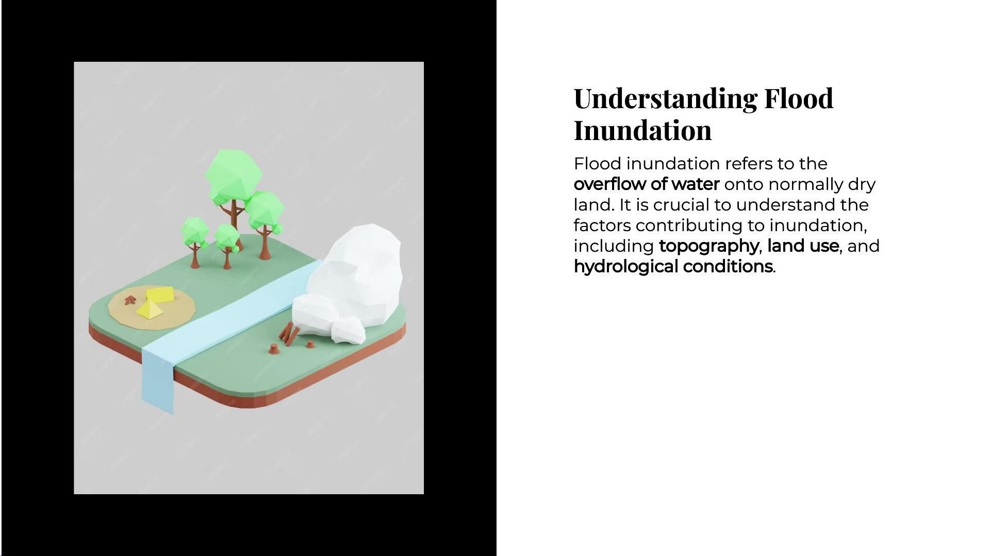

Slide 4
Alignment with UN Sustainable Development Goals(SDGs)
SDG 7: Affordable and Clean Energy Increase the share of renewable energy in the global energy mix. | SDG 13: Climate Action Take urgent action to combat climate change and its impacts.
SDG 15: Life on Land Protect, restore, and promote sustainable use of terrestrial ecosystems. | SDG 17: Partnerships for the Goals Strengthen global partnerships to support and achieve the SDGs.

Slide 5
Methodologies and Approach

Slide 6
Roadmap
FRONTEND
BACKEND
ML MODEL

Slide 7
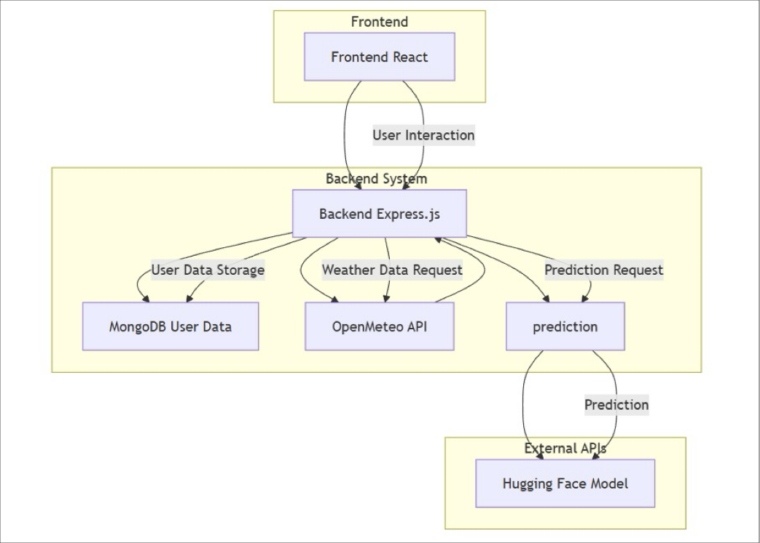
How does system works?

Slide 8
ROAD MAP for Machine Learning Model
Data Collection
Data Preprocessing
Data Transformation
Integrating with backend to get predictions
ML Model deployment
Machine learning model training

Slide 9
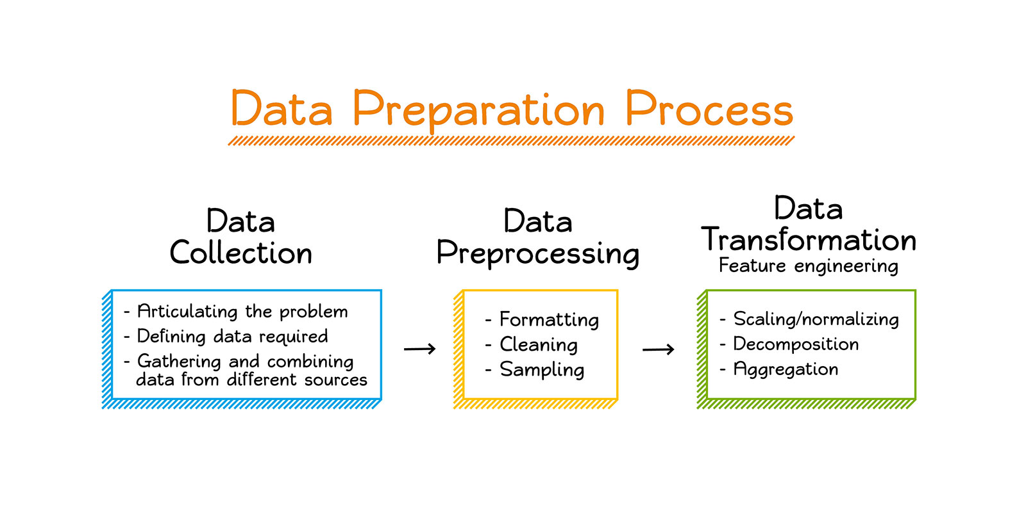
DATA PREPARATION PROCESS

Slide 10
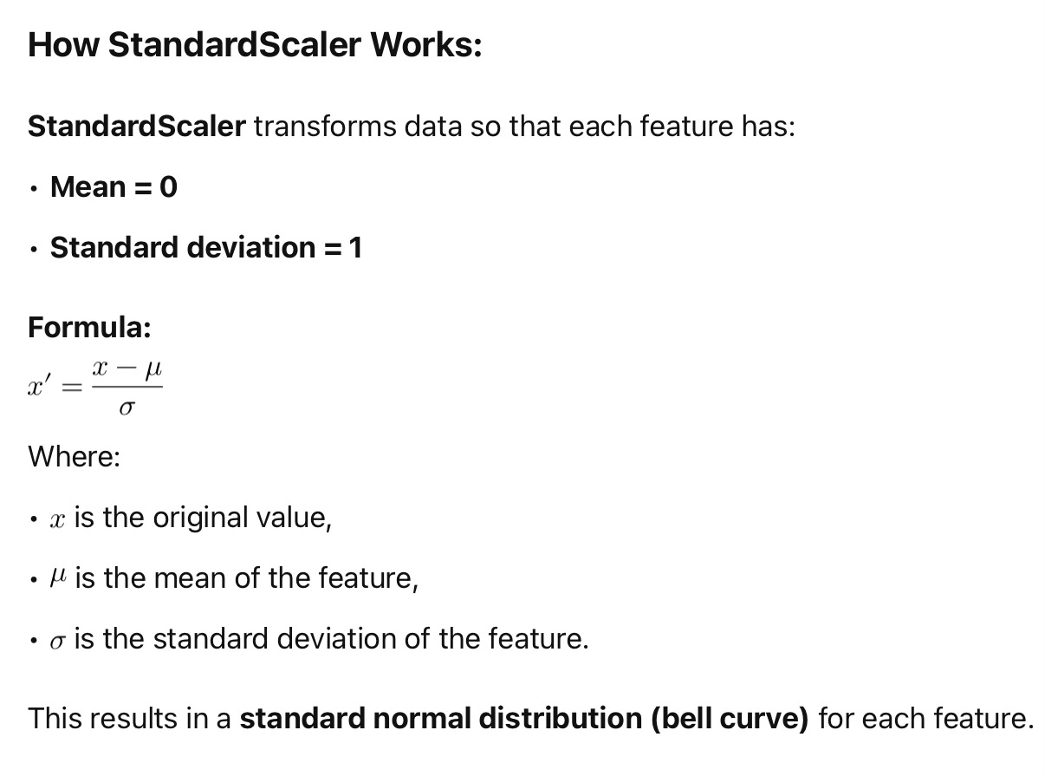
Feature scaling :
We do feature scaling to ensure all features contribute equally to the model and to improve the performance.
StandardScalar is used for feature scaling in all models.
Below is given how standardscalar works:

Slide 11
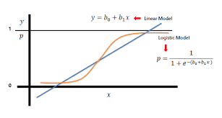
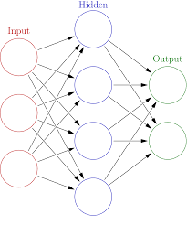
Machine Learning Models used :-
Logistic regression
XGBooster Algorithm
CatBoost Algorithm
Neural Networks

Slide 12
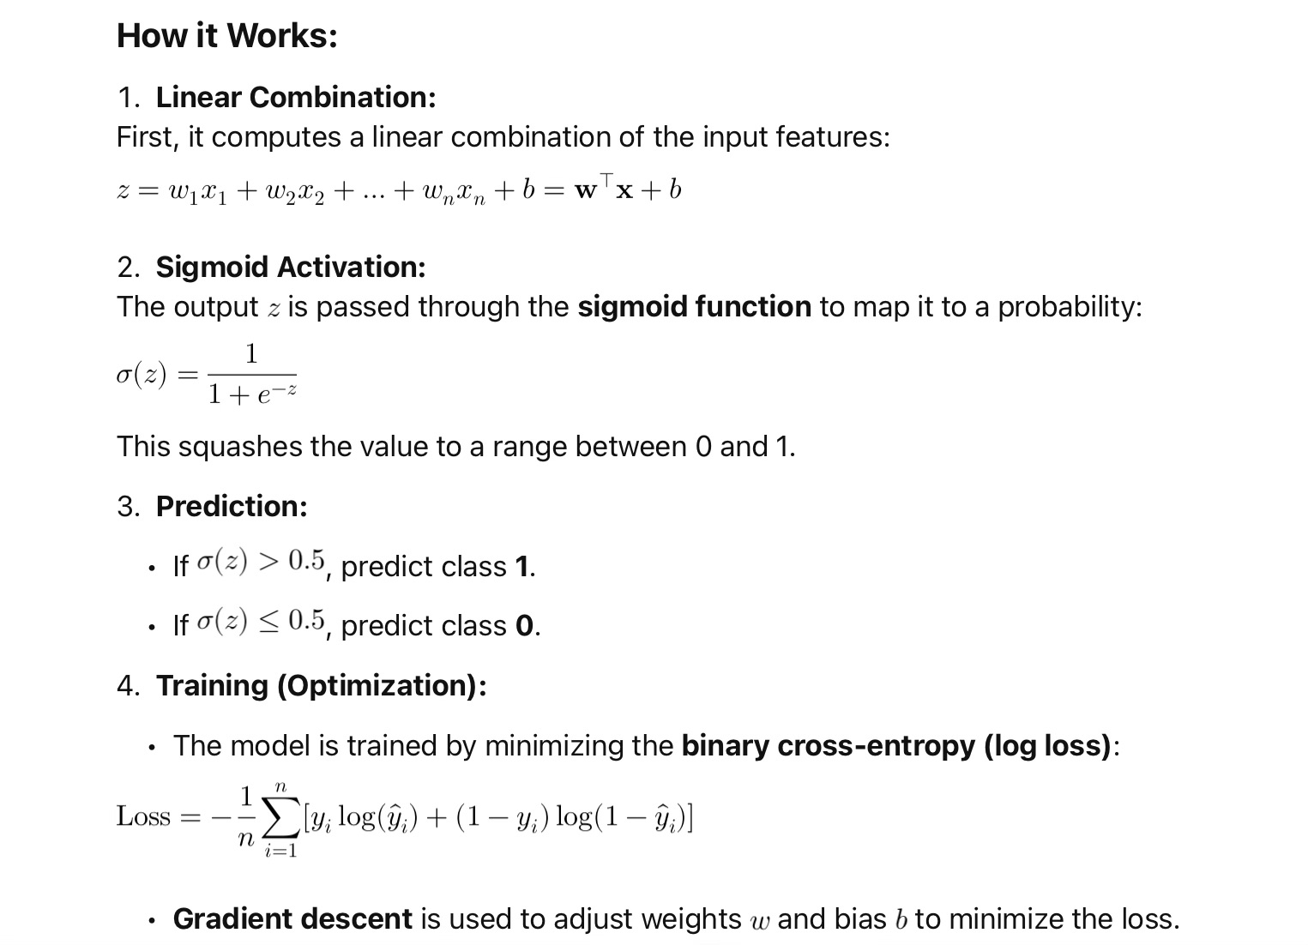
Models summary : Logistic Regression

Slide 13
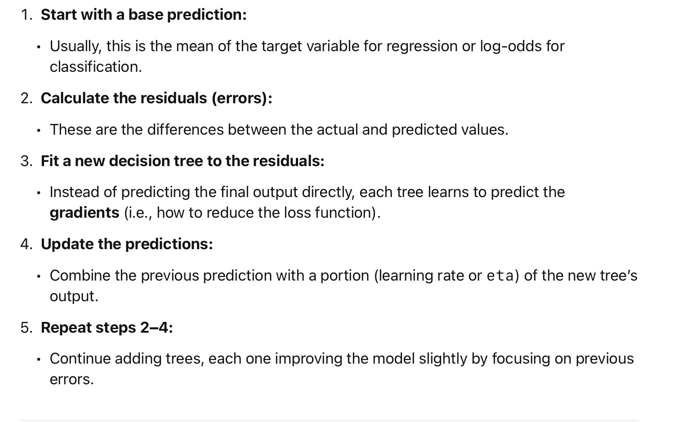
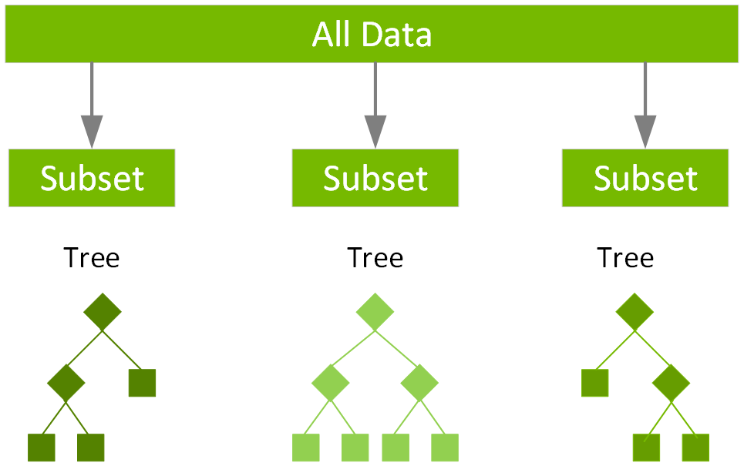
Model Summary: XGBoost and CatBoost

Slide 14
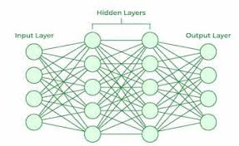
Model Summary : Neural Networks
Two hidden layers : 32 and 16 neurons respectively
activation function used is relu.
For compiling the model— optimizer used is Adam , loss function used is binarycrossentropy.
For training the model— epochs used are 100

Slide 15
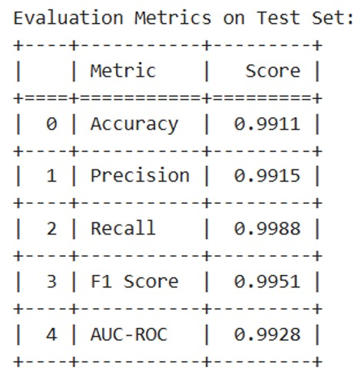
Model results : Logistic regression

Slide 16
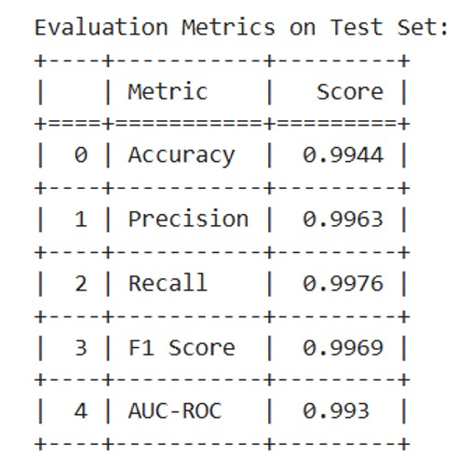
Model results : Neural Networks

Slide 17
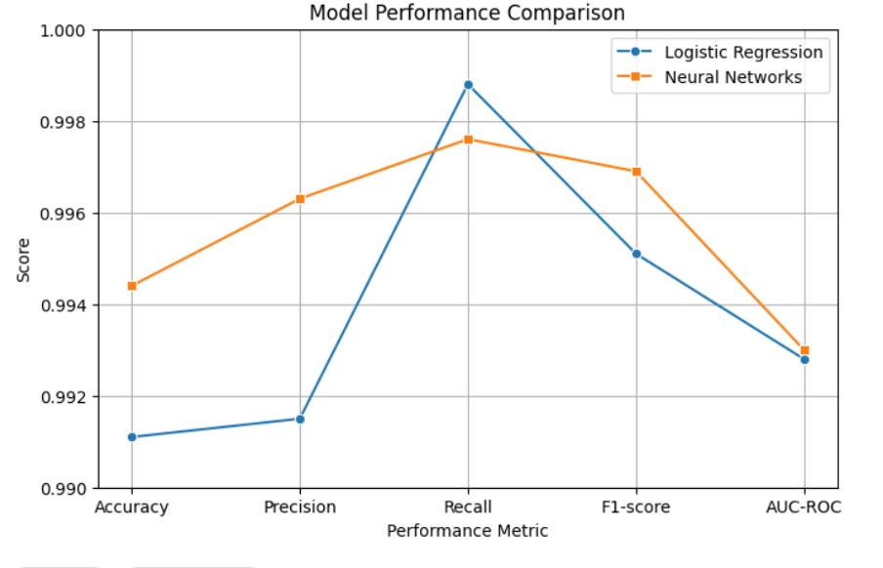
Comparison between logistic regression & neural networks:

Slide 18
LANGUAGE AND TECHNOLOGIES THAT ARE REQUIRED

Slide 19

PYTHON AS A PROGRAMMING LANGUAGE
It is widely used in Geospatial analysis and hydrological Modelling.
There are numerous libraries that are designed specifically for working with geospatial data such as rasterio, geopandas etc.

Slide 20






Machine learning technologies used
Python
Pandas
NumPy
Scikit-learn (sklearn)
Tensorflow
Huggingface (model deployment)

Slide 21


WEB TECHNOLOGIES
Technologies such as javascript, HTML, CSS are useful for creating interactive web based flood maps.
Libraries like Leaflet or OpenLayers can be used to develop web mapping application that allows users to explore and interact with flood inundation probability maps online.
React is what website is based mainly on.

Slide 22



API’s to be used
News API
Openweather API
Gradio API

Slide 23
Snapshots of website (user–end)

Slide 24



Slide 25

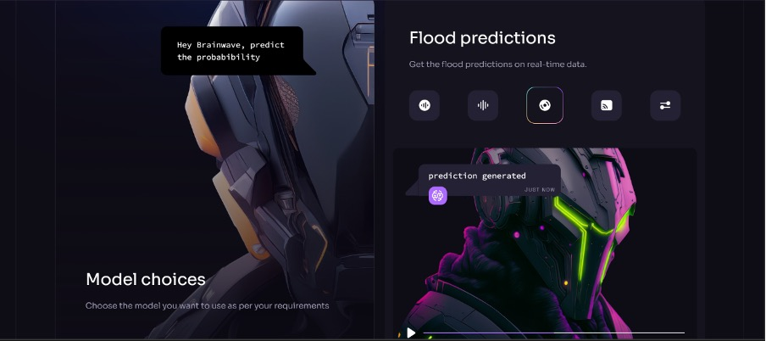

Slide 26
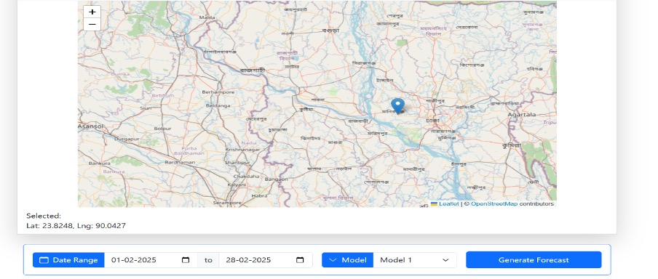
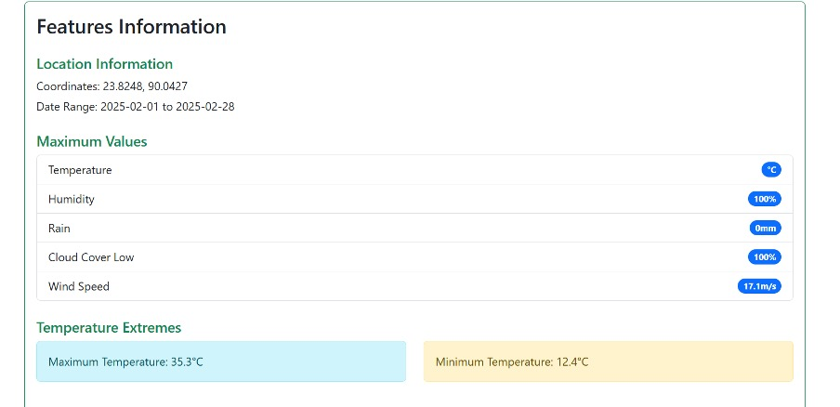
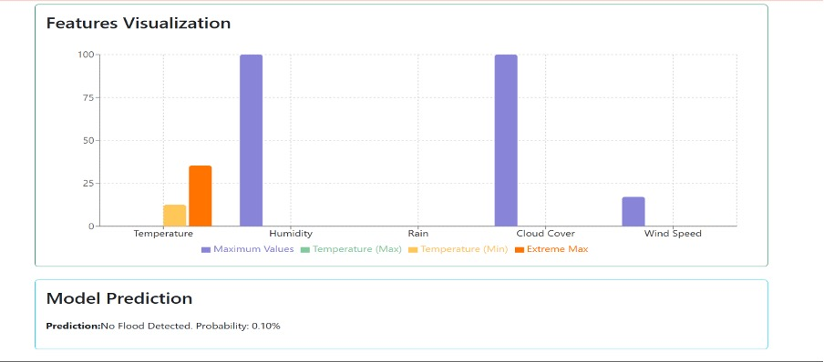

Slide 27
OUTCOMES
High precision predictive modeling
Easy Handling
Sustainable Innovation Framework
Strategic Impact for controlling flood disasters
Easy scope for future deve

Slide 28
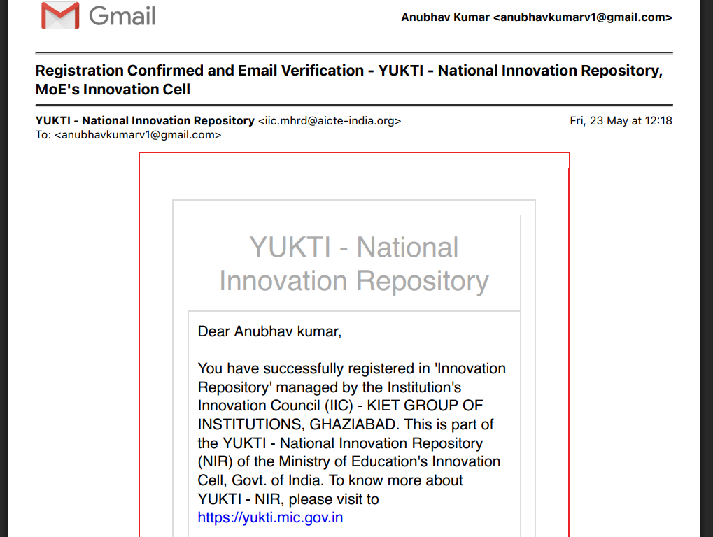
YUKTI PORTAL PROOF

Slide 29
Next steps and conclusions
Scale and expand
Include machine learning models for better performance
Partnerships with government and private sector for further increase performance of the proposed project.
Include MLops for more better results for future models.

Slide 30
THANK YOU

