Slide 1


Janak:
Nurturing Holistic Development
An app or progress card to guide parents to facilitate and ensure holistic growth in the cognitive, psychomotor, and affective domains.
Project id: PCS25-17
By
Guide Name - Dr. Ajay Kr. Shrivastava
Khushi Jain (2100290120096) sec-B
Deeksha Gupta (2100290120067)sec-B
Garima Shukla (2100290120078)sec-B
Kanishka Singh(2200290129011)sec-B
Notes:
1

Slide 2


PROBLEM STATEMENT
Parents often lack access to structured, stage-wise information and actionable goals for their child's development across cognitive, psychomotor, and affective domains.
This gap leaves them unaware of evidence-based parenting practices tailored to various growth stages, making it challenging to effectively support their child's holistic development.
There is a pressing need for a resource that combines developmental milestones, research insights, and practical parenting strategies to empower parents in nurturing their child's potential at each stage of growth

Slide 3
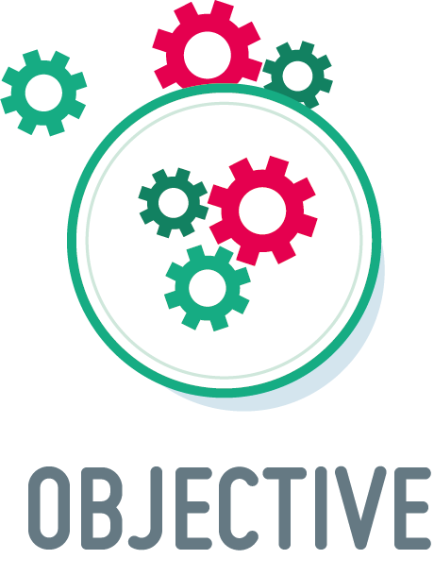
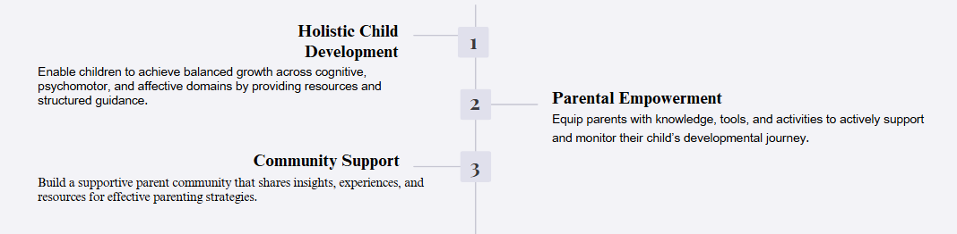
Key Objectives
1) Track holistic development of the child.
2) Guide parents about achievable stage-wise goals.
Notes:
3

Slide 4


Alignment with UN Sustainable Development Goals (SDGs)
SDG 3:
Good Health and Well-being
SDG 4:
Quality Education
Promoting children’s physical and mental health through guidance on nutrition, physical activities, and mental well-being, contributing directly to lifelong health and wellness.
Supporting equitable access to early
childhood and developmental education through cognitive, academic, and social learning modules, aligned with inclusive, quality education goals.
SDG 10:
Reduced Inequalities
SDG 16:
Peace, Justice, and Strong Institutions
Providing equal access to quality developmental resources and tools for parents across diverse backgrounds, thus reducing inequalities in child development opportunities.
Fostering social and emotional development in children to promote empathetic, responsible behaviors and contribute to building inclusive and peaceful societies.
Notes:
5

Slide 5
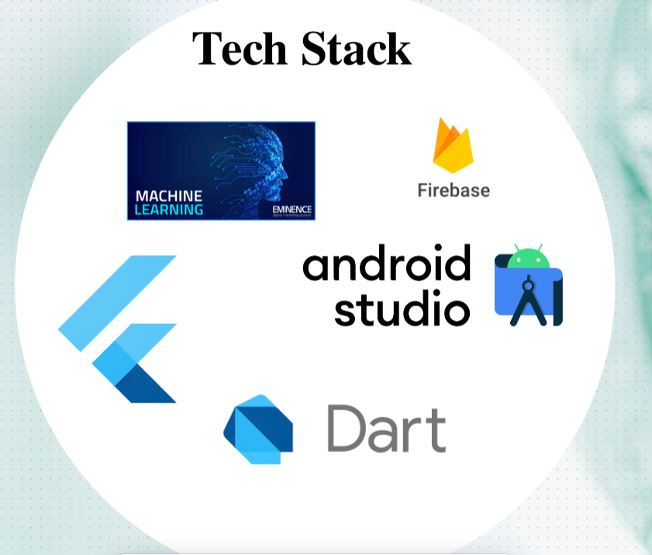



Methodology and Approach
Module Design
Conduct research and collaborate with experts to create modules (health, academics, cognitive, well-being) focused on key developmental outcomes.
Content Creation
Develop age-appropriate activities, assessments, and resources tailored to each child’s needs.
App Development and Testing
Build and test the app, ensuring user-friendly features, tracking tools, and community support
Notes:
6

Slide 6
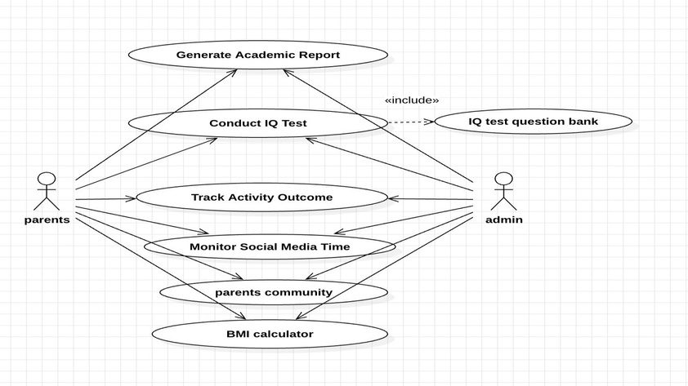
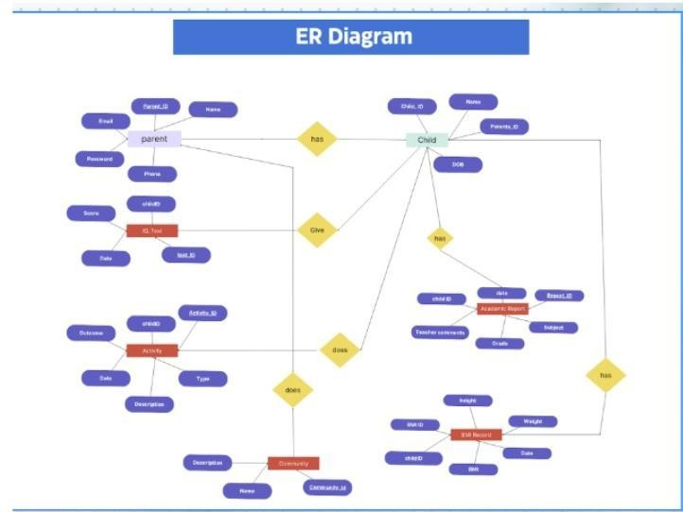
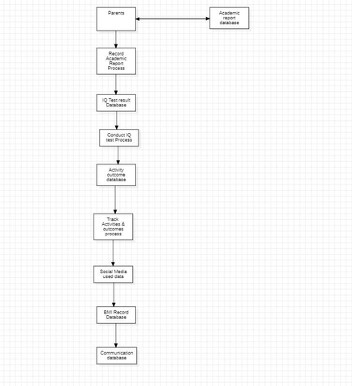
Workflows

Slide 7
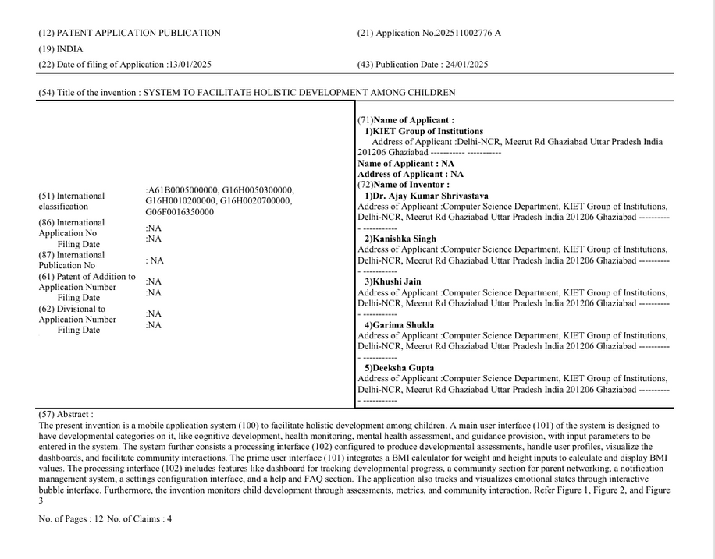
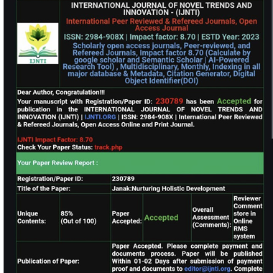
Patent Status & Research Publication

Slide 8
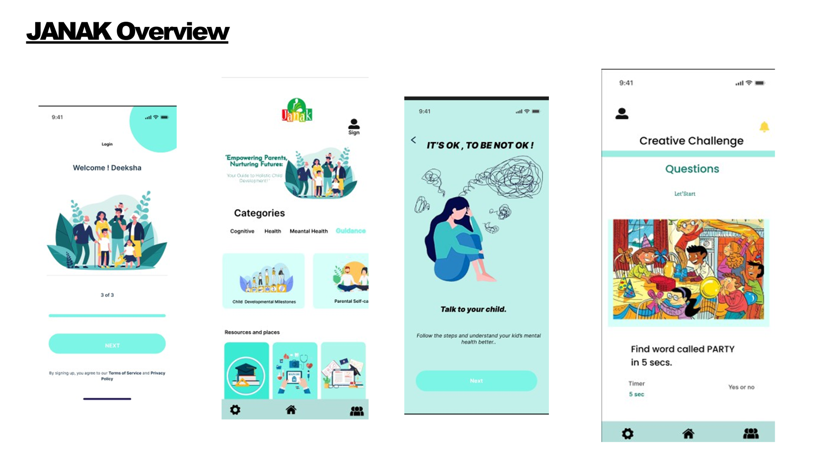

Slide 9
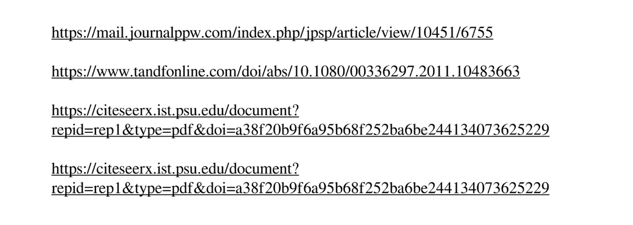
References

