Slide 1


Project Presentation (KCS 851) (Career Dendrogram)
KIET Group of Institutions, Ghaziabad
(An ISO – 9001: 2008 Certified & ‘A+’ Grade accredited Institution by NAAC)
Guide Name: Prof. Pawan Kumar Pal
Project Members Name with Roll Number & Section
1.Rajeev Ranjan (21002902120136 & 8C )
2.Rishabh Yadav (2100290120143 & 8C
3. Shayam (2100290120154 & 8C)
4. Shubham Verma (2100290120161 & 8C)

Slide 2
Problem Statement
There is a need for a career dendrogram to better educate people about their career option thus preventing them from making mistake in choosing their career

Slide 3
Objectives
A website will be created for this system, students can login and signup with their emails. First, a quick test will be carried out to get basic ideas about each student’s career choice. Then a long test will be carried out which will, with the help of a backend algorithm, suggest a list of perfect or matching educational fields according to the inputs.
A dendrogram or tree diagram for each education field will be created with deep information about each course inside a course, future scope, limitations, pros, and cons according to the region, and much more. Students can decide if they want to find the right field by giving the test.

Slide 4
Technology Used
Frontend (HTML, CSS, JS, Reactjs)
Backend (Nodejs, Expressjs, FastAPI)
Database (MongoDB)
ML Models (Random Forest Algorithm)

Slide 5
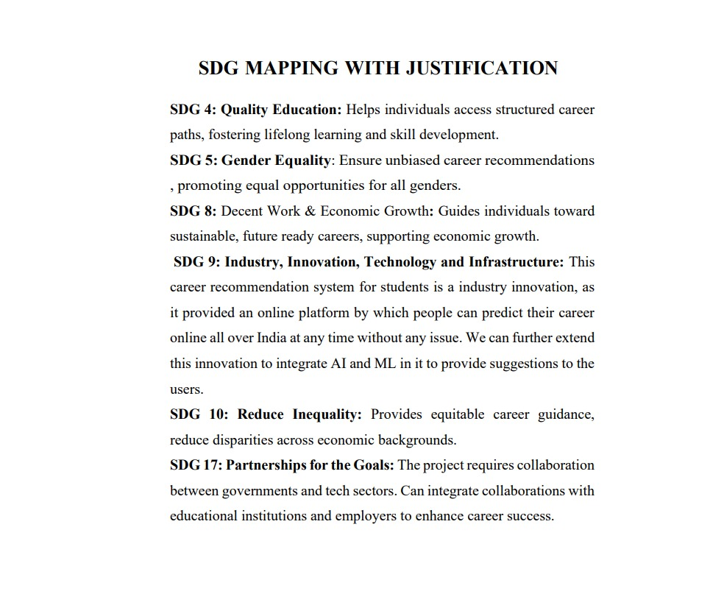

Slide 6
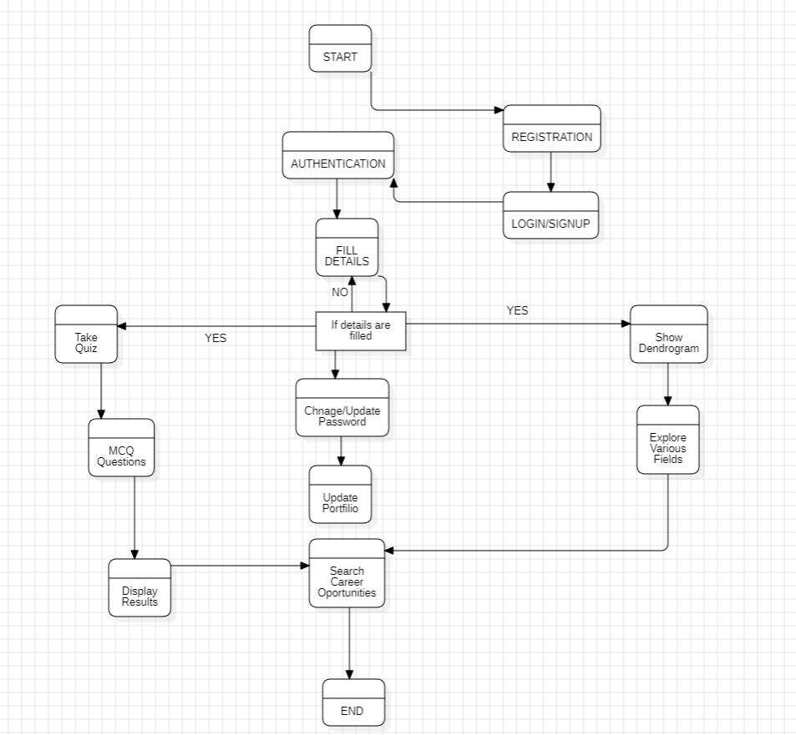
Workflow Diagram

Slide 7

Project Status
95% Completed

Slide 8
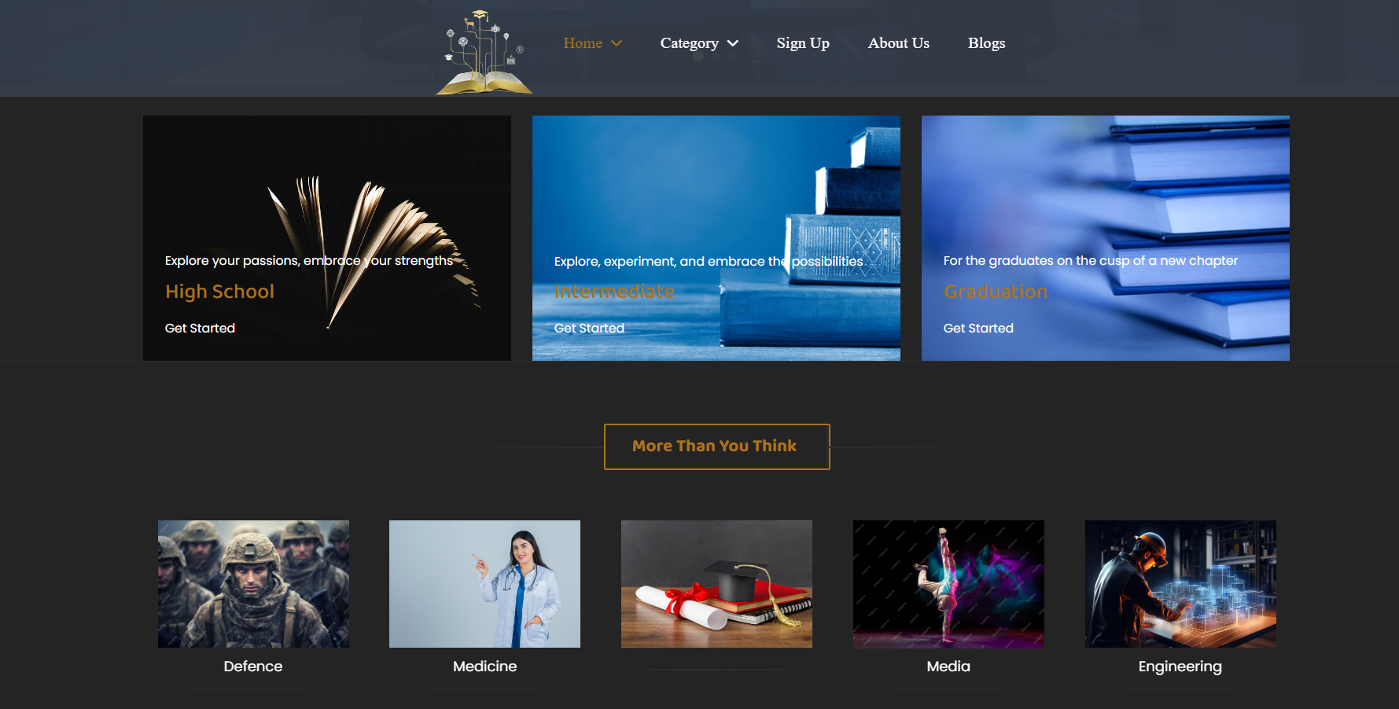

Slide 9
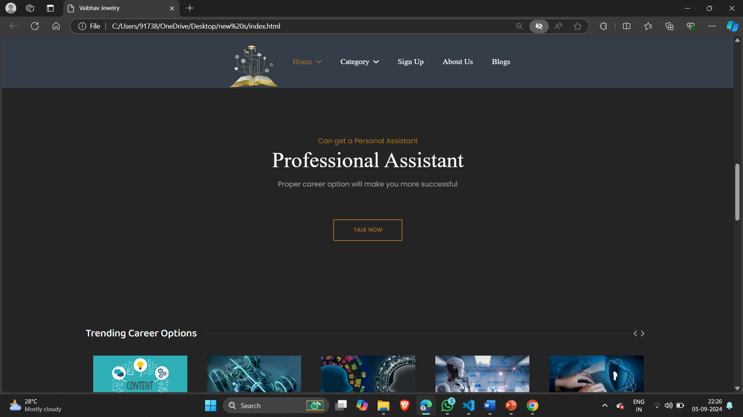

Slide 10
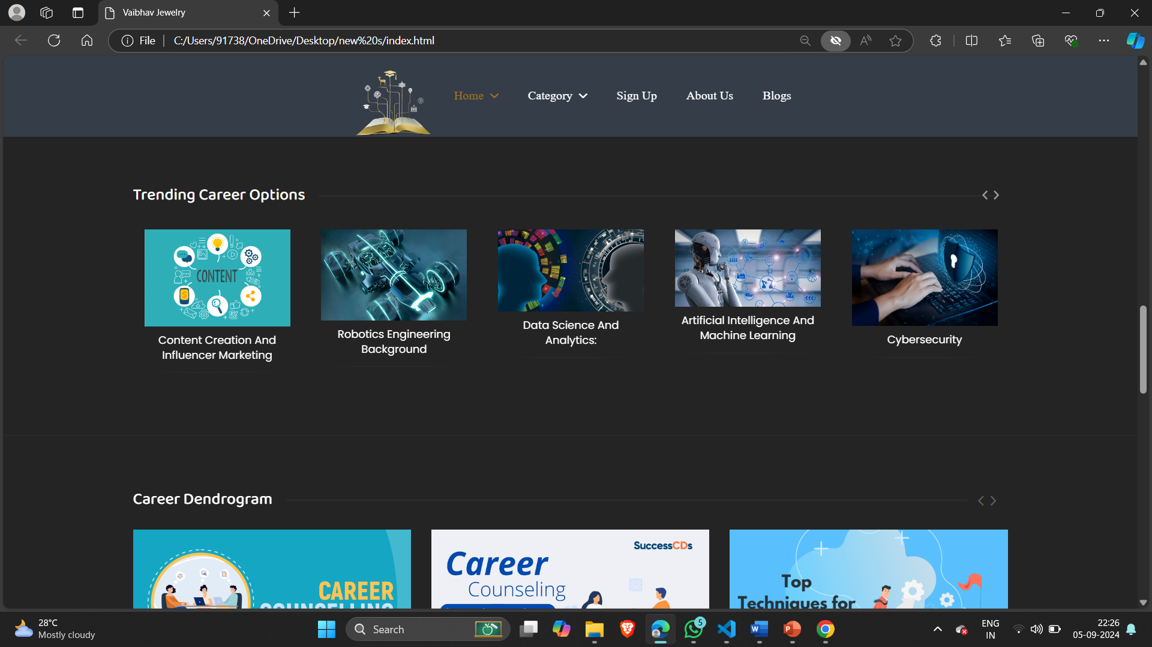

Slide 11
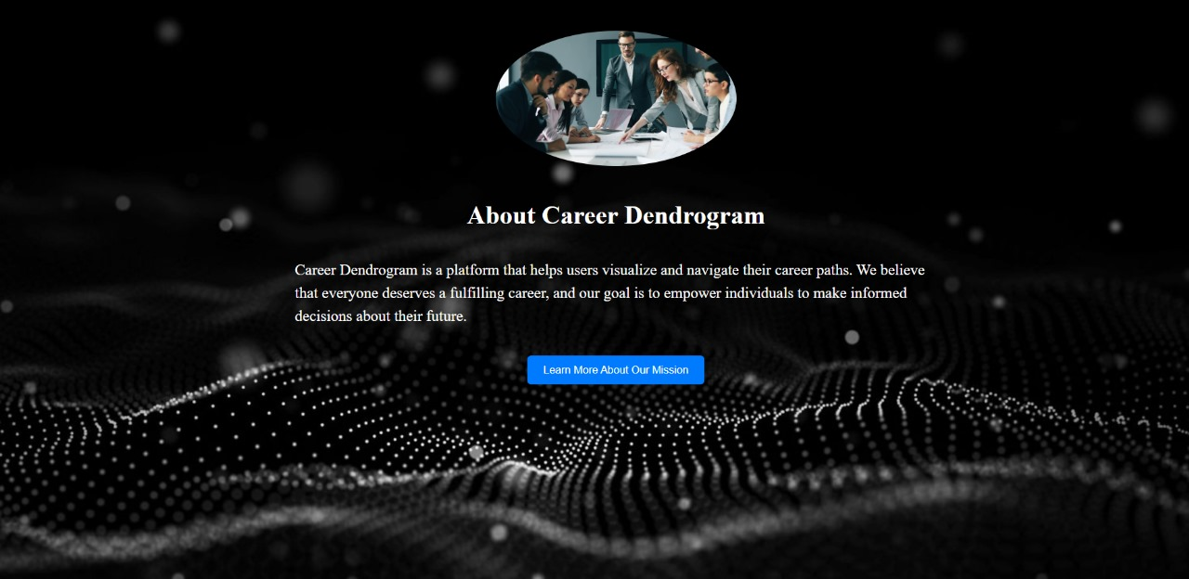

Slide 12
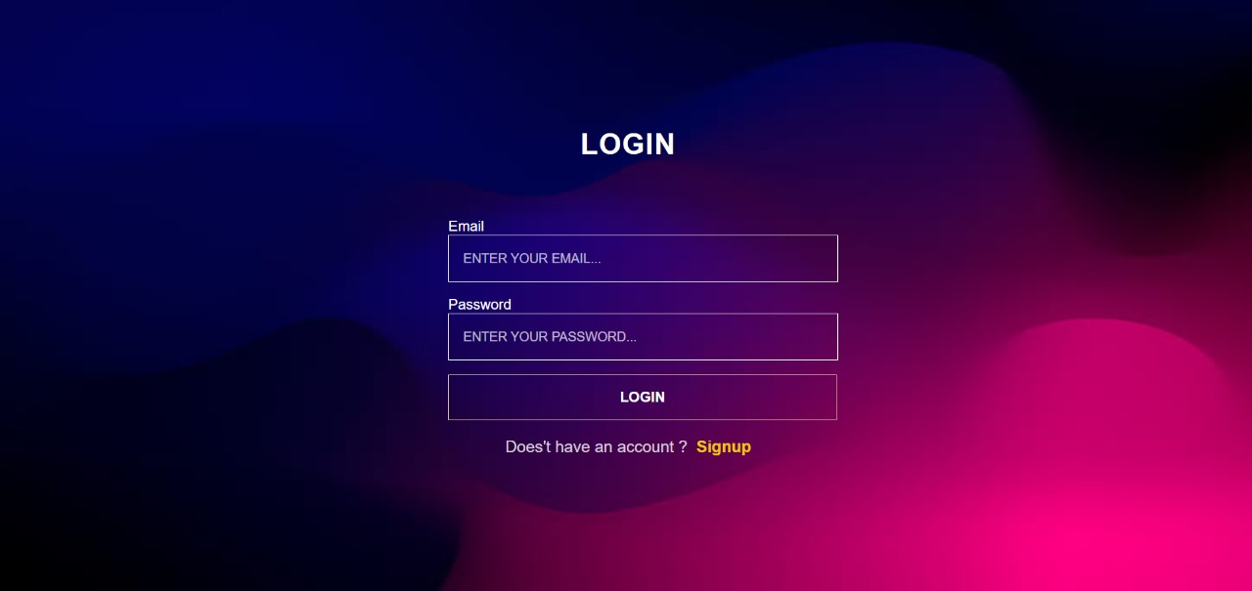

Slide 13
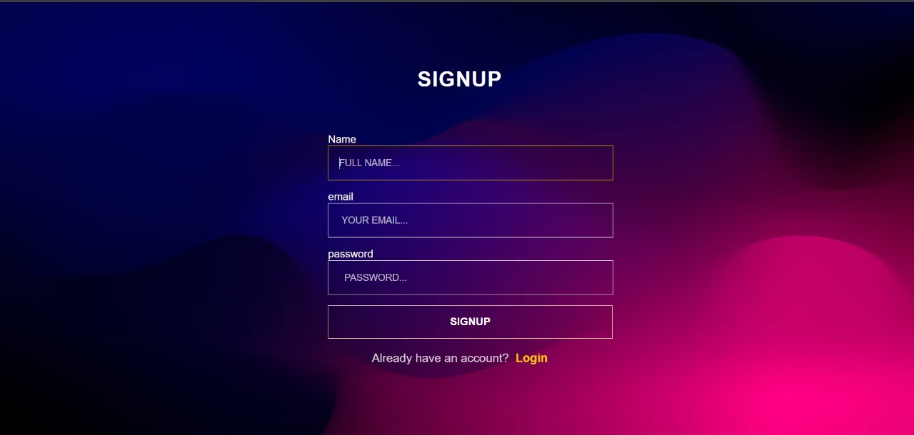

Slide 14
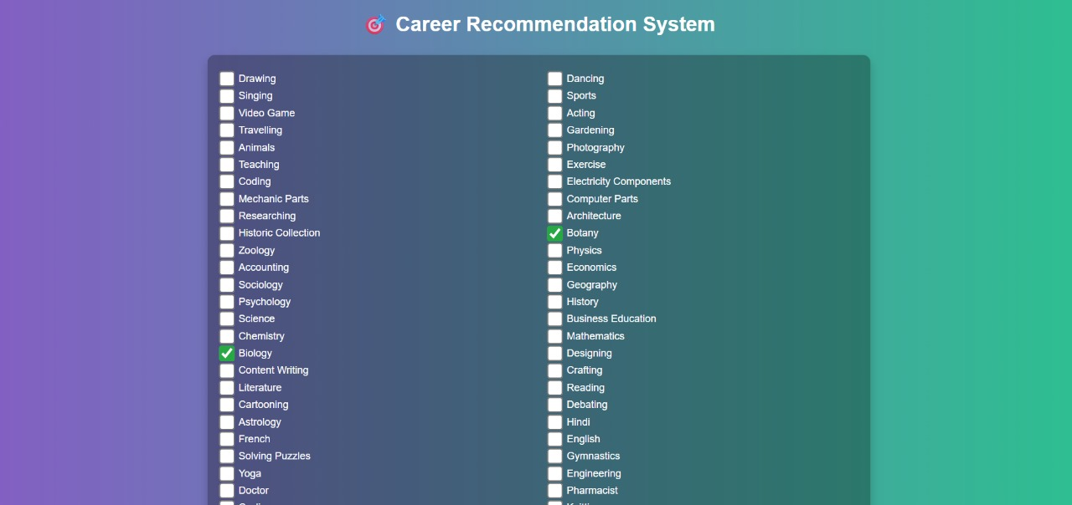

Slide 15
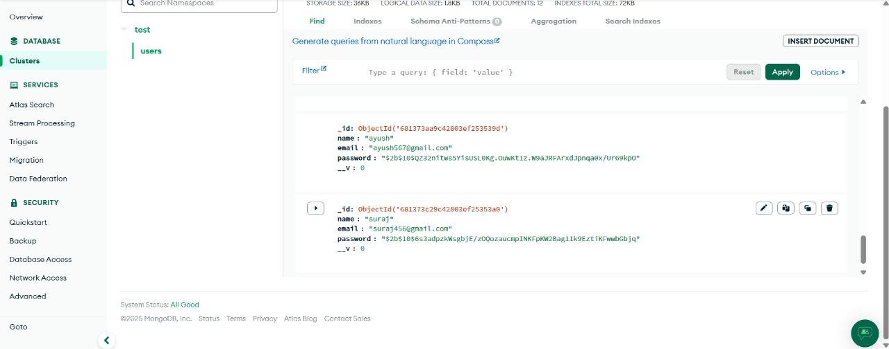

Slide 16
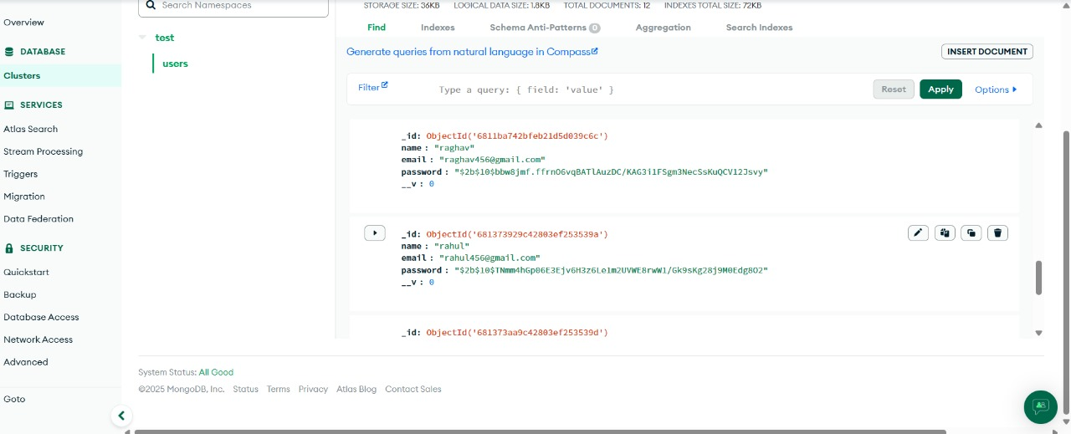

Slide 17
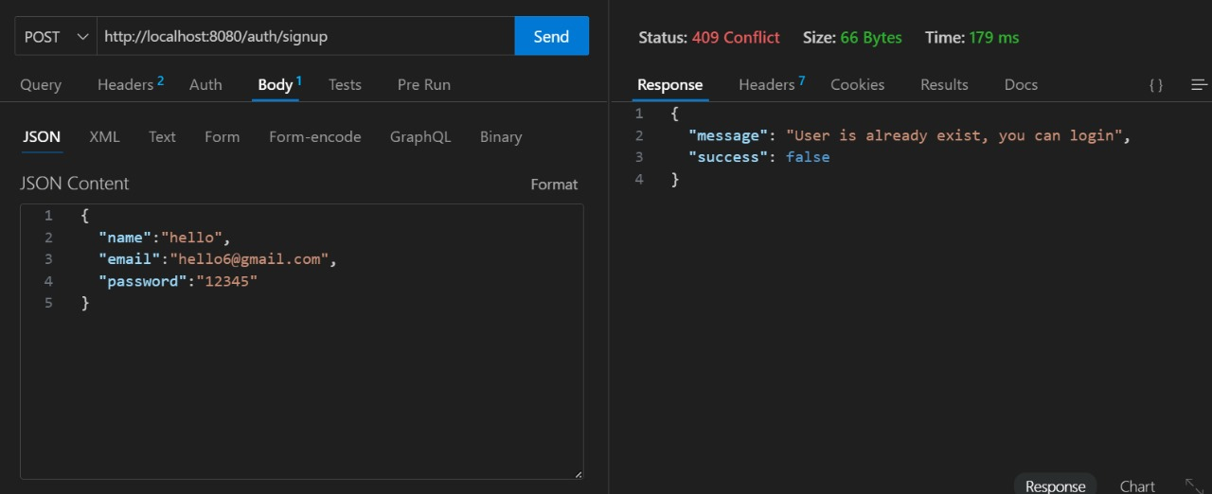

Slide 18
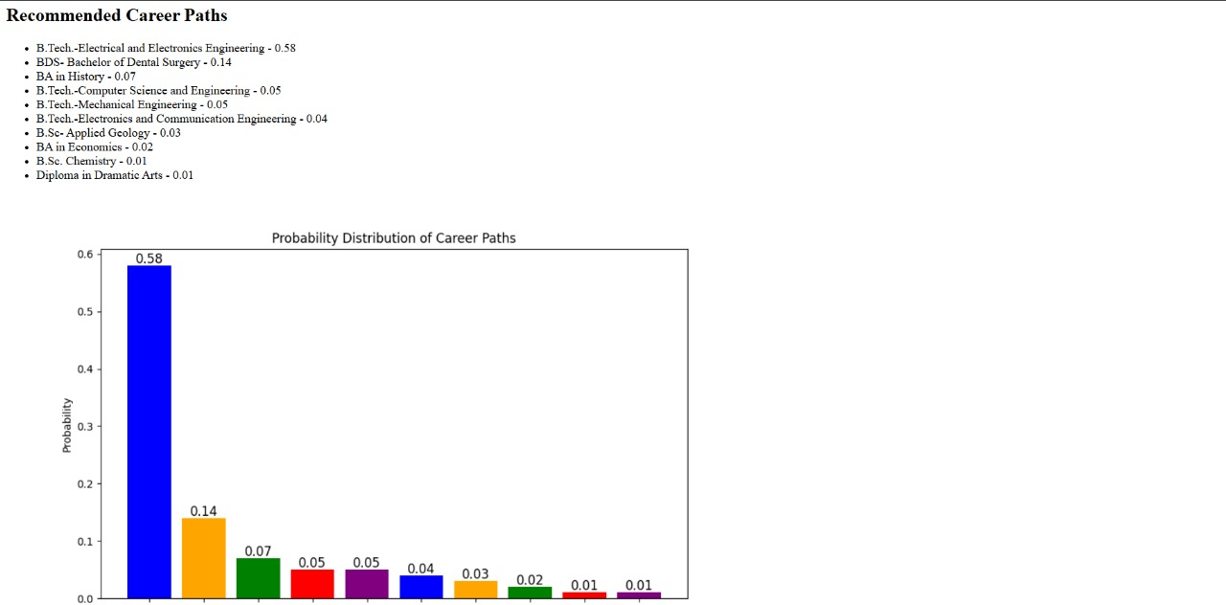

Slide 19
THANK YOU!

