Slide 1





KIET Group of Institutions, Ghaziabad
(An ISO– 9001: 2008 Certified & ‘A+’ Grade accredited
Institution by NAAC)
PLANT DISEASE DETECTION USING CNN
PCS-25_30, Guide: Prof. Vivek Sharma

Slide 2
Agriculture suffers significantly from undiagnosed or late-diagnosed plant diseases, which lead to poor crop yield and economic setbacks for farmers. Traditional inspection methods are slow, require expert intervention, and are often inaccurate due to human error. Farmers lack access to reliable, real-time diagnostic tools. This project aims to develop an intelligent, automated system that uses image processing and machine learning to accurately predict plant diseases and suggest timely treatment options.
PROBLEM STATEMENT

Slide 3
The primary objective of this project is to develop a practical solution for plant disease identification utilizing computer-based methodologies. This system aims to benefit agricultural stakeholders by integrating technology with real-world farming requirements. The specific objectives are detailed below:
Automated Disease Detection
User-Friendly Interface
Early Detection of Disease
Disease Database Development
Enhancement of Agricultural Productivity
OBJECTIVES

Slide 4






Frontend
Tech Stack
Backend

Slide 5
SDG MAPPING
SDG 2: Zero Hunger
Goal: End hunger, achieve food security and improved nutrition and promote sustainable agriculture
Justification:
Timely disease detection averts the loss of crops that guarantees food.
SDG 3: Good Health and Well-being
Goal: Ensure healthy lives and promote well-being for all at all ages
Justification:
Ensure healthy lives and promote well-being for all at all ages
SDG 9: Industry, Innovation, and Infrastructure
Goal: Build resilient infrastructure, promote inclusive and sustainable industrialization and foster innovation
Justification:
It also incorporates AI and IoT type technologies in farming and enhances precision agriculture.
SDG 12: Responsible Consumption and Production
Goal: Ensure sustainable consumption and production patterns
Justification:
The project assists in the achievement of the maximum level of resource efficiency and preventing agricultural loss.

Slide 6
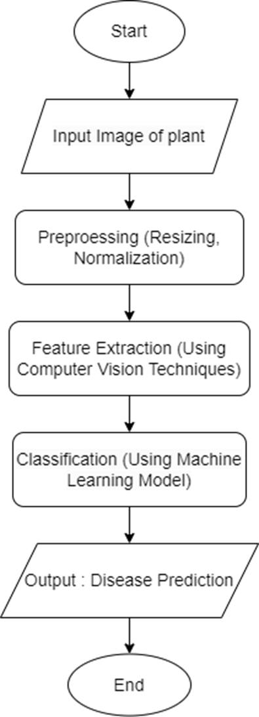
WORKFLOW

Slide 7
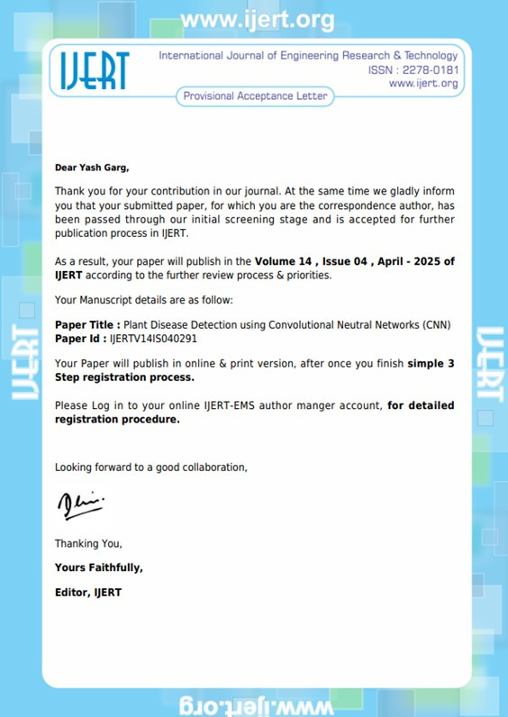
RESEARCH PAPER
Status: Acceptance

Slide 8
PROJECT
Team Members
Yash Garg
Vishwas Saroha
Vijendra Pandey
Aditya Tyagi
Status: 90%

Slide 9

Thank you
for attending!

