Slide 1


Fitness Activity Recognition for healthcare
PCS25-50
Team Members: Rahul Shoundic (2100290120134)
Saumya Maheshwari (2100290120151)
Vivek Kumar Yadav (2100290120193)
Vaishnavi Singh (2100290120183)
Superviser:
Vivek Kumar Sharma

Slide 2
PROBLEM STATEMENT:
The increasing prevalence of sedentary lifestyles and associated health issues, including psychological disorders and other chronic diseases, poses a significant challenge to public health In this context, the project aims to develop a Fitness Activity Model that utilizes machine learning algorithms and web development techniques to predict diseases like lung disease, breast cancer etc. based on individuals reports and activities.

Slide 3
Objective: Develop a state-of-the-art fitness tracker capable of predicting the likelihood of diseases such as lung cancer, breast cancer, kidney disorder, psychological diseases by analyzing comprehensive health data.
Predictive Analytics:
Machine Learning Algorithms: Analyzes patterns in collected data to identify potential early signs of disease. Uses historical data and real-time inputs to refine predictions.
Integration with Health Records: Syncs with electronic health records (EHRs) and genetic data for a comprehensive risk assessment.

Slide 4
Data Privacy and Security:
Encryption and Compliance: Ensures all health data is encrypted and complies with relevant privacy regulations.
Testing and Validation: Undergoes rigorous clinical trials to validate predictive accuracy and effectiveness.

Slide 5

Machine Learning in Healthcare
Training algorithms on vast medical datasets
Automated diagnosis and prediction Personalized treatment plans Machine learning can greatly enhance healthcare outcomes and efﬁciency.

Slide 6
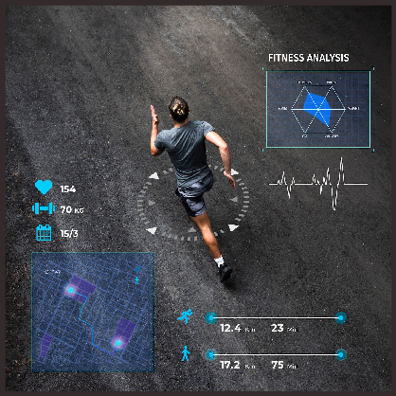
Web Development for Health Recognition
through web development
User-friendly interfaces for healthcare professionals
Real-time data visualization Integration with existing systems
Web development enables efﬁcient and intuitive health recognition systems.

Slide 7

Conclusion
Machine learning and web development empower healthcare
Improving accuracy, efﬁciency, and accessibility
Advancing towards a brighter future
By embracing these technologies, we can enhance healthcare and improve lives.

Slide 8
SDG mapping
3: Good Health and Well-being​
Predicting diseases early can lead to timely interventions, reducing mortality and improving health outcomes.​
9: Industry, Innovation, and Infrastructure​
Utilizes AI/ML, big data, and digital healthcare innovations to improve diagnostics.

Slide 9
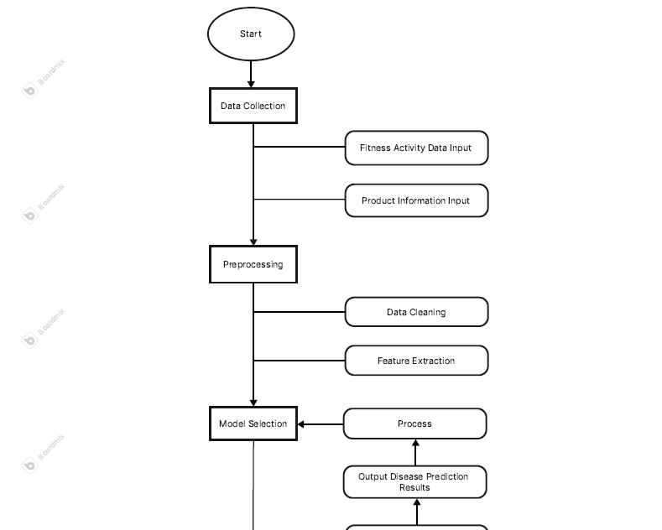
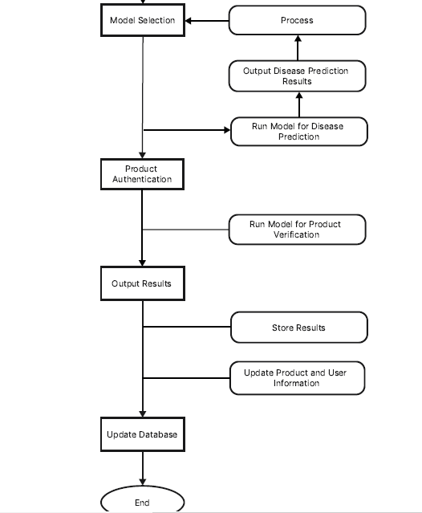

Slide 10
Disease Check
Lung cancer disease
Breast cancer disease
Diabetes disease
Heart disease
Psychological disease

Slide 11

ALGORITHMS
KNN
Random Forest
Logistic Regression

Slide 12
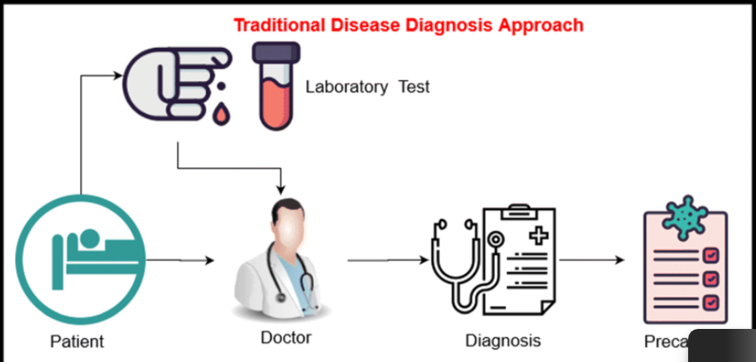
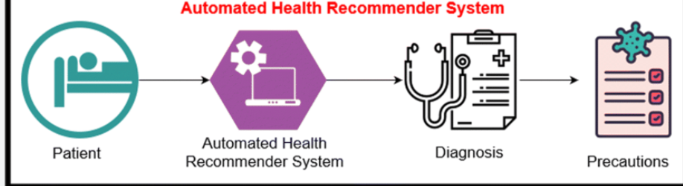

Slide 13
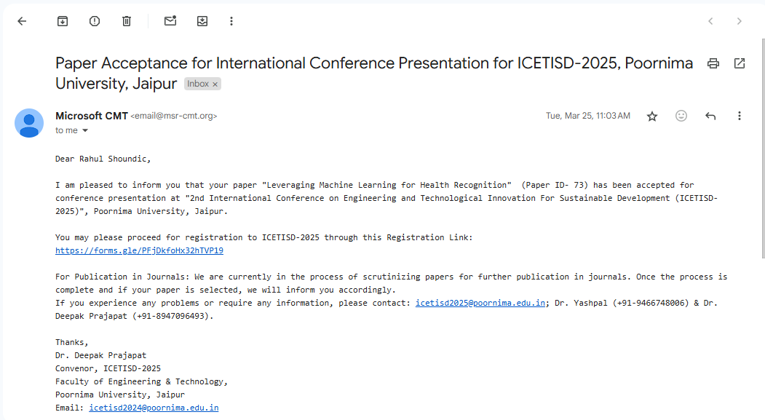
Research Paper Status: ACCEPTED

Slide 14
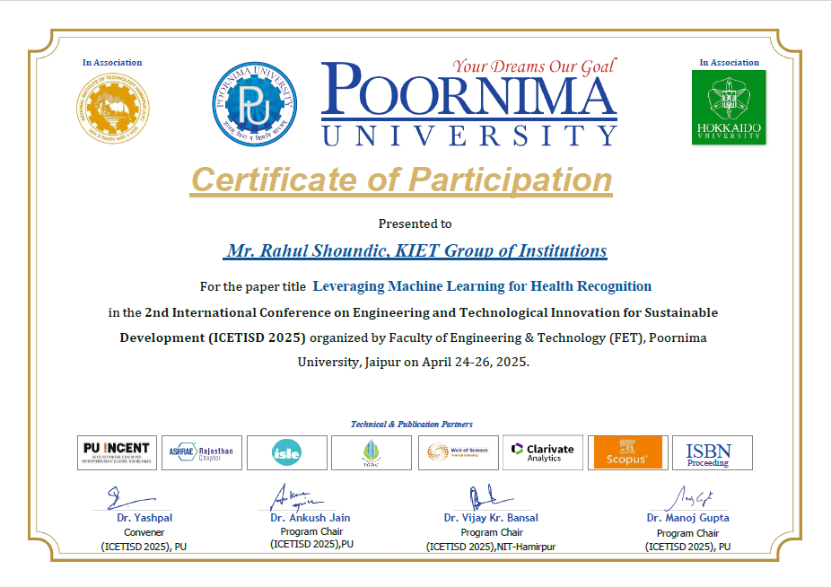
Research Paper Certificate

Slide 15
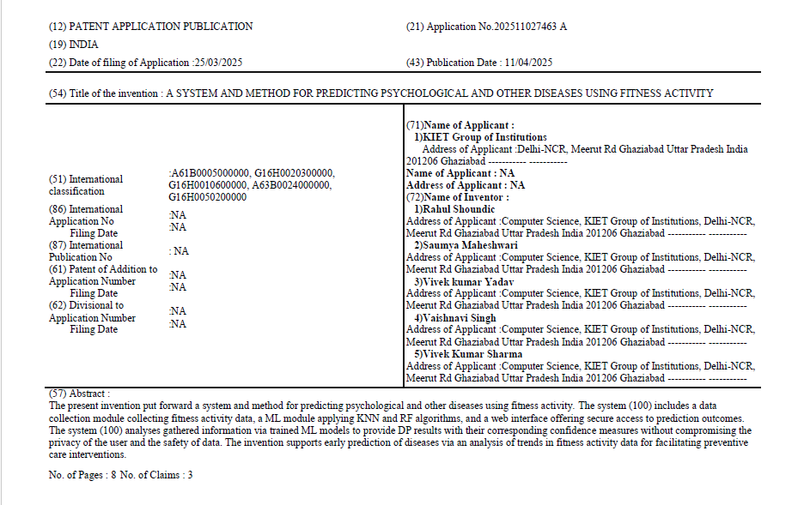
Patent Status : PUBLISHED

Slide 16


