Slide 1

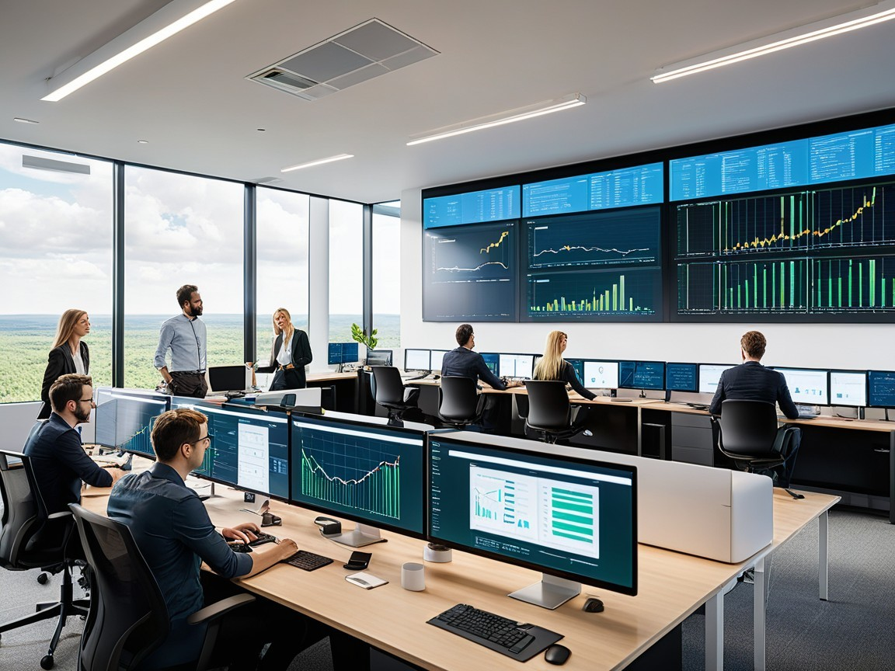
Uni-Link
PCS 25-41
This project addresses the critical need for centralized placement data by gathering and consolidating information from higher educational institutions across India. Our primary focus is on creating a unified database that offers data-driven insights, with additional functionalities to support policy-making, talent acquisition, and job opportunities for students.
Made By: Raj Singh 2100290120135
Shivam Kumar 2100290120157
Sudhanshu Singh 2100290120165
Vaibhav Bisht 2100290120181
Guided By: Ms. Shivani, Assistant Professor, Dept. of Computer Science

Slide 2
Project Abstract
Overview
Key Objectives
Approach
This project combines innovative data integration techniques, large-scale centralization of placement records, and collaborative initiatives with educational institutions to create a unified solution for higher education and employment insights.
Streamline data access for all stakeholders, provide actionable insights into placement trends, and enable educational institutions, companies, and government bodies to make informed decisions.
Aggregate and centralize placement data from diverse institutions; visualize trends through interactive graphs; and engage with key stakeholders to enhance data-driven policies and workforce planning.

Slide 3

Project Goals and Objectives
Data Centralization
1
Establish a large-scale, centralized database of placement records from higher educational institutions across India to streamline access to accurate, consolidated data.
2
Stakeholder Engagement
Empower educational institutions, companies, and government bodies to utilize data insights effectively and advocate for improved policy and hiring practices in the higher education sector.
Trend Analysis
3
Visualize placement trends and emerging college performance through interactive graphs, providing valuable insights into employment trends, skill demands, and workforce development.

Slide 4

Alignment with UN Sustainable Development Goals (SDGs)
SDG 4: Quality Education
SDG 8: Decent Work and
Economic Growth
Improve access to accurate placement data for better alignment of education with industry needs.
Facilitate job opportunities and enhance employment outcomes through data insights.
SDG 9: Industry, Innovation
and Infrastructure
SDG 17: Partnerships for the Goals
Promote innovation and growth in education and recruitment through data-driven solutions.
Foster collaboration between institutions, government, and industry for informed workforce decisions.

Slide 5





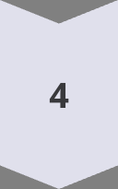



Methodology and Approach
Data Centralization
Consolidate placement data from educational institutions to provide a comprehensive view of trends and performance.
Technology Integration
Implement advanced data visualization tools and interactive graphs to enhance insights and decision-making.
Trend Analysis
Analyze placement trends, emerging colleges, and employment patterns to provide actionable insights for all stakeholders.
Stakeholder Engagement
Collaborate with institutions, companies, and government bodies to drive informed decisions and continuous improvement.

Slide 6
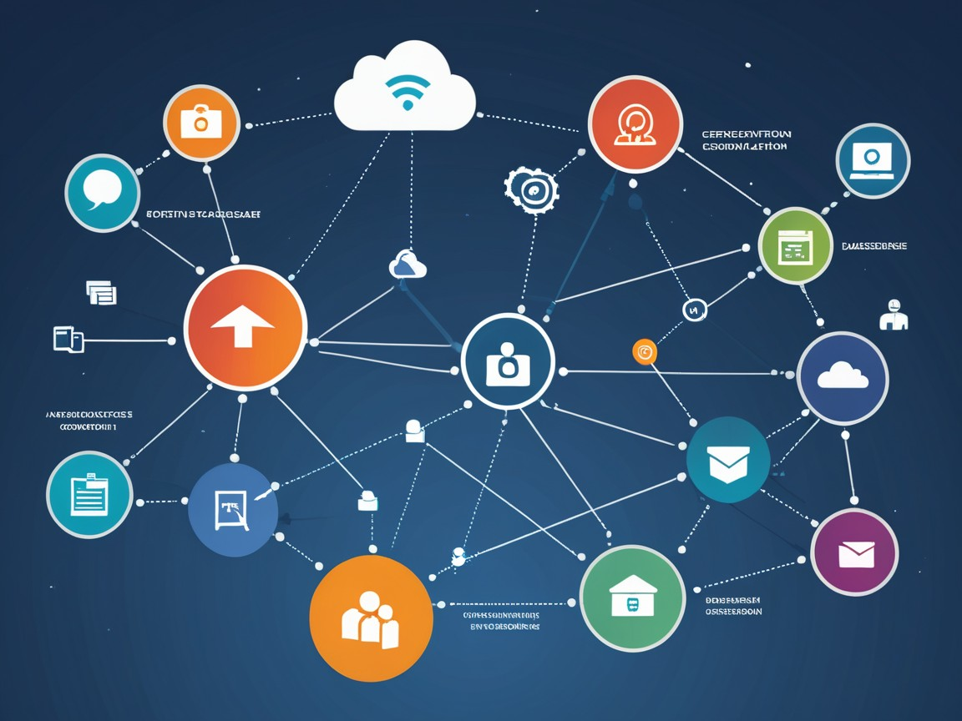
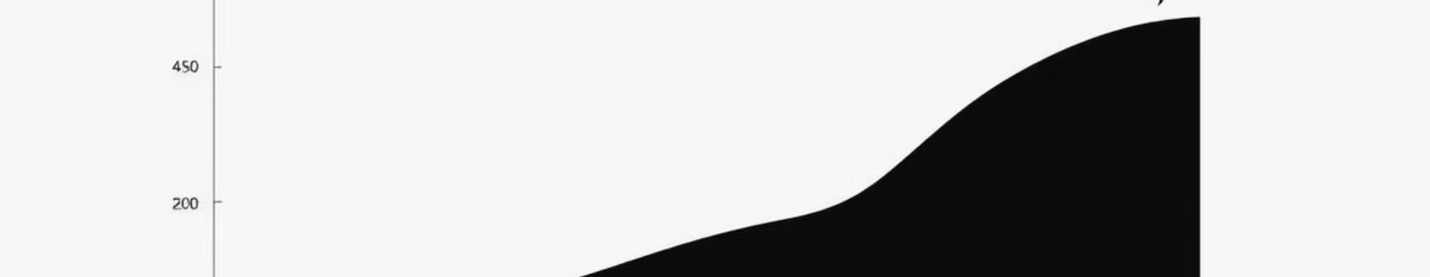
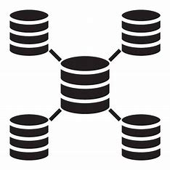
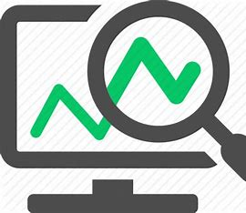

Expected Outcomes and Impact
Data Centralization
Trend Insights
Stakeholder Empowerment
A unified placement database, improving accessibility and data-driven decision-making across institutions.
Actionable insights into placement trends, helping institutions and companies align with emerging workforce demands.
Informed educational institutions, companies, and government bodies actively driving improvements in education and employment practices.

Slide 7
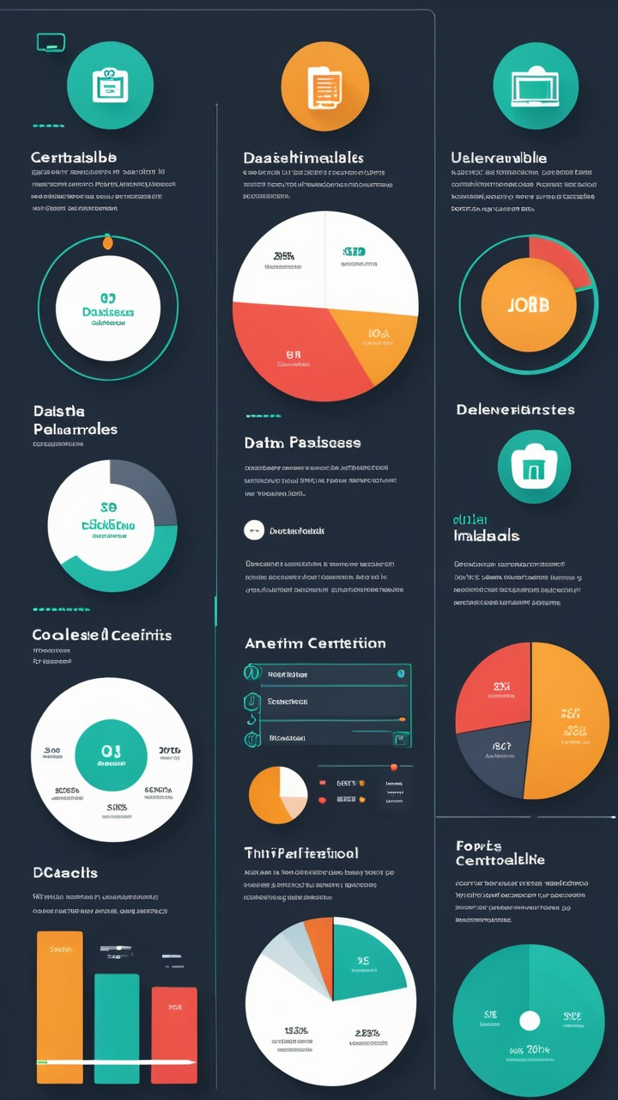
Key Project Deliverables
Placement Database
A centralized database of placement records.
Trend Visualizations
Graphs showing placement trends and college performance.
Stakeholder Collaboration
Collaborations with institutions, companies, and government for data-driven decisions.

Slide 8
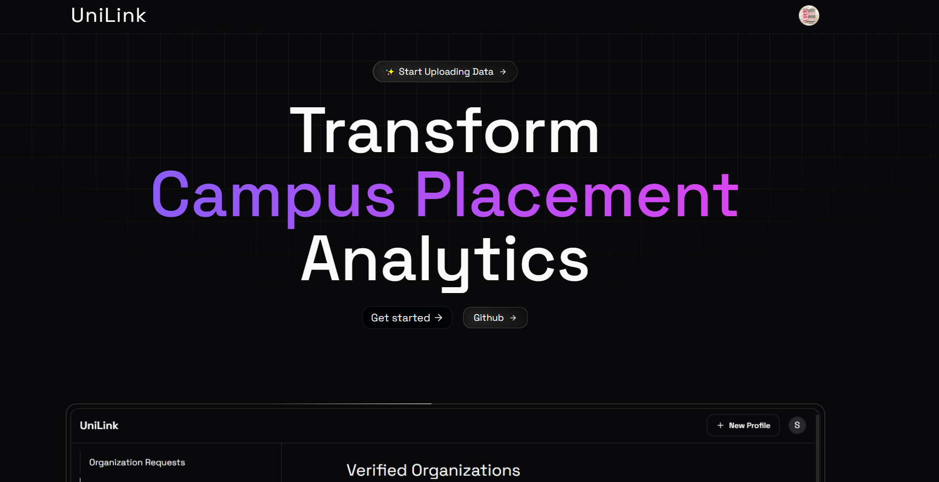
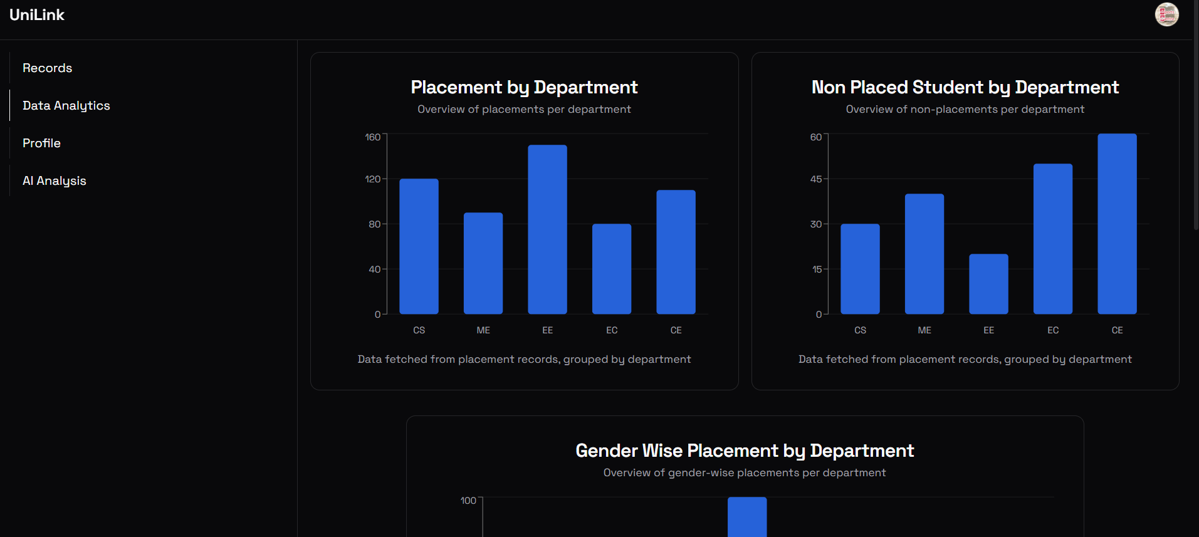
Results

Slide 9
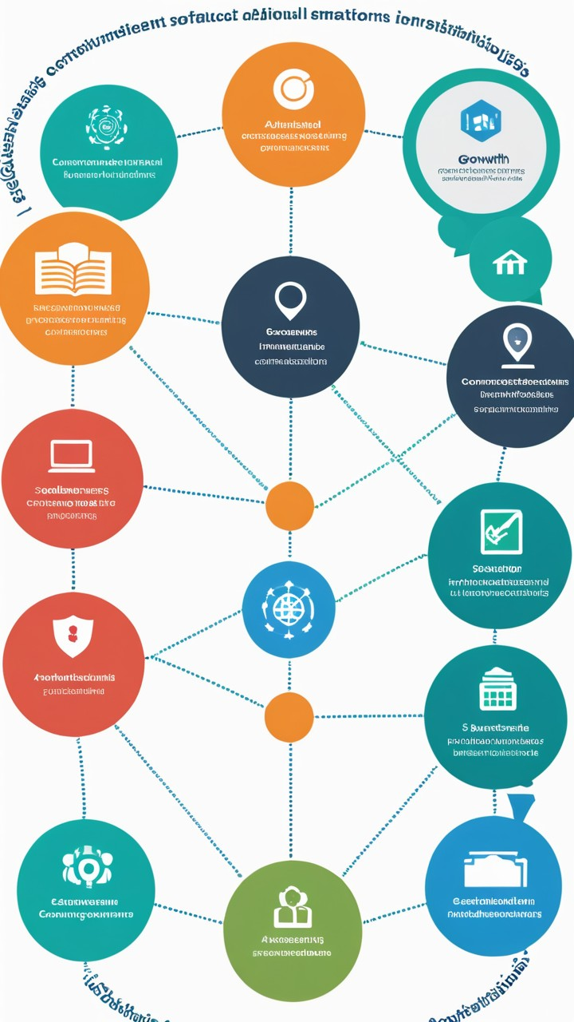
Next Steps and Conclusion
1
Scale and Expand
2
Forge Partnerships
Extend the platform to include more educational institutions across regions.
Collaborate with stakeholders (institutions, government, companies) to enhance data utilization.
3
Monitor and Evaluate
Track platform usage, data accuracy, and user engagement to ensure optimal performance.

