Slide 1
Heart Failure Prediction using Machine Learning

Slide 2
Hello!
I am Sweta Chopdar and I will be presenting alongside Sahil Sharma.
We both are final year students of Computer Science department, SUIIT.
19BTCSE73
19BTCSE69

Slide 3
Contents:
Introduction
Problem Statement
Data & Methods
Result
Conclusion
Future Scope
References

Slide 4
Introduction
Heart failure is a serious medical condition that affects millions of people worldwide.
Early prediction of heart failure can greatly improve patient outcomes and management.
In this presentation, we will discuss the use of machine learning techniques to predict heart failure in patients.
We will cover the data set used, the methods and algorithms employed, and the results of the prediction model.
By the end of the presentation, you will have a better understanding of the potential of machine learning in predicting heart failure and its importance in patient care.

Slide 5
Problem Statement
Let’s start with the first set of slides

Slide 6
Heart failure, a chronic condition characterized by the inability of the heart to pump blood effectively, is a leading cause of morbidity and mortality worldwide.
Current diagnostic methods, such as echocardiography and blood tests, have limitations in detecting heart failure in its early stages and may not be able to predict future development of the disease.
The goal of this project is to develop and evaluate a machine learning-based prediction model for early detection and risk stratification of heart failure in patients, using a combination of demographic, clinical, and laboratory data.

Slide 7
Data and Methods

Slide 8
1. Description of Dataset
The data set used for this analysis consists of 918 patients diagnosed with heart failure, collected from electronic health records, hospital databases.
The dataset includes 12 variables, such as demographic information (age, gender, race), clinical information (blood pressure, heart rate, ejection fraction), laboratory data (blood test results, such as creatinine, troponin, and B-type natriuretic peptide), and heart failure diagnosis.
The dataset is a balanced dataset, with an equal number of observations for heart failure and non-heart failure. The data is collected from various hospitals.

Slide 9
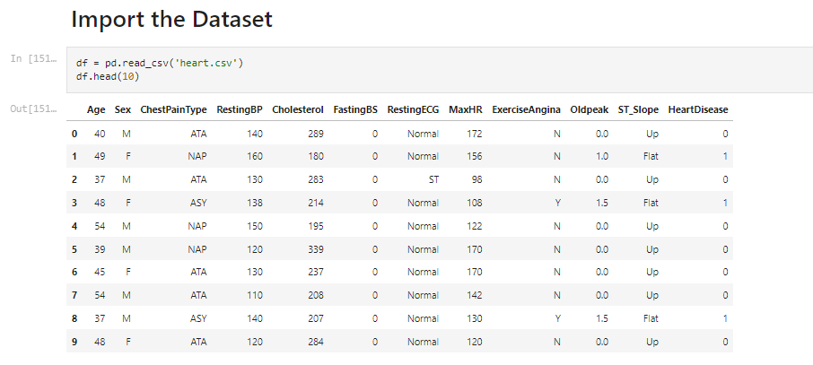
Figure 1: Extracted first 10 rows of the data set

Slide 10
2. Pre-Processing Steps
To ensure the quality and integrity of the data, several preprocessing steps were taken before the analysis.
First, we checked for missing values and handled them using linear interpolation.
Second, we checked for outliers and removed them using z-score method.
Third, we checked for errors and inconsistencies in the data and corrected them.
Fourth, we transformed the categorical variables into numerical variables using one-hot encoding.
Finally, we scaled the data to a common range using min-max scaling.
These preprocessing steps helped to ensure that the data was clean, consistent, and suitable for analysis.

Slide 11
3. Machine Learning Algorithms
We have used total of 8 Machine Learning(Regression & Classification) Algorithms in this Project,
Logistic Regression
Decision Tree Classifier
Random Forest Classifier
XGB Classifier
Gradient Boosting Classifier
Support Vector Classifier
KNN Model
Naive Bayes Classifier

Slide 12
3.1. Logistic Regression
Logistic regression is a statistical method used for predicting binary outcomes (i.e. outcomes with two possible results, such as yes or no, true or false). The logistic regression model uses a logistic function to model the relationship between a set of independent variables and the probability of a binary outcome.
An example of logistic regression could be predicting whether a customer will purchase a product based on their age, income, and location. In this example, the binary outcome would be whether the customer makes a purchase (yes or no), and the independent variables would be age, income, and location. The logistic regression model would then be used to estimate the probability that a customer with a specific set of age, income, and location values would make a purchase.

Slide 13
3.2. Decision Tree Classifier
A Decision Tree Classifier is a supervised machine learning algorithm that can be used for classification problems. The algorithm constructs a tree-like model of decisions and their possible consequences, which can be used to predict the outcome of a new observation.
The decision tree classifier starts with a single node (the "root node") that represents the entire data set. The algorithm then splits the data into subsets based on a chosen feature, and creates new nodes for each subset. The process is then repeated recursively for each of these new nodes, until the tree is fully grown. Each leaf node of the tree represents a class or a decision and each internal node represents a feature.

Slide 14
3.3. Random Forest Classifier
Random Forest Classifier is an ensemble machine learning algorithm that creates multiple decision trees and combines their predictions to improve the accuracy of the model. It is used for both classification and regression problems, it is considered as a powerful algorithm with high accuracy and stability, while being relatively easy to interpret.
For example, a Random Forest classifier could be used to predict whether a person will default on a loan based on their credit history and income. The classifier would use multiple decision trees, each trained on a different subset of the data, to make predictions. The final prediction would be the average of the predictions made by the individual trees.

Slide 15
3.4. XGB Classifier
XGBoost (Extreme Gradient Boosting) is an open-source implementation of gradient boosting, an ensemble machine learning algorithm that uses decision trees as its base model. It is designed to be efficient and scalable, and is commonly used for classification and regression problems.
One example of using XGBoost for classification would be to predict whether a customer will make a purchase on an e-commerce website based on their browsing history and past purchase behavior. The model would learn from the data, and use decision trees to make predictions on whether a customer will make a purchase or not.

Slide 16
3.5. Gradient Boosting Classifier
Gradient boosting is an ensemble machine learning technique that combines multiple weak models, such as decision trees, to create a stronger model. It is an iterative process, where the model is trained to correct the errors made by the previous iteration. The final prediction is the weighted average of the predictions made by the individual trees.
An example of using Gradient Boosting Classifier could be in the field of bioinformatics, where the goal is to predict if a given protein is membranal or soluble. The classifier would be trained using a dataset containing various features of a protein, such as its amino acid sequence and structure, and use decision trees to make predictions. As the model trains, it will correct its mistakes and improve its predictions.

Slide 17
3.6. Support Forest Classifier
A Support Vector Classifier (SVC) is a type of supervised learning algorithm that can be used for classification and regression problems. It works by finding the best boundary, or hyperplane, that separates the data into different classes. The best boundary is the one that maximizes the margin, or distance, between the boundary and the closest data points from each class, known as support vectors.
For example, a SVC could be used to classify images of handwritten digits (0-9) by finding a boundary that separates the images of the digits into different classes. The model would be trained on a dataset of images of handwritten digits and their corresponding labels (0-9), and use the pixels of the images as features to find the best boundary to separate the images into different classes.

Slide 18
3.7. KNN Model
K-Nearest Neighbors (KNN) is a non-parametric, instance-based, and supervised machine learning algorithm used for classification and regression problems. It works (e.g., distance functions). An object is classified by a majority vote of its neighbors, with the object being assigned to the class most common amongst its k nearest neighbors.
For example, a KNN model could be used to classify a new customer as a high-value or low-value customer based on their spending habits and demographics. The model would be trained on a dataset of customers and their corresponding labels (high-value or low-value), and use the spending habits and demographics of the customers as features to classify new customers. The number of nearest neighbors (k) that are used to make the classification decision can be specified by the user and adjusted as needed.

Slide 19
3.8. Naive Bayes Classifier
Naive Bayes is a probabilistic algorithm based on Bayes' theorem that is used for classification problems. It makes the assumption that the features in the dataset are independent of each other, which is called the "naive" assumption. It predicts the class of a new sample by applying Bayes' theorem with the "naive" assumption of independence.
For example, a Naive Bayes algorithm could be used to classify an email as spam or not spam. The algorithm would be trained on a dataset of emails and their corresponding labels (spam or not spam) and use the words in the emails as features. The algorithm would then use Bayes' theorem with the assumption that the words in the email are independent of each other to classify a new email as spam or not spam.

Slide 20
4. Evaluation Metrics
To evaluate the performance of the various model, we used several evaluation metrics. These metrics include:
Accuracy: the proportion of correctly classified instances. It is the number of correct predictions divided by the total number of predictions.
Sensitivity (True Positive Rate): the proportion of actual positive cases that were correctly identified.
Specificity (True Negative Rate): the proportion of actual negative cases that were correctly identified.
Precision (Positive Predictive Value): the proportion of predicted positive cases that were actually positive.
F1-Score: the harmonic mean of precision and recall.
AUC (Area Under the ROC Curve): a measure of the model's ability to distinguish between positive and negative cases.

Slide 21
Result

Slide 22
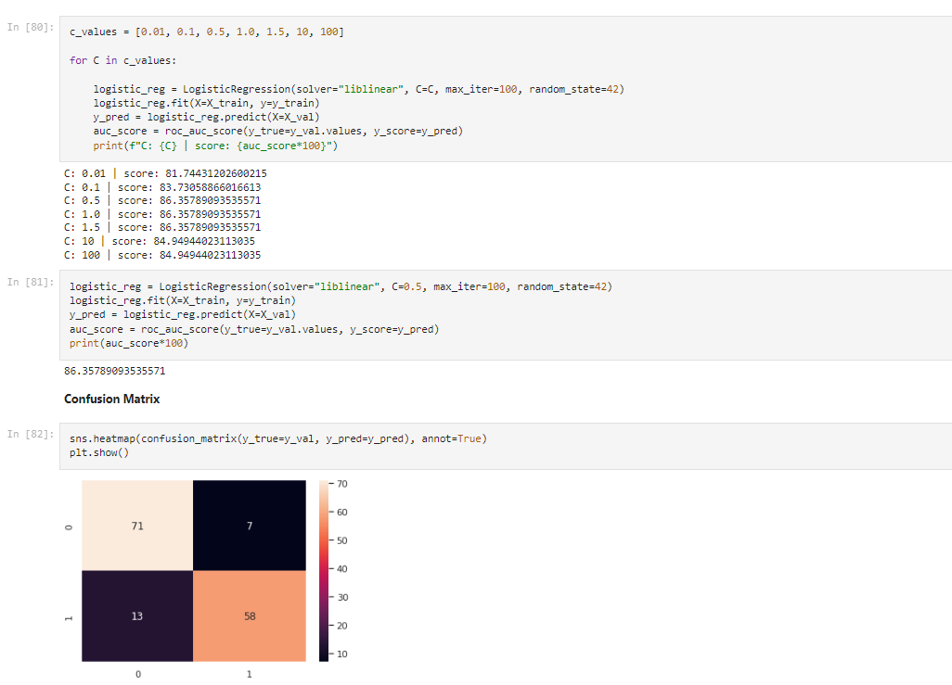
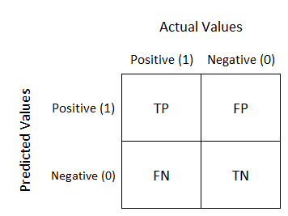
Logistic Regression
-----------
86.35%
Confusion Matrix: Well, it is a performance measurement for machine learning classification problem where output can be two or more classes. It is a table with 4 different combinations of predicted and actual values.
Figure 4: Confusion Matrix
TP: You predicted positive and it’s true.
TN: You predicted negative and it’s true.
FP: You predicted positive and it’s false.
FN: You predicted negative and it’s false.

Slide 23
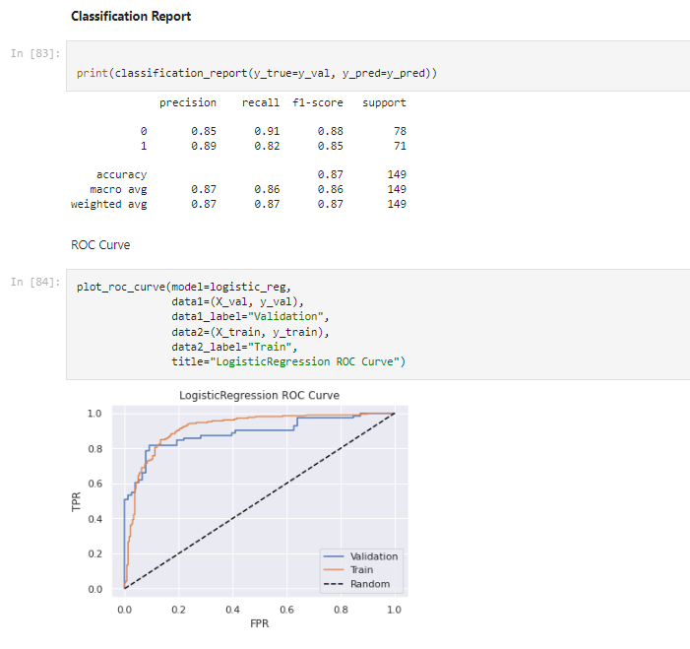
Roc Curve & Performance Metrics
ROC Curve: An ROC curve is a graph showing the performance of a classification model at all classification thresholds.
Classification Report:
To evaluate the performance or quality of the model, different metrics are used, and these metrics are known as performance metrics or evaluation metrics.
Figure 5: Figure of ROC Curve

Slide 24
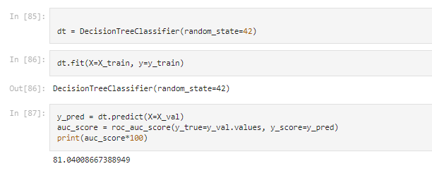
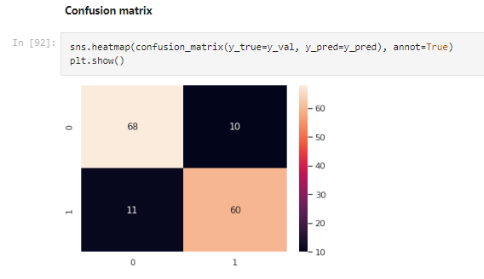
Decision Tree Classifier
-----------
81.04%
Figure 6: Confusion Matrix

Slide 25
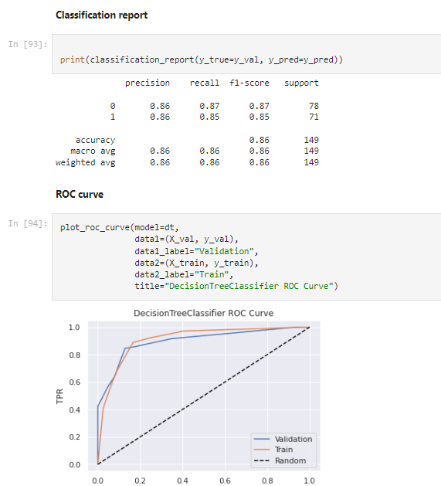
Roc Curve & Performance Metrics
Figure 7: Figure of ROC Curve

Slide 26
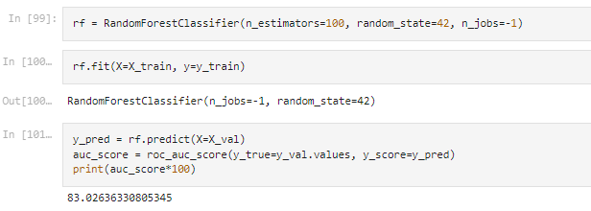
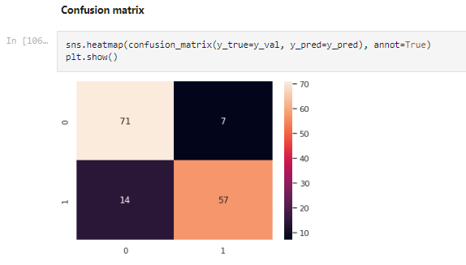
Random Forest Classifier
-----------
83.02%
Figure 8: Confusion Matrix

Slide 27
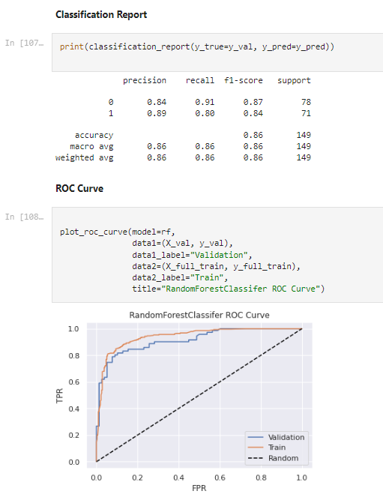
Roc Curve & Performance Metrics
Figure 9: Figure of ROC Curve

Slide 28
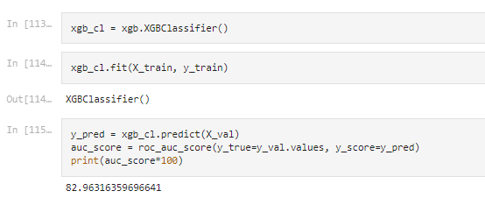
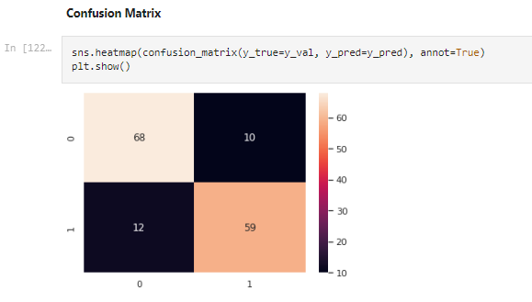
XG Boosting Classifier
-----------
82.96%
Figure 10: Confusion Matrix

Slide 29
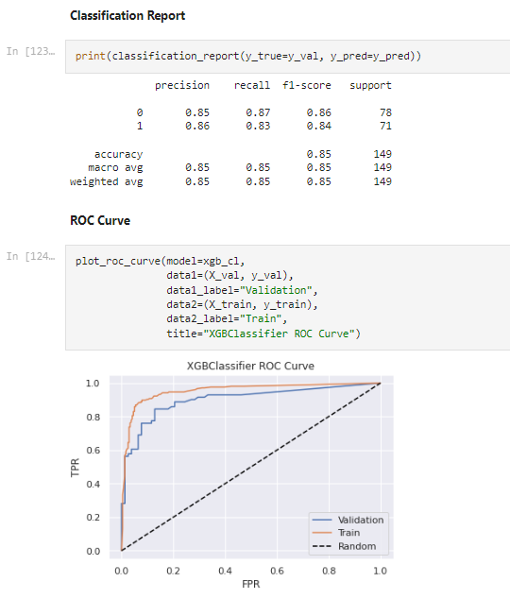
Roc Curve & Performance Metrics
Figure 11: Figure of ROC Curve

Slide 30
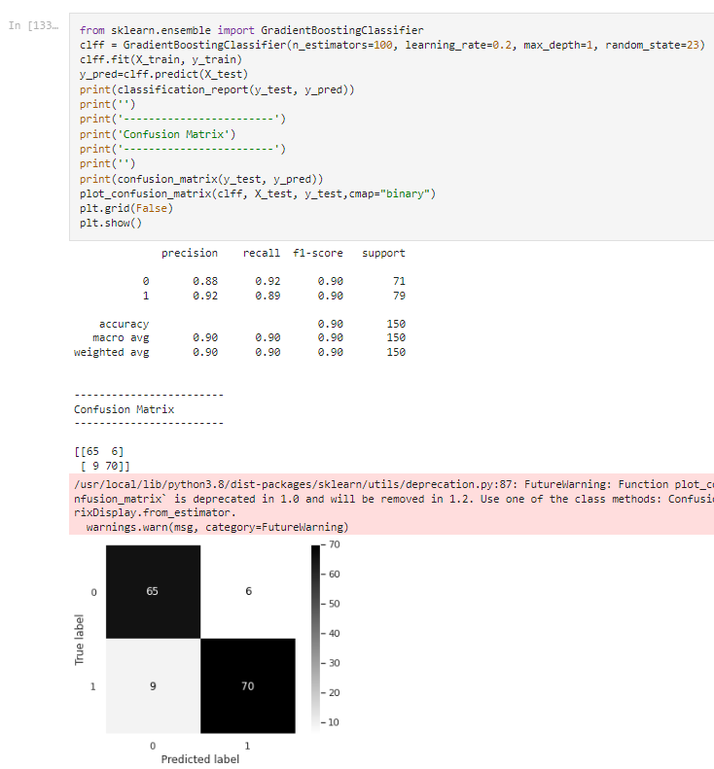
Gradient Boosting Classifier
-----------
90%
Figure 12: Confusion Matrix

Slide 31
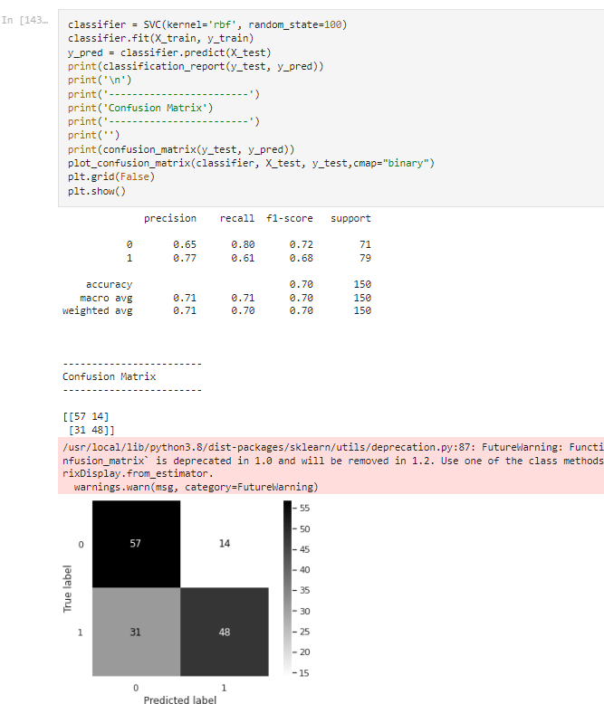
Support Vector Classifier
-----------
70%
Figure 13: Confusion Matrix

Slide 32
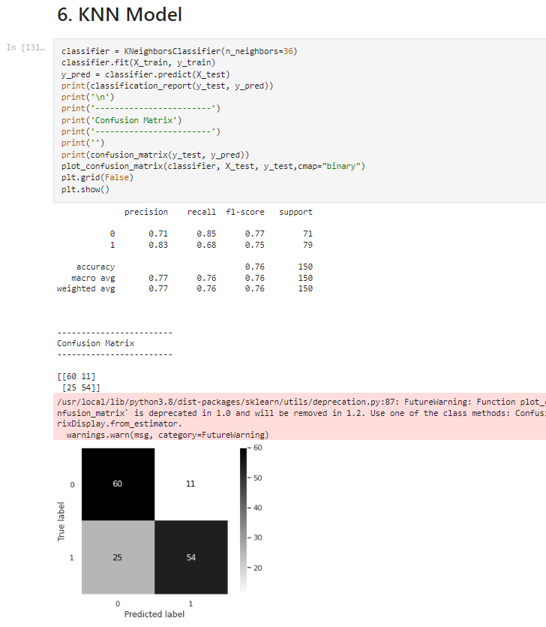
KNN Model
-----------
76%
Figure 14: Confusion Matrix

Slide 33
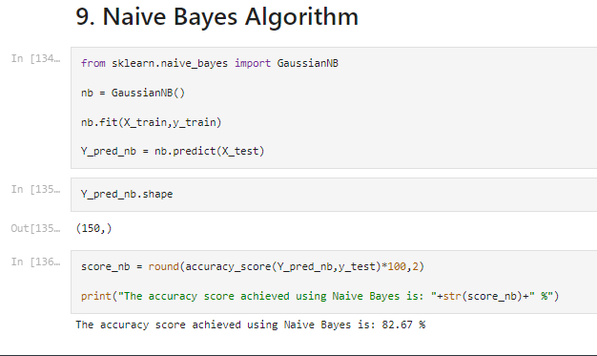
Naive bayes
-----------
76%
Figure 15: Code of Implementation

Slide 34
Conclusion

Slide 35
Heart disease is the most common disease in India. Early detection of heart diseases will increase the survival rate hence this research work is intended to predict the whether the patient has heart disease or not with the help of clinical data which will assist the diagnosis process.
Our machine learning algorithm can now classify patients with heart disease. Now we can properly diagnose patients, & get them the help they need to recover. Ny diagnosis detecting these features early, we may prevent worse symptoms from arising later.
Our Gradient Boosting Algorithm yields the highest accuracy, 90%. Any accuracy above 70% is considered good.

Slide 36
Future Scope

Slide 37
At some point in future, the machine learning model will make use of a larger training dataset, possibly more than a million different data points maintained in electronic health record system.
Although it would be a huge leap in terms of computational power and software sophistication but a system that will work on artificial intelligence might allow the medical practitioner to decide the best suited treatment for the concerned patient as soon as possible.
A software API can be developed to enable health websites and apps to provide access to the patients free of cost. The probability prediction would be performed with zero or virtually no delay in processing.

Slide 38
References

Slide 39
[1] Soni J, Ansari U, Sharma D & Soni S (2011). Predictive data mining for medical diagnosis: an overview of heart disease prediction. International Journal of Computer Applications, 17(8), 43-8
[2] Dangare C S & Apte S S (2012). Improved study of heart disease prediction system using data mining classification techniques. International Journal of Computer Applications, 47(10), 44-8.
[3] Ordonez C (2006). Association rule discovery with the train and test approach for heart disease prediction. IEEE Transactions on Information Technology in Biomedicine, 10(2), 334-43.
[4] Shinde R, Arjun S, Patil P & Waghmare J (2015). An intelligent heart disease prediction system using k-means clustering and Naïve Bayes algorithm. International Journal of Computer Science and Information Technologies, 6(1), 637-9.
[5] Bashir S, Qamar U & Javed M Y (2014, November). An ensemble-based decision support framework for intelligent heart disease diagnosis. In International Conference on Information Society (i-Society 2014) (pp. 259-64). IEEE. ICCRDA 2020 IOP Conf. Series: Materials Science and Engineering 1022 (2021) 012072 IOP Publishing doi:10.1088/1757-899X/1022/1/012072 9
[6] Jee S H, Jang Y, Oh D J, Oh B H, Lee S H, Park S W & Yun Y D (2014). A coronary heart disease prediction model: the Korean Heart Study. BMJ open, 4(5), e005025.
[7] Ganna A, Magnusson P K, Pedersen N L, de Faire U, Reilly M, Ärnlöv J & Ingelsson E (2013). Multilocus genetic risk scores for coronary heart disease prediction. Arteriosclerosis, thrombosis, and vascular biology, 33(9), 2267-72.
[8] Jabbar M A, Deekshatulu B L & Chandra P (2013, March). Heart disease prediction using lazy associative classification. In 2013 International MutliConference on Automation, Computing,Communication, Control and Compressed Sensing (iMac4s) (pp. 40- 6). IEEE.
[9] Brown N, Young T, Gray D, Skene A M & Hampton J R (1997). Inpatient deaths from acute myocardial infarction, 1982-92: analysis of data in the Nottingham heart attack register. BMJ, 315(7101), 159-64.
[10] Folsom A R, Prineas R J, Kaye S A & Soler J T (1989). Body fat distribution and self-reported prevalence of hypertension, heart attack, and other heart disease in older women. International journal of epidemiologyy, 18(2), 361-7.
11] Chen A H, Huang S Y, Hong P S, Cheng C H & Lin E J (2011, September). HDPS: Heart disease prediction system. In 2011 Computing in Cardiology (pp. 557- 60). IEEE.
[12] Parthiban, Latha and R Subramanian. "Intelligent heart disease prediction system using CANFIS and genetic algorithm." International Journal of Biological, Biomedical and Medical Sciences 3.3 (2008).
[13] Wolgast G, Ehrenborg C, Israelsson A, Helander J, Johansson E & Manefjord H (2016). Wireless body area network for heart attack detection [Education Corner]. IEEE antennas and

Slide 40
Thanks!

