Slide 1
Guide to build test auto system
2022.01.26
Taylor Kao

Slide 2
Outline
Introduction
Preparation
Roboframework Script
Jenkins in Docker
Trigger script with Jenkins
Demo
Q&A

Slide 3
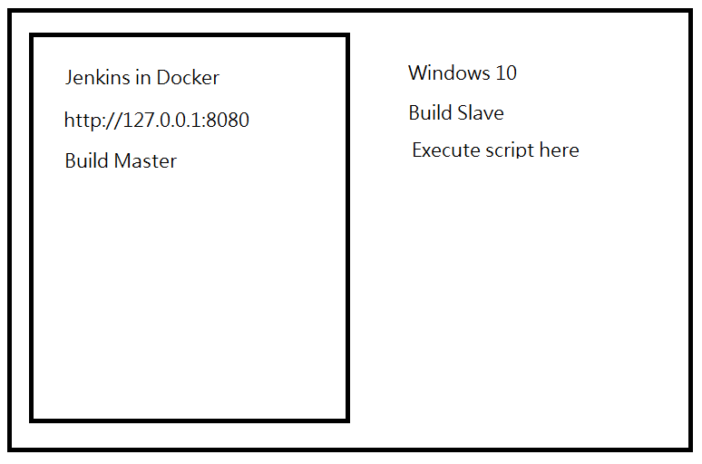
Introduction
This guide shows how to build a test auto system to verify google search result for keyword: ruckus wireless with Robotframework , and setup a CI system with Docker to trigger the testing

Slide 4
Preparation
One PC installed with Windows 10
Outside Network
Python 3.9
Python package : robotframework , robotframework-seleniumlibrary
Chromedriver.exe
WSL2 and Docker Desktop software

Slide 5
Roboframework Script – before testing
Purpose : open browser to send search keyword and enter in the search result to capture the image of the site
Preparation : download chromedriver.exe which’s version matched with the current running chrome version, and then add chromedriver.exe path into environment variable
How to do : write a single robot file with Seleniumlibrary

Slide 6
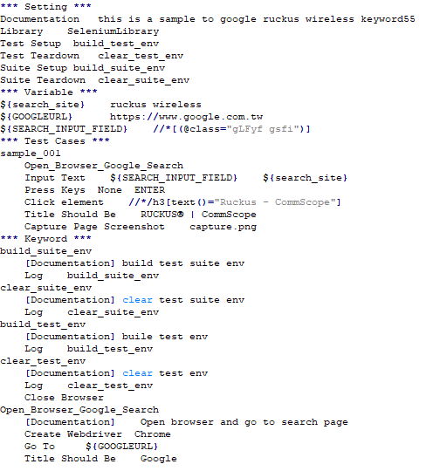
Roboframework Script – sample code

Slide 7
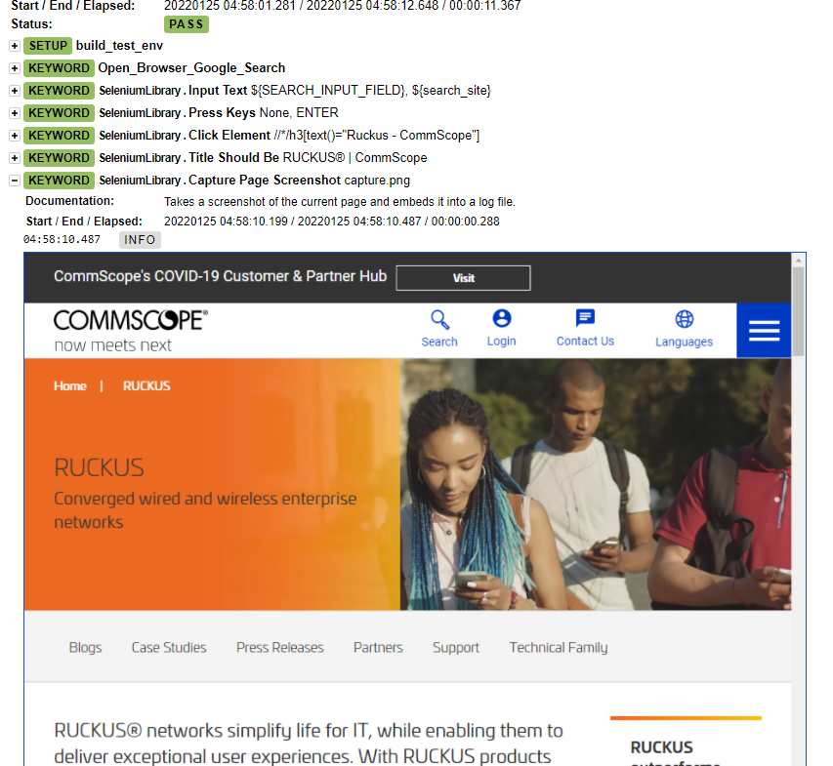
Roboframework Script – execution
How to execute : run the below command in window cmd
python –m robot google_search.robot
Check result : open log.html and check the capture official site image

Slide 8
Jenkins in Docker –Before installation
Purpose : setup Docker environment for Jenkins
Preparation :
1. Download the below packages:
- WSL2 Kernerl package : Click me to download
- Docker desktop : official site

Slide 9
Jenkins in Docker – Enable Virtual machine
Run the below command on command prompt window and then reboot
1. Enable Windows subsystem for Linux
# dism.exe /online /enable-feature /featurename:Microsoft-Windows-Subsystem-Linux /all /norestart
2. Enable Virtual Machine
# dism.exe /online /enable-feature /featurename:VirtualMachinePlatform /all /norestart
3. Reboot PC

Slide 10
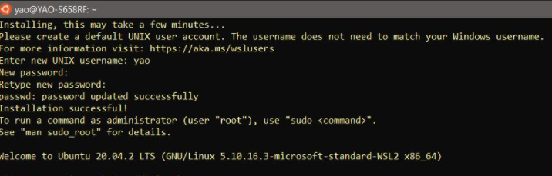
Jenkins in Docker – Setup WSL2
Install WSL2 package and download a Linux image from Microsoft store
Microsoft store link : Click me to go
Install the downloaded Linux image and then setup account and password as below

Slide 11
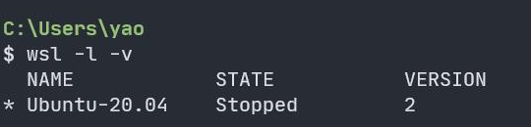
Jenkins in Docker – Setup WSL2 (con.)
Run the below command on command prompt window to setup WSL2
1. config wsl2 as the default version
# wsl --set-default-version 2
2. config wsl default linux package
# wsl --set-default Ubuntu-20.04
3. check the current version
# wsl -l -v

Slide 12
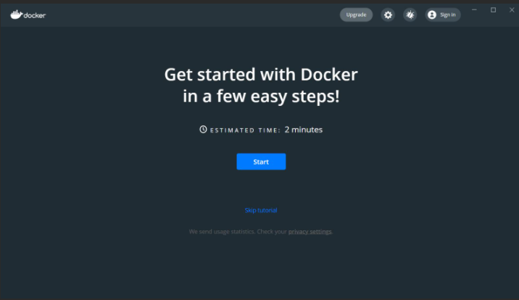
Jenkins in Docker – Setup Docker
Install Docker desktop package and then reboot pc

Slide 13
Jenkins in Docker – download Jenkins container
Run the below command on command prompt window to download and setup Jenkins container
1. Create a bridge network in Docker
# docker network create jenkins
2. Run a docker:dind Docker image
# docker run --name jenkins-docker --rm --detach --privileged --network jenkins --network-alias docker --env DOCKER_TLS_CERTDIR=/certs --volume jenkins-docker-certs:/certs/client --volume jenkins-data:/var/jenkins_home --publish 2376:2376 docker:dind

Slide 14
Jenkins in Docker – download Jenkins container (con.)
3. Create Dockerfile with the following content
FROM jenkins/jenkins:2.319.2-jdk11
USER root
RUN apt-get update && apt-get install -y lsb-release
RUN curl -fsSLo /usr/share/keyrings/docker-archive-keyring.asc \
https://download.docker.com/linux/debian/gpg
RUN echo "deb [arch=$(dpkg --print-architecture) \
signed-by=/usr/share/keyrings/docker-archive-keyring.asc] \
https://download.docker.com/linux/debian \
$(lsb_release -cs) stable" > /etc/apt/sources.list.d/docker.list
RUN apt-get update && apt-get install -y docker-ce-cli
USER jenkins
RUN jenkins-plugin-cli --plugins "blueocean:1.25.2 docker-workflow:1.27“
4. Build a new docker image from this Dockerfile and assign the image a meaningful name, e.g. "myjenkins-blueocean:2.319.2-1":
# docker build -t myjenkins-blueocean:2.319.2-1 .

Slide 15
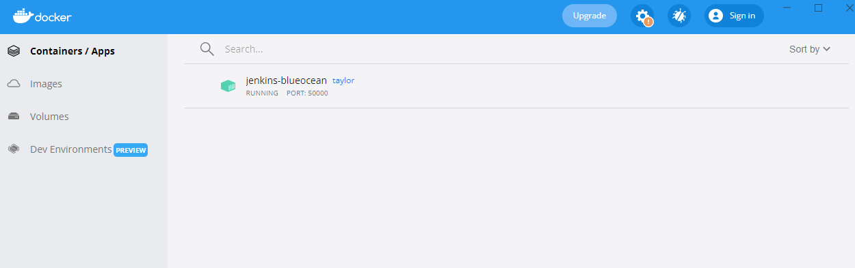
Jenkins in Docker – download Jenkins container (con.)
5. Run myjenkins-blueocean:2.319.2-1 image as a container in Docker using the following docker run command:
# docker run --name jenkins-blueocean --rm --detach --network jenkins --env DOCKER_HOST=tcp://docker:2376 --env DOCKER_CERT_PATH=/certs/client --env DOCKER_TLS_VERIFY=1 --volume jenkins-data:/var/jenkins_home --volume jenkins-docker-certs:/certs/client:ro --publish 8080:8080 --publish 50000:50000 myjenkins-blueocean:2.319.2-1
6. Check Jenkins container if running on Docker desktop

Slide 16
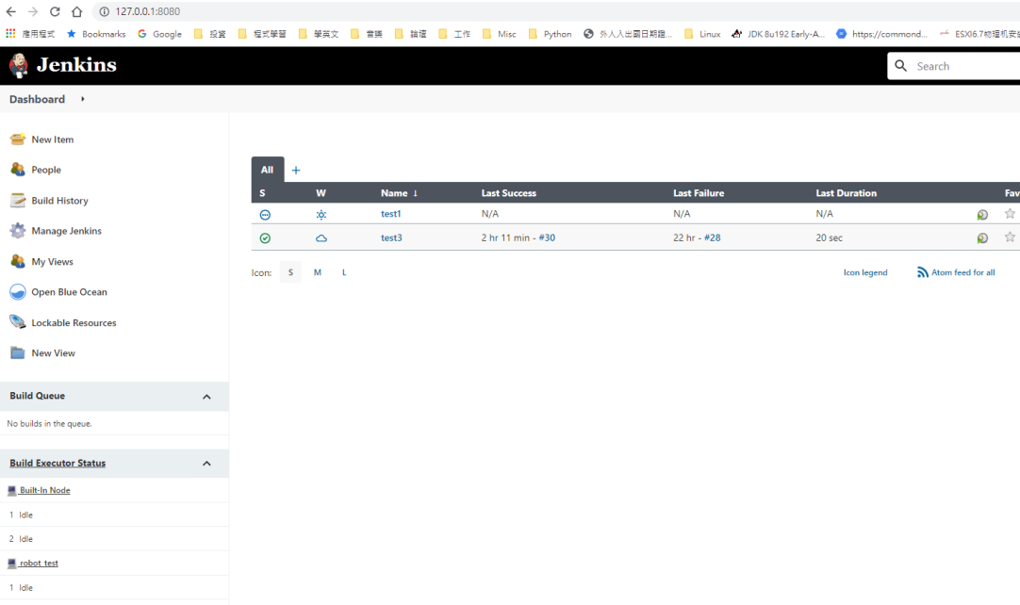
Jenkins in Docker – Setup Jenkins
Purpose : Initial Jenkins and download robotframework plugin
Start to do :
1. open http://127.0.0.1:8080
2. Input admin password
3. Create a new user
4. Download the default plugins
5. Download robotframework plugin

Slide 17
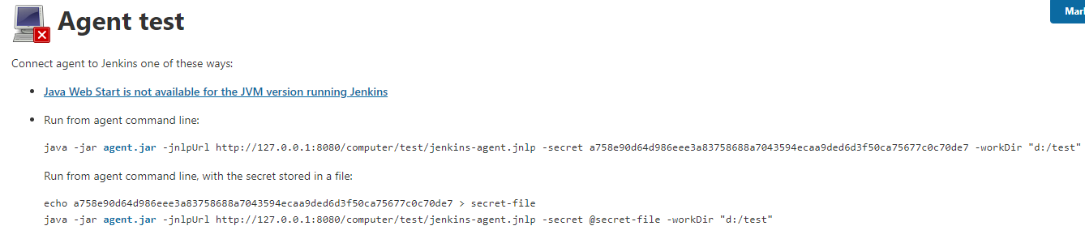
Jenkins in Docker – setup Master and Slave
Purpose : select my window pc to be a slave node and it needs to execute Robotframework script and then Master will get the test result
Start to do :
1. Jenkins dashboard -> Manage Jenkins -> Manage Nodes and Clouds -> New Node -> Input Node name -> select Permanent Agent -> Setup Remote root directory -> Save -> back to Nodes dashboard -> select new create node -> download agent.jar file and save it to my window pc ->

Slide 18
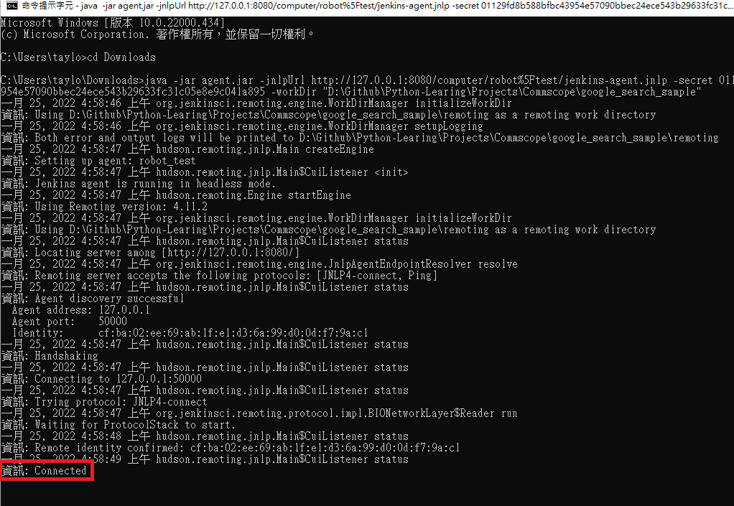
Jenkins in Docker – setup Master and Slave (con.)
2. Execute the node activate java command then node state will become connected as below :

Slide 19
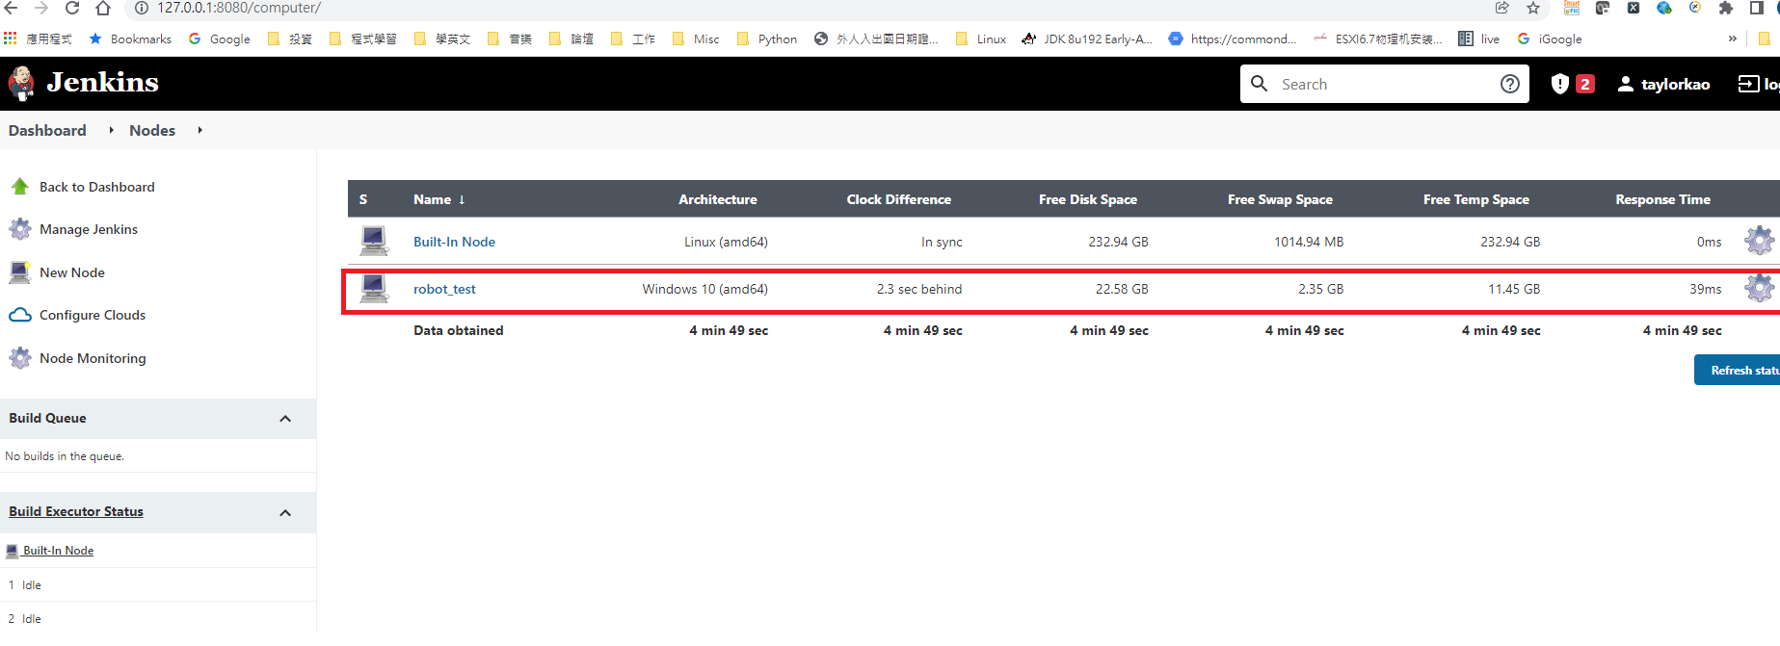
Jenkins in Docker – setup Master and Slave (con.)
3. Check node state on Jenkins node dashboard :

Slide 20
Trigger script with Jenkins
Purpose : Create a pipeline job to trigger Robotframework script
Start to do :
1. New a pipeline job
2. Write groovy script to start the test
- agent label : node name
- bat command : python command to trigger robot test
- output .xml path : robotframework’s log path

Slide 21
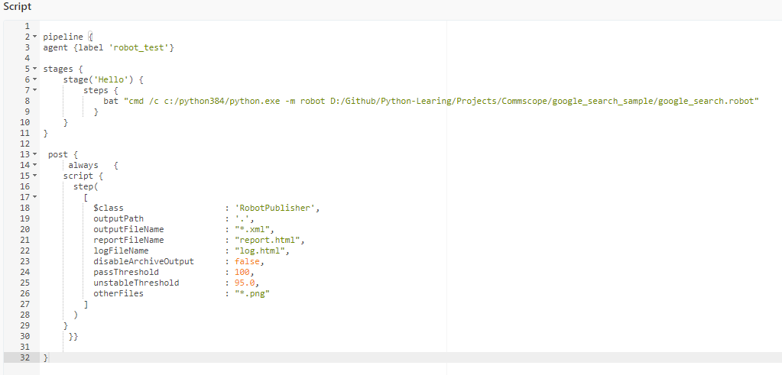
Trigger script with Jenkins (con.)
Groovy script :

Slide 22
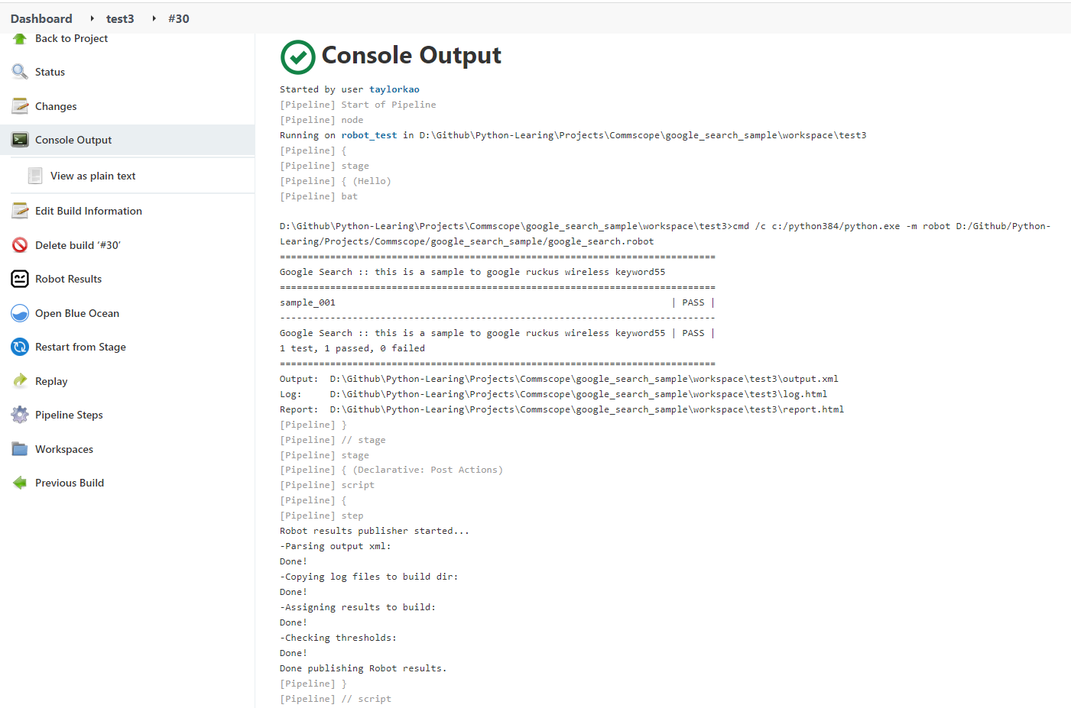
Trigger script with Jenkins (con.)
Click build now and check console

Slide 23
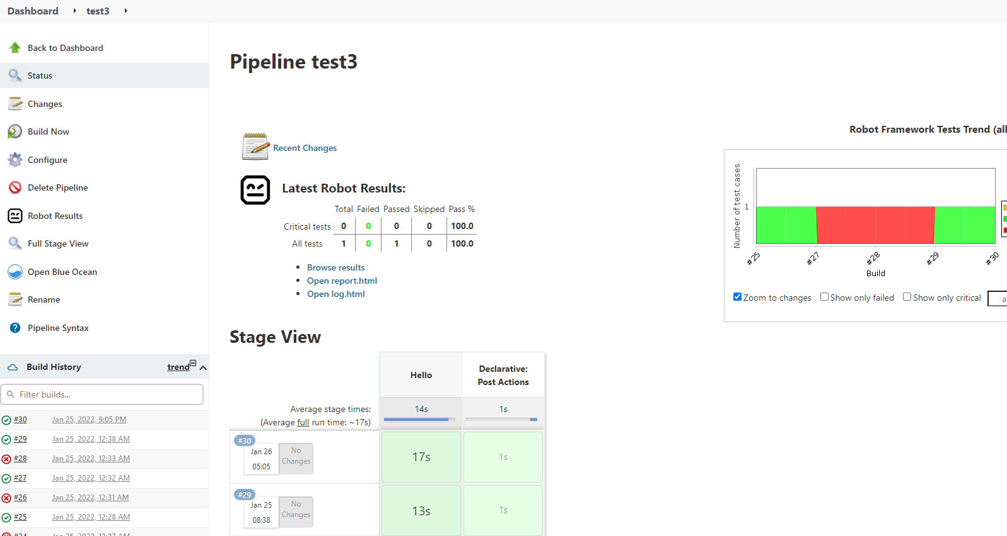
Trigger script with Jenkins (con.)
Check the result on job dashboard

Slide 24
References
https://www.dotblogs.com.tw/yc421206/2021/08/15/install_wsl2_and_docker_in_windows_10
https://www.jenkins.io/doc/book/installing/docker/

Slide 25
DEMO

Slide 26
Q&A

