Slide 1
Data@ANZ
1. Exploratory Data Analysis
The data set contains 3 months’ worth of transactions for 100 hypothetical customers. It contains purchases, recurring transactions, and salary transactions. The aim is to explore the data and gather some insights.

Slide 2
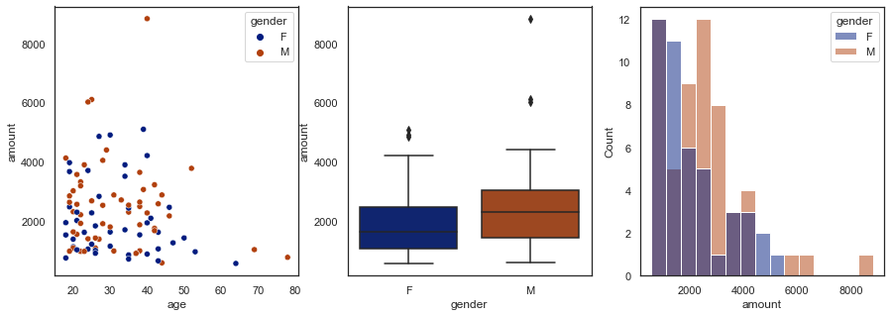
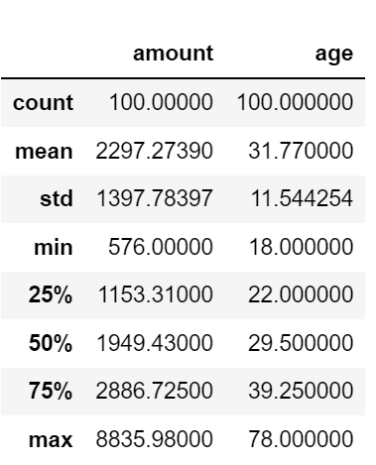




Analysis based on Account Credits
Considering the given accounts, there are 56 men and 44 women. The youngest account holder is 18 years of age, while the oldest is 78 years.
Considering the credits to the accounts, it can be seen that all the credits are of type pay/salary, and by checking the pay distribution among the customers.
The average pay is around $2297per month. By checking the figure, it can be seen that the average pay for men is slightly higher compared to the women. However, this value is effected by extreme outliers. Additionally, the data is positively skewed, meaning the median pay is less than the average, and is $1949.

Slide 3
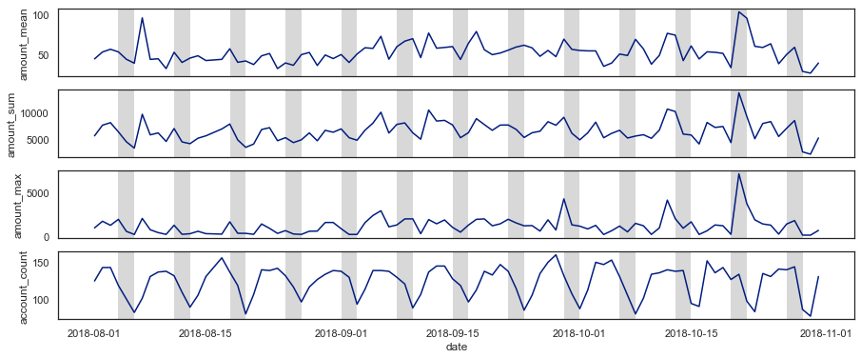
Analyzing Customer Expenses
By grouping the expenses by the date, and aggregating via the amount-sum, amount-mean, amount-max and number of transactions, the expenditure with time can be seen as follows. The gray areas denotes the weekends:
From the above figure, it can be seen than the customer spending habits are lower on Monday, whereas it increments as the week goes by.
Considering the total expenditure, it has slightly incremented throughout the months. On average there are 123 customer transactions per day and on average, the amount spend per transaction is around $53.

Slide 4
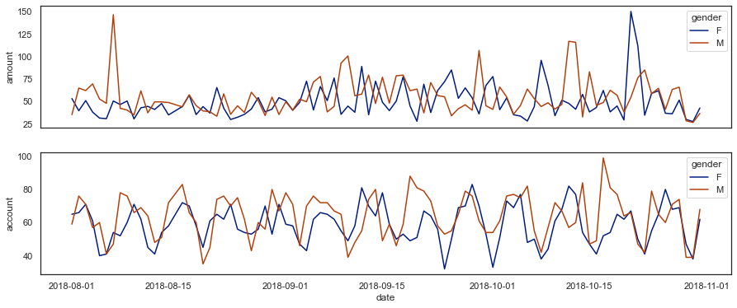
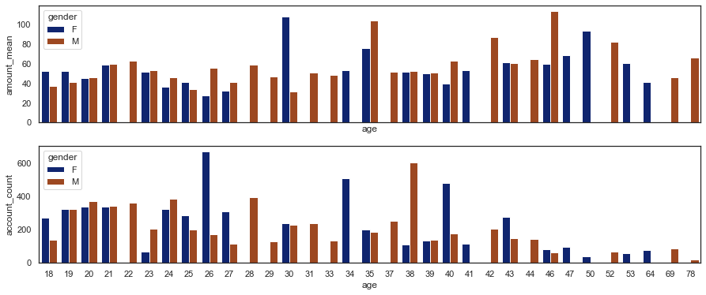
Spending habits by gender and age
According to these two figures, the number of transactions done by younger generation is comparatively higher than the elderly, whereas the amount spend on average per transaction by the elderly is higher. Few instances can be observed where younger women around the ages of 26, 34 and men at the age of 38 making more transactions in comparison with men and women on other age groups.

Slide 5
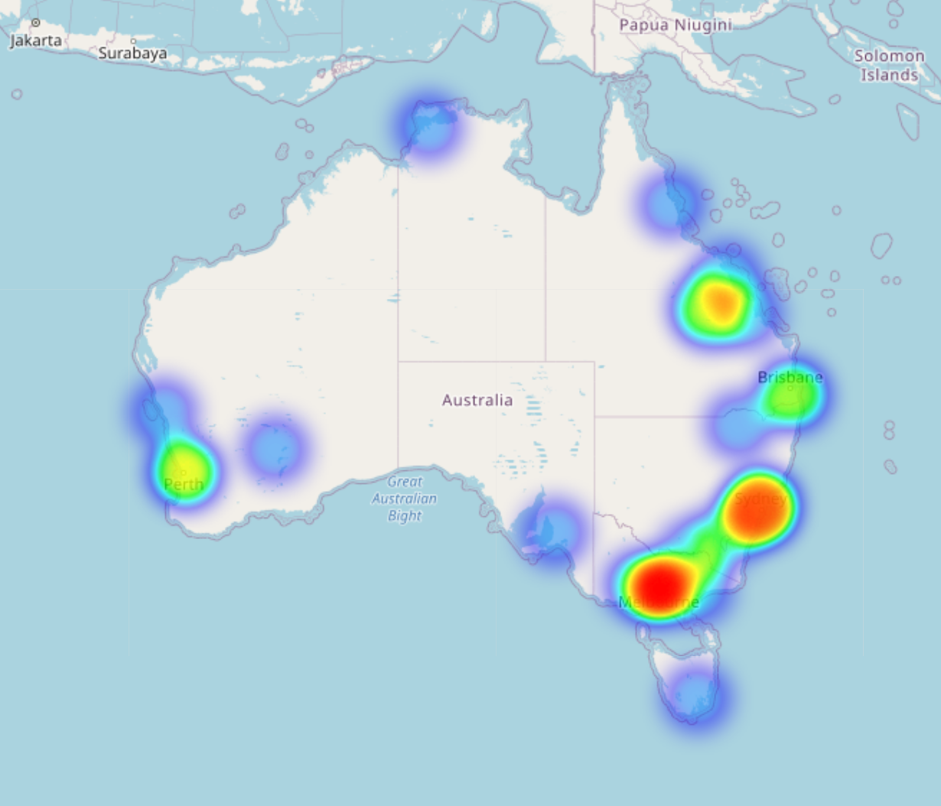
Account Transactions by Location
Since there is an issue with the lat-lng coordinates of an account, by checking the account number of the account with faulty coordinates with accounts numbers with similar starting digits, the location can be assumed to be in the same area.
Most account holders are concentrated on major cities such as Melbourne and Sydney, followed by Brisbane and Perth. Regional areas such as Darwin, Adelaide, Cairns, Hobart are shown as isolated clusters, where there is a low number of customers based on transaction amounts.

