Slide 1
Programming Assignment 2 (1/2)
Write a program to convert a set of documents into tf-idf vectors.
  Text collection:
    1095 news documents (https://ceiba.ntu.edu.tw/course/aa23ce/content/IRTM.zip )
  Construct a dictionary based on the terms extracted from the given documents.
    Record the document frequency of each term.
    Save your dictionary as a txt file (dictionary.txt).
t_index term df
Apple 3
Basketball 12
…
ascending order, by term
dictionary.txt
Notes:
df : 計算每個term在documents collection中出現幾次(出現在幾篇documents)

Slide 2
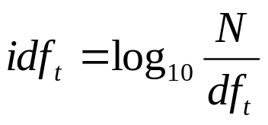
Programming Assignment 2 (2/2)
  Transfer each document into a tf-idf unit vector.
    Save it as a txt file (DocID.txt).
  Write a function cosine(Doc_{x}, Doc_{y}) which loads the tf-idf vectors of documents x and y and returns their cosine similarity.
  Please zip and submit ^{1.}your dictionary, ^{2.}the vector file of document 1, ^{3.}source code, and ^{4.}a report to TA.
    Also mention the cosine similarity between document 1 and 2 in your report.
    3 weeks to complete, that is, 2018/10/23.
The document has 3 terms
3
t_index tf-idf
2 0.731
0.218
22 0.014
1.txt

