Slide 1
Fintech Idea
By- Team
(Rumit Maiti and Pratistha Sinha)

Slide 2
Executive Summary
Fintech refers to the integration of technology into offerings by financial services or companies.
It is primarily focussed on increasing profit and aim to improve use and delivery to consumers.
Our app provides user friendly feature to track expenses yearly or monthly and represent the analysis using data visualisation.
This app also allows user to perform safe money transaction verifying payment via e-mail and OTP feature.

Slide 3
Secret sauce
Monitoring features provides Customer friendly services
The more downloads and engaging among users,the more profit we can incur
User Interface has skeleton components ,eye-pleasing colours and easy navigation among the screens.

Slide 4
Homepage
Layout contains:
1)Side Navigation-contains 3 fragments
Dashboard
Analytics
Transaction
2)Settings-
3)displays the user name in header

Slide 5
Dashboard(gist)
provides an estimate of the individual’s future income and expenses
A list shows income,expenditure and balance as per monthly income.
It can be compared to previously entered fields by rate percents
Spending Tracker that graphically shows monthly expenditure that user has transacted in that particular month
monitored using pie chart that shows where money has been spent in that month. Eg-Household,maintenance,food

Slide 6
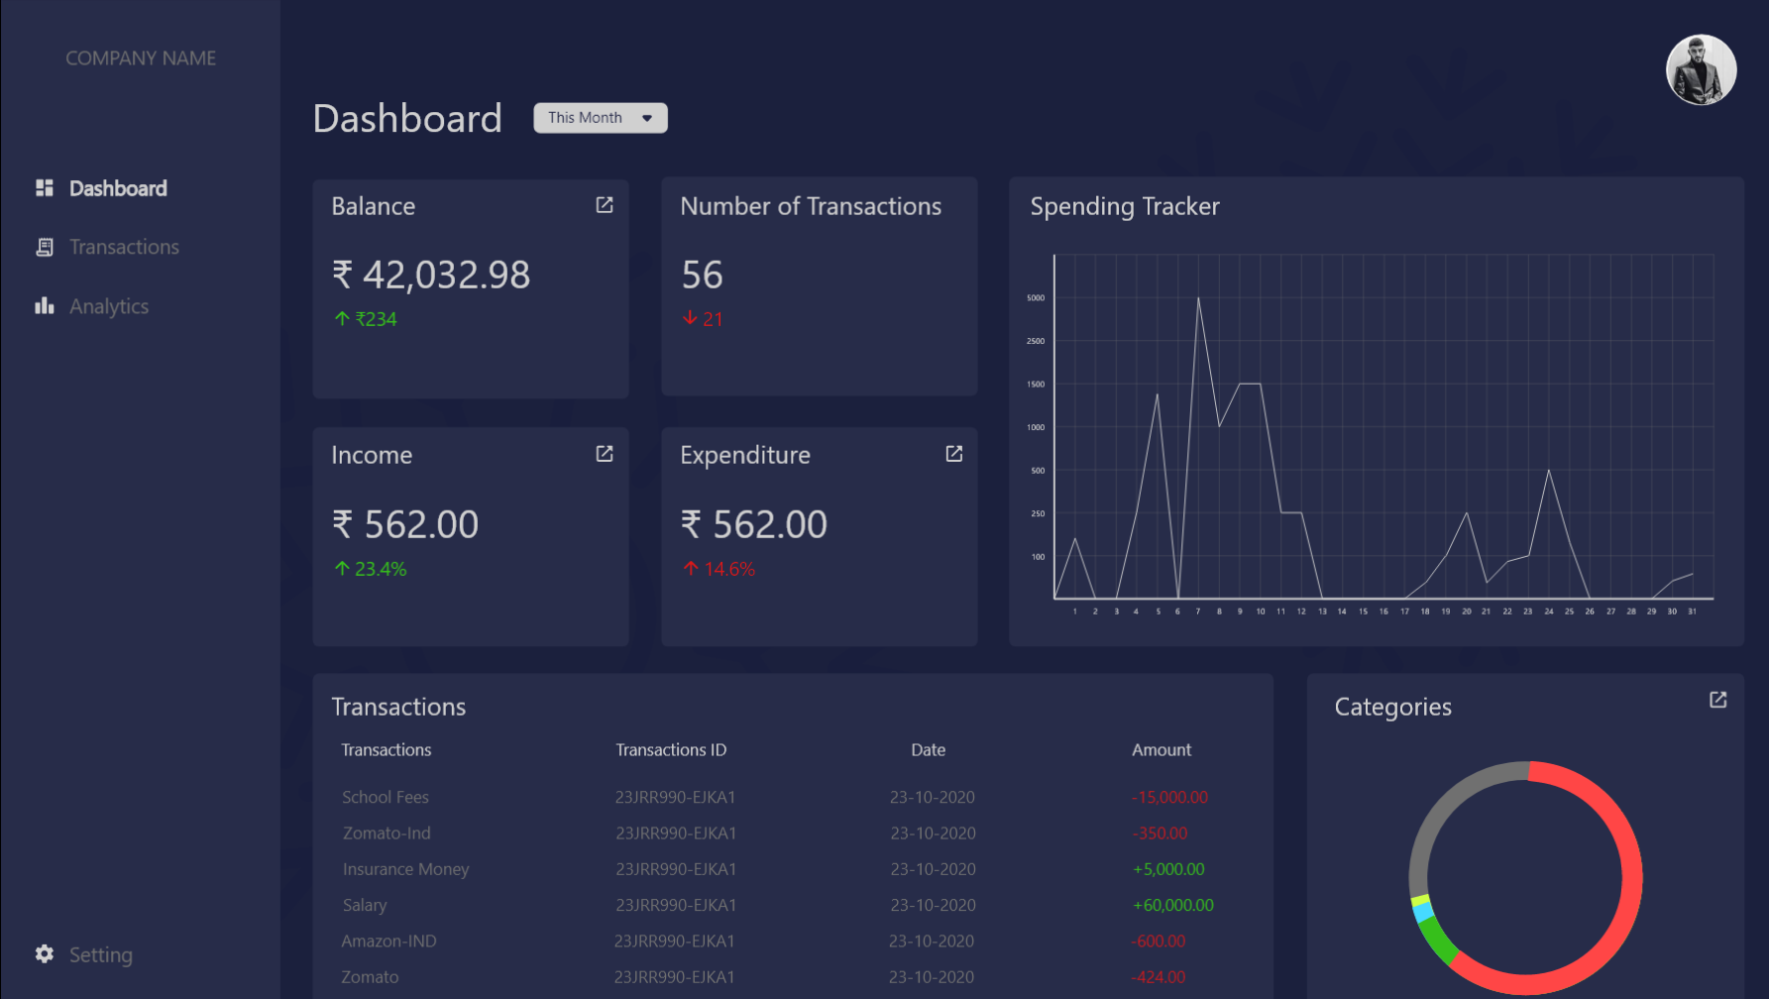
Dashboard(Gist)

Slide 7
Analytics
Monitors expenditure and displays related stats using graphical representation
Provides quick and clear idea to user and gets an understanding to save more or spend more
The graphical representation is shown according to the categories where money has been spent
Cost Management tool with different representation of
1)Income
2)Spending
With today's technology, businesses need to deal with a huge volume of Analytics.

Slide 8
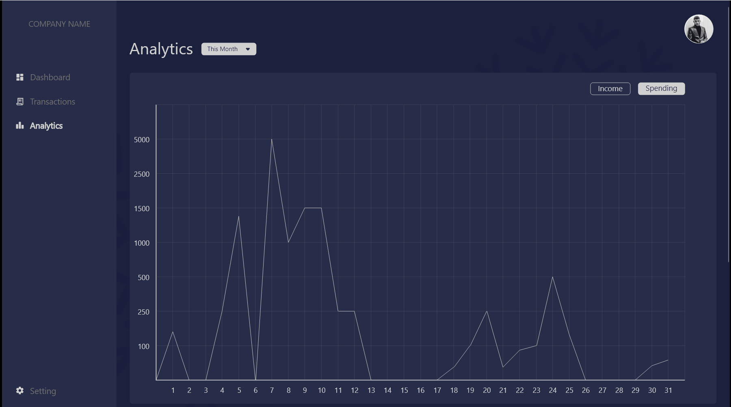
Analytics

Slide 9
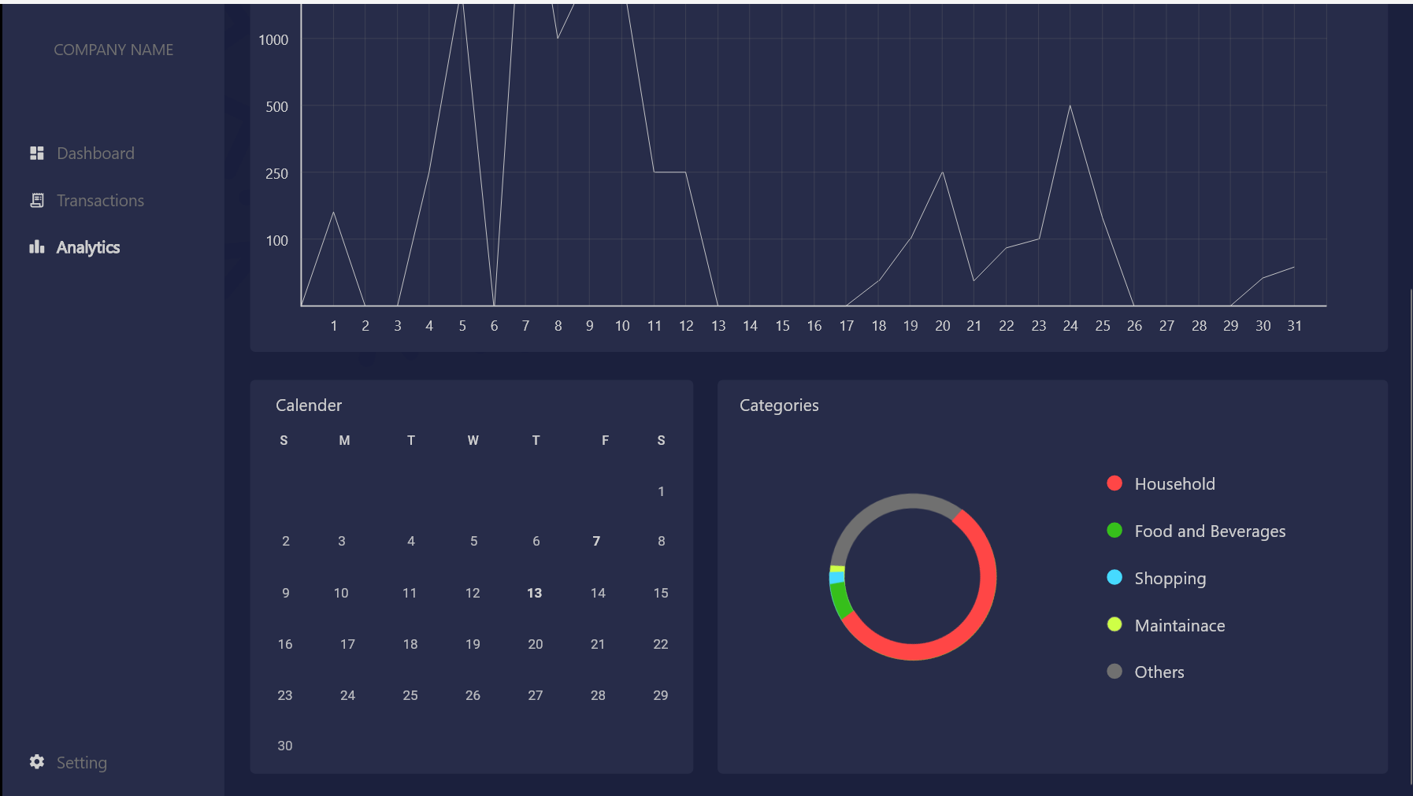
Analytics

Slide 10
Transaction
Represents transaction details in a tabular format
List shows where money is spent in a particular month and what amount is earned or spent.
monthly breakdown of these predicted figures is useful as it provides an easy visual reference for anyone wishing to ensure that their income will exceed their expenses every month
Layout contains:
income-displayed in green
expenditure-distinguished in red
Add expenditure-allows user to add new expense by entering amount, date and selecting category

Slide 11
Conclusion
the “Expense Analysis Chart” supplies a detailed breakdown of the user’s expenses by category
This data is invaluable for any individual—or business—who needs a quick and easy visual reference for evaluating their expenses.
With this information, individuals can analyze areas where they can cut unnecessary spending and implement long-term budget plans to ensure their current and future financial health.

