Slide 1



Credit Risk
Assessment
Manas Chandan Behera
Mohammad Daim Khan

Slide 2


Overview
Credit default risk is termed as the possibility of a loss for a lender due to a borrower’s failure to repay a loan.
Earlier in the days, Credit Analysts used to analyze a borrower’s capability to repay a loan.
Gone are these days!!
Machine learning algorithms have a lot to offer to the world of credit risk assessment due to their unparalleled predictive power and speed.

Slide 3

Understanding the problem
Analyzing if a client or future client will fail to meet their financial obligations is extremely important, and can have a major impact on the Institution’s balance sheet.
Increasingly, solutions are being developed and improved to minimize the risk of default.
Big banks, financial institutions, and fintech are increasingly using machine learning solutions to avoid or minimize the default.
We utilized machine learning’s power to predict whether a borrower will default on a loan or not and to predict their probability of default.

Slide 4
Project objective:
Create a Machine Learning algorithm that provides the likelihood that a customer will default.

Slide 5

Dataset Used
AGE: Age in years
PAY_0: Repayment status in September, 2005 (-1=pay duly, 1=payment delay for one month, 2=payment delay for two months, … 8=payment delay for eight months, 9=payment delay for nine months and above)
PAY_2: Repayment status in August, 2005 (scale same as above)
PAY_3: Repayment status in July, 2005 (scale same as above)
PAY_4: Repayment status in June, 2005 (scale same as above)
PAY_5: Repayment status in May, 2005 (scale same as above)
PAY_6: Repayment status in April, 2005 (scale same as above)
BILL_AMT1: Amount of bill statement in September, 2005 (NT dollar)
BILL_AMT2: Amount of bill statement in August, 2005 (NT dollar)
BILL_AMT3: Amount of bill statement in July, 2005 (NT dollar)
PAY_AMT4: Amount of previous payment in June, 2005 (NT dollar)
PAY_AMT5: Amount of previous payment in May, 2005 (NT dollar)
PAY_AMT6: Amount of previous payment in April, 2005 (NT dollar)
default.payment.next.month: Default payment (1=yes, 0=no)

Slide 6

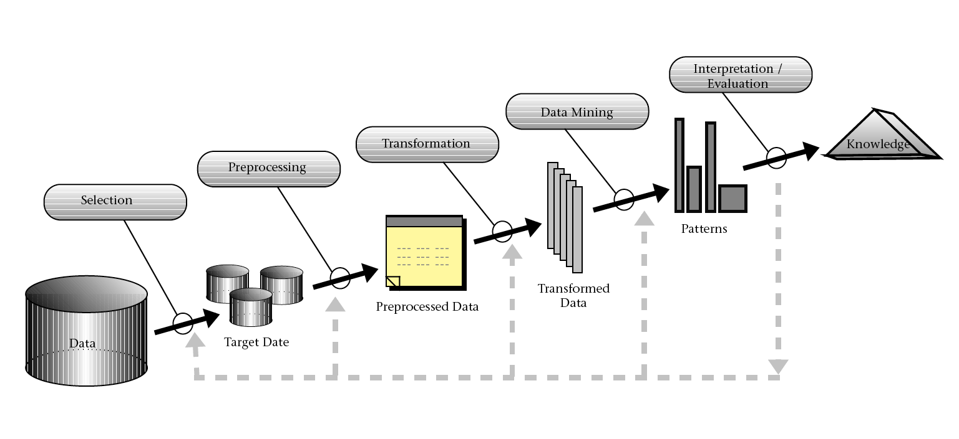


An overview of the processes happening inside the Machine Learning model

Slide 7





Target Customers
Banks
Private Loan Lending Firms
Education Institutions
Business Investments Firm
Insurance Companies

Slide 8
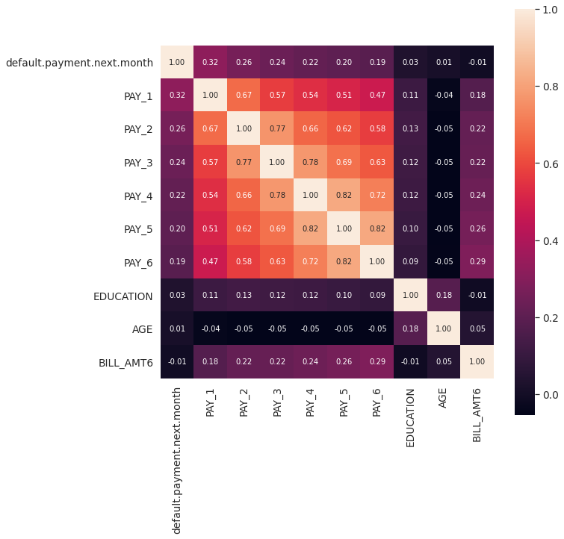
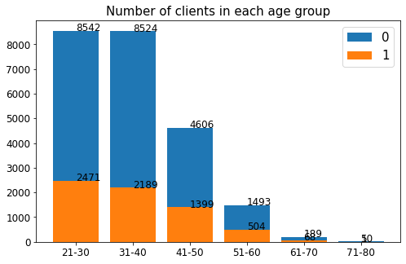
Trend analysis of our ML model
Item 1
Item 2
Findings
39
4
29
27
4
5
20
35
5
25
22
15
20XX
20XX
20XX
20XX

Slide 9

Proposed deliverables
Upload
The company will load the data in the csv format in out machine learning model.
Process
Our model will pre process the raw data into structured form and will do the feature extraction and make the data ready to be computed in the ML model
Predict
Now the input data will be computed inside the ML model and will analyze the score whether the customer is acceptable for being given the loan or not
Verdict
Finally, the verdict is provided in the form of the result and which can be later published on client dashboard for further work.

Slide 10




