Slide 1

INCUBATE IND HACKATHON
Prototype Build
Ideation
Presented By:
Group: BitOfCode
From: KIIT University,
Bhubaneswar
Members:
1.Priyotosh Saha (G.L)

Slide 2
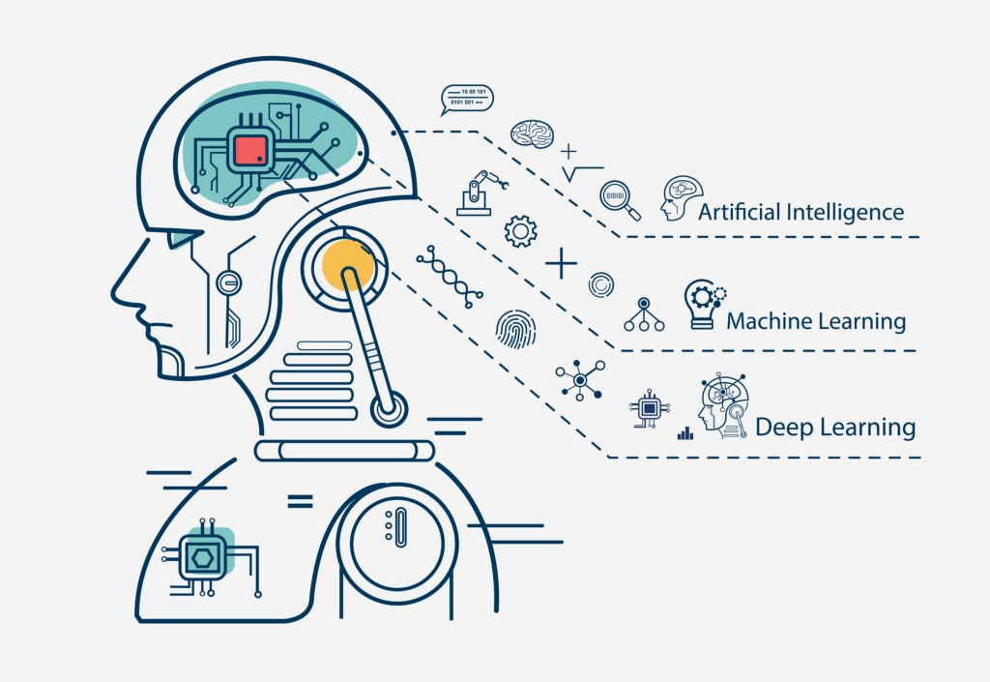
Theme
Open innovation for COVID-19
Keywords: Coronavirus; Pneumonia; Chest X-ray Radiographs; Convolutional Neural Network; Deep Transfer Learning

Slide 3
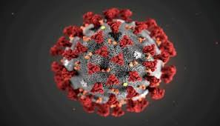
Title: Diagnosing COVID-19 using AI-based medical image analyses

Slide 4
Abstract
The 2019 novel coronavirus (COVID-19), with a starting point in China, has spread rapidly
among people living in other countries, and is approaching approximately 305,275 cases worldwide according to the statistics of European Centre for Disease Prevention and Control. There are a limited number of COVID-19 test kits available in hospitals due to the increasing cases daily. Therefore, it is necessary to implement an automatic detection system as a quick alternative diagnosis option to prevent COVID-19 spreading among people. In this study, three different convolutional neural network based models (ResNet50, InceptionV3 and Inception- ResNetV2) have been proposed for the detection of coronavirus pneumonia infected patient using chest X-ray radiographs. ROC analyses and confusion matrices by these three models are given and analyzed using 5-fold cross validation. Considering the performance results obtained, it is seen that the pre-trained ResNet50 model provides the highest classification performance with 98% accuracy among other two proposed models (97% accuracy for InceptionV3 and 87% accuracy for Inception-ResNetV2).

Slide 5
Introduction
The 2019 novel coronavirus (COVID-19) pandemic appeared in Wuhan, China in December 2019 and has become a serious public health problem worldwide. The virus that caused COVID-19 pandemic disease was called as severe acute respiratory syndrome coronavirus 2, also named SARS-CoV-2 . Coronaviruses (CoV) are a large family of viruses that cause diseases resulting from colds such as the Middle East Respiratory Syndrome (MERS-CoV) and Severe Acute Respiratory Syndrome (SARS-CoV). Coronavirus disease (COVID-19) is a new species that was discovered in 2019 and has not been previously identified in humans. Coronaviruses are zoonotic due to contamination from animals to humans . There are studies that the SARS-CoV virus is contaminated from musk cats to humans, and the MERS-CoV virus is contaminated from dromedary to humans . COVID-19 virus is presumed to be contaminated from bats to humans. Respiratory transmission of the disease from person to person caused rapid spread of the epidemic.

Slide 6
Introduction contd.
While COVID-19 causes milder symptoms in about 82 percent of cases, the others are severe or critical . Coronavirus cases total number is approximately 335,403 and 14,611 of them died and 97,636 were recovered. Currently infected patients’ number is 223,156. While 95% of the number of infected patients survive the disease slightly, 5% the rest has a serious or critical condition .
Signs of infection include respiratory symptoms, fever, cough and dyspnea. In more serious cases, the infection can cause pneumonia, severe acute respiratory syndrome, septic shock, multi-organ failure, and death . It has been determined that men are more infected than women and that there is no death in children between the ages of 0-9 . Respiratory rates of cases with COVID-19 pneumonia have been shown to be faster compared to healthy people .
Even in many developed countries, the health system has come to the point of collapse due to the increasing demand for intensive care units simultaneously. Intensive care units are filled with patients who get worse with COVID-19 pneumonia. The distribution of COVID-19 cases seen worldwide between the days of February 16th and March 21st, 2020 is shown in Figure 1.

Slide 7
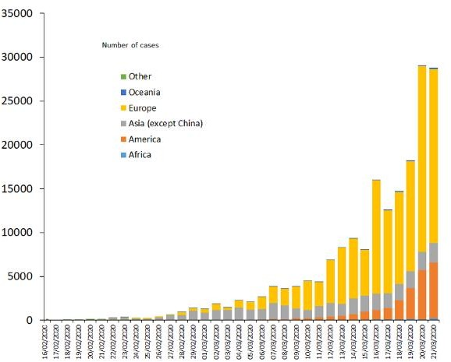
Figure 1. Distribution of COVID-19 cases worldwide (16th February-21st March 2020).
According to the latest guidelines published by the Chinese government, the diagnosis of COVID-19 should be confirmed by gene sequencing for respiratory or blood samples as a key indicator for reverse transcription polymerase chain reaction (RT-PCR) or hospitalization. In the current public health emergency, the low sensitivity of RT-PCR means that many COVID- 19 patients will not be identified quickly and may not receive appropriate treatment. In addition, given the highly infectious nature of the virus, they run the risk of infecting a larger population .
Instead of the patients waiting to get positive virus tests, diagnoses now include everyone who reveals the prominent pneumonia pattern of chest scan COVID-19. Through this method, authorities will be able to isolate and treat patients more quickly. Even if death does not occur in COVID-19, some patients survive with permanent lung damage. According to the World Health Organization, COVID-19 also opens holes in the lungs like SARS, giving them a "honeycomb-like appearance".
Computed Tomography (CT) scan of the chest is one of the methods used to diagnose pneumonia. Artificial Intelligence (AI) based automated CT image analysis tools for the detection, quantification and monitoring of coronavirus and to distinguish patients with coronavirus from disease-free have been developed . In a study by Fei et al., they developed

Slide 8
a deep learning-based system for automatic segmentation of all lung and infection sites using chest CT . Xiaowei et al. aimed to establish an early screening model to distinguish COVID-19 pneumonia and Influenza-A viral pneumonia from healthy cases using pulmonary CT images and deep learning techniques . In Shuai et al. study, based on the COVID-19 radiographic changes from CT images, they have developed a deep learning method that can extract the graphical features of COVID-19 to provide clinical diagnosis prior to pathogenic testing and thus save critical time for the disease diagnosis .
MERS-CoV and SARS-CoV are expressed as cousins of COVID-19. There are scientific publications using chest X-ray images in the diagnosis of MERS-CoV and SARS- CoV. In the study of Ahmet Hamimi about MERS CoV showed that there are features in the chest X-ray and CT that are like the manifestations of pneumonia . In the study by Xuanyang et al., data mining techniques were used to distinguish SARS and typical pneumonia based on X-ray images .

Slide 9
X-ray machines are used to scan the affected body such as fractures, bone dislocations, lung infections, pneumonia and tumors. CT scanning is a kind of advanced X-ray machine that examines the very soft structure of the active body part and clearer images of the inner soft tissues and organs . Using X-ray is a faster, easier, cheaper and less harmful method than CT. Failure to promptly recognize and treat COVID-19 pneumonia may lead to increase in mortality.
In this study, we have proposed an automatic prediction of COVID-19 using a deep convolution neural network based pre-trained transfer models and Chest X-ray images. For this purpose, we have used ResNet50, InceptionV3 and Inception-ResNetV2 pre-trained models to obtain a higher prediction accuracy for small X-ray dataset. The novelty of this paper is summarized as follows: i) The proposed models have end-to-end structure without manual feature extraction and selection methods. ii) We show that ResNet50 is an effective pre-trained model among other two pre-trained models. iii) Chest X-ray images are the best tool for the detection of COVID-19. iv) The pre-trained models have been shown to yield very high results in the small dataset (50 COVID-19 vs. 50 Normal).
The manuscript is organized as follows: Dataset is expressed in detail in Section 2.1. Deep transfer learning models and experimental setup parameters are described in Section 2.2 and 2.3, respectively. Performance metrics are given in detail in Section 2.4. Discussion and obtained results from proposed models are presented in Section 3. Finally, in Section 4, the conclusion and the future works are summarized.

Slide 10
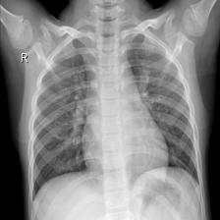
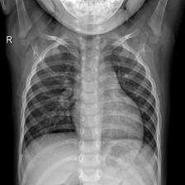
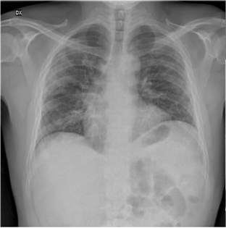
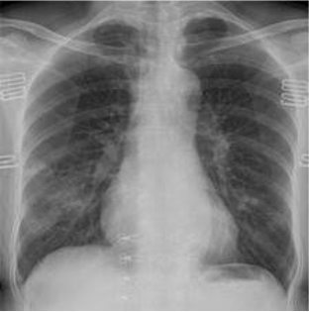
Materials and Methods
Dataset
In this study, chest X-ray images of 50 COVID-19 patients have been obtained from the open source GitHub repository shared by Dr. Joseph Cohen [20]. This repository is consisting chest X-ray / CT images of mainly patients with acute respiratory distress syndrome (ARDS), COVID-19, Middle East respiratory syndrome (MERS), pneumonia, severe acute respiratory syndrome (SARS). In addition, 50 normal chest X-ray images were selected from Kaggle repository called “Chest X-Ray Images (Pneumonia)” .
Our experiments have been based on a created dataset with chest X-ray images of 50 normal
and 50 COVID-19 patients (100 images in total). All images in this dataset were
resized to 224x224 pixel size. In Figure 2 and Figure 3, representative chest X-ray images of normal and COVID-19 patients are given, respectively.

Slide 11
2.2 Deep Transfer Learning
Deep learning is a sub-branch of the machine learning field, inspired by the structure of the brain. Deep learning techniques used in recent years continue to show an impressive performance in the field of medical image processing, as in many fields. By applying deep learning techniques to medical data, it is tried to draw meaningful results from medical data.
Deep learning models have been used successfully in many areas such as classification, segmentation and lesion detection of medical data. Analysis of image and signal data obtained with medical imaging techniques such as Magnetic Resonance Imaging (MRI), Computed Tomography (CT) and X-ray with the help of deep learning models. As a result of these analyzes, detection and diagnosis of diseases such as diabetes mellitus, brain tumor, skin cancer and breast cancer are provided with convenience .
In the analysis of medical data, one of the biggest difficulties faced by researchers is the limited number of available datasets. Deep learning models often need a lot of data. Labeling this data by experts is both costly and time consuming. The biggest advantage of using transfer learning method is that it allows the training of data with fewer datasets and requires less calculation costs. With the transfer learning method, which is widely used in the field of deep learning, the information gained by the pre-trained model on a large dataset is transferred to the model to be trained.
In this study, we built deep convolutional neural network (CNN) based ResNet50, InceptionV3 and Inception-ResNetV2 models for the classification of COVID-19 Chest X-ray images to normal and COVID-19 classes. In addition, we applied transfer learning technique that was realized by using ImageNet data to overcome the insufficient data and training time. The schematic representation of conventional CNN including pre-trained ResNet50, InceptionV3 and Inception ResNetV2 models for the prediction of COVID-19 patients and normal were depicted in Figure 4.

Slide 12
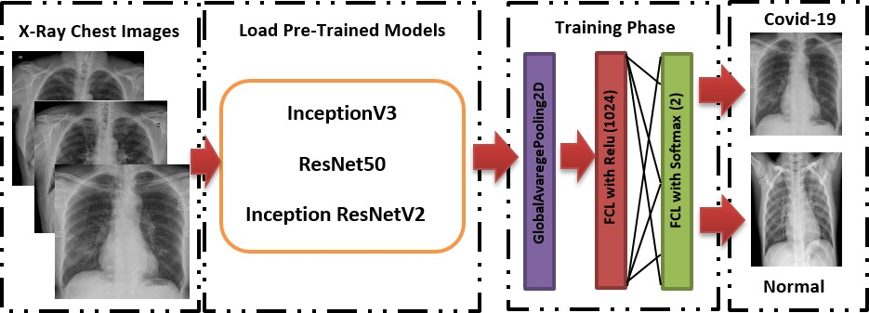
Residual neural network (ResNet) model is an improved version of convolutional neural network (CNN). ResNet adds shortcuts between layers to solve a problem. Thanks to this, it prevents the distortion that occurs as the network gets deeper and more complex. In addition, bottleneck blocks are used to make training faster in the ResNet model . ResNet50 is a 50- layer network trained on the ImageNet dataset. ImageNet is an image database with more than 14 million images belonging to more than 20 thousand categories created for image recognition competitions . InceptionV3 is a kind of convolutional neural network model. It consists of numerous convolution and maximum pooling steps. In the last stage, it contains a fully connected neural network . As with the ResNet50 model, the network is trained with ImageNet dataset. The model consists of a deep convolutional network using the Inception ResNetV2 architecture that was trained on the ImageNet-2012 dataset. The input to the model is a 299×299 image, and the output is a list of estimated class probabilities.
Figure 4. Schematic representation of pre-trained models for the prediction of COVID-19 patients and normal.

Slide 13
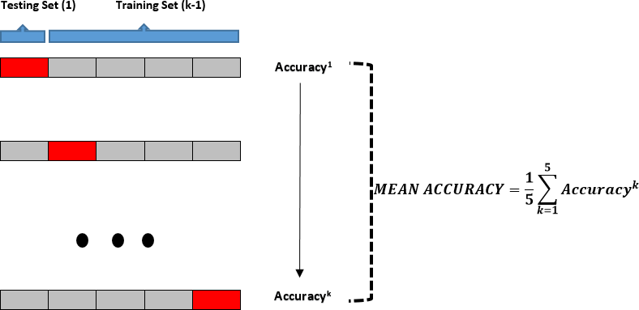
2.3 Experimental Setup — Python programming language was used to train the proposed deep transfer learning models. All experiments were performed on a Google Colaboratory Linux server with Ubuntu 16.04 operating system using Tesla K80 GPU graphics card. CNN models (ResNet50, InceptionV3 and Inception-ResNetV2) were pre-trained with random initialization weights using the Adam optimizer. The batch size, learning rate and number of epochs were experimentally set to 2, 1e- 5 and 30, respectively for all experiments. The dataset used was randomly split into two independent datasets with 80% and 20% for training and testing respectively. As cross validation method, k-fold was chosen and results were obtained according to 5 different k values (k=1-5) as shown in Figure 5.

Slide 14
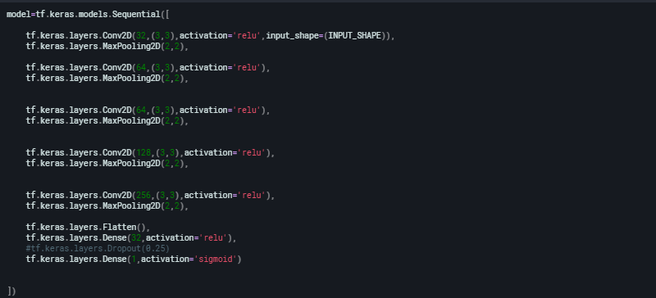
IMPLEMENTATION
Here is the model implementation consisting a series of densely connected convolution,pooling and flatten layers and lastly connected to a classification layer with Sigmoid Activation .

Slide 15

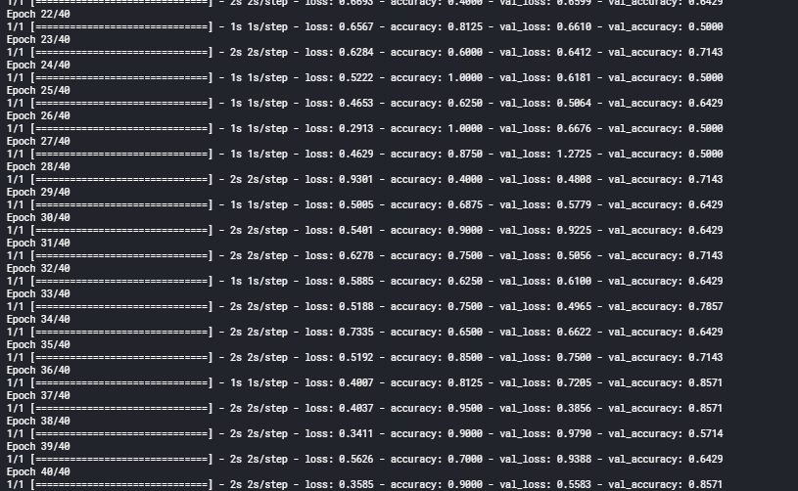
The Model is then compiled and we use fit() on the model with a given number of Epochs as hyperparameters.
The Validation accuracy is found out to be 85%.

Slide 16
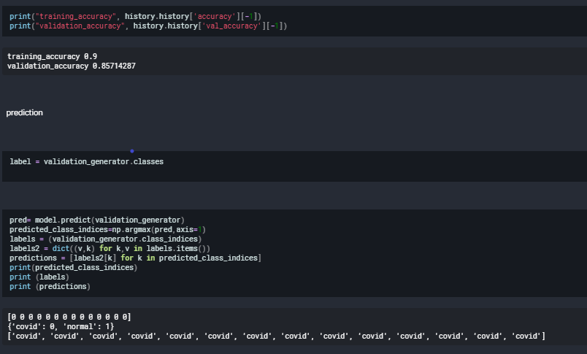
The model is then tested on a test dataset with the results obtained as shown .

Slide 17
2.4 Performance Metrics-
5 criteria were used for the performances of deep transfer learning models. These are:
Accuracy = (TN + TP) / (TN + TP + FN + FP)
Recall = TP / (TP + FN)
Specificity = TN / (TN + FP
Precision = TP / (TP + FP)
F1-Score = 2x((PrecisionxRecall)/(Precision+Recall))
TP, FP, TN and FN given in Equation (1) – (5) represent the number of True Positive, False Positive, True Negative and False Negative, respectively. Given a test dataset and model, TP is the proportion of positive (COVID-19) that are correctly labeled as COVID-19 by the model; FP is the proportion of negative (normal) that are mislabeled as positive (COVID-19); TN is the proportion of negative (normal) that are correctly labeled as normal and FN is the proportion of positive (COVID-19) that are mislabeled as negative (normal) by the model.

Slide 18
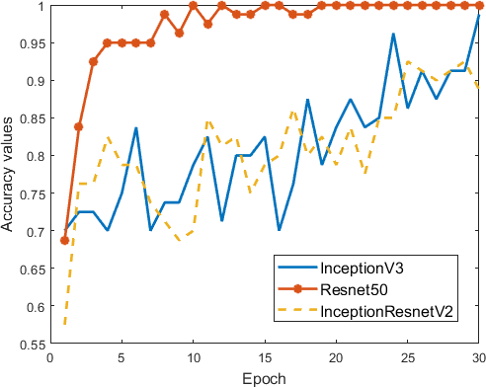
3. Results and Discussion
In this study, chest X-ray images have been used for the prediction of coronavirus disease patients (COVID-19). Popular pre-trained models such as ResNet50, InceptionV3 and Inception ResNetV2 have been trained and tested on chest X-ray images. Training accuracy and loss values for fold-3 of the pre-trained models are given in Figure 6 and Figure 7, respectively. The training stage has been carried out up to 30th epoch to avoid overfitting for all pre-trained models. It can be seen from Figure 6 that the highest training accuracy is obtained with the ResNet50 model. InceptionV3 and Inception-ResNetV2 models have similar performance. However, it is seen that ResNet50 shows a fast training process than other models. Although the pre-trained models give very high initial values, the initial values are below 70% due to the low number of data. The training loss values of ResNet50, InceptionV3 and Inception ResNetV2 are shown in Figure 7. When the loss figure are analyzed, it is seen that the loss values decrease in three pre-trained models during the training stage. It can be said that the ResNet 50 model both decreases loss values faster and approaches zero.
.

Slide 19
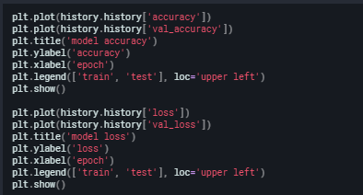
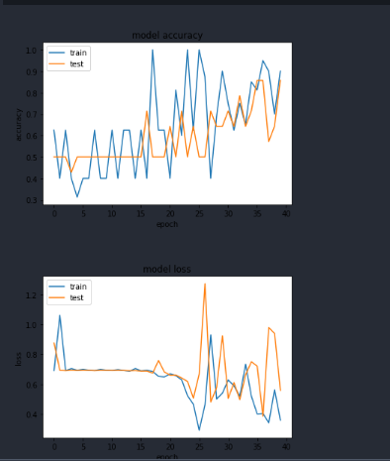
The first comparison is between train and test accuracy which clearly shows the similarity between the curves
The second comparison is between train and test loss which shows a similar trend as the model is optimised.

Slide 20
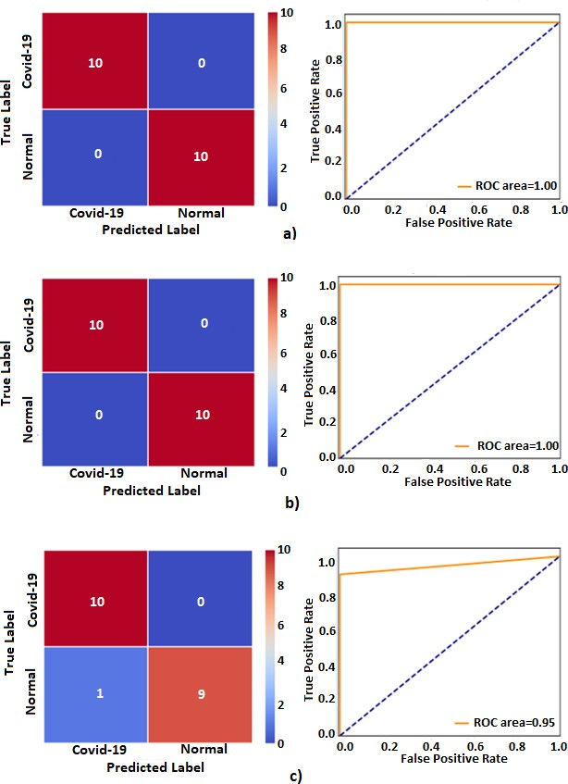
Figure 8. The confusion matrix and ROC plots obtained using pre-trained models for fold-3 results: a) InceptionV3, b) ResNet50, c) Inception-ResNetV2.

Slide 21
In another detailed performance, comparisons of three models using the test data are shown in Table 1. We have obtained the best performance as an accuracy of 98%, recall of 96%, and specificity value of 100% for ResNet50 pre-trained model. The lowest performance values have been yielded an accuracy of 87%, recall of 84%, and specificity value of 90% for Inception- ResNetV2. As a result, the ResNet50 model provides superiority over the other two models both training and testing stage.
Table 1. Prediction performance results obtained from different pre-trained CNN models for 5-fold cross validation methods. The abbreviations in Table 1 are: True Positive (TP), True Negative (TN), False Positive (FP), False Negative (FN), Accuracy (Acc), Recall (Rec), Specificity (Spe), Precision (Pre), F1-Score (F1).

Slide 22
MODELS/FOLD |  | Confusion matrix and Performance results (%)
 |  | TP | FP | FN | Acc | Rec | Spe | Pre | F1
InceptionV3 | Fold-2 | 10 | 0 | 0 | 100 | 100 | 100 | 100 | 100
 | Fold-3 | 10 | 0 | 0 | 100 | 100 | 100 | 100 | 100
 | Fold-4 | 10 | 0 | 0 | 100 | 100 | 100 | 100 | 100
 | Fold-5 | 10 | 0 | 0 | 100 | 100 | 100 | 100 | 100
 | Mean |  |  |  | 97 | 94 | 100 | 100 | 96
ResNet50 | Fold-1 | 8 | 0 | 2 | 90 | 80 | 100 | 100 | 89
 | Fold-2 | 10 | 0 | 0 | 100 | 100 | 100 | 100 | 100
 | Fold-3 | 10 | 0 | 0 | 100 | 100 | 100 | 100 | 100
 | Fold-4 | 10 | 0 | 0 | 100 | 100 | 100 | 100 | 100
 | Fold-5 | 10 | 0 | 0 | 100 | 100 | 100 | 100 | 100
 | Mean |  |  |  | 98 | 96 | 100 | 100 | 98
Inception- ResNetV2 | Fold-1 | 9 | 3 | 1 | 80 | 90 | 70 | 75 | 82
 | Fold-2 | 10 | 1 | 0 | 95 | 100 | 90 | 91 | 95
 | Fold-3 | 10 | 1 | 0 | 95 | 100 | 90 | 91 | 95
 | Fold-4 | 7 | 0 | 3 | 85 | 70 | 100 | 100 | 82
 | Fold-5 | 6 | 0 | 4 | 80 | 60 | 100 | 100 | 75
 | Mean |  |  |  | 87 | 84 | 90 | 91 | 86

Slide 23
Potential Covid-19 Case prediction Portal
Here we have tried to implement the whole model used for classifying the x-ray images into potential covid-19 positive or negative case using the Flask framework.
Flask is a Python-based free and open-source web framework, which follows the model-template-view architectural pattern. It is maintained by the Flask Software Foundation, an independent organization established as a 501 non-profit. Flask's primary goal is to ease the creation of complex, database-driven websites.
Following is the implementation of the website for self assesment portal.

Slide 24
Concluding Remarks
As we know the world is facing testing times in the face of global Covid-19 Pandemic, we must unite to bring feasible and rapid solutions to control the outbreak.
As per WHO guidelines and ICMR(Indian Council of Medical Research) for detecting potential Covid-19 Patients, their symptoms are taken note of, their the Swab Samples are taken and also their travel history is taken note of.
Since the testing of the Swab samples takes considerable amount of time, the need of the hour is rapid testing strategies.
There are very few studies on literature due to the emergence of COVID-19 virus disease. Some of these are as follows: Prabira et al. proposed a detection of COVID-19 using X-ray images based on deep feature and SVM. They collected X-ray images from GitHub, Kaggle and Open-I repository. They extracted the deep feature of CNN models and fed to SVM classifier individually. They have obtained 95.38% of accuracy for ResNet50&SVM. Fei et al methods can be used. In subsequent studies, the classification performance of different CNN models can be tested by increasing the number of images in the dataset.
Although the primary means of confirming the covid-19 case will be the test of Swab Sample ,in order to assist the doctor and staff to scale and look for rapid testing, these X-ray image samples can help to some extent in detecting Covid-19 potential case .

Slide 25


Slide 26


