Slide 1
Secure The Chat Program!
Because the client's data should be private.

Slide 2
Member
Nabila Tsurayya Silmi 5112100055
Karsten Ari Agathon 5112100110
I Putu Pradnyadipa 5112100128
Reyhan Arief 5112100175

Slide 3
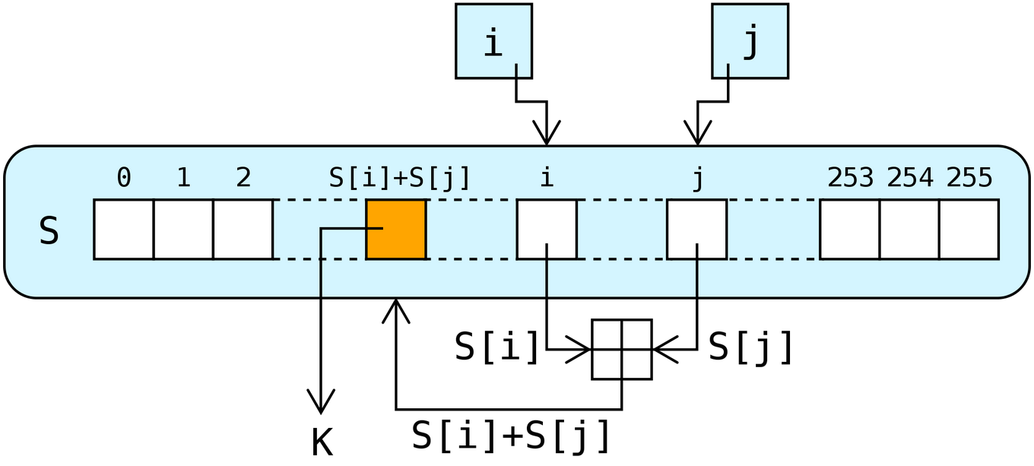
Algorithm..
Will use stream chiper encryption, RC4*
*RC4 (Rivest Cipher 4)

Slide 4
WHY rc4?
Can be used freely for public application development.
Simple, yet very fast.
Most widely-used stream cipher used in SSL(Secure Sockets Layer).

Slide 5
RELAX!
The whole message's content will be encrypted!

Slide 6
When will the user get the key?

