Slide 2
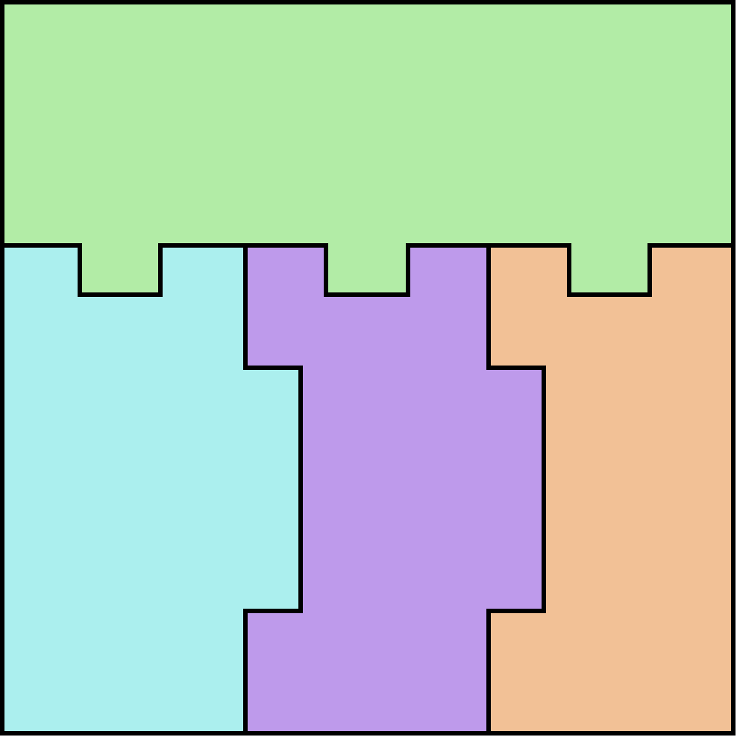
P1
1
2
1
2
P2
P3
P4
+y
3
4
3
4
+x
G(+x, A)
G(+y, A)

