Slide 1
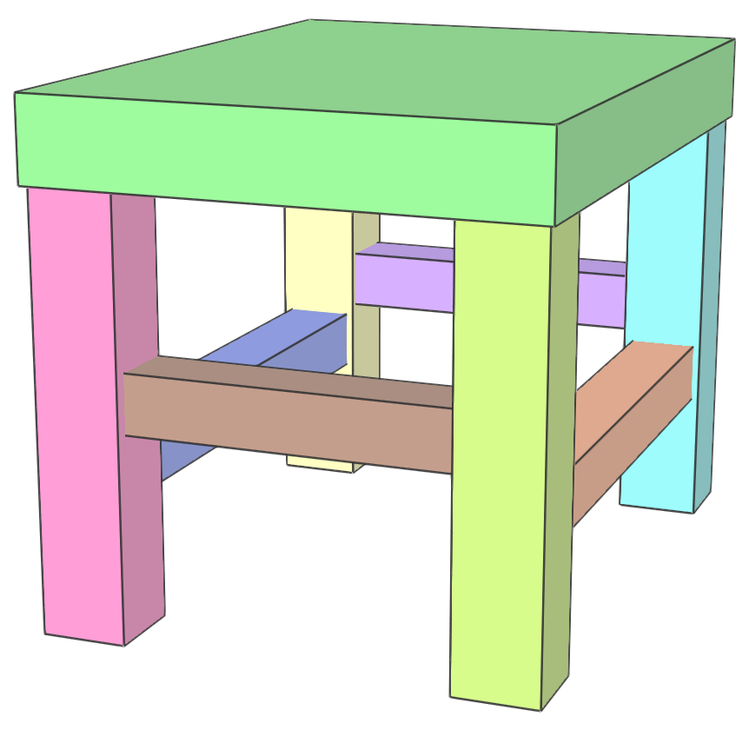
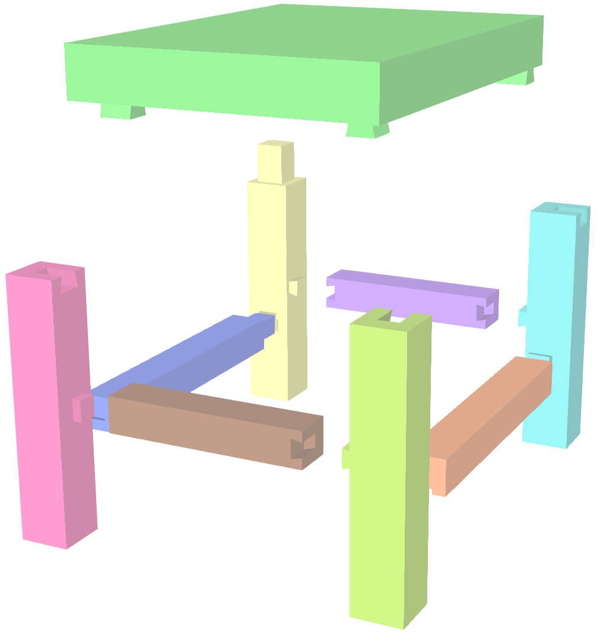
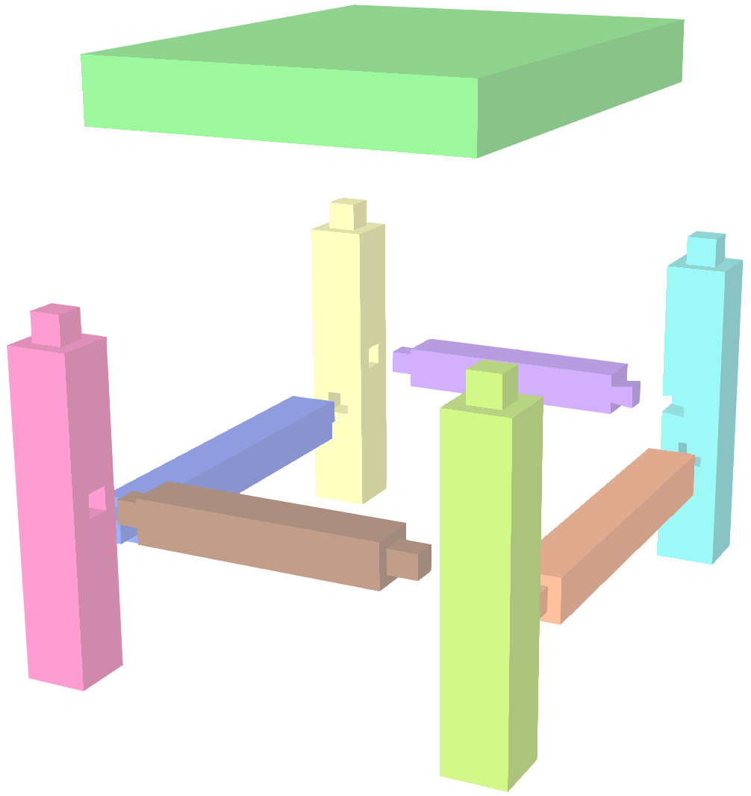
G₁
G₂
G₃
G₄
4
3
2
4
+z
-z
3
-z
+z
2
P1
4
3
2
4
G₁
4
-y
G₁
+x
2
2
-z
-y
+x
1
+y
1
-x
-x
P4
P3
P2
+z
+y
-x
+x
P5
5
1
9
5
G₄
1
1
G₂
9
5
G₄
1
1
G₂
9
P7
P9
+x
+x
1
-z
+y
P6
1
-x
+x
-z
-y
+y
P8
6
7
8
6
G₃
8
6
-x
G₃
+z
8
+z
-x
+z
+x
6
7
8
6
-y
+y
7
-z
+z
8
4
+z
-z
3
-z
+z
2
4
+z
-z
3
+x
-x
2
-z
-y
-x
-x
-x
-y
-y
-x
G₁
+z
+y
+x
+x
+x
+y
+y
+x
5
G₄
1
G₂
9
5
1
9
+x
+x
-z
+y
-x
+y
+y
-x
-x
G₃
-y
+x
+x
6
-x
7
+z
8
6
-y
7
-y
8
-y
+y
-z
+z
+z
-z
+z
-z

Slide 2
G₁
G₂
G₃
G₄
2
9
8
2
-x
+x
9
+y
-y
8
P1
2
G₂
2
-x
G₂
+z
8
9
8
2
8
-x
+z
+z
P2
1
+z
-x
1
-z
P4
P3
-z
+x
-z
-z
P5
3
1
7
3
G₁
1
1
G₃
7
3
G₁
1
1
G₃
7
P7
P9
-z
+y
1
+x
+y
+y
P6
1
+z
+y
+x
-x
-y
P8
4
5
6
4
G₄
6
4
-y
-y
G₄
-x
6
+z
4
5
6
4
5
6
+x
-z
+z
+x
-x
2
-x
+x
9
+y
-y
8
2
-x
+x
9
-x
+x
8
+z
-x
G₂
+z
+z
-x
-y
-y
-z
-z
+x
-z
-z
+x
+y
+y
+z
3
G₁
1
G₃
7
3
1
7
-z
+y
+x
+y
-z
+y
+y
-z
+z
G₄
-y
+z
+z
4
-y
5
-x
6
4
-y
5
-y
6
-z
+z
+x
-x
-x
+x
-x
+x

Slide 3
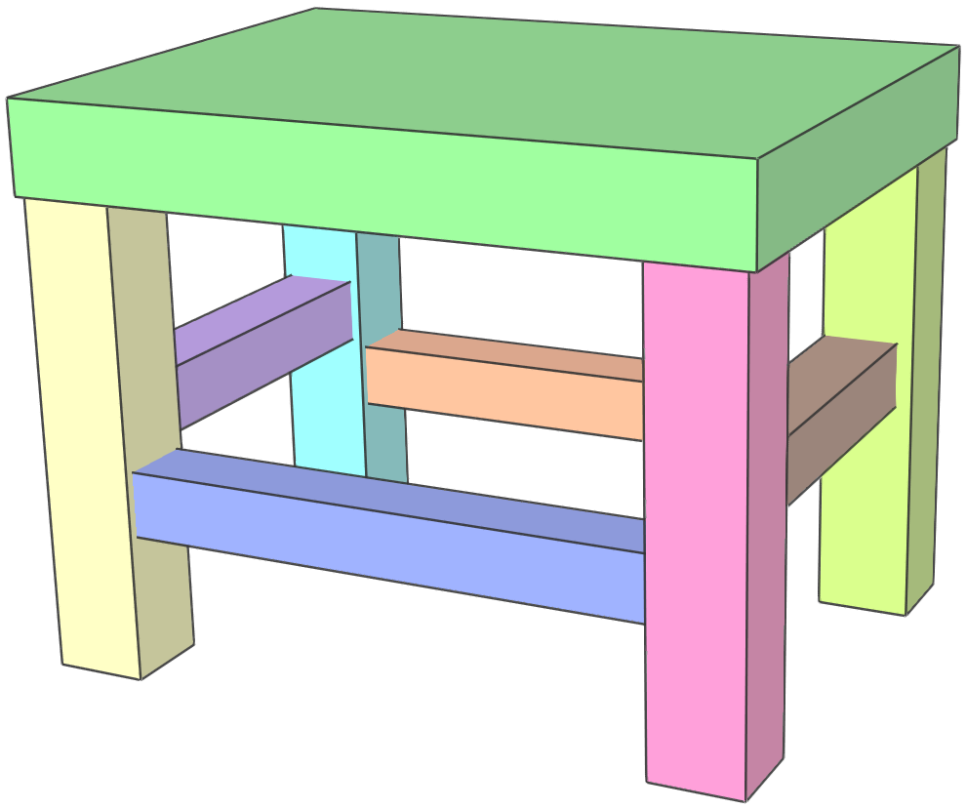
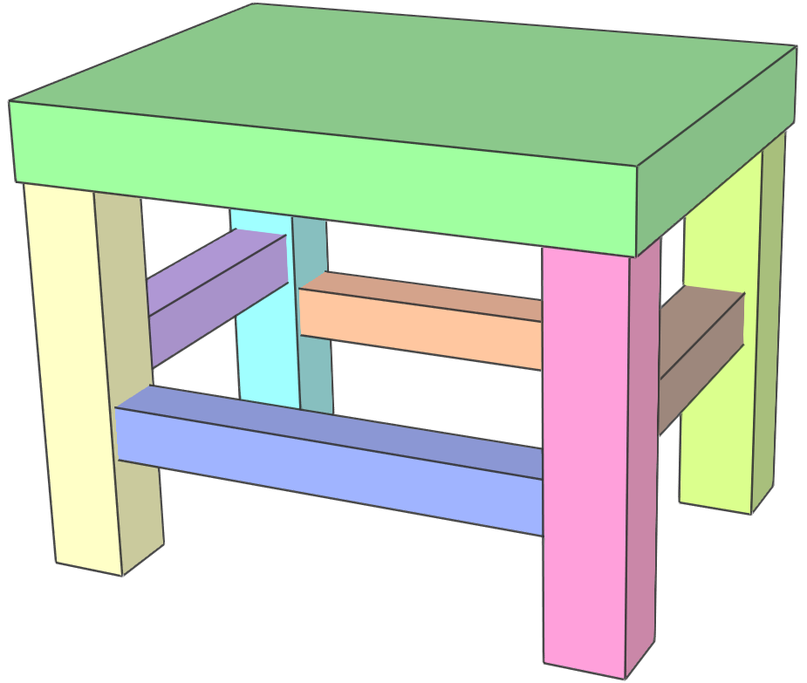
2
9
8
2
-x
+x
9
+y
-y
8
P1
2
G₂
2
-x
G₂
+z
8
9
8
2
8
-x
+z
+z
P3
1
+z
-x
1
-z
P4
P2
P9
P7
-z
+x
-z
-z
3
1
7
3
G₁
1
1
G₃
7
3
G₁
1
1
G₃
7
+y
P5
P6
P8
-z
+y
+x
+y
1
+z
+y
1
+x
-y
+z
4
5
6
G₄
4
-y
G₄
-x
6
+x
4
6
-y
-x
4
5
6
4
-z
+z
5
+x
-x
6
G₁
G₂
G₃
G₄
2
-x
+x
9
+y
-y
8
+z
-x
G₂
+z
+z
2
-x
+x
9
-x
+x
8
-z
-x
-y
-y
-z
-z
+x
-z
3
G₁
1
G₃
7
+x
+y
+y
+z
-z
+y
+x
+y
3
1
7
+z
G₄
-y
-z
+y
+y
-z
4
-y
5
-x
6
+z
+z
-z
+z
+x
-x
4
-y
5
-y
6
-x
+x
-x
+x

Slide 4
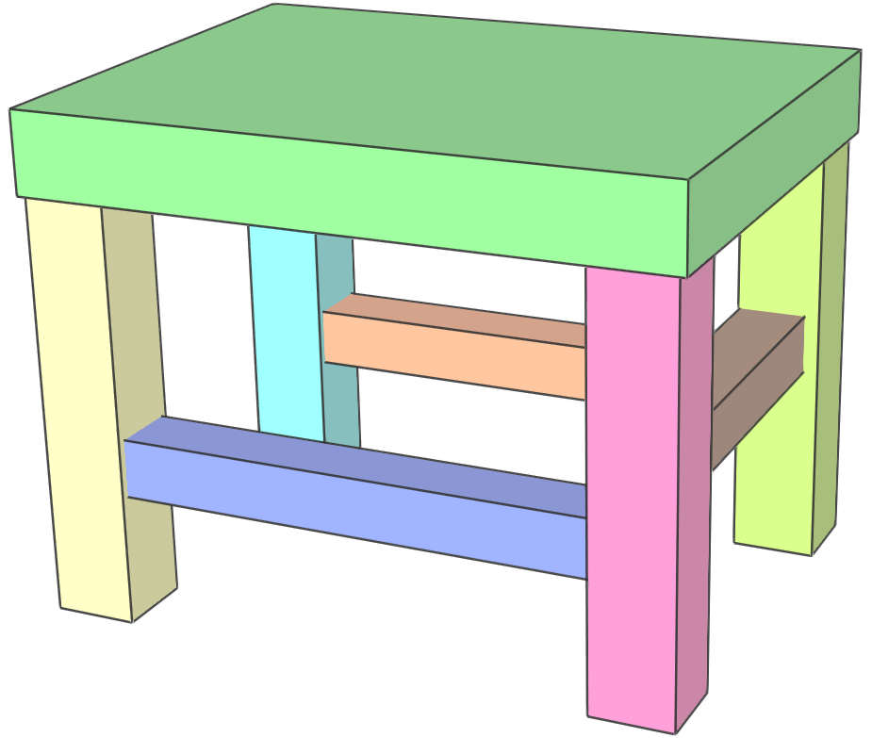
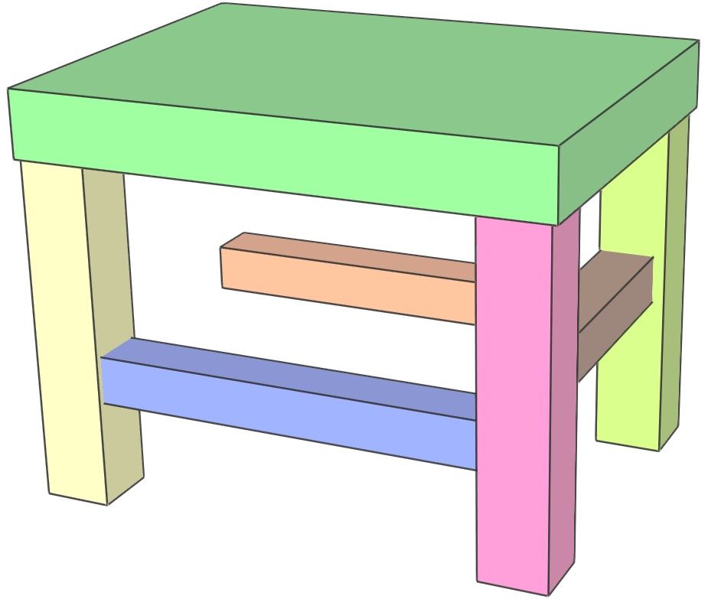
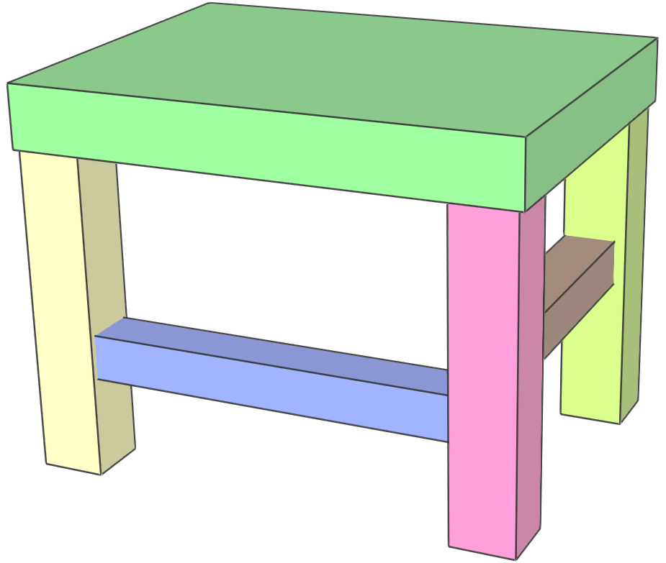
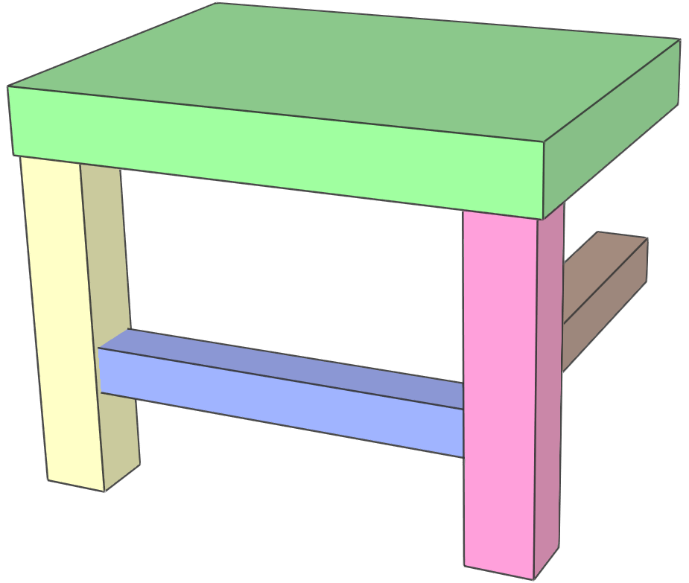
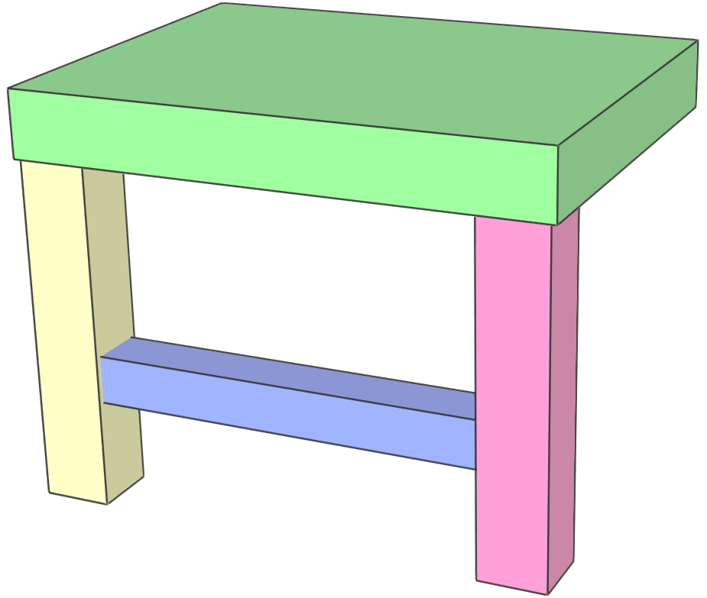
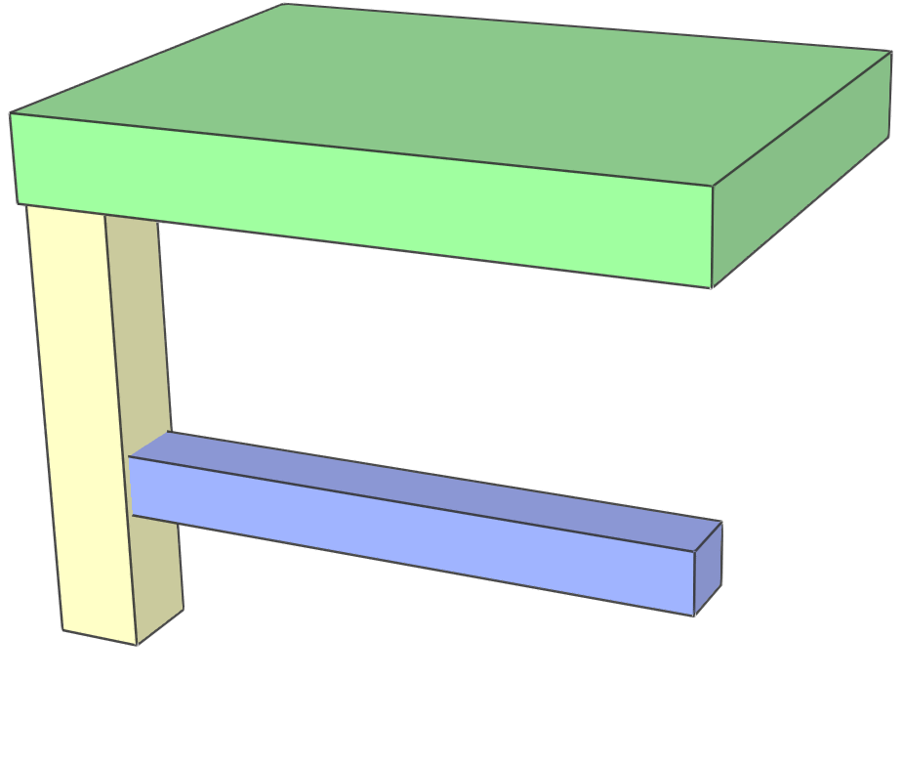
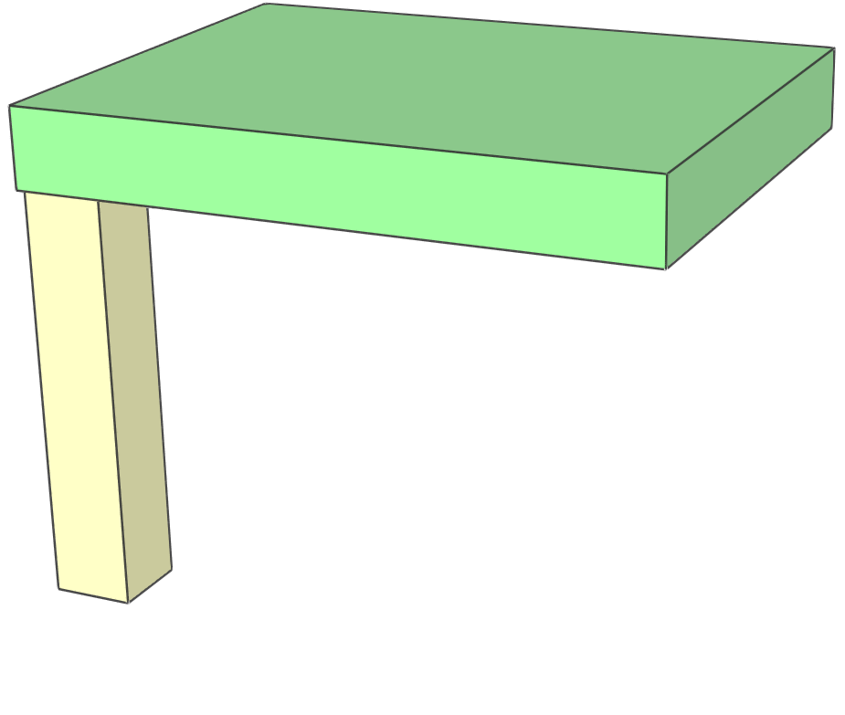
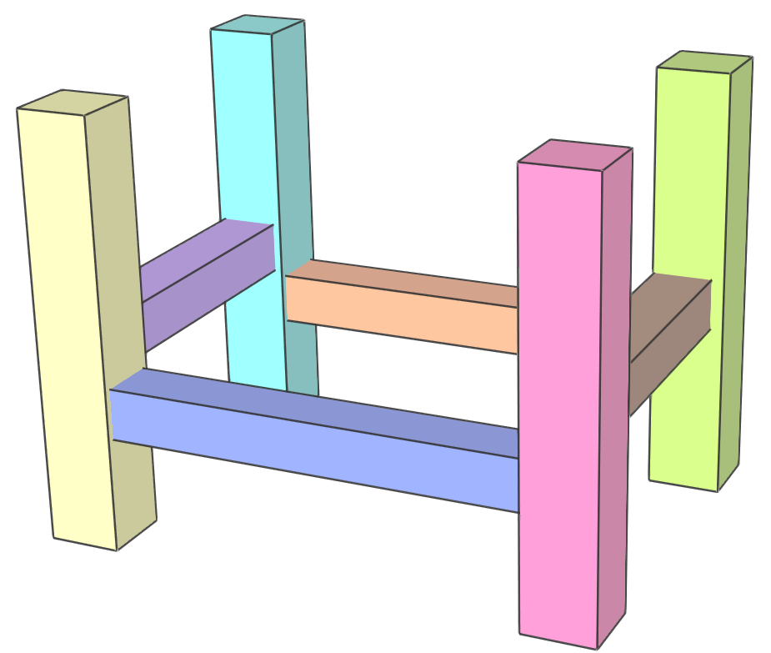
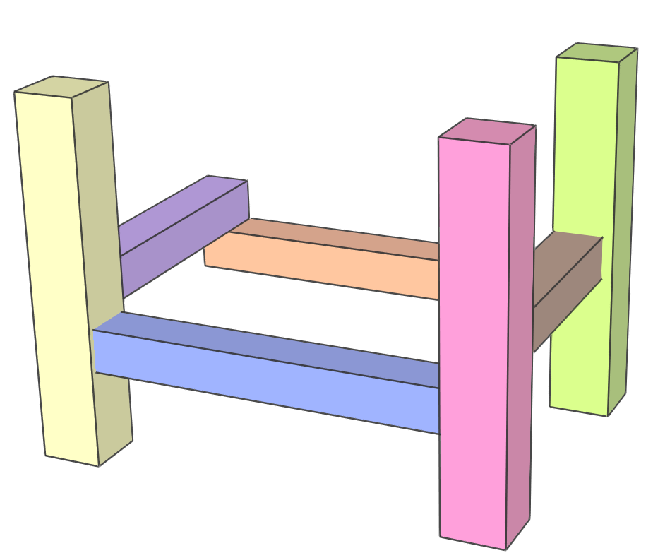
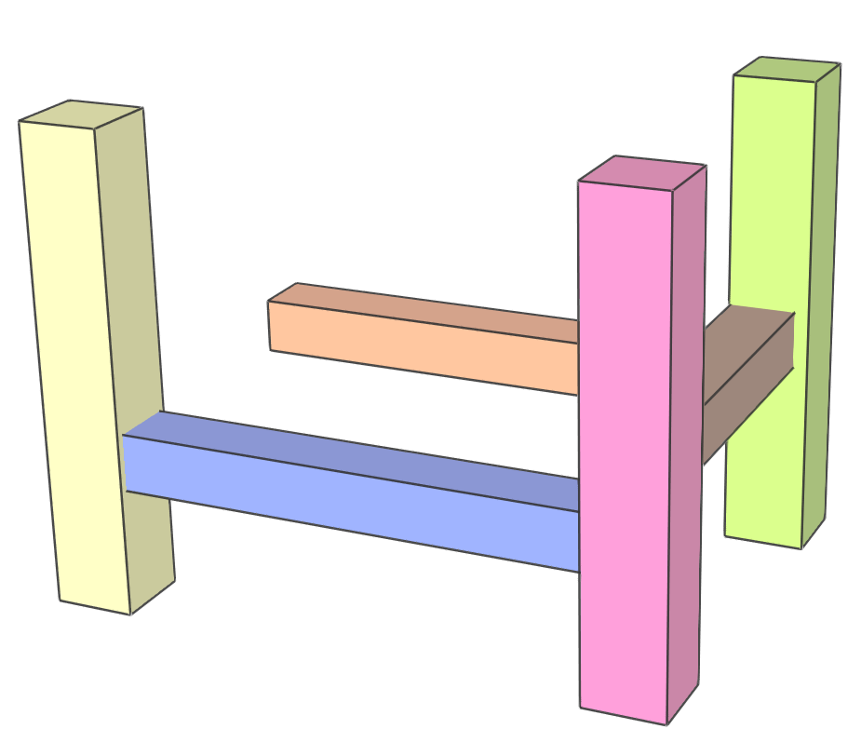
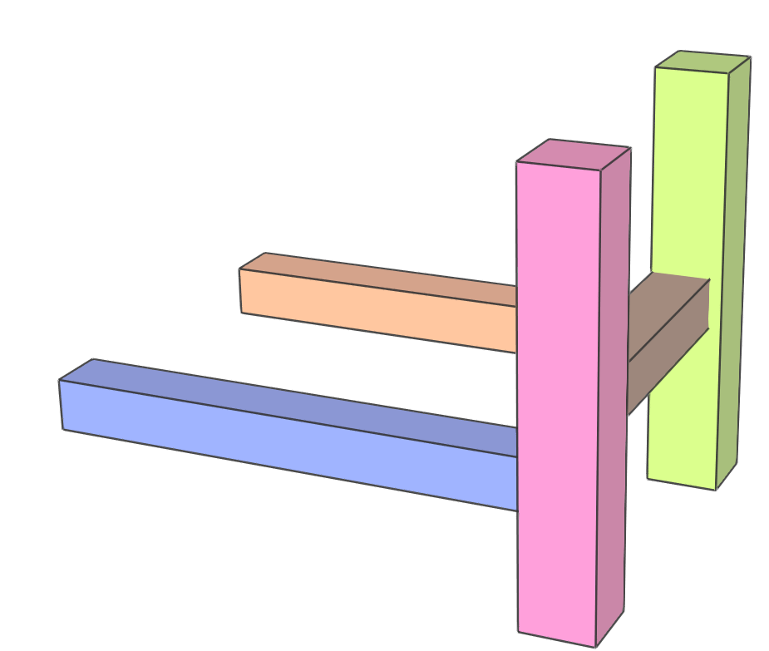
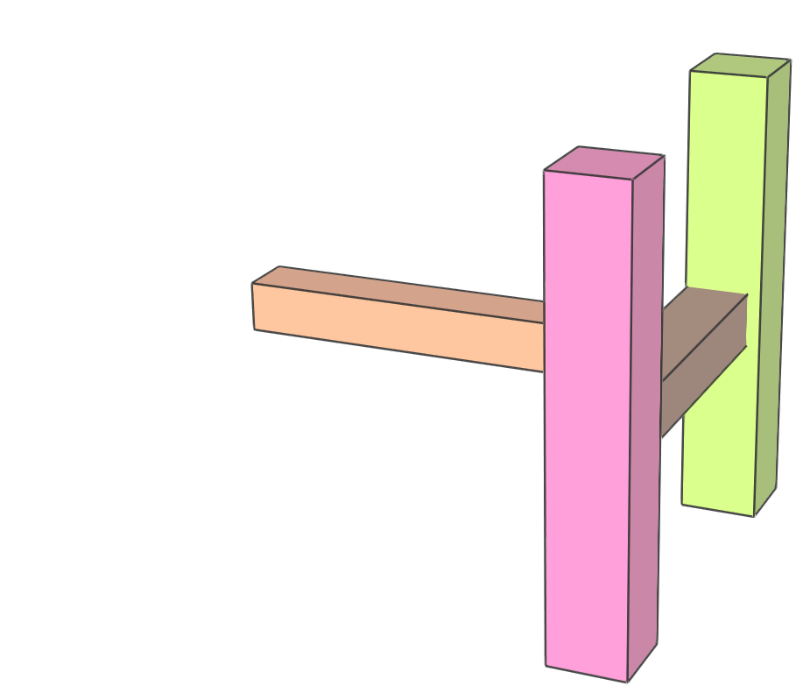
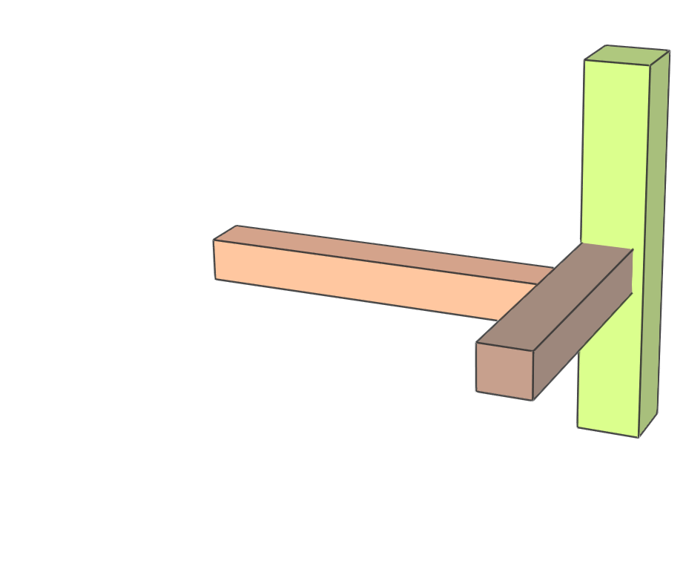
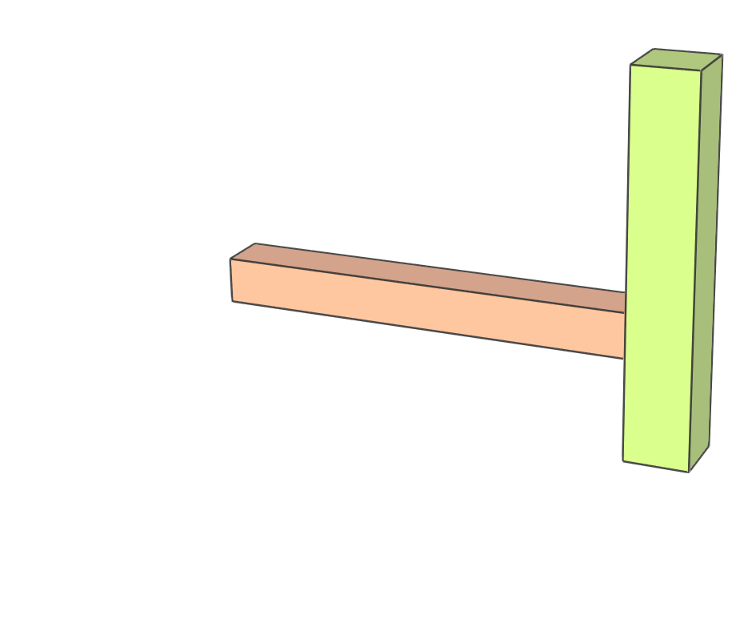
2
9
8
2
9
8
2
-x
+x
9
+y
-y
8
2
-x
+x
9
+y
-y
8
2
-x
+x
9
+y
-y
8
P1
2
9
8
2
G₂
8
2
-x
G₂
8
2
-x
-x
G₂
+z
8
2
-x
-x
G₂
+z
+z
8
2
-x
-x
G₂
+z
+z
8
P3
1
+z
1
+z
-x
1
-z
+z
-x
1
-z
+z
+z
-x
1
-z
+z
P4
P2
P9
P7
G₁
G₃
-z
G₁
+x
G₃
-z
G₁
+x
G₃
-z
G₁
+x
-z
G₃
-z
-z
G₁
+x
-z
G₃
-z
+y
P5
P8
3
1
7
3
1
1
7
3
1
1
7
3
1
1
7
3
1
1
7
3
1
1
7
P6
1
-z
+y
1
-z
+y
1
-z
+y
1
+x
+y
-z
+y
1
+x
+x
+y
+z
G₄
+z
-y
G₄
+z
-y
G₄
+z
-y
G₄
-x
-y
+z
-y
+y
G₄
-x
6
-y
+x
4
5
6
4
6
4
6
4
6
4
6
4
-y
-x
4
5
6
4
5
6
4
5
6
4
5
6
4
-z
+z
5
+x
-x
6
2
-x
+x
+y
-y
G₁
G₂
G₃
G₄
+z
-x
9
+z
8
[Fu et al. 2015]
G₂
+z
-z
G₁
+x
-z
G₃
-z
3
1
7
-z
+y
+x
+y
+z
-y
G₄
-x
-y
4
-z
+z
5
+x
-x
6
2
-x
+x
9
-x
+x
8
-x
-y
-y
-z
+x
+y
+y
+z
Our result
3
1
7
-z
+y
+y
-z
+z
-y
-y
+z
4
-x
+x
5
-x
+x
6

Slide 5
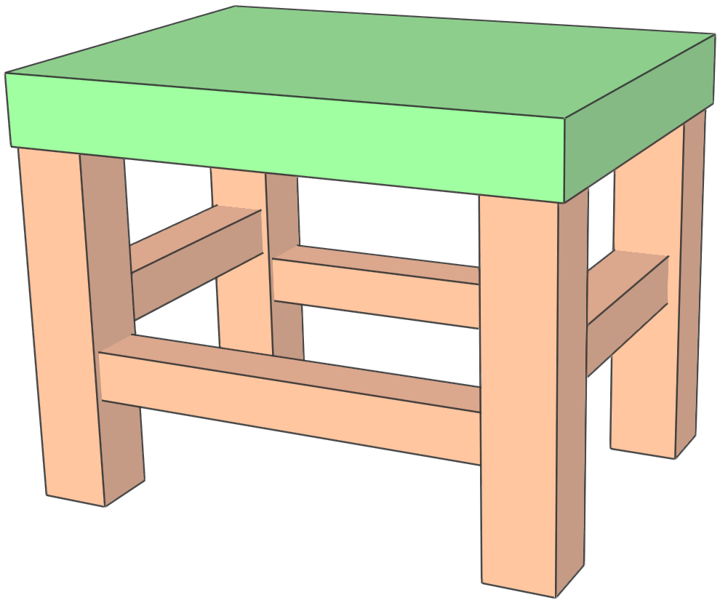
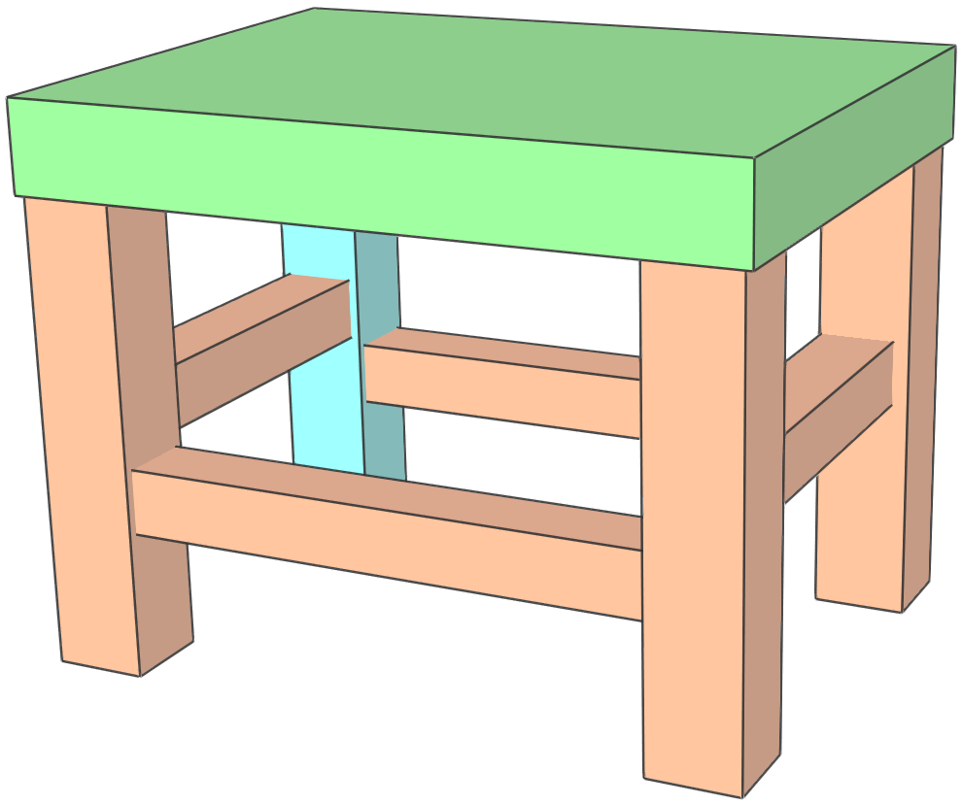
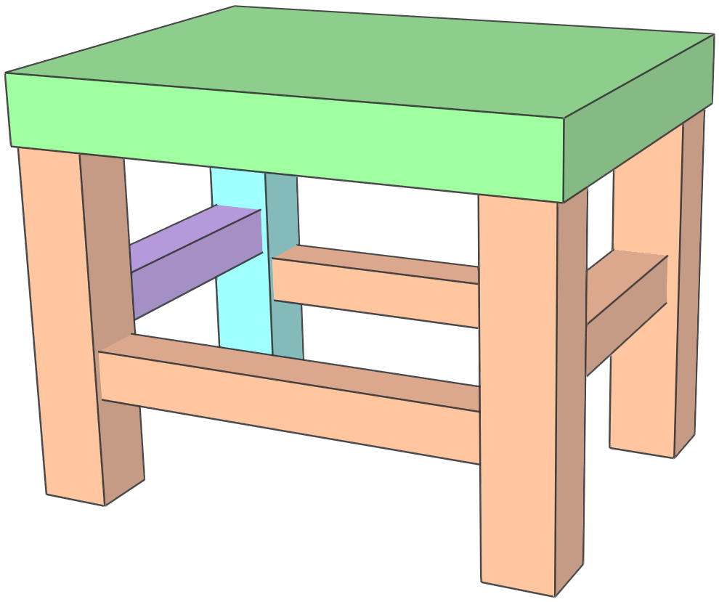
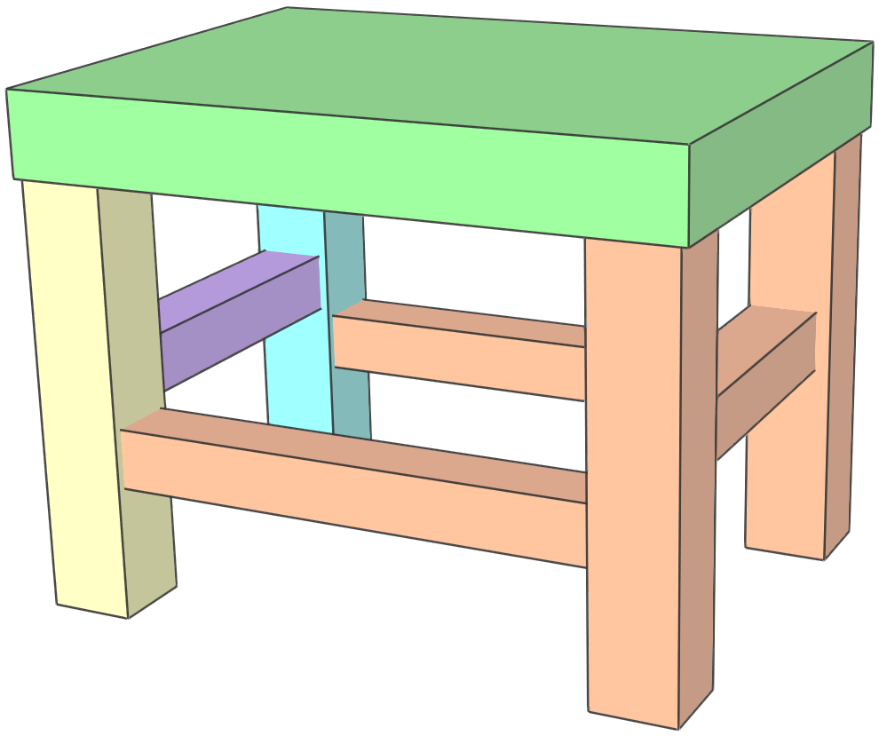
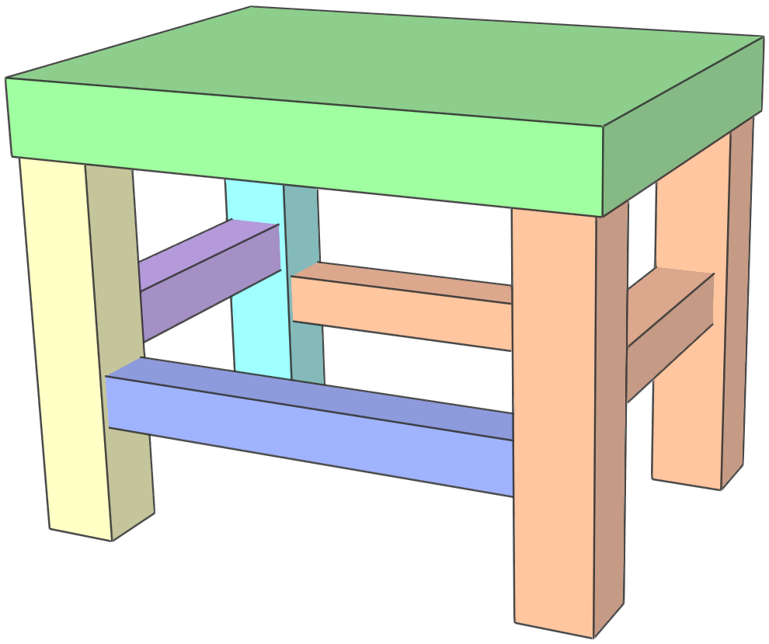
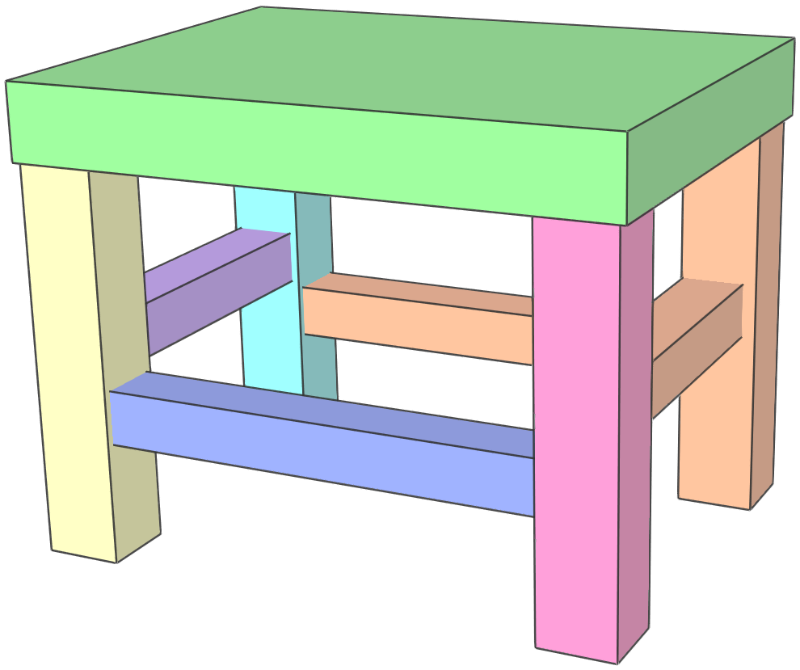
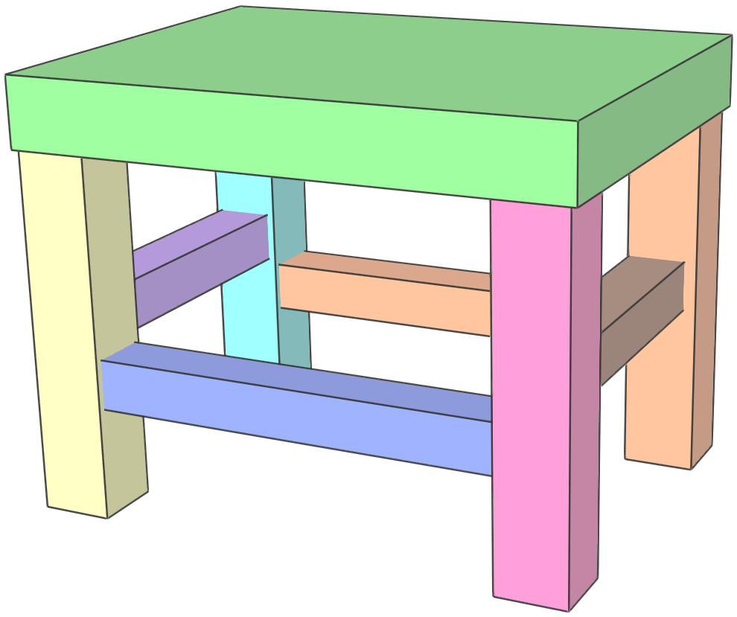
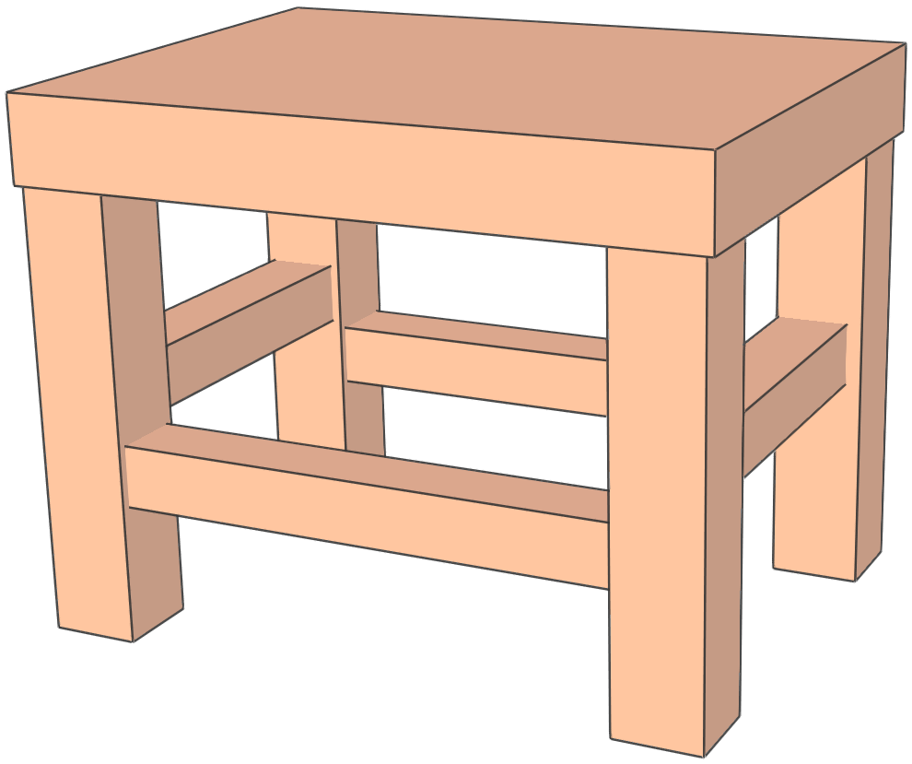
+y
+z
+x
2
9
8
2
9
8
2
9
8
2
9
8
2
9
8
2
9
8
2
9
8
2
9
8
DBGs
for
d = +x
3
1
7
3
1
7
3
1
7
3
1
7
3
1
7
3
1
7
3
1
7
3
1
7
4
5
6
4
5
6
4
5
6
4
5
6
4
5
6
4
5
6
4
5
6
4
5
6
2
9
8
2
9
8
2
9
8
2
9
8
2
9
8
2
9
8
2
9
8
2
9
8
DBGs
for
d = +y
3
1
7
3
1
7
3
1
7
3
1
7
3
1
7
3
1
7
3
1
7
3
1
7
4
5
6
4
5
6
4
5
6
4
5
6
4
5
6
4
5
6
4
5
6
4
5
6
2
9
8
2
9
8
2
9
8
2
9
8
2
9
8
2
9
8
2
9
8
2
9
8
DBGs
for
d = +z
3
1
7
3
1
7
3
1
7
3
1
7
3
1
7
3
1
7
3
1
7
3
1
7
4
5
6
4
5
6
4
5
6
4
5
6
4
5
6
4
5
6
4
5
6
4
5
6
+y
1
+y
1
-y
-x
+x
-z
+z
-y
P1
2
-x
+x
9
-x
+x
8
5
3
2
5
3
2
+y
-x
-y
-y
-z
-x
+z
P4
P3
P2
P9
P7
+x
+y
+y
+z
+x
-y
+y
-z
P5
P8
3
1
7
6
4
6
4
+z
+x
P6
-z
+y
+y
-z
+z
-y
-y
+z
4
-x
+x
5
-x
+x
6

