Slide 1


Housez
Group Members : Saikat Das - 1906355
Riya Rani Manal - 1906493
Puskal Mukherjee - 1906345
Housez

Slide 2
What is Housez ?
Getting an estimate of house price in certain areas is painful. All you can get is the individual house prices and decide upon the scattered information.
To solve the problem this project "Housez" a web-app is made to bring to you the exact brief price prediction of a place.
Housez

Slide 3
Problem Description
Build a full stack apartment price prediction application that helps users to get an idea of approximate price of an apartment in Bangalore. Before buying any apartment, a buyer should have an idea about price in that locality else brokers,owners could easily con them with much higher price.
The problem statement is divided into two parts:
First part is to build a machine learning model which will predict the price of the apartment when provided certain parameters & convert it to REST Api using Flask
Second part is to build web-app using ReactJs & connect it to REST Service
Housez

Slide 4
~ ML Model & Prediction API
Housez

Slide 5
Steps
Importing necessary libraries: Importing libraries like pandas, numpy, matplotlib.
Data Cleaning: Dropping unnecessary columns and rows containg null values.
Feature Engineering: Extracting numerical values from size column, converting total_sqft to float type, and dropping data points of location which are less than 20
Outlier detection & removal: Detecting extreme cases in price, apartments where number of bathrooms exceeds number of bhk and other outliers and removing them.
One hot encoding of location columns: As location column is categorical feature.
Model building: Training our model using linear regression and testing using test data.
Housez

Slide 6
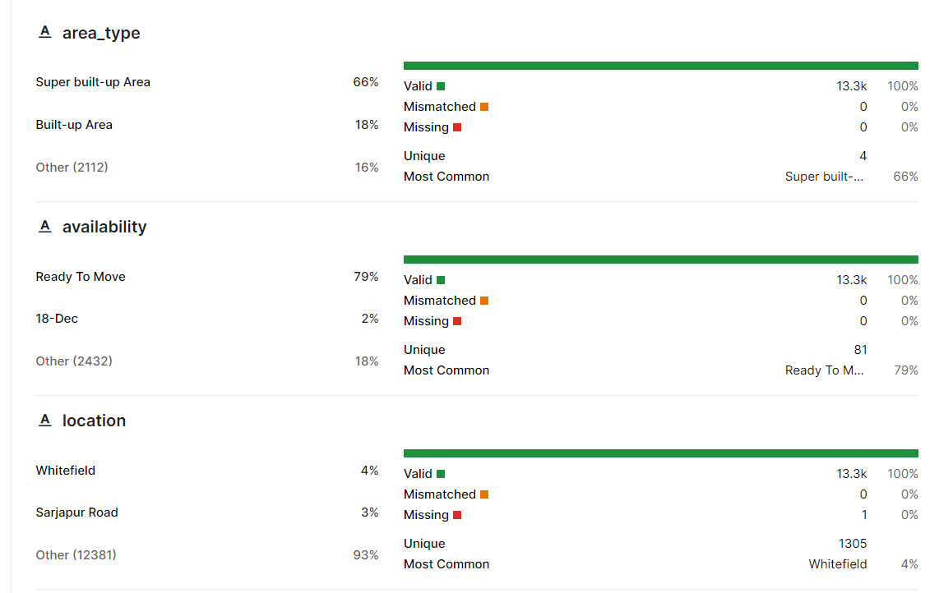
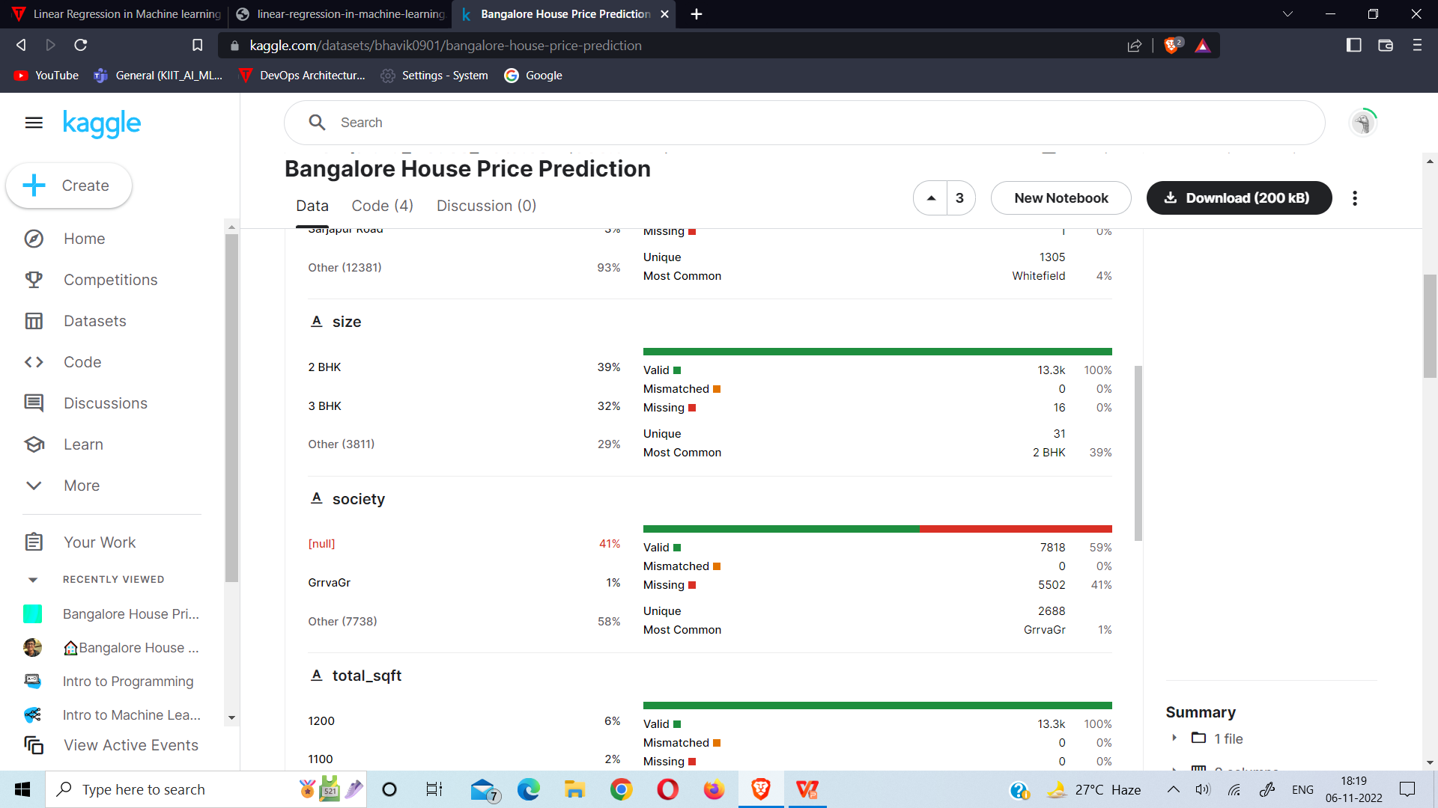
Dataset
The dataset contains 13320 rows and 9 columns which are:
area_type, availability, location, size, society, total_sqft, bath, balcony, price
Housez

Slide 7
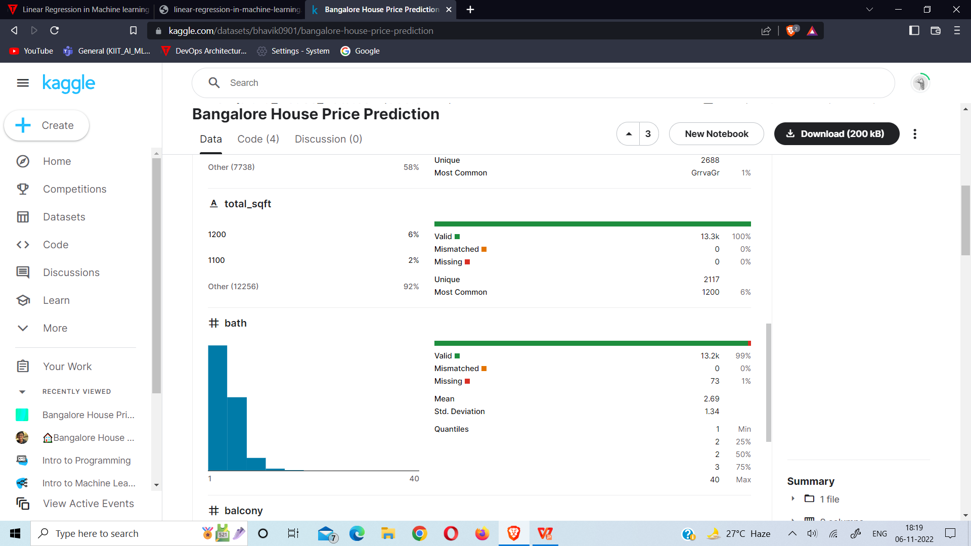
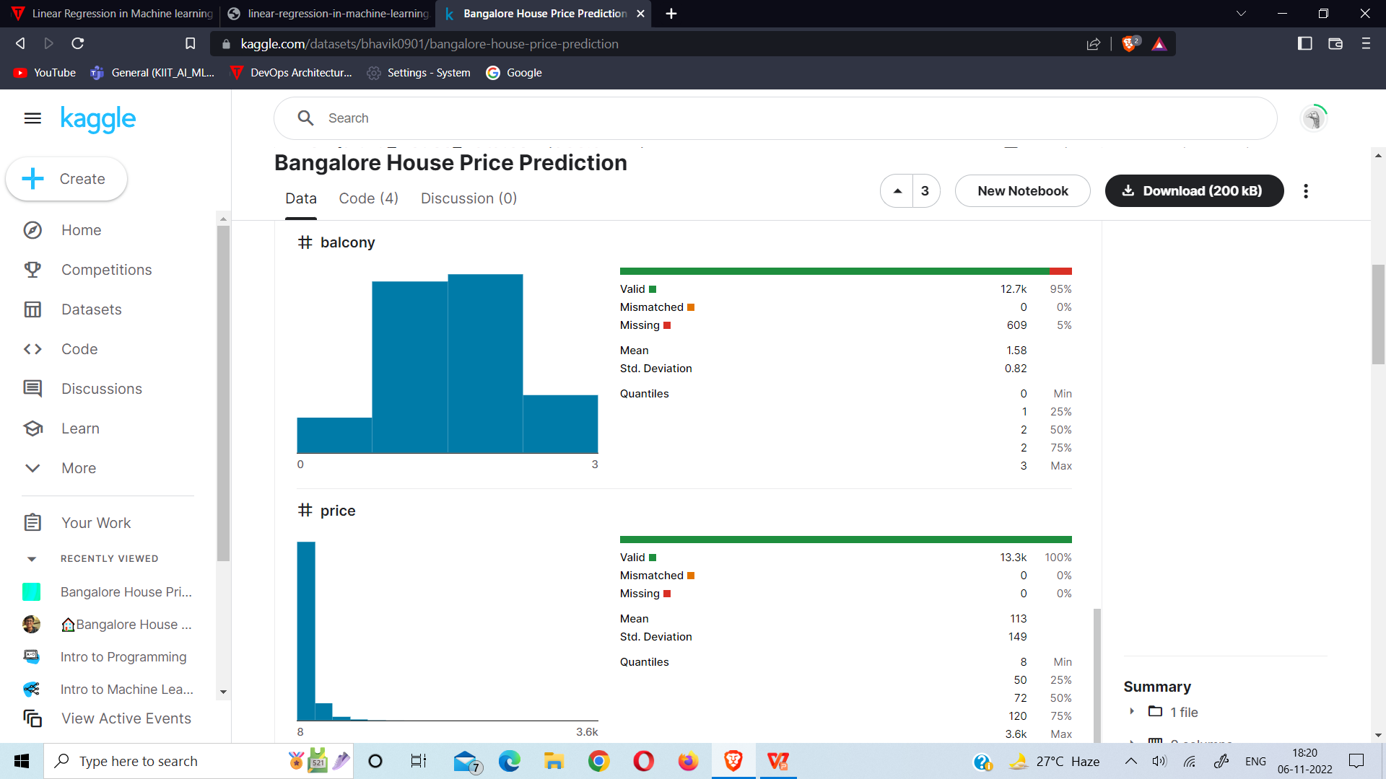
The dataset has been collected from Kaggle
Link: https://www.kaggle.com/datasets/bhavik0901/bangalore-house-price-prediction
Housez

Slide 8
Model (Linear Regression)
Linear Regression algorithm is used to build the model. It is a statistical method that is used for predictive analysis. Linear regression makes predictions for continuous/real or numeric variables such as sales, salary, age, product price, etc
Linear regression algorithm shows a linear relationship between a dependent (y) and one or more independent (x) variables, hence called as linear regression. Since linear regression shows the linear relationship, which means it finds how the value of the dependent variable is changing according to the value of the independent variable
Housez

Slide 9
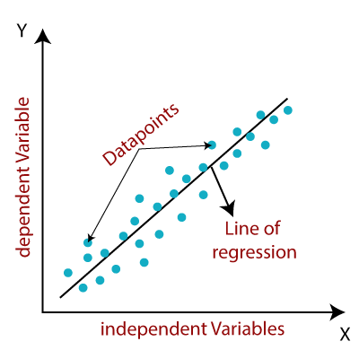
The linear regression model provides a sloped straight line representing the relationship between the variables. Consider the image:
Linear Regression in Machine Learning
Mathematically, we can represent a linear regression as:
y = a0+a1x+ ε
Here,
y = Dependent Variable (Target Variable)
x = Independent Variable (predictor Variable)
a0 = intercept of the line (Gives an additional degree of freedom)
a1 = Linear regression coefficient (scale factor to each input value)
ε = random error
The values for x and y variables are training datasets for Linear Regression model representation
Housez

Slide 10

Flask Api
Flask is a popular micro framework for building web applications. Since it is a micro-framework it is easy to use
Here, the instance of the trained ml-model is extracted using “pickle” & converted to REST-Api using “Flask”
End-points Created :
→ getLocations(GET) - get locations
→ getPricePrediction(POST) - get the predicted price on parameters
Housez

Slide 11
~ Web App
Housez

Slide 12
Steps
Importing libraries : axios, mui, formik, mapbox-gl, closest-match, react-bootstrap, react-mapbox-gl-geocoder
Components : Creating Map, Input & Data Componets to reuse
Data Link : Connecting to REST Service using axios & storing the information in optimized manner
Resolving Prop-Drilling : Making the states global using Context-Api & passing to its children
Using Component LifeCycle : useEffect() has been used to detect & render the changes on the Web-App
Testing & Deployment : React code was tested using JEST & deployed on Netlify using Github pipelining
Housez

Slide 13

Data Link Layer
Firstly the Web-App is connected to REST Service using “Axios” & the data is fetched stored in states in optimize manner :
Locations (GET) : it throws back the locations of the available areas in Bangalore. It’s stored in the Context for free access without the prop-drilling
Price Prediction (POST) : it respond in price in lakhs & has required parameters in its request such as the bhk, sqft, location, bath & balcony. Its not global but a hook which is called when required
Housez

Slide 14

Components
The concept of library & framework of JS is dependent upon components. Its made to make our life easy & reuse as many times we want. Here we made 3 components :
MapBox Map & Geocoder - used for rendering map on the web-app and geolocate the desired search location using ‘react-mapbox-gl’ made by Uber
Meta Data - for rendering the result on the right side
Modal Form - for accepting the parameters from user. Formik is used for its optimize performance & efficiency
Housez

Slide 15
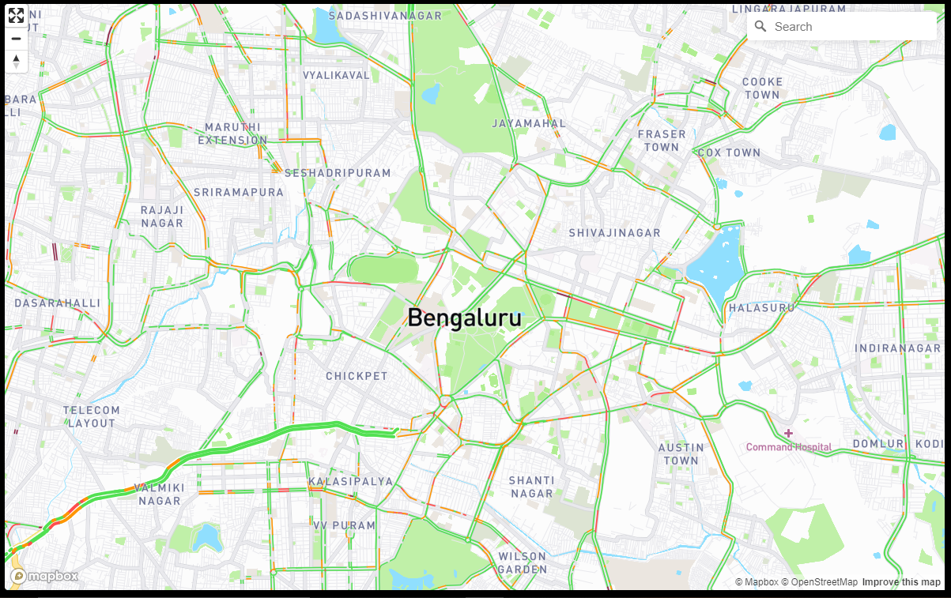
Map Component
Housez

Slide 16
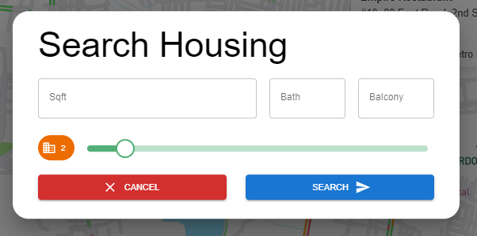
Modal Form Component
Housez

Slide 17
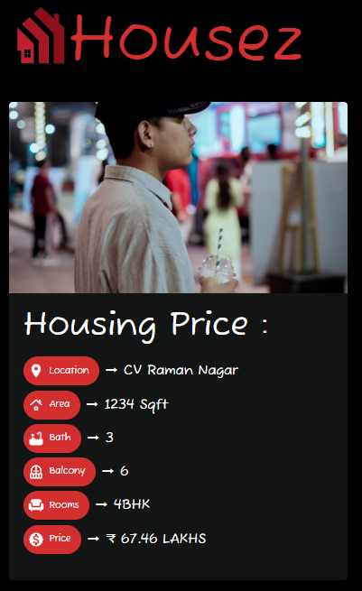
Meta Data Component
Housez

Slide 18

Resolving Prop-Drilling
Prop drilling is a situation where data is passed from one component through multiple interdependent components until we get to the component where the data is needed It makes the application slower, reduces efficiency & increases latency. Which needs to be removed for better performance
→ We have resolved the prop drilling by using ‘’Context-Api” which makes the states global, making the state reachable from anywhere on the tree
Housez
Bioscope

Slide 19

Component Life-Cycle
Each component in React has a lifecycle which we can monitor and manipulate during its three main phases
The three phases are: Mounting, Updating, and Unmounting In this project lifecycle of each component has its trigger depenency :
MapBox → web-app reload
Modal Form → search-request Price Prediction → search-request
Meta Data → house-price
Housez

Slide 20

Testing & Hosting
Testing is integral part of software development. Hosting cannot be done without testing
→ Testing in React : Unit tests, Integration tests, end-to-end tests. Unit test is single test of code isolation.
→ Hosting : After testing the web-app is hosted on “Netlify” & pipelined to “Github” so that any changes pushed to the repository will automatically deploy the changes on the Internet
Housez
Bioscope

Slide 21
~ Final Product
Housez

Slide 22
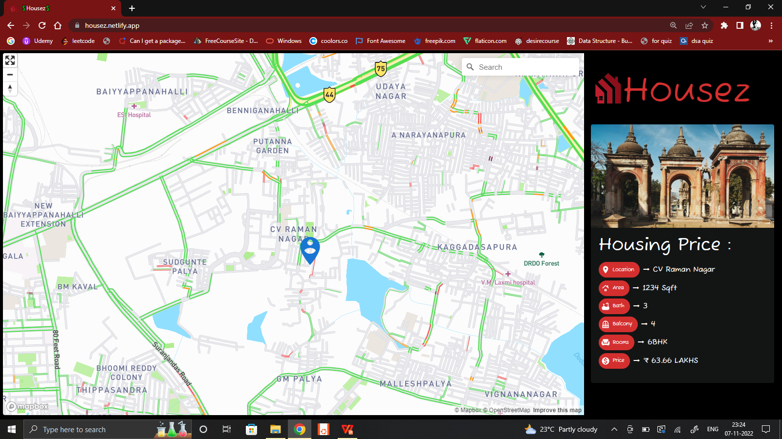
Housez

Slide 23
~ Links
Housez

Slide 24
Github :
PPT & Report Doc - https://github.com/saikatXshrey/college-major-project
ML Model - https://github.com/saikatXshrey/college-major-project/tree/ml-model
Prediction Api - https://github.com/saikatXshrey/college-major-project/tree/prediction-api
Client Side - https://github.com/saikatXshrey/college-major-project/tree/client
Live Link : https://housez.netlify.app/
Housez

Slide 25

TV FEATURES:-fgjfjfjfjjf
THANK YOU !!!
Housez

