Slide 1
What is the main focus of this course?
This course is about Computer Science
Geometry was once equally misunderstood.
  Term comes from ghia & metra or earth & measure – suggests geometry is about surveying
  But in fact it’s about…
By analogy, computer science deals with computation; knowledge about how to compute things
Imperative knowledge

Slide 2
Declarative Knowledge
“What is true” knowledge

Slide 3
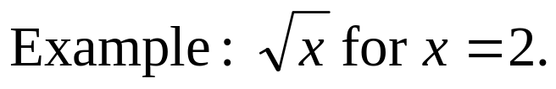
Imperative Knowledge
“How to” knowledge
To find an approximation of square root of x:
  Make a guess G
  Improve the guess by averaging G and x/G
  Keep improving the guess until it is good enough
X = 2 | G = 1

Slide 4
Imperative Knowledge
“How to” knowledge
To find an approximation of square root of x:
  Make a guess G
  Improve the guess by averaging G and x/G
  Keep improving the guess until it is good enough
X = 2 | G = 1
X/G = 2 | G = ½ (1 + 2) = 1.5

Slide 5
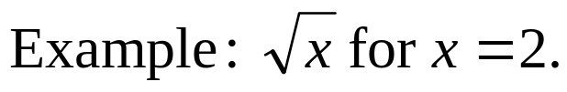
Imperative Knowledge
“How to” knowledge
To find an approximation of square root of x:
  Make a guess G
  Improve the guess by averaging G and x/G
  Keep improving the guess until it is good enough
X = 2 | G = 1
X/G = 2 | G = ½ (1 + 2) = 1.5
X/G = 4/3 | G = ½ (3/2 + 4/3) = 17/12 = 1.416666

Slide 6
Imperative Knowledge
“How to” knowledge
To find an approximation of square root of x:
  Make a guess G
  Improve the guess by averaging G and x/G
  Keep improving the guess until it is good enough
X = 2 | G = 1
X/G = 2 | G = ½ (1 + 2) = 1.5
X/G = 4/3 | G = ½ (3/2 + 4/3) = 17/12 = 1.416666
X/G = 24/17 | G = ½ (17/12 + 24/17) = 1.4142156

Slide 7
“How to” knowledge
Why “how to” knowledge?
Could just store tons of “what is” information

Slide 8
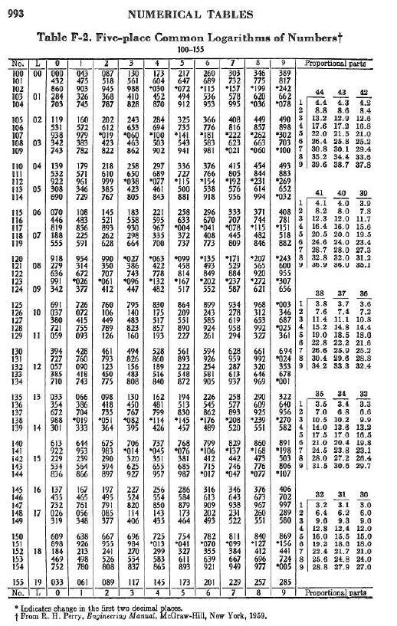
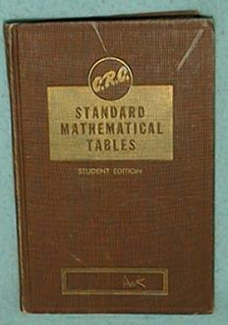
6.001 SICP
<number>/56

Slide 9
“How to” knowledge
Why “how to” knowledge?
Could just store tons of “what is” information
Much more useful to capture “how to” knowledge – a series of steps to be followed to deduce a particular value
  a recipe
  called a procedure
Actual evolution of steps inside machine for a particular version of the problem – called a process
Want to distinguish between procedure (recipe for square root in general) and process (computation of specific result); former is often much more valuable

Slide 10
Describing “How to” knowledge
If we want to describe processes, we will need a language:
Vocabulary – basic primitives
Rules for writing compound expressions – syntax
Rules for assigning meaning to constructs – semantics
Rules for capturing process of evaluation – procedures
15 minutes

Slide 11
Using procedures to control complexity
This is what we are actually going to spend the term discussing
Goals: Given a specific problem domain, we need to
Create a set of primitive elements– simple data and procedures
Create a set of rules for combining elements of language
Create a set of rules for abstracting elements – treat complex things as primitives
Why abstraction? -- Can create complex procedures while suppressing details
Target: Create complex systems while maintaining: efficiency, robustness, extensibility and flexibility.

Slide 12
Key Ideas of this course
Linguistic perspective on engineering design
  Primitives
  Means of combination
  Means of abstraction
  Means for capturing common patterns
Controlling complexity
  Procedural and data abstractions
    Recursive programming, higher order procedures
  Functional programming versus object oriented programming
Metalinguistic abstraction
  Creating new languages
  Creating evaluators
But no HASS credit!
Look at generic elements, but also at how to design for specific problem domain

Slide 13
This course
Today
  The structure of this course
  The content of this course
  Beginning Scheme

Slide 14
Computation as a metaphor
Capture descriptions of computational processes
Use abstractly to design solutions to complex problems
Use a language to describe processes

Slide 15
Describing processes
Computational process:
  Precise sequence of steps used to infer new information from a set of data
Computational procedure:
  The “recipe” that describes that sequence of steps in general, independent of specific instance
What are basic units on which to describe procedures?
  Need to represent information somehow

Slide 16
Representing basic information
Numbers
  Primitive element – single binary variable
    Takes on one of two values (0 or 1)
    Represents one bit (binary digit) of information
  Grouping together
    Sequence of bits
      Byte – 8 bits
      Word – 16, 32 or 48 bits
Characters
  Sequence of bits that encode a character
    EBCDIC, ASCII, other encodings
Words
  Collections of characters, separated by spaces, other delimiters

Slide 17
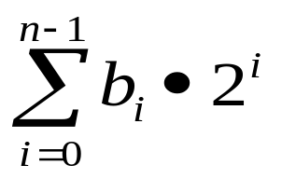

Binary numbers and operations
Unsigned integers
Bit place i
N-1
N-2
1
0
1
0
1
1
Weight b
2^(n-1)
2^(n-2)
2^1
2^0
where is 0 or 1
1 + 2 + 8 = 11

Slide 18
Binary numbers and operations
Addition
0 0 1 1
+0 +1 +0 +1
0 1 1 10
10101
111
11100

Slide 19
Binary numbers and operations
Can extend to signed integers (reserve one bit to denote positive versus negative)
Can extend to character encodings (use some high order bits to mark characters versus numbers, plus encoding)

Slide 20

Where Are The 0’s and 1’s?

Slide 21
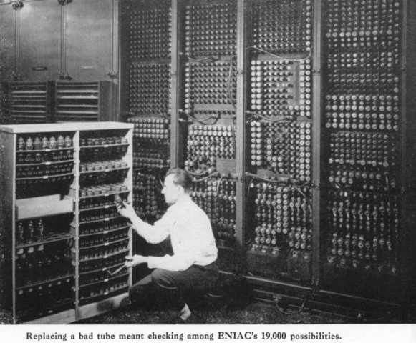
Where Are The 0’s and 1’s?

Slide 22
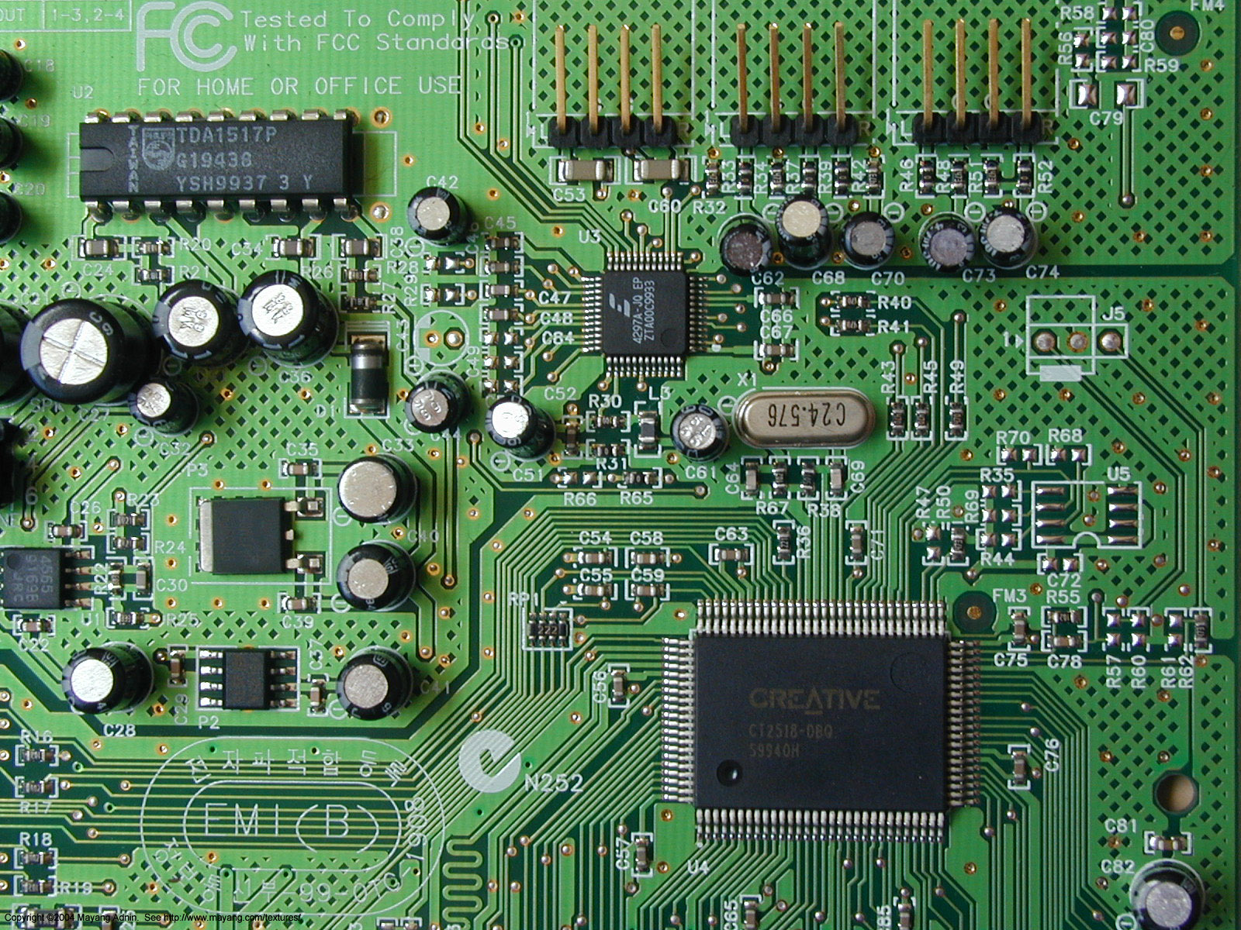
Where Are The 0’s and 1’s?

Slide 23
… we don’t care at some level!
Dealing with procedures at level of bits is way too low-level!
From perspective of language designer, simply need to know the interface between
  Internal machine representation of bits of information, and
  Abstractions for representing higher-order pieces of information, plus
  Primitive, or built-in, procedures for crossing this boundary
    you give the procedure a higher-order element, it converts to internal representation, runs some machinery, and returns a higher-order element

Slide 24
Assuming a basic level of abstraction
We assume that our language provides us with a basic set of data elements …
  Numbers
  Characters
  Booleans
… and with a basic set of operations on these primitive elements, together with a “contract” that assures a particular kind of output, given legal input
Can then focus on using these basic elements to construct more complex processes

Slide 25

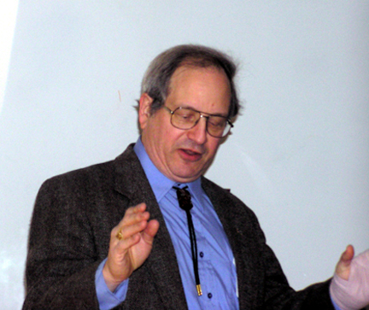
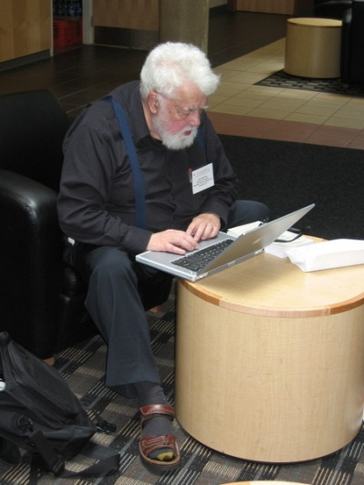
Our language for this course
Scheme
  Invented in 1975
Dialect of Lisp
  Invented in 1959
Guy Steele
Gerry Sussman
John McCarthy

Slide 26
Rules for describing processes in Scheme
Legal expressions have rules for constructing from simpler pieces
(Almost) every expression has a value, which is “returned” when an expression is “evaluated”.
Every value has a type, hence every (almost) expression has a type.
Syntax
Semantics

Slide 27
Kinds of Language Constructs
Primitives
Means of combination
Means of abstraction

Slide 28
Language elements – primitives
Self-evaluating primitives – value of expression is just object itself
  Numbers: 29, -35, 1.34, 1.2e5
  Strings: “this is a string” “ this is another string with %&^ and 34”
  Booleans: #t, #f

Slide 29
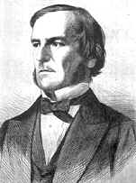
George Boole
A Founder
An Investigation of the Laws of Thought, 1854
-- “a calculus of symbolic reasoning”

Slide 30
Language elements – primitives
Built-in procedures to manipulate primitive objects
  Numbers: +, -, *, /, >, <, >=, <=, =
  Strings: string-length, string=?
  Booleans: boolean/and, boolean/or, not

Slide 31
Language elements – primitives
Names for built-in procedures
  +, *, -, /, =, …
  What is the value of such an expression?
  + → [#procedure …]
  Evaluate by looking up value associated with name in a special table

Slide 32
Language elements – combinations
How do we create expressions using these procedures?
  (+ 2 3)
Close paren
Other expressions
Open paren
Expression whose value is a procedure
Evaluate by getting values of sub-expressions, then applying operator to values of arguments

Slide 33
Language elements - combinations
Can use nested combinations – just apply rules recursively
  (+ (* 2 3) 4)
  →10
  (* (+ 3 4)
  (- 8 2))
  →42

Slide 34
Language elements -- abstractions
In order to abstract an expression, need way to give it a name
(define score 23)
This is a special form
  Does not evaluate second expression
  Rather, it pairs name with value of the third expression
Return value is unspecified

Slide 35
Language elements -- abstractions
To get the value of a name, just look up pairing in environment
  score → 23
  Note that we already did this for +, *, …
  (define total (+ 12 13))
  (* 100 (/ score total)) → 92
This creates a loop in our system, can create a complex thing, name it, treat it as primitive

Slide 36
Scheme Basics
Rules for evaluation
If self-evaluating, return value.
If a name, return value associated with name in environment.
If a special form, do something special.
If a combination, then
a. Evaluate all of the subexpressions of combination (in any order)
b. apply the operator to the values of the operands (arguments) and return result

Slide 37
Read-Eval-Print Loop
(+ 3 (* 4 5))
Visible world
READ
Internal representation for expression
EVAL
Value of expression
Execution world
PRINT
Visible world
23

Slide 38
A new idea: two worlds
visible world
execution
world
printed representation of value
37
37
expression
eval
self-rule
print
100101
value

Slide 39
A new idea: two worlds
printed representation of value
visible world
execution
world
expression
37
37
score
23
eval
self-rule
print
eval
name-rule
print
100101
10111
value
value
name-rule: look up value of name in current environment

Slide 40
Define special form
define-rule:
  evaluate 2nd operand only
  name in 1st operand position is bound to that value
  overall value of the define expression is undefined
visible world
execution
world
scheme versions differ
(define pi 3.14)
"pi --> 3.14"
eval
define-rule
print
name value
undefined
Pi 3.14

Slide 41
Mathematical operators are just names
(+ 3 5) ➔ 8
(define fred +) ➔ undef
(fred 4 6) ➔ 10
How to explain this?
Explanation
  + is just a name
  + is bound to a value which is a procedure
  line 2 binds the name fred to that same value

Slide 42
Primitive procedures are just values
visible world
execution
world
expression
printed representation of value
*
#[compiled-procedure 8 #x583363]
eval
name-rule
print
A primitive proc
that multiplies its
arguments
value

Slide 43
Summary
Primitive data types
Primitive procedures
Means of combination
Means of abstraction – names

