Slide 1
Multimedia & Lab
Image-Denoising
Team 7
김주현 윤호찬
윤동균 서경호

Slide 2
CONTENTS
Introduction
Related Work
Methods
Experiments
Conclusion

Slide 3
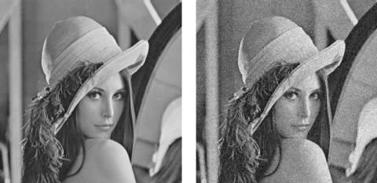
INTRODUCTION
Digital images are normally prone to additive white Gaussian noise
During image acquisition due to electronic circuits.
This noise increases over time and degrades image quality.
To maintain quality, it is important to reduce or eliminate noise.
We have made various attempts to eliminate or minimize noise generated.
We tried to restore the image using Autoencoding.
It's a simple way, but We tried to improve the results through various changes.

Slide 4
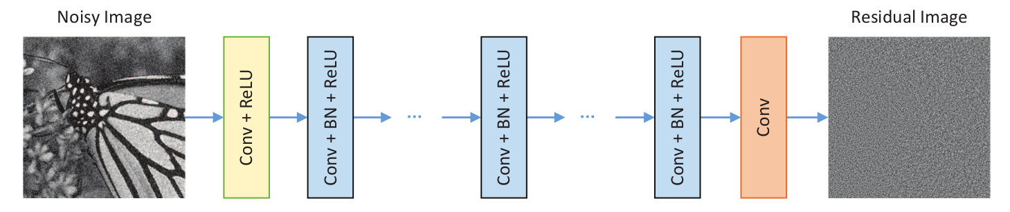
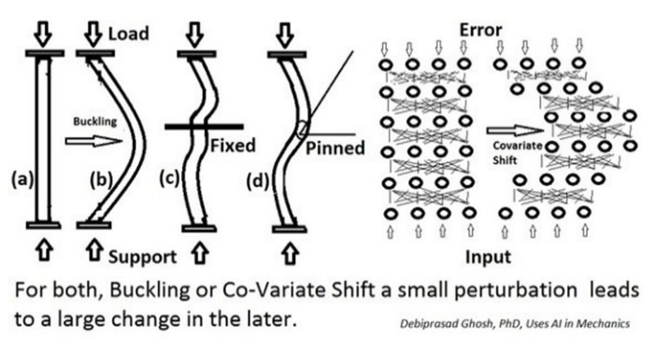
RELATED WORK
DnCNN
There are three types of layers in DnCNN.
Conv + ReLU
Conv + BN + ReLU
Conv
Predicting residential images instead of denied images.
Residual learning and BN are combined to achieve better performance.
Similar to DnCNN, we used Conv, ReLU, and BN to construct the layer.
The difference is that DnCNN repeats the same hidden layer, but we don't.
https://arxiv.org/pdf/1608.03981.pdf

Slide 5
METHODS
We started with the simplest Autoencoder structure.
Encoder
Decoder
In the basic structure,
encoding and decoding are carried out
using pooling and upsampling.
Instead of using the basic method.
We use Conv that return various out channels
Encoder
Decoder

Slide 6
METHODS
Of course, Pooling can reduce unnecessary parameters and extract features well.
However, in order to return a denoised image, Upsampling is required during decoding.
Encoder
Decoder
pooling
upsampling
Upsampling is not lossless.

Slide 7
METHODS
So, we built a layer in the following way.
Encoder
Conv+ReLU
Conv
Conv+ReLU
Conv+ReLU
Conv+ReLU
Conv+ReLU
Conv+(BN)+ReLU
Decoder layer is similar to this.

Slide 8
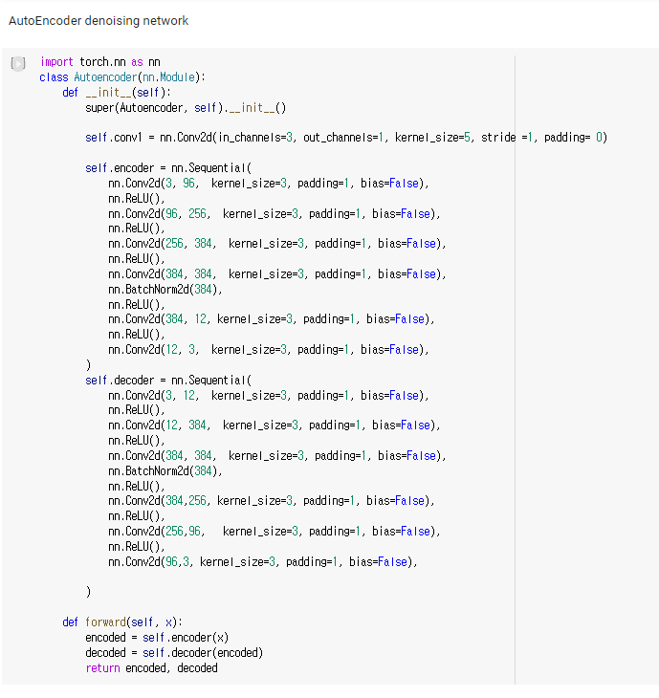
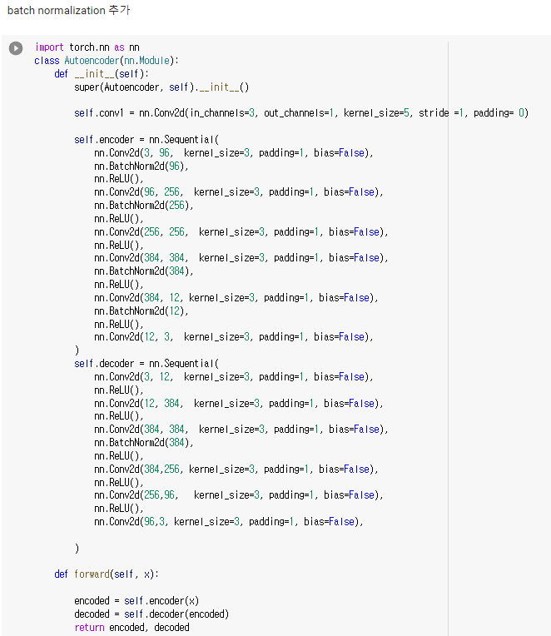
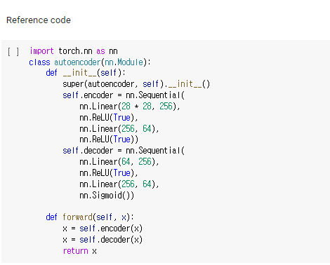
METHODS
Network Code
Auto Encoder
(Reference code)
Auto Encoder Network structure
for Image Denoising
Auto Encoder Network structure
for Image Denoising
with batch normalization

Slide 9
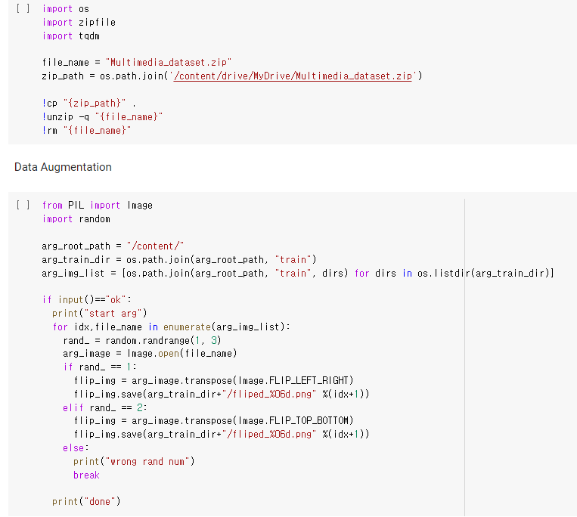

METHODS
We doubled the size of the test set
by randomly flipping the test image horizontally or vertically.
OR
In addition,
We tested using Adam as optimizer while changing lr and eps values.
We tested within limited resources while changing the batch size and epoch values.

Slide 10
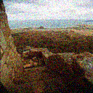
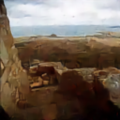
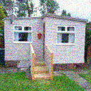
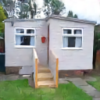
EXPERIMENTS
Result samples
noised
denoised
noised
denoised
score

Slide 11
CONCLUSION
What's good about this project
Building a network for image denoising in a simple structure using Auto encoder.
Direct experience with various deep learning networks such as DnCNN, AlexNet, Auto Encoder, etc.
What’s unfortunate about our project
Google Colaboratory was used as a development environment, and limited resources allowed it to run up to its current parameters.
We have yet to find any distinct ways to improve the performance of our network.
The potential for this network to evolve
Increase the number of epochs and add more layers.
Increase the train data further using more different augmentation methods.
It can be applied in other fields besides image Denoising by using another layer instead of convolution.

Slide 12
Multimedia & Lab
Thank you☺

