Slide 1
Smart Digital Library, Metaverse Dido
TEAM15

Slide 2
CONTENTS
1
Overview
2
Goal & Method
3
Team & Plan
4
Effect

Slide 3
1. Overview

Slide 4



Background
COVID-19
Library
Metaverse
Restrictions on the use of multi-use facilities due to COVID-19
Expand the user base by connecting various media materials in the library to a virtual community
Perform multiple functions such as online meeting, media room, and chatbot in the metaverse

Slide 5


Background
Online meeting service grow 3.3 times more than before COVID-19 as non-face-to-face requests increase after the pandemic
ONLINE MEETING
01.
The e-book usage rate is growing at an average annual rate of 303%, reaching $20.8 billion in the global publishing market, accounting for 18% of the total
02.
E-BOOK
Smart Digital Library, Metaverse Dido

Slide 6


Background
OTT captivates people’s eyes and ears among non-face-to-face services, allowing users to consume desired contents anytime, anywhere, transcending time and space constraints
OTT SERVICE
03.
Chatbot creates virtual customer service agent that provide 24/7 service, and play a variety of roles including marketing, sales, and daily tasks
04.
CHATBOT
Smart Digital Library, Metaverse Dido

Slide 7
2. Goal & Method
Development of a Virtual Library in Unity & VR Chat for Smart Campus

Slide 8


Our Goal
ONLINE MEETING
KINGOBOT
READING ROOM
DVD ROOM
Creating a virtual meet-up discussion facility
Provide School Life and Academic guidance
Create an information hub that utilizes E-books database and private rooms
Open streaming platform

Slide 9

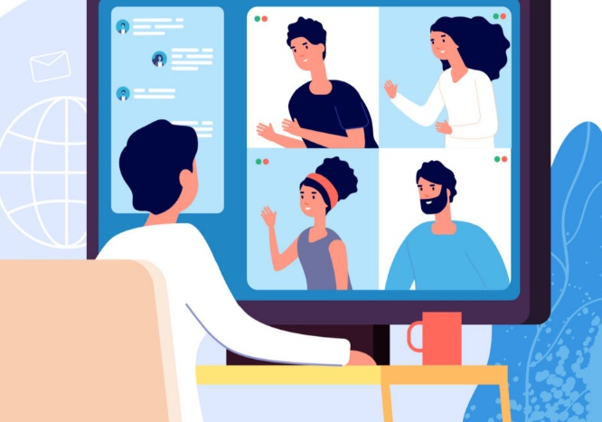

ONLINE MEETING ROOM
Video Conference System
Seat reservation management
Video View
Annotatable Board
Material sharing
Creating an
interface to write

Slide 10
KINGO BOT
24-hour solution
School Life and Academic-related Inquiries

Slide 11

READING ROOM
Reservation system
Metaverse room reservation for private use
E-Book
24/7 Accessible reading material

Slide 12

DVD ROOM
Video Streaming
Screening by utilizing public API (e.g. Youtube)
Pre-recorded Lecture
Provide mock class environment

Slide 13
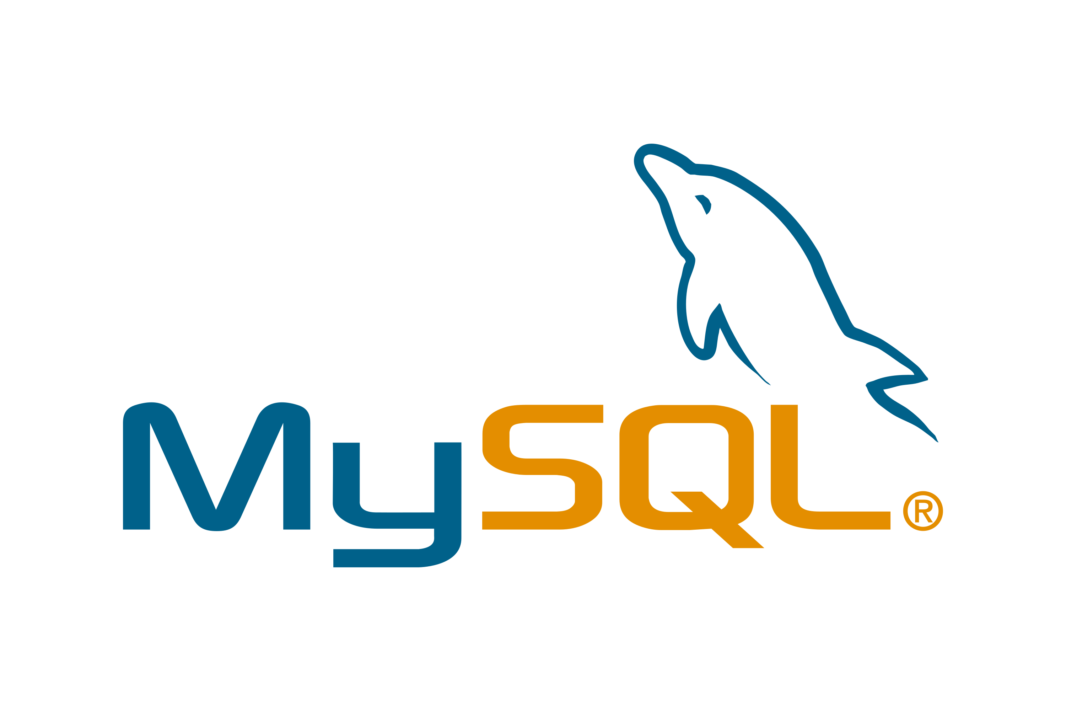



Development tools
VRChat
Unity
Flask
MySQL
User Interaction with Library Environment
3-Dimensional World Creation
E-Book Database
Access & Enable Chatbot service using API
Relational Database
Creation and
Maintenance
Frontend
Backend

Slide 14
3. Team & Plan

Slide 15
Team formation
Team 15
Design
Develop
World
Design
UI/UX
Design
Server API &
DB connection
DB construction
Dasol Lee
Keunha Kim
Minsu Kim
Fatdzirul Izzat
Kyunghyun Jo
Ukcheol Choe
Aizat Hamizuddin Azlan

Slide 16
Planning in details
step1
Plan and Design the Metaverse World by Unity and VRChat
Set up server and API with **
Construct Database storage using **
Dasol
Keunha
Minsu
4th week of September
~ October
Izzat
Kyunghyun
Ukcheol
Aizat
step2
Improve UI/UX design of specific functions
Integrate server and database
Dasol
Keunha
Minsu
November
Aizat
Izzat
Kyunghyun
Ukcheol
step3
Connect frontend and backend
Modify and supplement the service
Dasol
Keunha
Minsu
Mid November
~ December
Aizat
Izzat
Kyunghyun
Ukcheol

Slide 17
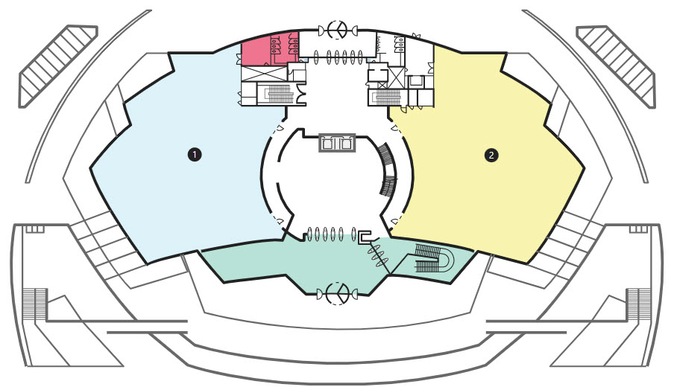
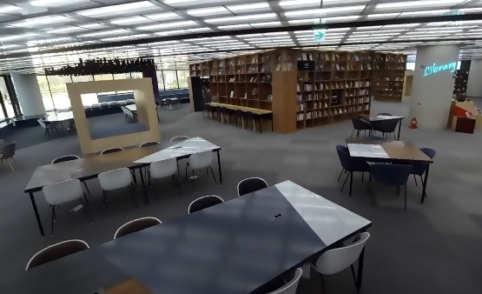
1st Floor
Kingo Bot
Reading Room
If you enter this room,
you can read E-books anywhere.
This bot will help you with
your campus life and
Academic inquiries.

Slide 18
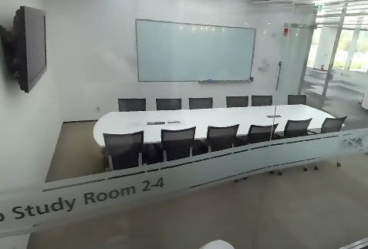
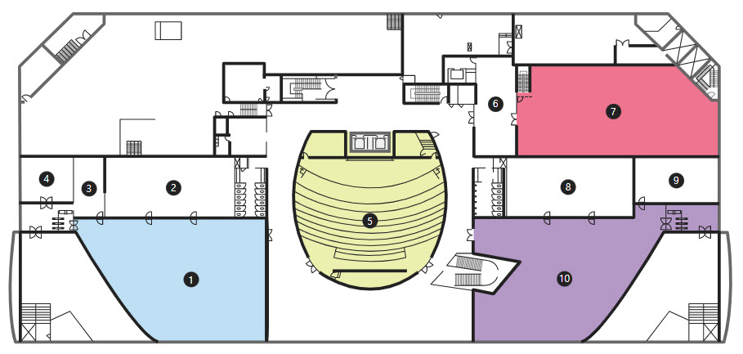
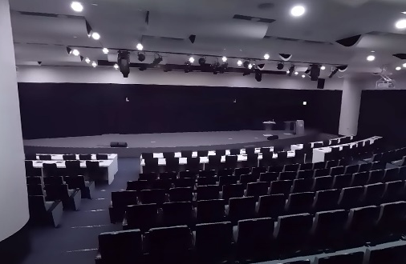
2nd Floor
Meeting Room
DVD Room
You can reserve this room
to meet in metaverse.
You can see video together
and also use white board
to presentation.
You can see some movies,
lectures, etc.

Slide 19
4. Effect
Expected Effects

Slide 20



Effects & Benefits
Borrow and Read books
Conference
Get information
Without threat of Pandemic Any time Anywhere
Can access data In the absolutely new world
Innovative Active experience

Slide 21



Maybe in future
This project can be fundamental of…
Add another functions
Add another floors
Add another buildings
Actions can do in our library
Like our real library, provide expanded space
In SKKU such as classroom

