Slide 1
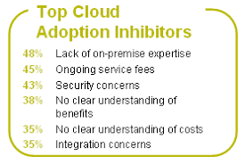
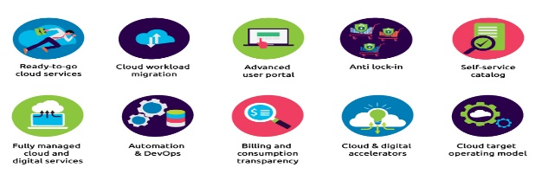
Cloud Accelerators and Inhibitors
Highlighted below are they key factors that determine whether an application is suitable for Cloud or not
Accelerators
Highlighted below are factors that would signify that workloads are Cloud suitable.
Inhibitors
Highlighted below are factors that would hinder the suitability of a workload for Cloud.
Dev/Test Environments – Sandbox environments can be easily scaled up or torn down on demand in the Cloud and are prime candidates for migration.
High Network Throughput Applications – Applications with high throughput requirements may see performance issues and latency if they are located away from their users.
Infrequently Accessed Storage Archives – It can be more cost effective to host large storage volumes that do not require frequent or immediate access.
Heavily Integrated Applications – Applications that are heavily integrated will continue to require a high amount of communication or dependencies with their counterparts. In this case it is recommended that they remain together, be it in the Cloud or on premise.
The Move from Capital Expenditures to Operational Expenditures - Especially in organizations with more than 5,000 Employees, the move from CapEx to OpEx is becoming increasingly important. Specifically, 27% of respondents believe that the use of a cloud platform service will help them to lower capital expenditure.
Security: Cited by 49% of respondents, security is an overwhelming concern among businesses.
Privacy: Up 6% from Last Year, 31% of respondents find privacy to be a concern in the cloud. This tension comes into play as companies strive to find a middle ground between personalization and anonymity.
Cost - With over 80% of IT budgets going to legacy and other non-cloud applications, it is important to consider that cost is a major driver for companies to choose cloud computing. Thanks to a simple subscription-based model, cloud computing is an easier option and requires little to no physical maintenance costs.
Compliance: While many vendors pride themselves on their documentation as secure and compliant, over 33% of purchasers still consider regulatory issues an inhibitor to cloud selection.
Agility: Why choose a platform that is complex to implement, expensive to expand, and slow at limits? Cloud Agility is an important driver in today’s business world.
Interoperability: The value of an integrated cloud solution still is not grasped by some purchasers. Although there was a 45% decrease in consumer fears of interoperability, this still was listed as a notable fear.
Scalability: Growing companies need solutions that are able to grow with the company. When a legacy platform hits its cap, things like uptime and are affected. This is what makes the cloud valuable to businesses.
Lock-In: An ironic fear of consumers using on-premise products, 29% of purchasers cite lock-in as an inhibitor to their cloud selection. Finally, 25% think that bandwidth will inhibit their cloud adoption.
Cloud Suitable
Less Cloud Suitable
Please note, inhibitors are not part of the ideal answer, and have only been included here for reference.

Slide 2
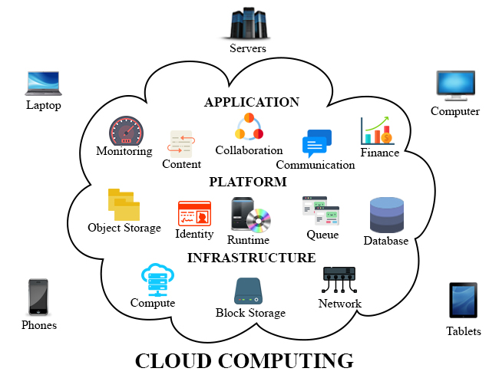
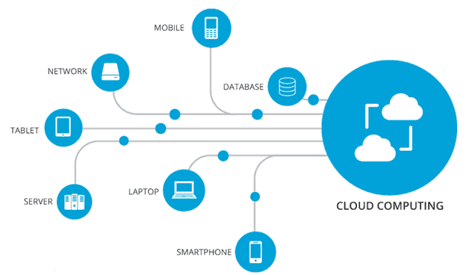
Application Prioritisation
Highlighted below are the applications that should be prioritised for the Cloud Proof of Concept and a brief justification as to why
Priority | Application | Justification
1 | Mobile Applications | Mobile applications can utilize cloud environments. Cloud computing can do the heavy lifting in the backend and mobile devices can leverage the elasticity and scalability attributes of cloud.
2 | Multimedia applications | Multimedia applications are finding a home in cloud environment. You can find how cloud can address multimedia and service heterogeneity, QoS heterogeneity, device heterogeneity, responsiveness and user experience and others in my blog “Hey, Cloud! So you think you can manage and deliver multimedia content?”
3 | Batch applications | Batch applications are clouduitable – suitable for cloud. To make the process faster, even more instances of virtual images can be provisions to perform tasks in parallel. Only cloud can offer this capability of rapid provisioning of IT infrastructure.
4 | Interaction-intensive Web 2.0 applications | Interaction-intensive Web 2.0 applications, mash-ups and data-intensive applications like analytics, data mining and business intelligence are very clouduitable. Many organizations have already moved CRM, ERP, HR, management tools and business analytics onto cloud and getting good return on investment.
5 | Desktop cloud and productivity applications | Desktop cloud and productivity applications like calendars, word processors, blogging tools, e-learning, mobile applications and others are better off with the cloud.

