Slide 1
STROKE
CVA/E

Slide 2
OBJECTIVES
Definition
Epidemiology
Causes and risk factors
Classification
Types of stroke
Pathophysiology
Clinical features
Management
Prognosis

Slide 3

Acute neurologic injury that occurs as a result of ischemic infarction or bleeding into part of the brain manifested by rapid onset of focal CNS signs and symptoms with or without a focal higher cerebral dysfunction (e.g. aphasia, hemisensory loss, visual defect) lasting >24 hours.

Slide 4
2. EPIDEMIOLOGY
Stroke is the third most common cause of death in the developed world after cancer and ischemic heart disease
It is a common medical emergency with an annual incidence of between 180 - 300 per 100,000

Slide 5
Race
In US stroke has a higher incidence in the black population than in the white population. Hispanics have a lower overall incidence of stroke
Sex
In patients younger than 60 years, the incidence of stroke is greater in males (3:2 ratio).
Age
Stroke can occur in patients of all ages, including children.
Risk of stroke increases with age, especially in patients older than 64 years, in whom 75% of all strokes occur.

Slide 6
3. RISK FACTORS
UNMODIFIABLE
Age
Sex: Male>female
Ethnicity- lowest risk among Hispanics
History of prior stroke
Heredity
Pregnancy

Slide 7
MODIFIABLE
Hypertension
Diabetes mellitus
Heart disease
Atrial fibrillation
Carotid disease- Assymetrical bruit Stenosis
Smoking
Obesity
Physical inactivity
Excessive alcohol consumption
Hypercholesterolemia
Blood disorders

Slide 8
4. CLINICAL CLASSIFICATION
Transient ischemic attack(TIA)
The standard definition of TIA requires that all neurologic signs and symptoms resolve within 24 h regardless of whether there is imaging evidence of new permanent brain injury.
Stroke: reserved for events in which symptoms last for > 24 hours.

Slide 9
CLINICAL CLASSIFICATION
RIND (Reversible Ischemic Neurological Deficit):
symptoms persist beyond 24hrs but resolve within one week.
Stroke-in-evolution (progressing stroke): stroke in which the focal deficit worsens after the patient first presents (i.e. increasing volume of infarction).
Completed stroke: Means a focal deficit persists and is not progressing.

Slide 10
5. TYPES OF STROKE
Two major types:
  Ischemic stroke (85%)
1.) thrombosis
2.) embolism
3.) systemic hypoperfusion
  Hemorrhagic strokes (15%)
1.) intracerebral
2.) subarachnoid

Slide 11
ISCHEMIC STROKE: Thrombosis
Thrombosis refer to local in situ obstruction of an artery
Are either large or small vessel disease.
1) Large vessel disease — Large vessels include both the extracranial (common and internal carotids, vertebral) and intracranial arterial system (Circle of Willis and proximal branches)

Slide 12
Pathologies affecting large extracranial vessels include: Atherosclerosis, Dissection , Takayasu arteritis , Giant cell arteritis , Fibromuscular dysplasia.
Pathologies affecting large intracranial vessels include: Atherosclerosis, Dissection, Arteritis/vasculitis, Noninflammatory vasculopathy, Moyamoya syndrome Vasoconstriction.
Note - atherosclerosis is most commonest in both.

Slide 13
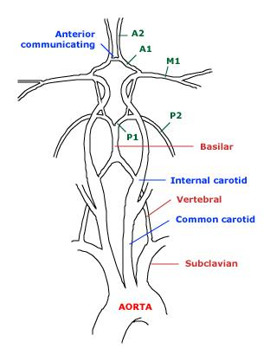
EXTRACRANIAL LARGE VESSELS

Slide 14
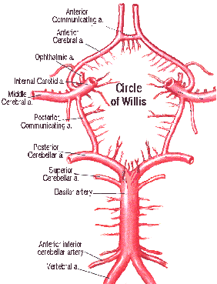

Slide 15
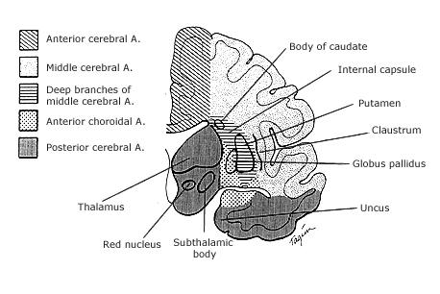
VASCULAR SUPPLY

Slide 16
In patients with thrombosis, the neurologic symptoms often fluctuate, remit, or progress in a sputtering fashion

Slide 17
Small vessel disease (30%): affect the intra cerebral arterial system, specifically the penetrating arteries of the vertebral, basilar, MCA & arteries of circle of Willis.
Deep Structures supplied are : Basal ganglia, internal capsule, thalamus & pons

Slide 18
Thrombosis in small vessels is due to
a.) lipohyalinosis : lipid hyaline built up distally
due to hypertension & fibrinoid degeneration
b.) atheroma formation at their origin or in the
parent large artery, extending into the orifices
of the small arteries (atheromatous branch
disease).
Stroke due to obstruction of these vessels is referred to as a lacunar infarct
Symptoms develop quickly, within hrs to a few days.

Slide 19
Ischemic strokes: Embolic
Divided into four categories
  Known cardiac source
  Possible cardiac / aortic source after TTE/TEE (Transthoracic Echocardiography/ Transesophageal Echocardiography)
  Artery to artery embolism
  Unknown source of embolism
  Symptoms are abrupt, maximal at onset & depend upon the region of the brain rendered ischemic.

Slide 20
Trial of Org 10172 in Acute Stroke Treatment
(TOAST) CLASSIFICATION
It classifies ischemic strokes into 5 subtypes using clinical features & ancillary diagnostic studies including neuro-imaging
    Large artery atherosclerosis (LAA)
    Cardioembolism
    Small vessel occlusion
    Strokes of other determined etiology
    Strokes of other undetermined etiology (cryptogenic)
    - 2 ≥ causes identified
    - negative evaluation
    - incomplete evaluation

Slide 21
PATHOPHYSIOLOGY OF ISCHEMIC STROKE
Acute occlusion of vessel→ reduction in blood flow to brain→ ischemia / infarction
A fall in cerebral blood flow to zero causes death of brain tissue within 4–10 min
Values <16–18 mL /100 g tissue / min cause infarction within an hour; & values <20 mL/100 g tissue / min cause ischemia without infarction unless prolonged for several hours or days.
NB - tissue surrounding the core region (umbra) of infarction is ischemic but reversibly dysfunctional and is referred to as ischemic penumbra

Slide 22
Pathways of Focal Cerebral Infarction in ischemic strokes
2 distinct pathways
Necrotic pathway in which cellular cytoskeleton breakdown is rapid, due principally to energy failure of the cell. Occur in umbra region
Apoptotic pathway in which cells become programmed to die. Occur in the penumbra

Slide 23
Necrotic pathway: ischemic cascade
Ischemia produces necrosis by starving neurons of glucose, which results in failure of mitochondria to produce ATP. Without ATP, membrane ion pumps fail & neurons depolarize, allowing intracellular calcium to ↑.
Cellular depolarization also cause glutamate release from synaptic terminals; ↑ EC glutamate induce neurotoxicity by activating postsynaptic glutamate receptors that increase neuronal calcium influx.
Free radicals are produced by membrane lipid degradation & mitochondrial dysfunction: cause catalytic destruction of membranes & likely damage other vital functions of cells

Slide 24
Net effect
The resultant overload in intracellular Ca²⁺ appears to be especially toxic & may exceed the ability of the neuron to extrude or sequester the cation.
This results in sustained activation of a variety of calcium-sensitive enzymes, including proteases, phospholipases, and endonucleases, leading to cell death.

Slide 25
Hemorrhagic strokes
Two subtypes:
Intra - cerebral (ICH) / parenchymal
subarachnoid Hemorrhage (SAH)

Slide 26
Etiology:
  hypertension (about 60%)
  trauma
  bleeding diathesis
  amyloid angiopathy
  illicit drug use (cocaine, amphetamin)
  vascular malformations.
  Less frequent etiologies: bleeding into tumor, aneurysmal rupture & Vasculitis.

Slide 27
PATHOPHYSIOLOGY
The bleeding is directly into the brain, forming a localized hematoma that spreads along white matter pathways.
Accumulation of blood occurs over minutes or hours; the hematoma gradually enlarges by adding blood at its periphery.
The hematoma continues to grow until the pressure surrounding it increases enough to limit its spread or until the hemorrhage decompresses itself by emptying into the ventricular system or into the cerebrospinal fluid (CSF) on the pial surface of the brain .

Slide 28
Headache, vomiting, and a decreased level of consciousness develop if the hematoma becomes large enough to increase intracranial pressure or cause shifts in intracranial contents

Slide 29
7. CLINICAL FEATURES
HISTORY
These symptoms include the following:
  -Sudden numbness or weakness of face, arm, or leg, especially on one side of the body
  -Sudden confusion, difficulty in speaking or understanding
  -Sudden deterioration of vision of one or both eyes

Slide 30
Sudden difficulty in walking, dizziness, and loss of balance or coordination
Sudden, severe headache with no known cause
Establishing the time the patient was last normal is especially critical when thrombolytic therapy is an option.
Rule out risk factors for atherosclerosis and CVS D’SES e.g. HPTN, DM.
Also rule out hx of smoking, alcohol, high cholesterol levels. hx of drugs, trauma.

Slide 31
Physical exam.
Physical examination is directed toward 5 major areas:
assessing the airway, breathing, and circulation (ABCs),
defining the severity of the patient's neurologic deficits
identifying potential causes of the stroke
identifying potential stroke mimic;e.g seizures, brain tumor, systemic infxns, e.t.c
identifying comorbid conditions.

Slide 32
General exam; vitals *blood pressure.
Head and neck exam; Contusions, lacerations, and deformities may suggest trauma as the etiology for the patient's symptoms. Auscultation of the neck may elicit a bruit, suggesting carotid disease as the cause of the stroke.
Cardiac: Cardiac arrhythmias, such as atrial fibrillation, are found commonly in patients with stroke.

Slide 33
The neurologic examination must be thorough; able to localise which site has been affected based on neurological deficits.
A useful tool in quantifying neurological impairment is the National Institutes of Health Stroke Scale (NIHSS).
It focuses on 6 major areas of the neurologic examination: (1) level of consciousness, (2) visual function, (3) motor function, (4) sensation and neglect, (5) cerebellar function, and (6) language. The NIHSS is used most by stroke teams.

Slide 34
8. MANAGEMENT

Slide 35
Investigations
CBC- anemia, SCD, polycythemia, thrombocytosis,
RBS- hypoglycemia may mimic stroke
Coagulation profile
Cardiac enzymes- MI may occur concurrently
ABG
EEG
Renal function tests
HIV test
Pregnancy test
ECG
Others

Slide 36
Imaging
CT scan remains the commonest modality used
Not very sensitive in the first 6 hours
Findings that can suggest ischemic changes relatively early include loss of the gray-white matter interface, loss of sulci, and loss of the insular ribbon are subtle signs of early ischemia

Slide 37
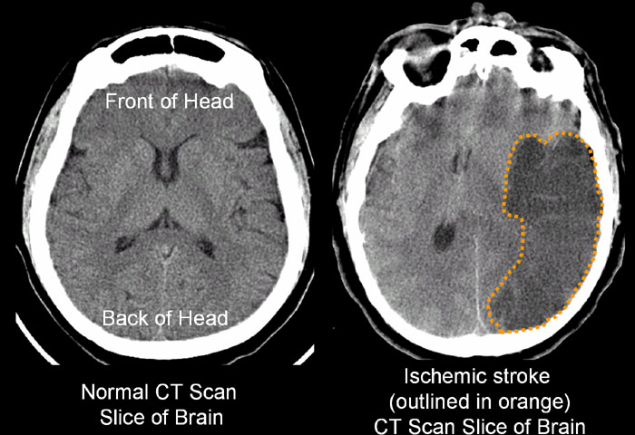

Slide 38
CT scan may demonstrate other causes of the patient's symptoms including;
      -neoplasm
      -epidural
      -subdural hemorrhage
      -aneurysm
      -abscess
      -arteriovenous malformation
      -hydrocephalus.

Slide 39
CT angiography can demonstrate the vascular occlusion and areas of perfusion deficits
Diffusion-weighted MRI (DW-MRI) can detect areas of ischemic brain injury earlier in the evolution of ischemia than standard T1/T2-weighted MRI images or CT scan by detecting changes in water molecule mobility

Slide 40
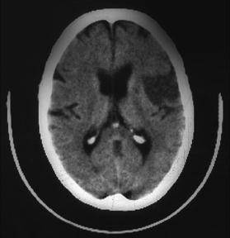
Hypodense area:
Ischemic area with edema, swelling
Indicates >3 hours old
No fibrinolytics!

Slide 41
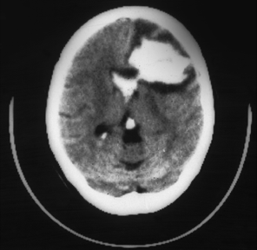
(White areas indicate
hyperdensity = blood)
Large left frontal
intracerebral hemorrhage.
Intraventricular bleeding
is also present
No fibrinolytics!

Slide 42
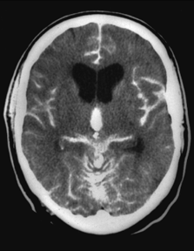
Acute subarachnoid hemorrhage
Diffuse areas of white (hyperdense) images
Blood visible in ventricles
and multiple areas on surface of brain

Slide 43
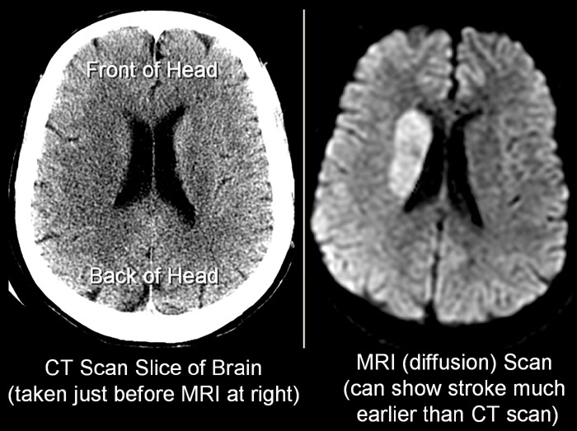

Slide 44
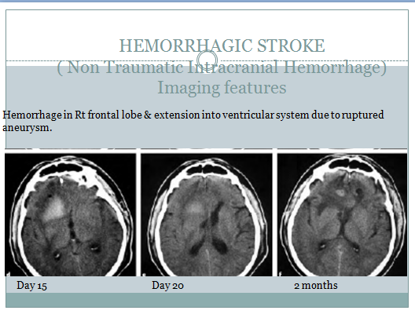

Slide 45
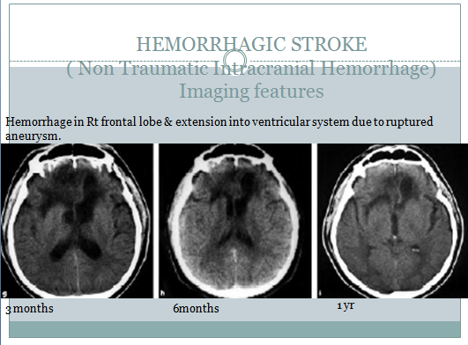

Slide 46
MRA: This noninvasive technique demonstrates vascular anatomy and occlusive disease of the head and neck without the need for contrast material

Slide 47
MR spectroscopy
Carotid duplex scanning
Transcranial Doppler ultrasonography.
The use of single-photon emission computed tomography (SPECT) in stroke is still relatively experimental and available only at select institutions; it can define areas of altered regional blood flow
ECHO, ECG, CXR

Slide 48
Treatment
ABCs
Stabilize the patient
Supportive
1)Blood glucose
Correct hypoglycemia
Treat hyperglycemia if rbs >11mmol/l coz may increase the infarct volume therefore use insulin to normalize levels.
2)Correct BP- see below
3)Cardiac monitor- continuous monitoring for ischemic changes or Atrial fibrillation
4)hydration;
IVF- avoid D5W and excess fluid admin- use
NS ( not >50ml/h)

Slide 49
5) NPO initially due to risk of aspiration; avoid oral intake until swallowing is assessed because dysphagia is common after stroke
6) O2 therapy if SaO2 <90% or patient is hypotensive
7) Temp- ensure normothermia-use
acetaminophen. Raised temp increase infarct volume.

Slide 50
8) Rehabilitation
Physiotherapy – Prevent Pressure sore, Contractures
Occupational Therapy, Speech therapy, Recreational therapy
9) Catheterization – Prevent UTI
10) Fibrinolytics within 3 hrs of ischaemic stroke, Antiplatelets, Anticoagulants for Ischaemic strokes
10) Surgical intervention – Craniotomy, surgical evacuation, Neurosurgical decompression

Slide 51
NOTE

Slide 52
BP control:
Hypertensive ischemic stroke patients with a moderate elevation of Bp (up to 180/110 mmHg) may not require antihypertensive therapy. Early BP reduction may decrease cerebral perfusion and increase infarction.also the BP normalizes within few days.
If any of the following is present treat HTN regardless of BP-hypertensive encephalopathy, aortic dissection, acute renal failure, acute pulm edema, acute MI, severe HTN ( > 220/120 mmHg)
Avoid >10% reduction in DBP or >25% reduction in SBP within first 24%hrs unless values exceed SBP >220, DBP >115
Drugs of choice: labetalol, Enalapril, Sodium nitroprusside, Nicardipine

Slide 53
Fibrinolytic therapy
Fibrinolytic therapy: Intravenous t-PA for appropriate patients within 3 hours from symptom onset remains a Class I recommendation by the American Stroke Association.
A recent re-analysis of the original NINDS data reaffirmed the original findings.
Similarly, a meta-analysis of published t-PA use demonstrated efficacy and safety comparable to that of the original NINDS trial

Slide 54
Key points:
(1) Thrombolytics must be given within 3 hours of symptom onset.
(2) Head CT or MRI must be performed before treatment
(3) BP should be <185/100 mm Hg.
(4) Platelet counts >100 X 10⁹/L, INR <1.6, APTT <40 seconds
.

Slide 55
5. Glucose levels should be 50-400mg/dl
6. Recent surgery, trauma, and bleeding diatheses should be screened in the history
7.The earlier treatment is administered, the better the outcomes may be.
The patient should be treated within 90 minutes of symptom onset if possible

Slide 56
The protocol for treatment is as follows:
(1) IV tPA (0.9 mg/kg) is administered (maximum of 90 mg).
(2) The first 10% is given as a bolus over 1 minute. The remaining 90% is delivered over the next hour.
(3) No anticoagulants or antiplatelet agents are used for the next 24 hours.

Slide 57
(4) BP is monitored closely over the next 24 hours and aggressively managed
(5) Opportunities for neurosurgical consultation and reversal of bleeding (e.g. with cryoprecipitate, fresh frozen plasma) should be available if intracerebral hemorrhage complicates treatment.

Slide 58
Prourokinase is also known as recombinant prourokinase or r-proUK.
This intra-arterial therapy requires the involvement of a skilled interventionist.
The time window is 6 hours from symptom onset.

Slide 59
Antiplatelets
The Chinese Acute Stroke Trial (CAST) and the International Stroke Trial (IST) are 2 large studies in which investigators evaluated aspirin 160-300 mg/d within 48 hours of ischemic stroke symptom onset.
Compared with no treatment, aspirin resulted in a 1% absolute reduction in risk of stroke and death in the first few weeks.
At later time points (e.g. 6 months), aspirin had absolute reduction of approximately 1% for death or dependence.
Aspirin reduces the risk of early recurrence .

Slide 60
Anticoagulants
Heparin and heparinoids
Only 1 randomized trial has shown benefit for heparins or heparinoids in acute ischemic stroke.
In that study, benefit was seen only at 6 months and not at 10 days or 3 months.
Other large studies have failed to show the benefit of heparin or heparinoids, given either IV or subcutaneously (SC), at 3 months.

Slide 61
Other
Surgical intervention is rarely required urgently in AIS
However, current recommendations suggest that neurosurgical care should be available within 2 hours when needed
Increased ICP is a life-threatening event occurring in as many as 20% of all strokes
It is more common in large, hemispheric strokes.
Edema and herniation are the most common causes of early death in patients with hemispheric stroke.

Slide 62
Patient position, hyperventilation, hyperosmolar therapy, and rarely, barbiturate coma may be used, as in patients with increased ICP secondary to closed head injury
Hemicraniectomy to treat life-threatening ICP.
Surgical evacuation of the hematoma, no evidence from RDB studies

Slide 63
Stroke - Management
Management of Hemorrhagic Stroke
  Subarachnoid
    Neurosurgical intervention
    Nimodipine
  Intracerebral
    Management of ICP
    Neurosurgical decompression
  Cerebellar
    Surgical evacuation
      Often associated with good outcome
  Lobar
    Surgical evacuation

Slide 64
Rehabilitation
The American Stroke Association guidelines for rehabilitation focus on 6 major areas, as follows;
  Preventing, recognizing, and managing comorbid conditions and medical complications
  Training for maximum independence
  Facilitating maximum psychosocial coping and adaptation by patient and family
  Preventing secondary disability by promoting community reintegration, including resumption of home, family, recreational, and vocational activities
  Enhancing quality of life in view of residual disability
  Preventing recurrent stroke and other vascular conditions

Slide 65
Types of Stroke Rehabilitation
Physical Therapy (PT)
  Walking, range of movement
Occupational Therapy (OT)
  Taking care of one’s self
Speech Language Therapy
  Communication skills, swallowing, cognition
Recreational Therapy
  Cooking, gardening
Notes:
There are different types of Stroke Rehabilitation
Physical Therapy helps restore skills like walking and range of movement. Physical therapy works on improving partial or one-sided paralysis, faulty balance and foot drop.
Occupational Therapy involves relearning skills needed for everyday living such as eating, using the bathroom, dressing and taking care of oneself.
Speech Language Therapy helps stroke survivors that have problems with aphasia – which is when stroke survivors are able to think clearly but cannot put those thoughts into words. Speech language pathologists can teach the aphasic stroke survivor and caregiver methods for coping with this frustrating condition. Speech therapy also helps stroke survivors cope with memory loss and other “thought” problems caused by stroke. Additionally, speech therapy treats stroke survivors with dysphasia, or swallowing problems, that could result in pneumonia if not appropriately managed.
Recreational Therapy involves regaining enjoyable skills and pastimes such as cooking, gardening, sewing and playing cards. These activities also may help stroke survivors regain some lost thinking abilities and physical capabilities.
References:
National Stroke Association. The Complete Guide to Stroke. 2003. At: http://www.stroke.org/site/DocServer/NSA_complete_guide.pdf?docID=341.
National Stroke Association. National Stroke Association Web site. At: www.stroke.org.

Slide 66
Stroke Recovery
10% of stroke survivors recover almost completely
25% recover with minor impairments
40% experience moderate to severe impairments requiring special care
10% require care within either a skilled-care or other long-term care facility
15% die shortly after the stroke
Notes:
There’s still so much we don’t know about how the brain can seemingly repair itself from the functional damage caused by stroke. Some brain cells may be only temporarily damaged and may resume functioning. In some cases, the brain can “relearn” what was lost. Sometimes, a region of the brain “takes over” for a region damaged by the stroke. People who have had a stroke sometimes experience remarkable and unanticipated recoveries that can’t be explained. General recovery guidelines show:
10 percent of stroke survivors recover almost completely.
25 percent recover with minor disabilities.
40 percent experience moderate to severe disabilities requiring special care.
10 percent require care within either a skilled-care or other long-term care facility.
15 percent die shortly after the stroke.
Stroke survivors and their families can find workable solutions to most difficult situations by approaching every problem with patience, creativity and tenacity.

