Slide 1

Hospital Management System
by Team VitalBolts

Slide 2


CONTENT
01
02
03
04
05
ABOUT OUR TEAM
APPLICATION FEATURES
USER INTERFACE
TOOLS USED
LEARNING OUTCOMES

Slide 3

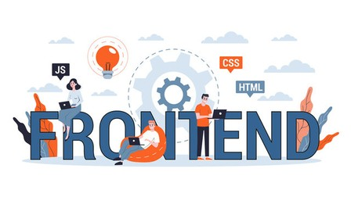

TEAM- VITALBOTS
FRONTEND TEAM
BACKEND TEAM
01
02
03
04
01
02
03
04
AVI PURTHI
KRITTIKA MAITY
SANJAYAN S
TINA CHOUDARY YALAMANCHILI
VELAGA SOHITH RAGHAVA
ISHITA SHARMA
ARCHITA SINGLA
SATHWIK KARNE

Slide 4

Application Features
User Management:
Registration and Login: Users, including both patients and doctors, can register and securely log in to the system.
Profile Management: Users can update their personal information such as contact details, address, and other relevant data.
Admin Dashboard:
Hospital Resource Management: Admins have comprehensive tools to manage hospital resources, including adding, updating, and removing doctor and patient records.
Schedule Management: Admins can allocate and manage doctor availability, ensuring that doctors are scheduled efficiently based on their expertise and availability.
Doctor Portal :Schedule Management: Doctors can view their daily, weekly, or monthly schedules, set their availability, and manage appointments.Patient Records Access: Doctors have secure access to patient medical records and history, enabling them to make informed decisions during consultations.
Prescription Management: Doctors can prescribe medicines directly through the system, with the ability to select from a list of available medications.Test Orders: Doctors can order specific tests for patients, which will be tracked and managed within the system.

Slide 5

Application Features
Patient Portal:
Appointment Booking: Patients can easily book appointments with their preferred doctors based on availability.
Health Records Access: Patients have secure access to their personal health records,
Appointment Management: Patients can view their appointment history, upcoming visits, and cancel or reschedule if necessary.
Appointment and Schedule Management:
Real-Time Scheduling: The system allows for real-time scheduling and booking of appointments.
Notifications: Patients and doctors receive notifications for upcoming appointments
Conflict Management: The system automatically checks for and prevents double-booking, ensuring that no scheduling conflicts arise.
6. Medicine and Tests Management:
Responsive Design: Accessible on desktops, tablets, and mobile devices. Intuitive Navigation: Easy-to-use navigation for quick access to all features.
Customer Dashboard: Personalized customer dashboard displaying active subscriptions, order history, and account details.

Slide 6
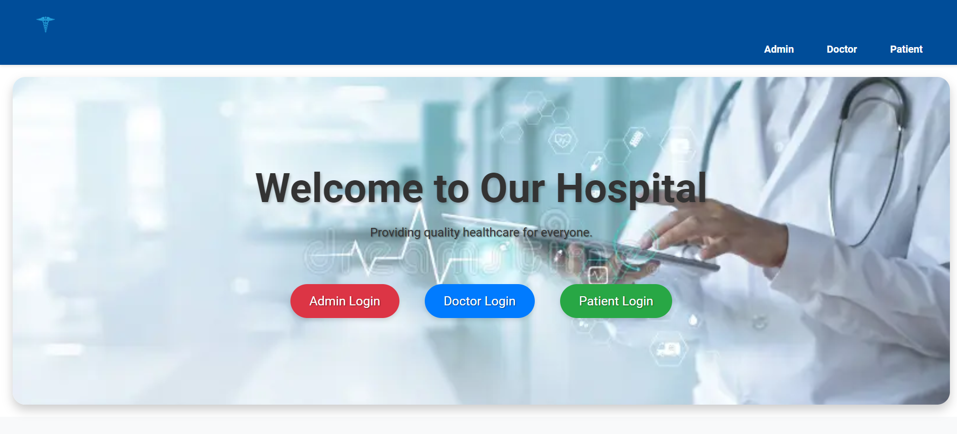
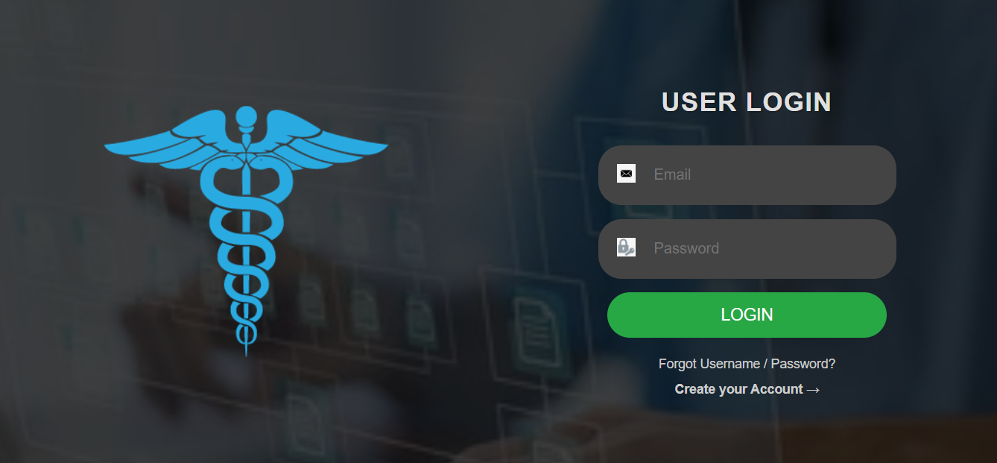
User Interface

Slide 7
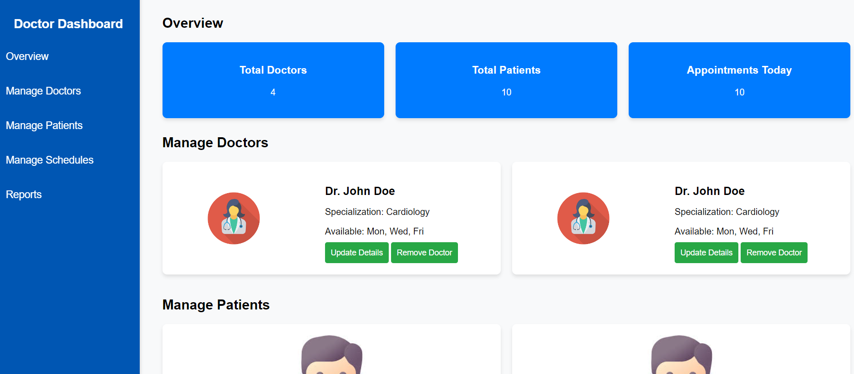
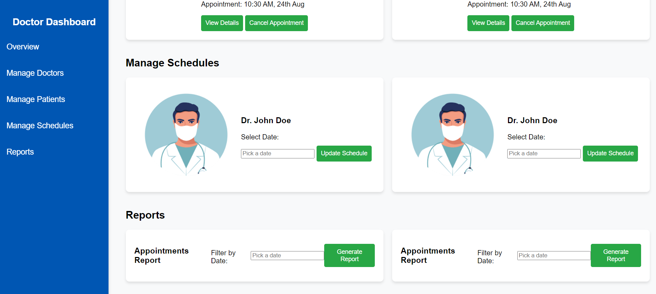
User Interface

Slide 8
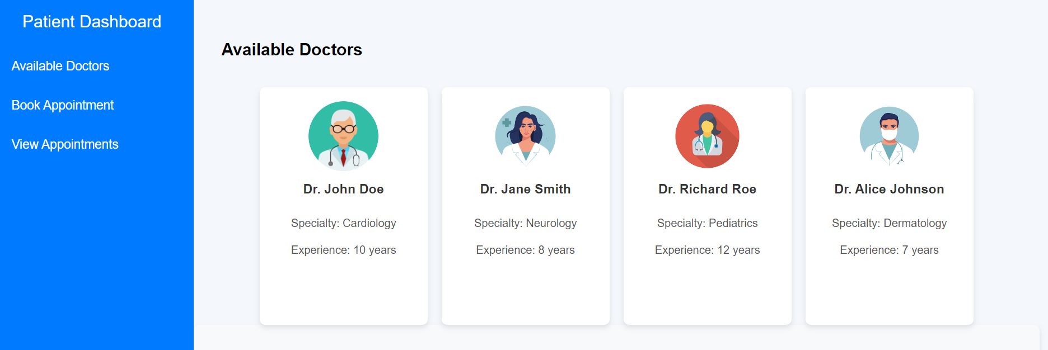
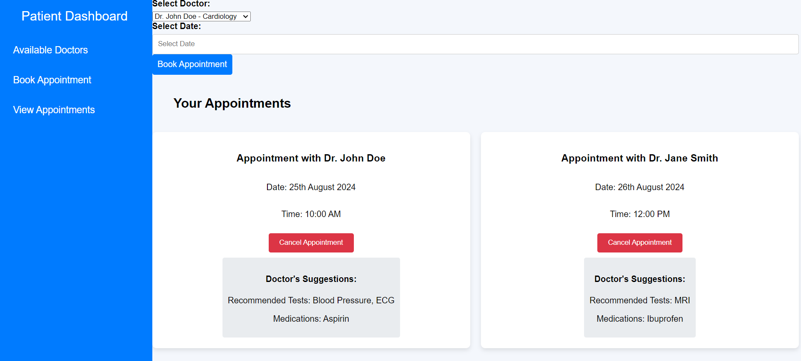
User Interface

Slide 9

Tools Used
VSCode: Utilized Visual Studio Code for efficient HTML, CSS, and JavaScript development with its powerful extensions and integrated terminal.
IntelliJ IDEA: Leveraged IntelliJ IDEA for Java development, taking advantage of its advanced code analysis, refactoring tools, and seamless integration with version control.
GitHub: Used GitHub for version control and collaboration, managing code repositories, tracking changes, and facilitating team collaboration.
MySQL: Employed MySQL as the database management system to design, implement, and manage the application's relational database.

Slide 10

Tools Used
Draw.io: Created UML and ER diagrams using Draw.io to visually model the system architecture and data relationships, ensuring a clear design.
Google Meet: Conducted virtual meetings and project discussions using Google Meet, enabling real-time collaboration with team members.
Google Docs: Used Google Docs for collaborative document creation, allowing multiple contributors to work on project documentation simultaneously.

Slide 11

Learning Outcomes
Java: Developed proficiency in Java, focusing on object-oriented programming, database connectivity (JDBC), and exception handling to build the backend of the application.
HTML: Gained expertise in creating structured and semantic HTML5 code for building user interfaces, including forms and dynamic content areas.
CSS: Learned to apply CSS and the Bootstrap framework to design responsive, visually appealing, and user-friendly web pages.
JavaScript: Enhanced skills in JavaScript for client-side validation, dynamic content manipulation, and event handling to improve user interaction.

Slide 12

Learning Outcomes
SQL: Acquired knowledge in designing and managing relational databases, writing efficient SQL queries, and handling transactions to ensure data integrity.
UML Diagrams: Learned to create UML diagrams, including class, use case, and sequence diagrams, to visually model the system's architecture and behavior.
ER Diagrams: Developed the ability to design ER diagrams to model the application's data structure and ensure a normalized, efficient database schema.
Collaboration: Gained experience in collaborating with team members using tools like Google Meet and Google Docs, facilitating seamless communication, real-time document sharing, and efficient project management.

