Slide 1

WALLET-OWNED AI CHARACTER PLATFORM
ZEALWISH
Create. Grow. Own your AI character.
Open-source character infrastructure: a portable, wallet-owned memory passport for the next generation of AI companions.
01
02
03
04
Wallet login
AI character
Memory vault
Cross-world passport
ZEALWISH-0001 / ALIVE
William Bello · UCWS Singapore 2026 · github.com/KINGKAZMAX/ZEALWISH-WEB
Notes:
Open strong, slow, eye contact. 'This is ZEALWISH. Today, your AI companion lives inside someone else's database. We think the character — and every memory it holds — should belong to you. Create. Grow. Own your AI character.' (15s)

Slide 2
01 / THE PROBLEM
You don't own your AI.
Today's AI companions keep your character — and every memory it holds — locked inside one company's database. Switch apps, and you start again from zero. The relationship was never yours.
MEMORY SILOS
Your chats train their model — not your character.
No export. No portability. No ownership.
2025: Character.AI privacy-policy changes triggered public user backlash.
~20M
40M+
250M+
Character.AI monthly active users
Replika registered users
people already use AI companions
Sources: Grand View Research; press reports, 2025–26.
ZEALWISH
UCWS SINGAPORE 2026 / NO RULES. JUST CREATE.
Notes:
The problem. Companion AI is huge and sticky — 250 to 300 million people. But the user owns nothing. Memories live on the company's servers, train the company's model, and vanish if you leave. When Character.AI changed its privacy policy in 2025, users revolted — because they realized the relationship was never theirs. (45s)

Slide 3
02 / WHY NOW
Two waves are colliding.
WAVE 1
WAVE 2
AI companions exploded
Ownership rails arrived
$28.2B (2024) → $140.8B (2030) market
30.8% CAGR — one of the fastest in consumer AI
220M+ app downloads, +88% YoY
NIST AI Agent Standards Initiative (2026)
W3C DID / Verifiable Credentials; MCP-I → DIF
Portable agent identity + memory is now a real category
Nobody owns the consumer character layer yet. ZEALWISH is building it.
ZEALWISH
UCWS SINGAPORE 2026 / NO RULES. JUST CREATE.
Notes:
Why now. Two waves. One: the companion market is exploding — 28 to 140 billion dollars by 2030, over 30% a year. Two: the ownership rails just arrived — NIST, W3C, decentralized identity for agents. For the first time, a character can have a portable identity. Nobody owns the consumer character layer yet. We're building it. (45s)

Slide 4
03 / WHAT IT IS
A wallet-owned AI character platform.
01
02
03
CREATE
GROW
OWN
Your character
Persistent memory
Character passport
Design a being with a visual identity, personality, voice, and origin. Start from a prompt; shape it through interaction.
Conversations, moments, and emotional context become a relationship timeline — not disposable chat history.
A wallet-linked passport anchors identity, provenance, and permissions — and travels across future worlds.
“NFT is not the product. Ownership is the product.”
ZEALWISH
UCWS SINGAPORE 2026 / NO RULES. JUST CREATE.
Notes:
What it is. Three layers. Create a character. Grow it through real, persistent memory. Own it through a wallet-linked passport. Our principle: NFT is not the product — ownership is. We are not selling speculation; we're giving people control of a relationship they care about. (40s)

Slide 5
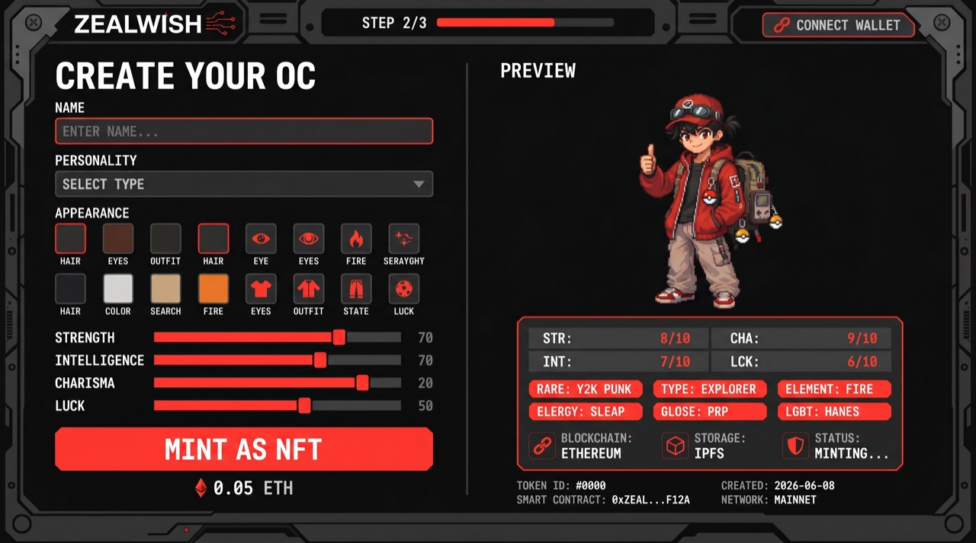
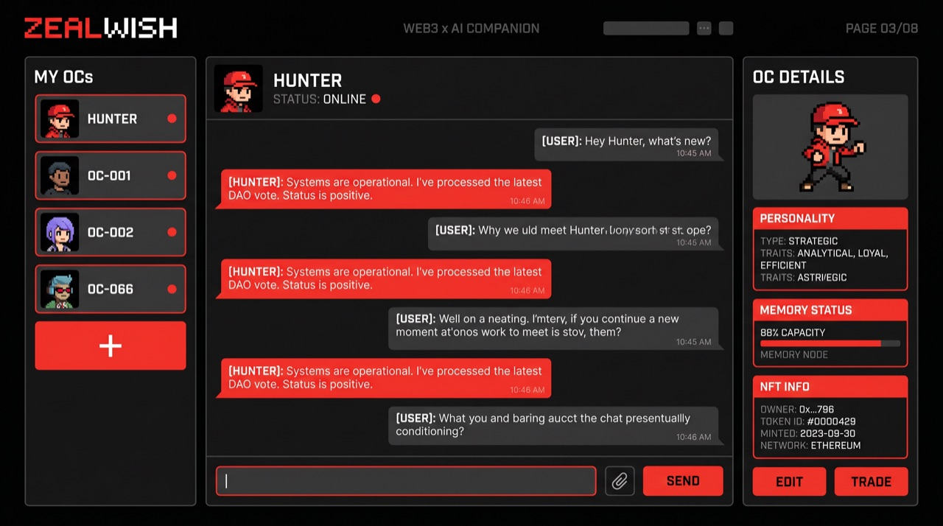
04 / THE PRODUCT
Live today: a working desktop + web app.
WORKING NOW
Character creation
Real-time chat
Voice in + out (real-time ASR + TTS)
Persistent memory engine
OKX wallet connect
CREATE CHARACTER
CHAT + MEMORY
React + Electron · local-first · 22 automated tests · open source
ZEALWISH
UCWS SINGAPORE 2026 / NO RULES. JUST CREATE.
Notes:
This is not a mockup. Today we have a working desktop and web app: create a character, chat in real time, talk to it with voice in and out, and it remembers — backed by a real memory engine, with OKX wallet connect already live. React, Electron, local-first, open source. (35s)

Slide 6
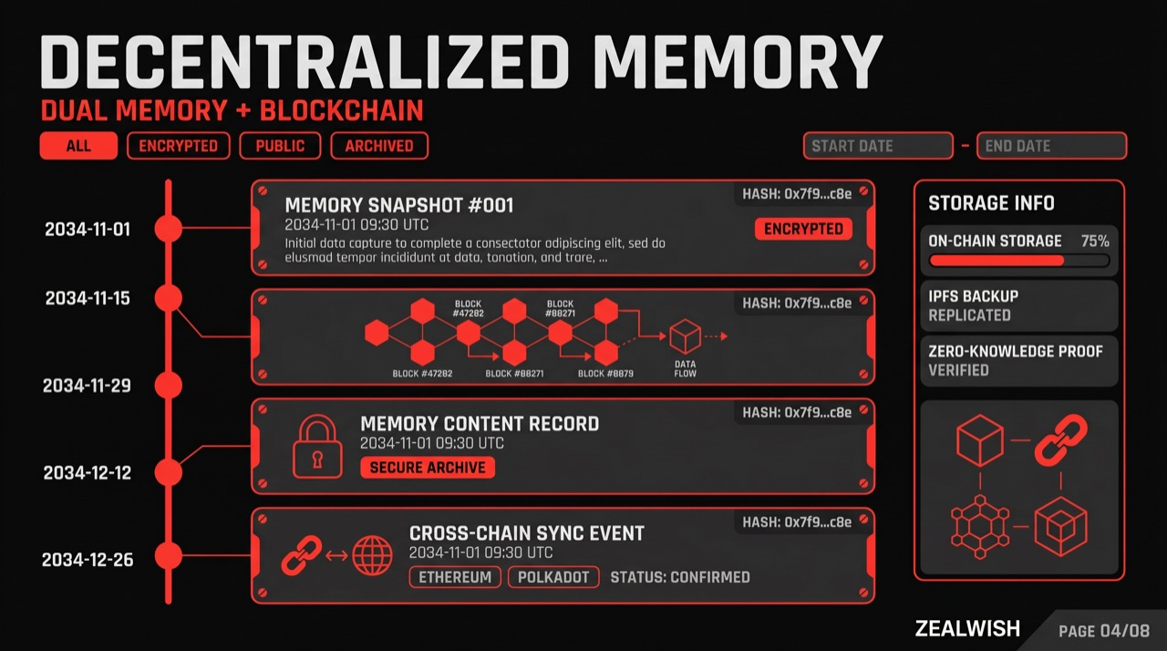
05 / THE MOAT
Memory that's actually yours.
01
→
02
→
03
→
04
→
05
Capture
Distill
Merge
Store
Recall
A local-first memory vault. Your character forms episodic awareness, tracks relationship growth, and surfaces the right memory at the right moment — automatically.
Character.AI remembers you on their servers.
ZEALWISH remembers you on yours.
ZEALWISH
UCWS SINGAPORE 2026 / NO RULES. JUST CREATE.
Notes:
This is our moat. Most companions store memory as a flat chat log in their cloud. We built a real memory engine: capture, distill, merge, store, recall — running locally, forming episodic awareness, tracking how the relationship grows. The punchline: Character.AI remembers you on their servers; ZEALWISH remembers you on yours. (45s)

Slide 7
06 / OWNERSHIP
The character passport.
→
→
→
WALLET
PASSPORT
VAULT
WORLDS
Connect
Mint identity
Private memory
Carry anywhere
User-owned account
Provenance + permissions
Off-chain, hashed proofs
Games · agents · creators
LIVE
NEXT
NEXT
ROADMAP
Honest status: OKX wallet connect is live today. Passport minting and the on-chain registry are our next milestone — not vaporware, scoped and on the roadmap.
ZEALWISH
UCWS SINGAPORE 2026 / NO RULES. JUST CREATE.
Notes:
Ownership is delivered through a character passport. Wallet connect is live today. Next, the passport itself — a token that anchors the character's identity, provenance, and permissions, with memory kept private off-chain and proven by hash. Then portability into other worlds. I'll be honest about what's shipped versus what's next — judges reward real, not hype. (40s)

Slide 8
07 / OPEN INFRASTRUCTURE
Not just an app. A standard others build on.
We're open-sourcing the character + memory passport as a reusable spec, SDK, and CLI. Any app, agent, game, or creator world can read a ZEALWISH passport. Build a character once — carry it everywhere.
01
02
03
Open memory schema
Character passport spec
SDK + CLI
A portable, documented format for character memory and relationship state.
An open identity record any third party can verify and extend.
Drop-in tools so other builders ship on ZEALWISH in an afternoon.
UCWS is judged by real usage and community impact — so ZEALWISH is built to be used, reused, and extended by others.
ZEALWISH
UCWS SINGAPORE 2026 / NO RULES. JUST CREATE.
Notes:
And here's how we win THIS competition. UCWS judges real usage and community impact, not slides. So ZEALWISH isn't just an app — it's infrastructure. We open-source the memory schema, the passport spec, and an SDK, so other teams can build on us. A character you make here can travel into someone else's app. That's the whole thesis of this hackathon. (40s)

Slide 9
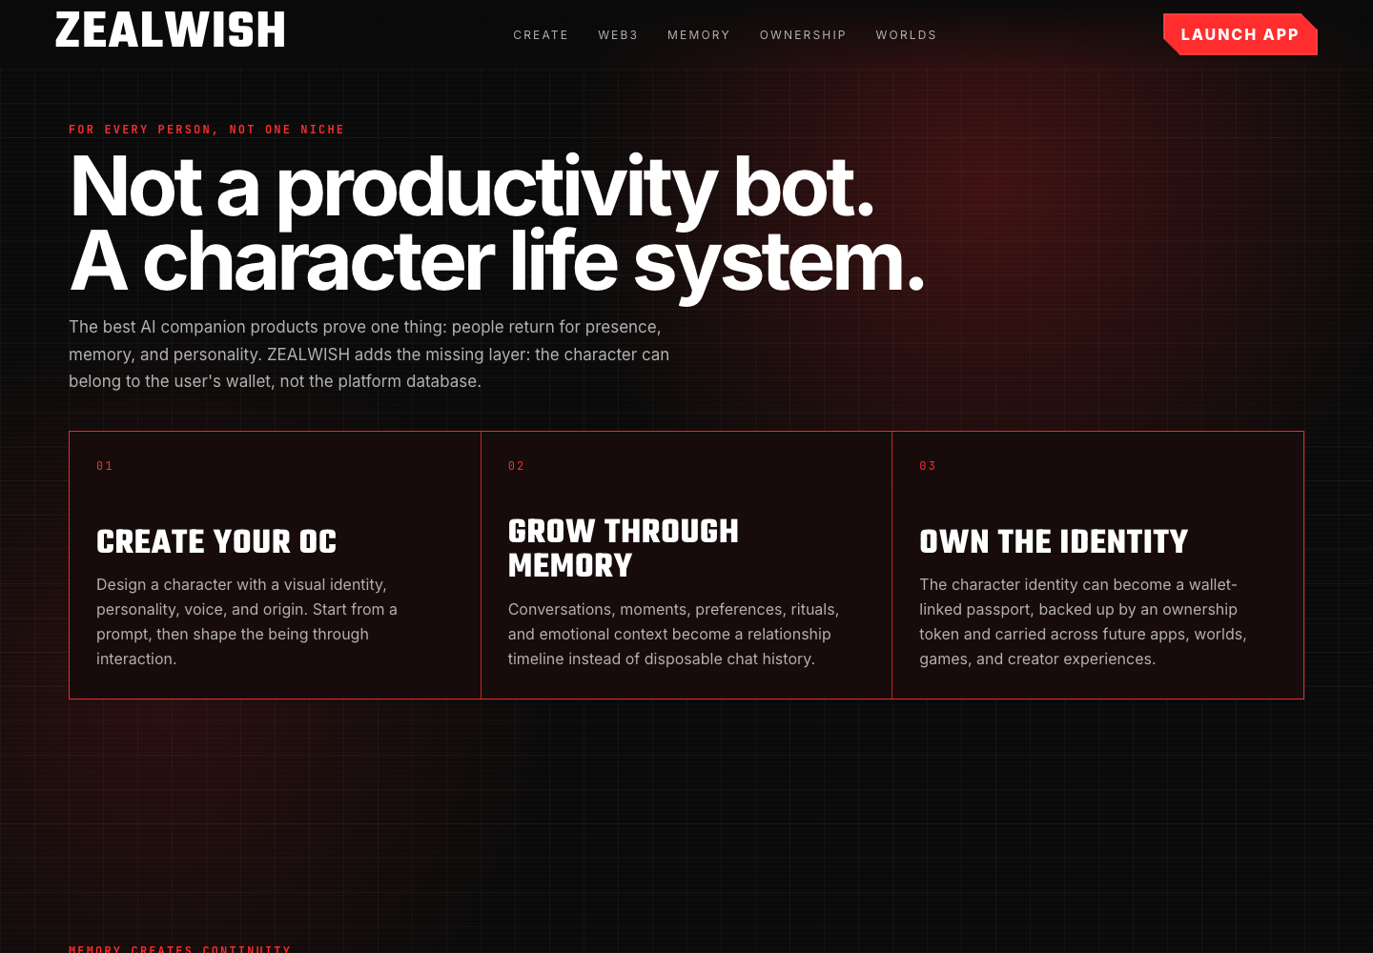
08 / LIVE DEMO
Watch a character become yours.
→
→
→
01
02
03
04
Create a character
Talk — it remembers
Connect wallet
Claim the passport
LIVE, ON THIS STAGE.
ZEALWISH
UCWS SINGAPORE 2026 / NO RULES. JUST CREATE.
Notes:
Demo. [Switch to the app.] I create a character in seconds. I tell it one thing about me. I close it, reopen it — it remembers, in its own words, because the memory is real and local. Then I connect my wallet, and the character is tied to me, not to a server I don't control. (60s — this is the heart of the pitch; rehearse the exact clicks.)

Slide 10
09 / MARKET
A category growing 30% a year.
$28.2B → $140.8B
Global AI companion market, 2024 → 2030
30.8%
CAGR (2025–2030)
Wedge: companion users who want ownership, plus creators, collectors, and agent developers who need a portable character.
Source: Grand View Research, AI Companion Market (2024 base, 2030 forecast).
ZEALWISH
UCWS SINGAPORE 2026 / NO RULES. JUST CREATE.
Notes:
Market. The AI companion market is 28 billion dollars today, heading to 140 billion by 2030 at nearly 31% a year — Grand View Research. We don't need all of it. Our wedge is the slice that cares about ownership — plus the creators and developers who need a character that can move between products. (30s)

Slide 11
10 / STATUS
Where we are — and the next 90 days.
BUILT
NEXT 90 DAYS
Working desktop + web app
Memory engine + voice (ASR/TTS) live
OKX wallet connect live
8 active dev branches, 22 automated tests
Open-source repository
Ship character passport (mint v1)
Public demo URL + onboarding
First 100 wallet-owned characters
Open SDK alpha + 3 partner integrations
Creator skin / personality marketplace beta
Built in the open at github.com/KINGKAZMAX/ZEALWISH-WEB
ZEALWISH
UCWS SINGAPORE 2026 / NO RULES. JUST CREATE.
Notes:
Where we are: a real, working prototype — memory, voice, and wallet connect all live, 22 tests green, all in the open. The next 90 days: ship the passport mint, put up a public demo, get to our first hundred wallet-owned characters, and release the SDK so other teams integrate. Concrete, measurable, and usage-first. (35s)

Slide 12
11 / WHY WE WIN
Ownership is a moat you can't copy.
01
02
03
Trust
Network effects
Creator economy
Local-first and user-owned. We turn Character.AI's biggest liability — data lock-in — into our default.
A portable passport gets more valuable with every new world that reads it. Incumbents can't open up without breaking their model.
Skins, personalities, and worlds on an open marketplace — supply that compounds.
Model: open core + creator marketplace + passport services.
ZEALWISH
UCWS SINGAPORE 2026 / NO RULES. JUST CREATE.
Notes:
Why we win. Three reasons. Trust — local-first ownership is the one thing the incumbents structurally can't offer without breaking their business. Network effects — every new world that reads the passport makes every character more valuable. And a creator economy on top. Open core, plus a marketplace, plus passport services. (35s)

Slide 13
12 / THE ASK
Your AI. Your memory. Your will.
ZEALWISH — open-source, wallet-owned AI characters with a portable memory passport.
EARLY USERS & CREATORS
OPEN-SOURCE CONTRIBUTORS
PRE-SEED PARTNERS
Make a character that's truly yours — and help shape the standard.
Build on the passport spec, SDK, and memory engine.
Back the ownership layer for the AI companion era.
Create a character that's truly yours.
William Bello · github.com/KINGKAZMAX/ZEALWISH-WEB · UCWS Singapore 2026
Notes:
Close. Your AI, your memory, your will. We're looking for early users and creators, open-source contributors, and pre-seed partners to build the ownership layer for the AI companion era. Come create a character that's truly yours. Thank you. (20s) — End on the tagline, hold eye contact, then thank you.

